Slide 1
Start Lecture Recording
Start Lecture Recording

Slide 2
PS477/577:
International Environmental Politics
Prof. Ronald B. Mitchell
rmitchel@uoregon.edu

Slide 3
Plan for today
A Word on this class in the time of Coronavirus
Learning Zoom and Solving Zoom problems
Themes of the Course
Review syllabus

Slide 4
A word on this class in the time of Coronavirus
Coronavirus/COVID-19 has disrupted everything and will do so for some time, but how it disrupts will change
Individual and collective successes depend on being flexible and compassionate with selves and others
I will bring my best to teaching; you please bring your best to learning
Will challenge you intellectually but recognize that numerous worries and realities mean many can’t bring their best “studenting” to class
Do everything that is more important than school first and then do your best “studenting” with what is left over

Slide 5
Using Canvas and Zoom
ALWAYS access Zoom through Canvas
Lectures: Live on Zoom or Recorded
Sections: Live on Zoom or Recorded
Office hours: Live on Zoom
Questions: Email Prof or GE
Assignments, Quizzes, Surveys: On Canvas

Slide 6
Staying on top of the class
Make sure you receive UOREGON emails promptly == that is how Canvas contacts you. Set Canvas NOTIFICATIONS properly to get daily or immediate notifications, NOT weekly or never!
Make sure you go to the Canvas course page every day or two and check Syllabus, Assignments and Announcements

Slide 7
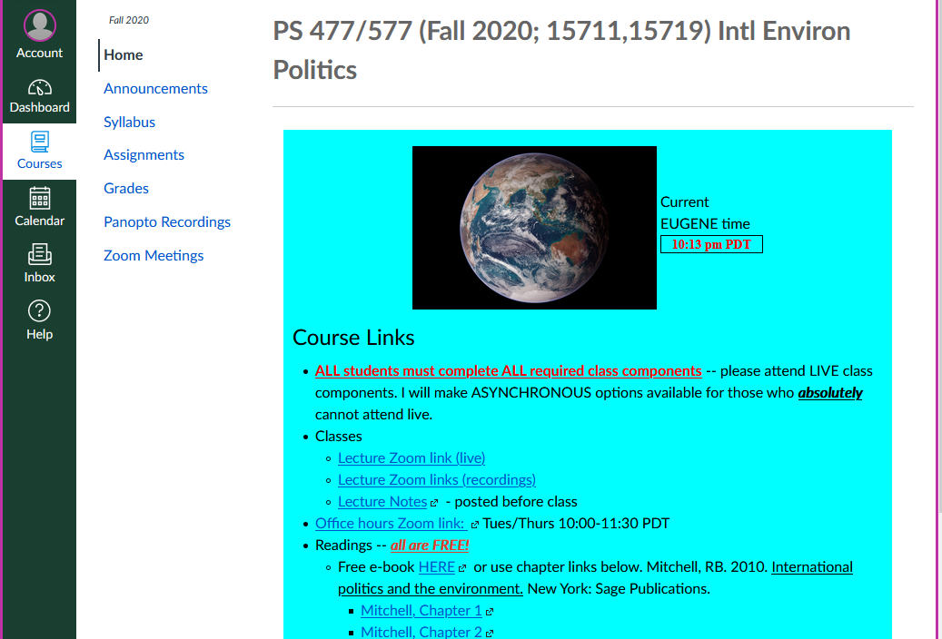

Slide 8
Getting the Tech Working

Slide 9
We are going to get Tech issues out of the way first: Virtual Classroom via Zoom
Because it’s a large class
  I am the only one who is Unmuted, everyone else Muted
  I am the only one who can Share Video and Share Screens, everyone else is prevented from doing so.
If you can hear me but not see me, or see me but not hear me, do not worry, this is a test. Just sign off, have a good morning and watch email for another opportunity. Please send me an email at rmitchel@uoregon.edu and tell me what the problems were.

Slide 10
Open the Chat Window by doing:
Mac: ⌘+Shift+H
PC/Windows: Alt+H
OR
Click the part of your screen that says “Start Chat”

Slide 11
Open the Participants Window by doing:
Mac: ⌘+U
PC/Windows: Alt+U
OR
Click the part of your screen that says “Participants”

Slide 12
I will send a Chat now saying
“Hello – click Yes if you see this”
Wait a moment and then …
In the PARTICIPANTS window (NOT the Chat window)
Click “Yes” if you see my “Hello – click Yes if you see this”
Click “No” if you can’t

Slide 13

Can you hear my voice?
Click “Yes” if you can
Click “No” if you can’t

Slide 14
Can you see video of me talking?
Click “Yes” if you can
Click “No” if you can’t

Slide 15
Can you see my Powerpoint slides?
Click “Yes” if you can
Click “No” if you can’t

Slide 16
Did you log in using your UO email address (withOUT the @uoregon.edu part)?
Click “Yes” if you did
Click “No” if you did not
Entering UO email address is essential to take attendance

Slide 17
Can you hear the Youtube AUDIO?
Click “Yes” if you did
Click “No” if you did not
Entering UO email address is essential to take attendance

Slide 18
Some Zoom “tricks”
Action | MAC | Windows
Chat panel display | ⌘+Shift+H | Alt+H
Participant panel display | ⌘+U | Alt+U
Audio mute/unmute (disabled) | ⌘+Shift+A | Alt+A
Video start/stop (disabled) | ⌘+Shift+V | Alt+V
Raise/lower hand | Option+Y | Alt+Y
Enter or exit full screen | ⌘+Shift+F | Alt+F

Slide 19
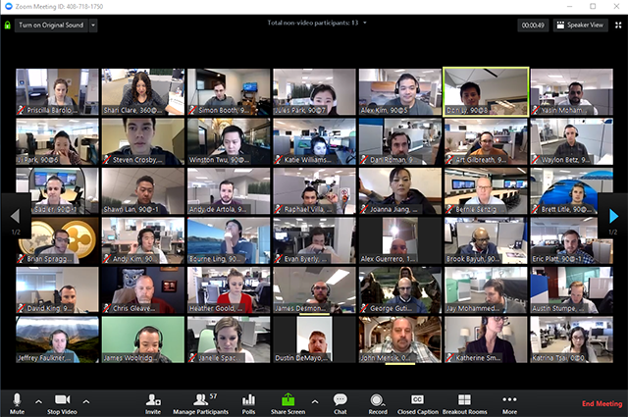
This is “Gallery View”
The upper right corner says “Speaker view” when it is IN Gallery view because it will switch to Speaker view if you click it

Slide 20
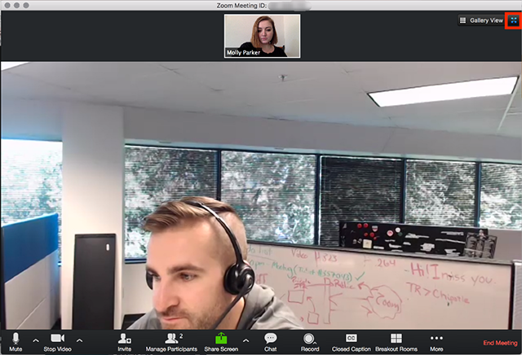
This is “Speaker view”
The upper right corner says “Gallery view” when it is IN Speaker view because it will switch to Gallery view if you click it

Slide 21
Screen-sharing PLUS video of me at same time
Can have it in Pop-out mode or Side-by-Side mode
Side-by-Side mode avoids my face overlapping the slides

Slide 22
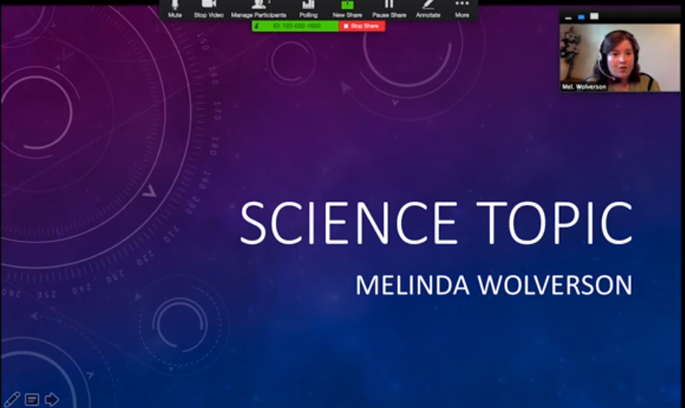
Pop-out mode vs. Side-by-Side mode
Make person’s picture bigger by pulling corner of picture, but it may cover the screen

Slide 23
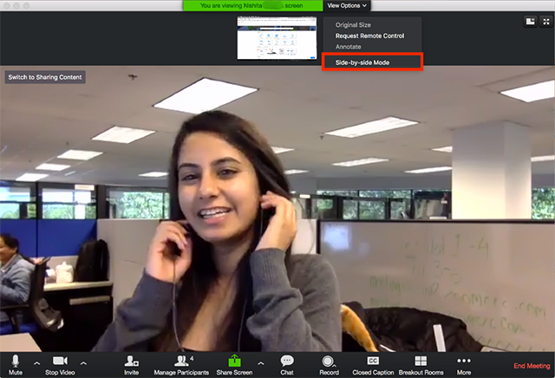
Side-by-Side mode:
Can select once Prof shares Screen
If Screen Sharing has started, the top of screen offers “View Options” -- select Side-by-Side mode from that dropdown menu

Slide 24
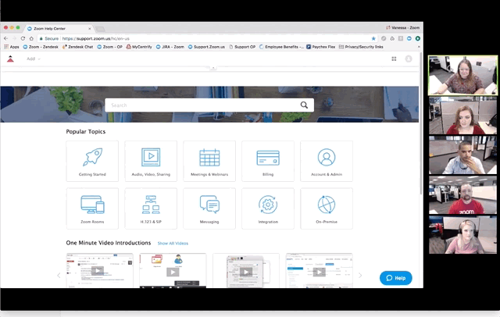
Side-by-Side mode, once selected
Once Side-by-Side mode is selected, you can resize two parts of screen without overlapping them

Slide 25
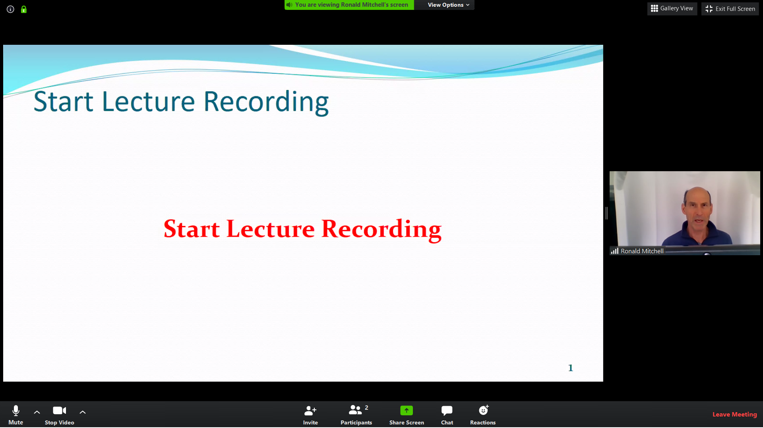
Your screen should look like this
Click “Yes” if it does
Click “No” if it does not

Slide 26
Last step to avoid Participants/Chat windows obscuring part of screen
To fix this problem, Click Exit Full screen
Now you have same screen but in a window
Resize window to take up most but not all of screen
Now you can move Chat & Participant windows to the side

Slide 27
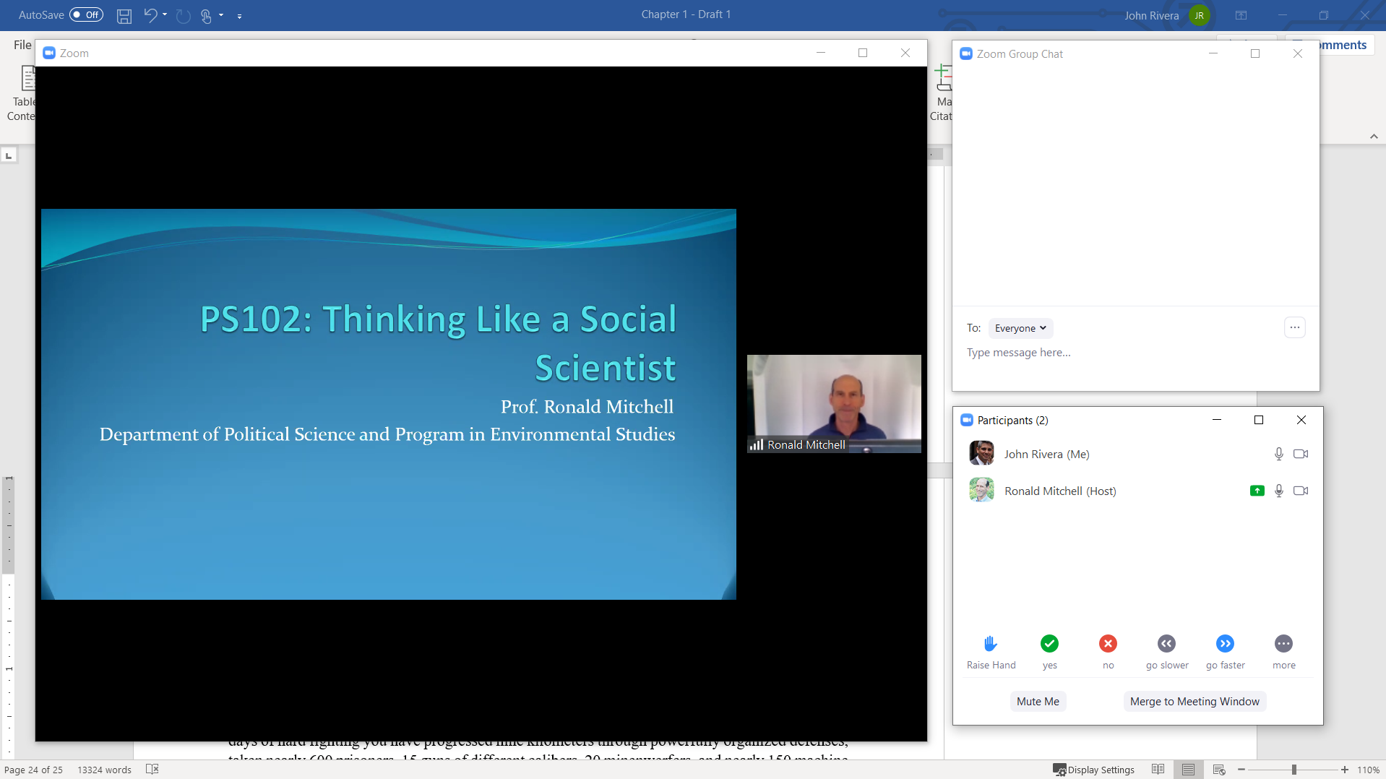
Final view

Slide 28
Hope that helped some of you!

Slide 29
PS477/577:
International Environmental Politics
Prof. Ronald B. Mitchell
rmitchel@uoregon.edu

Slide 30
Julia Butterfly Hill
What problem did Hill want to fix?
What was Hill’s solution to it?
Was her solution effective / did it work?
  If so, what do you mean by “effective”?
  If you believe it was effective, would you do it?
  Are there other actions that would be more effective?
  Why do you think they are more effective?
[Could do this same exercise with Greta Thunberg, of course]

Slide 31
In-Class Exercise
Write Down
Problem: one international environmental problem that you are concerned about
Cause: what you think is the most important cause of that problem
Solution: a policy you think could make a major contribution to fixing the problem

Slide 32
Human Impacts on the
Natural Environment

Slide 33
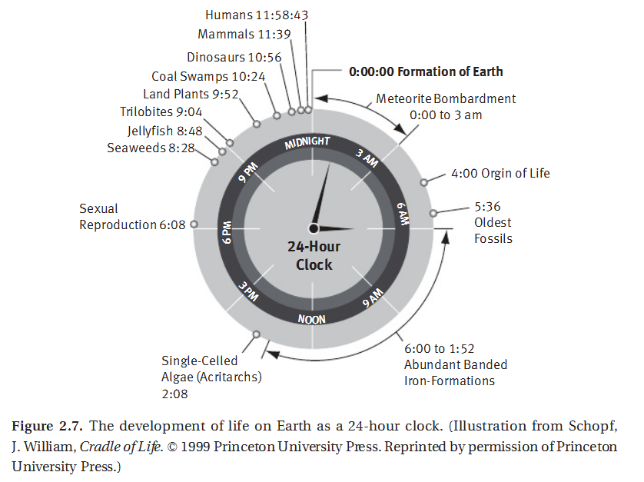
Earth Time & Human Time
If Earth were 24 hours old
If Earth were 100 years old
Humans arrived 2 days ago
Recorded history started 2 hours ago
The industrial revolution in ~1860 and its impact on the environment started 2 minutes ago

Slide 34
Humans began altering nature early
(but we have gotten much better at it over time)
“Native American predation of sea otters in California after ~9000 years ago and in the Aleutians ~3000 years ago allowed abalone and sea urchin populations to expand greatly, changing the entire structure of the kelp forest ecosystem. This “trophic cascade” may have resulted in localized urchin barrens” (Rick and Erlandson, 2009)
“Cod, a keystone species that is depleted in the North Atlantic today, may have been locally overfished by hunter-gatherers in the Gulf of Maine beginning some 3500 years ago” (Rick and Erlandson, 2009)
“Human hunting and fishing in ancient coastal ecosystems thus caused declines in key species, triggered trophic cascades, or reduced the size of prey” (Rick and Erlandson, 2009)

Slide 35
The Anthropocene
“The Anthropocene connotes not just an extension or intensification of existing environmental pressures, but a more fundamental shift because humanity’s impact on social‐ecological systems is now so great that it is altering basic Earth system processes, such as the global climate and the chemical composition of the oceans.”
Clive Hamilton. 2017. Defiant Earth: The fate of humans in the Anthropocene. (St Leonards, NSW: Allen Unwin)

Slide 36
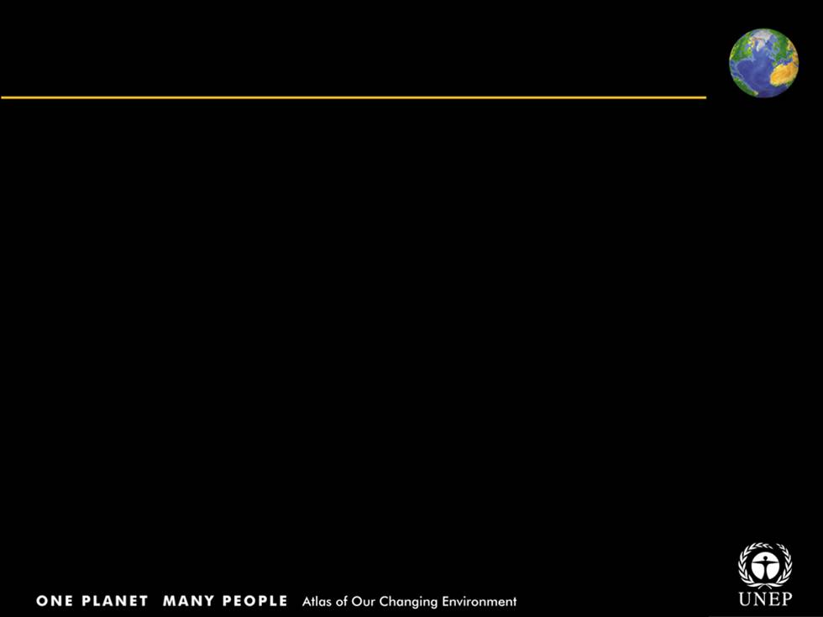
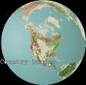
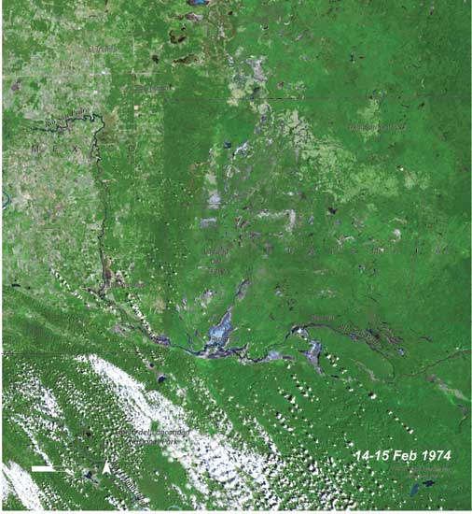
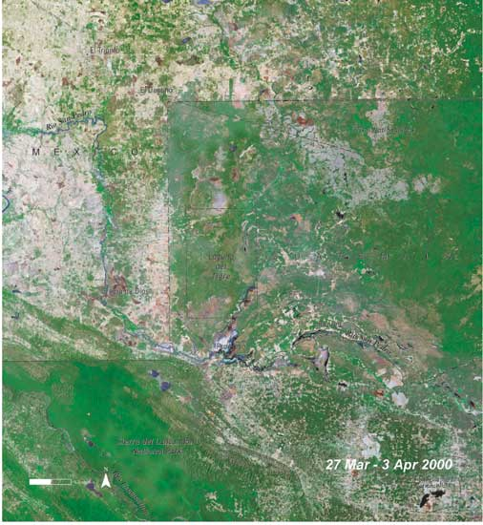
Different land use practices visible
across country border, Mexico/Guatemala
1974 - 2000: Conversion of forest to agriculture
Now country border can be seen even from space
Notes:
The border between Guatemala and Mexico runs through Mexico’s Chiapas Forest and Guatemala’s El Peten. In this pair of images, the border even without the black lines that have been overlaid on the images to show the outlines of the two countries. The region crossed by this border was once biologically very diverse. On the Guatemalan side, it still is, as most of the El Peten remains as closed canopy forest because of lower population densities and the protected status of the Sierra de Lacondon and Laguna del Tigre National Parks. Across the border in Chiapas, however, a larger and increasing population has an obvious effect on the landscape. Between 1974 and 2000, much of the forest on the Mexican side of the border has been converted to cropland or pasture.

Slide 37
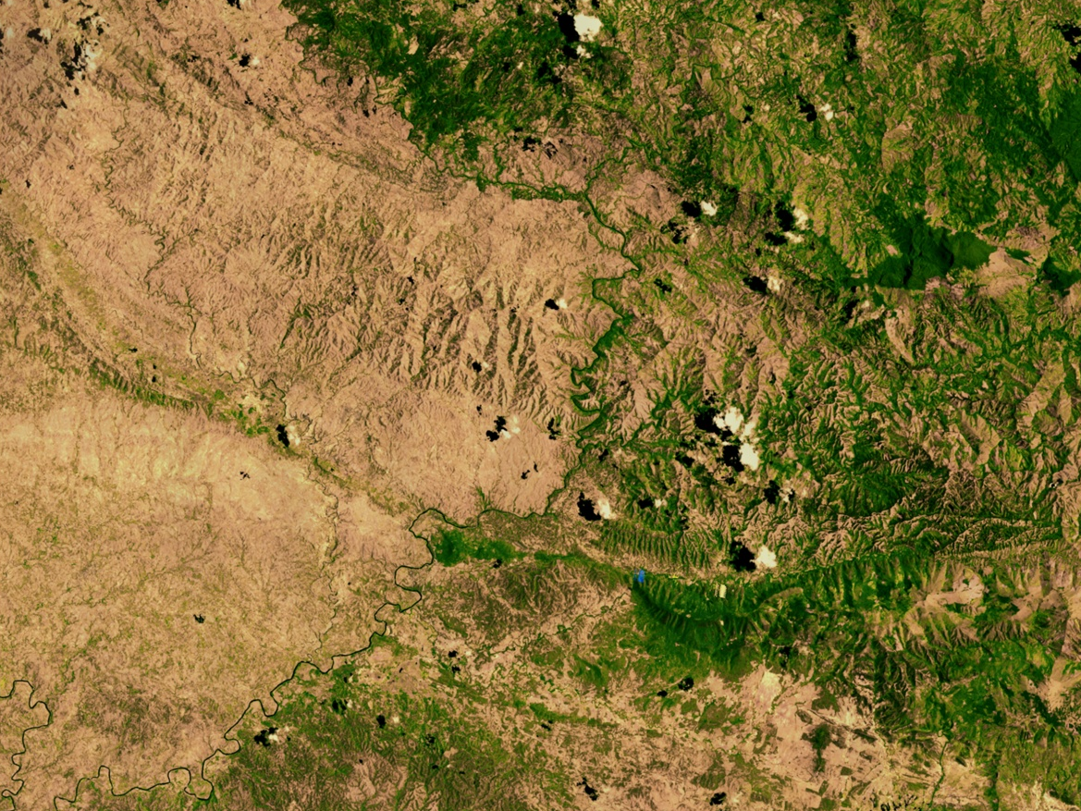
Haitian Deforestation
Dominican Republic
Haiti
Source: NASA - Goddard Space Flight Center Scientific Visualization Studio (Darrel Williams, Alex Kekesi, Stuart Snodgrass), 2002 (25 Sep). “Haitian Deforestation.” http://svs.gsfc.nasa.gov/vis/a000000/a002600/a002640/index.html.

Slide 38
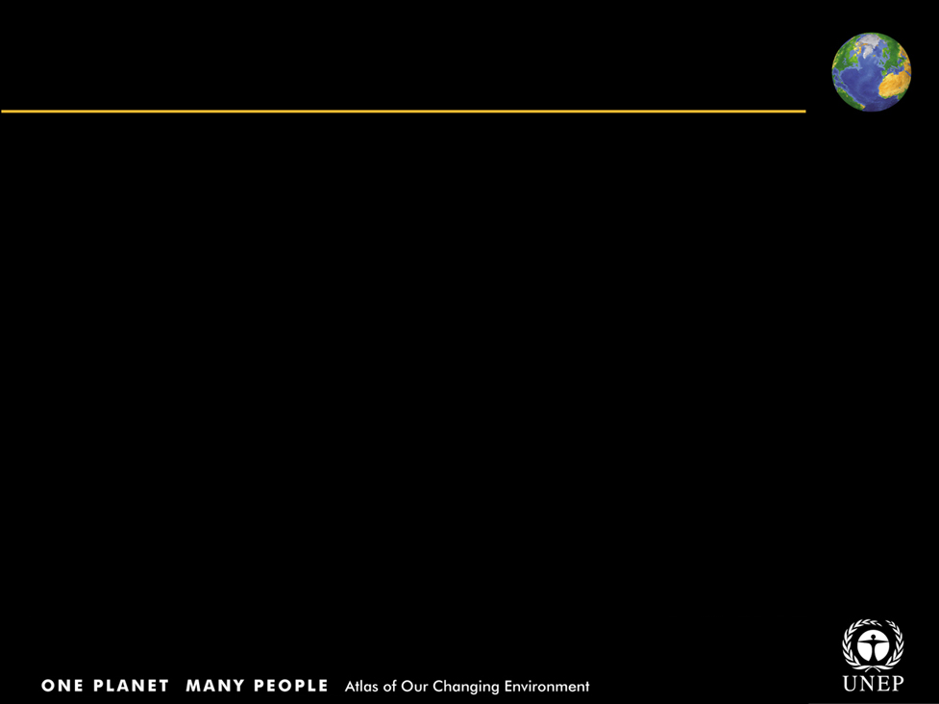
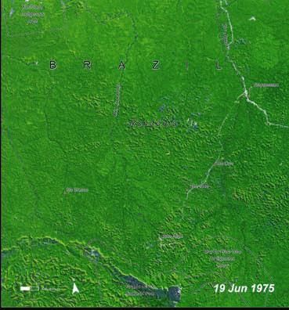
Deforestation: Rondonia, Brazil
Title
Body text
1975 -Healthy natural vegetation
1986 -“Fishbone” pattern on the landscape indicate agriculture fields
2001 -Agriculture continues to replace forest cover.

Slide 39
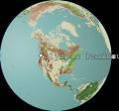
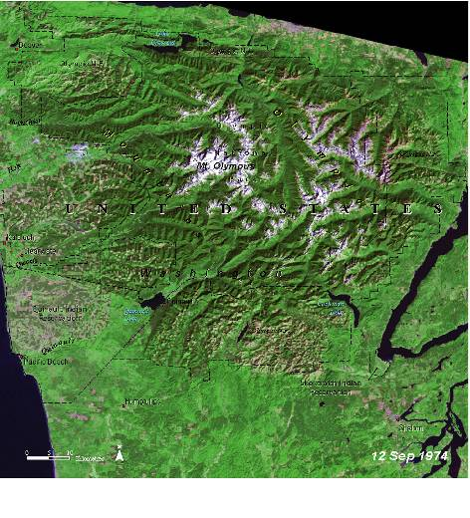
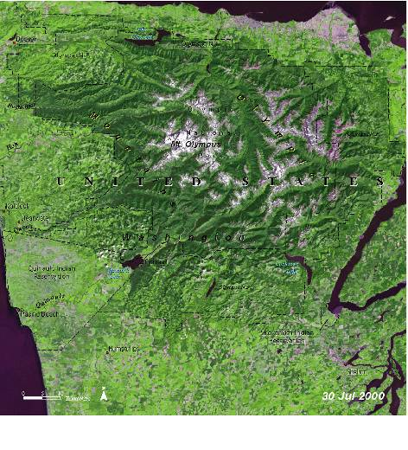
Disappearing temperate forests of Olympic Peninsula, United States
1974: Shows patchwork of purple and pink, indicating clear-cutting
2000: Evidence of good re-growth of trees in forest reserve areas
Notes:
On the slopes and the surrounding areas of Mt. Olympus in the Olympic Peninsula of the Pacific Northwest, one of the last remnants of temperate forests in the United States is quickly disappearing. Between 1971 and 2002, nearly half a million hectares (1.1 million acres), or almost 29 per cent of the forest covering the Peninsula, was clear-cut. That is an area equal in size to the Olympic National Park and its fi ve adjacent wilderness areas. The 1974 image shows the characteristic patchwork of purple and pink areas where clear-cutting has taken place. Light green patches signify regrowth in the forest areas. On a percentage basis, forests owned by Native tribes on the Peninsula were the most severely impacted during this period of time: 48 per cent of the forests on Native lands were clear-felled. In the 2000 image, clear-cutting is obviously still continuing, as is development to the north, west, and south of the national park. There is evidence of good regrowth of trees in forest reserve areas in preparation for the next clear-felling cycle.

Slide 40
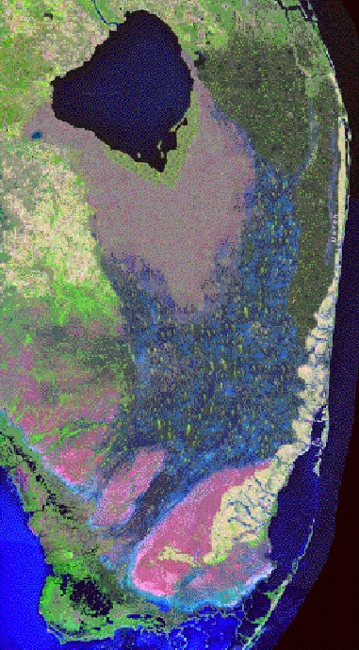
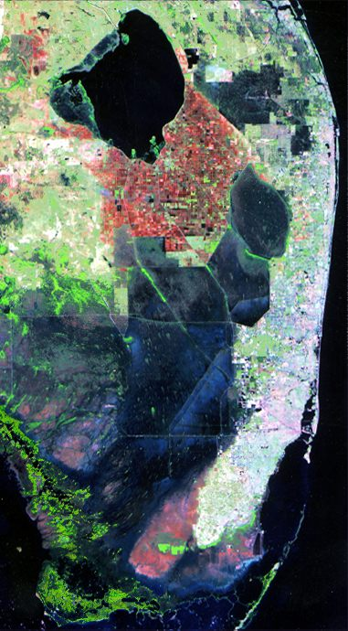
Wetlands Loss:
US Everglades
1850
1995
Source: Exploring the Environment Team. 2003 (23 January) “Remote Sensing: Waterflow” Wheeling Jesuit University, Center for Educational Technologies http://www.cotf.edu/ete/modules/everglades/FEremote2.html

Slide 41
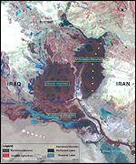
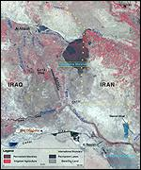
Wetlands Loss:
Intentional Drainage in Iraq
1973
2000
Source: Kirby, Alex. 2001 (16 May) “Mesopotamia's marshes 'set to vanish’” BBC News Online http://news.bbc.co.uk/1/hi/sci/tech/1332128.stm

Slide 42
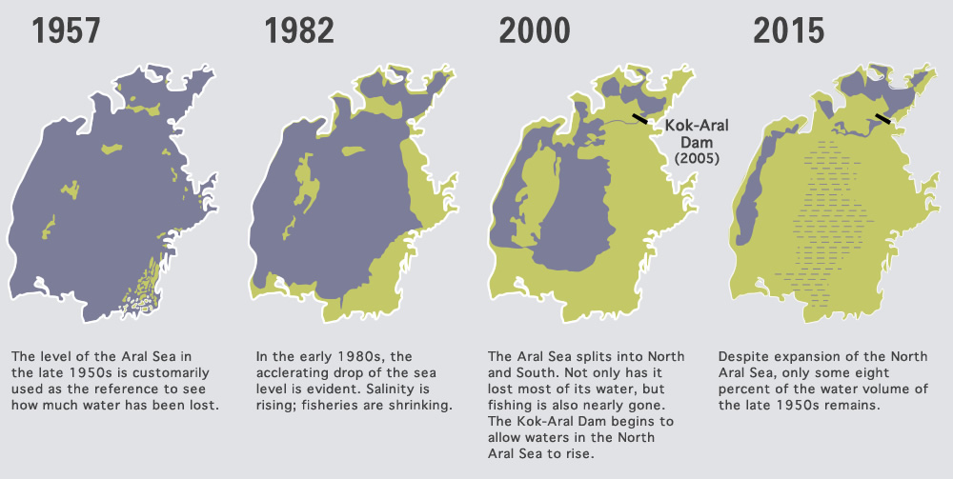
Desertification: Aral Sea
4th largest body of freshwater
Source: http://archive.aramcoworld.com/issue/201505/reviving.the.north.aral.sea.htm and https://earthobservatory.nasa.gov/WorldOfChange/AralSea

Slide 43
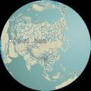
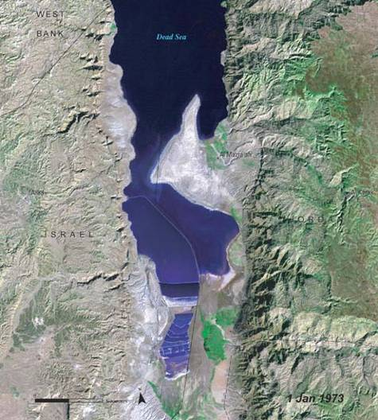
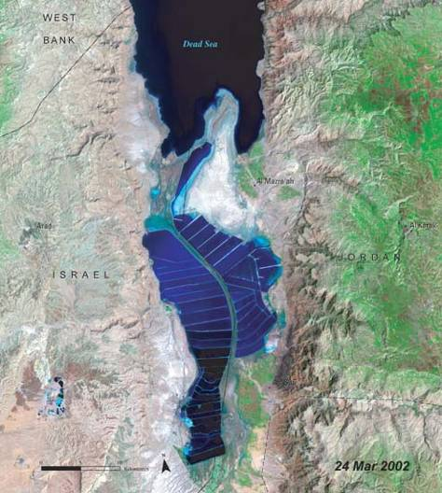
Dramatic changes in Dead Sea, Jordan
Images show dramatic changes in the Dead sea over 30 years
1973: The Sea level is dropping at the rate of 1m/year
2002: Notice the expansion of salt works, and near-complete closing off of the southern part by dry land
Notes:
For decades, heavy demands have been placed on the land-locked Dead Sea to meet the needs of growing populations in the countries that border it. Both Israel and Jordan draw water from rivers that flow into the Dead Sea, reducing the amount of water that would naturally replenish it. The amount of area devoted to evaporation ponds for producing salt has greatly expanded over the past three decades. The creation of salt works tends to accelerate evaporation, further contributing to the reduction in water level. Currently, it is estimated that the water level of the Dead Sea is dropping at a rate of about one metre (3 feet) per year. These two images, from 1973 and 2002, reveal dramatic changes in the Dead Sea over a period of about 30 years. Declining water levels, coupled with impoundments and land reclamation projects, have greatly increased the amount of exposed arid land along the coastline. The near-complete closing off of the southern part of the Sea by dry land (2002 image) reveals the severity of water level decline.

Slide 44
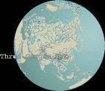
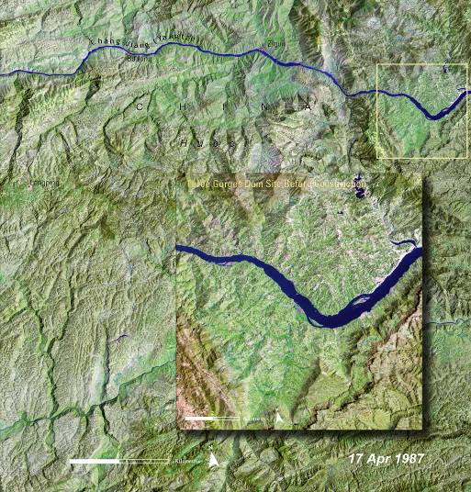
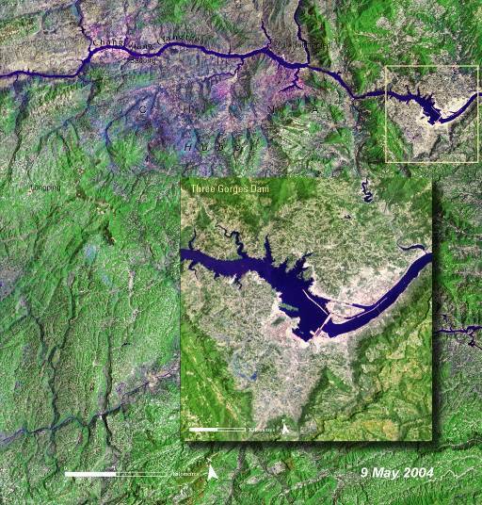
Changes due to Three Gorges Dam construction, China
Changes due to the construction of dam
1987: Nature of the river and surrounding landscape before the dam
2004: The enormous dam is clearly visible
Notes:
The Three Gorges Dam on the Chang Jiang (Yangtze) River in China is one of the largest single construction projects ever attempted on the planet. The dam was constructed to supply approximately one-ninth of China’s electricity—as much power as could be generated by at least fifteen nuclear power plants. It is a relatively environmentally clean option compared to coal burning or nuclear power plants. It is also hoped that the dam will help control flooding on a river where seasonal floods during the past century has caused death of over one million people. However, the Three Gorges Dam project has also had negative environmental and social impacts as a result of the massive construction efforts and the submergence of land along the river above the dam. The former village of Zigui (top center of image) has already been submerged. The 1987 image shows the nature of the river and surrounding landscape before work on the dam was begun. In the May 2004 image, the enormous Three Gorges Dam is clearly visible, as is the reservoir of impounded river water that has been created behind it.

Slide 45
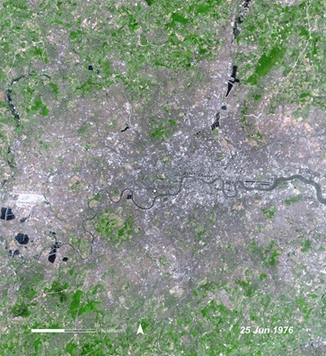
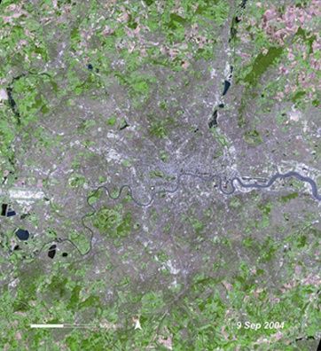
Title
Urbanization:
London, England
Body text
The capital and largest city of the United Kingdom
Area of 659 sq. mi. (1 706 sq. km.)
Over 7 million residents.
Population projected to approach 8 million by 2021.

Slide 46
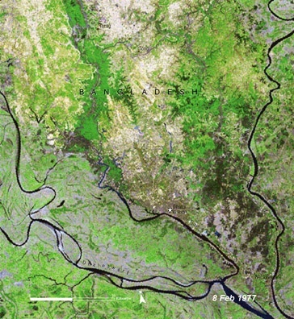
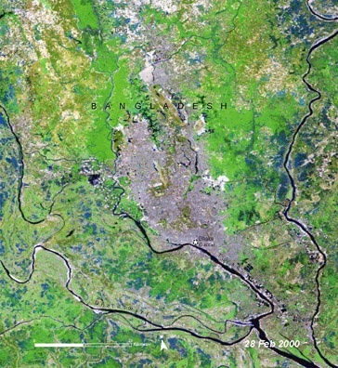
Urbanization:
Dhaka, Bangladesh
Title
Body text
1977-2000: the capital of Bangladesh, has grown from a city of 2.5 million more than 10 million.

Slide 47
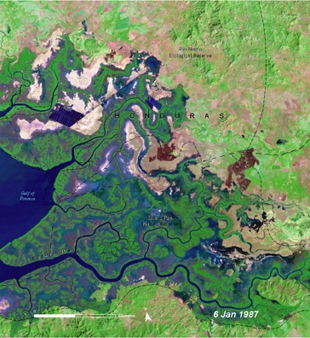
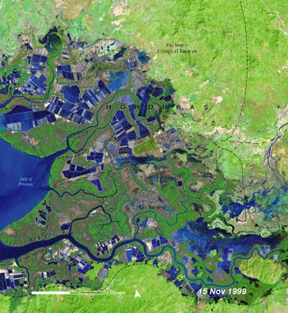
Aquaculture Impact:
Gulf of Fonseca,Honduras
Title
Body text
Over a period of 12 years, the images reveal how shrimp farms and ponds have mushroomed carpeting the landscape around the Gulf of Fonseca, Honduras, in blocks of blue and black shapes.
Honduras is second only to Ecuador in the cultivation and export of shrimp from Latin America.

Slide 48
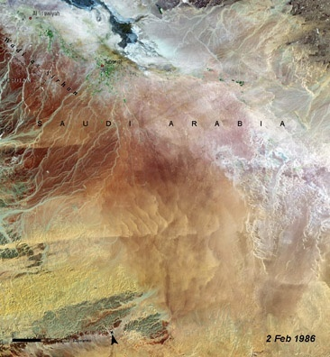
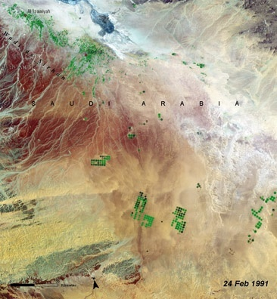
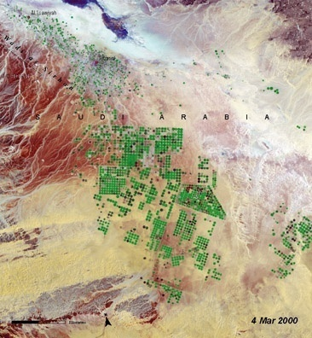
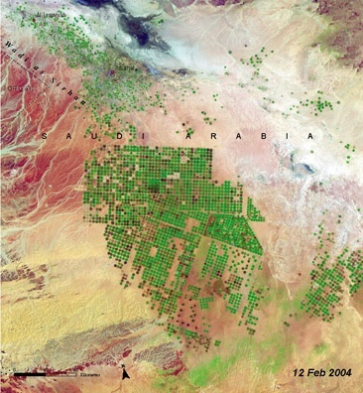
Title
Agriculture Impact:
Al Isawiyah, Saudi Arabia
Body text
Greening of a desert
1986 -A desert landscape
1991 -Irrigation begins…
2000 -And transforms the desert
2004 –Irrigation intensity increases

Slide 49
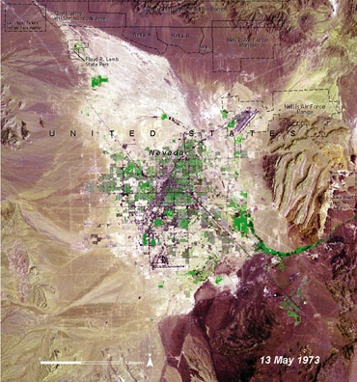
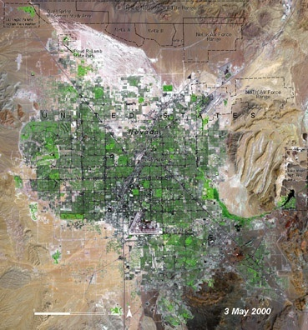
Luxury Impact?
Las Vegas, United States
Title
Body text
1973 -A small settlement
2000 -The landscape is now dramatically modified

Slide 50
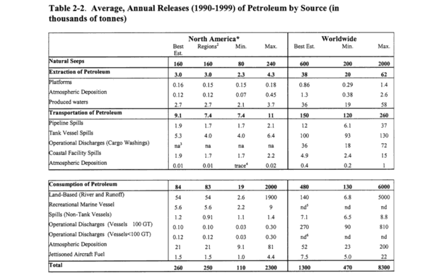
Oil Entering the Oceans
Source: National Academy of Sciences’ Committee on Oil in the Sea. 2002. Oil in the Sea III: Inputs, Fates, and Effects Washington, DC: Ocean Studies Board, Division on Earth and Life Studies, and Marine Board, Transportation Research Board, p. 33. Available at: http://books.nap.edu/books/0309084385/gifmid/41.gif

Slide 51
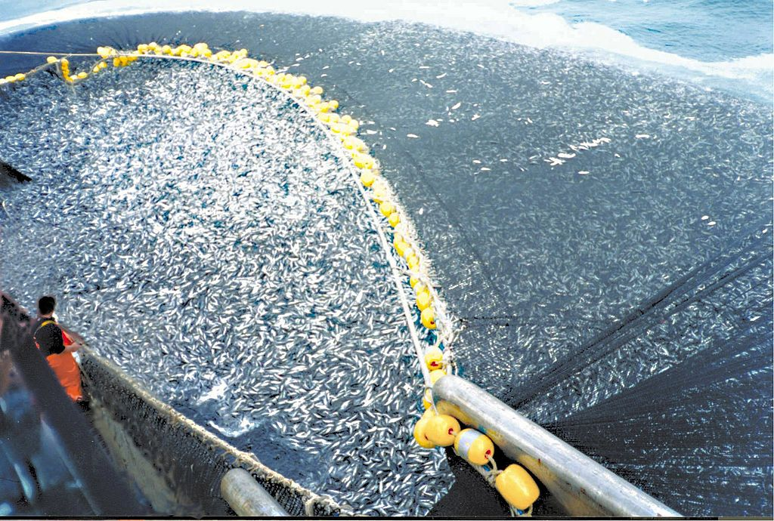
Decline in Large Fish Biomass
Visual of the cause, 400 tons, 1 haul, 1 ship
1952
1958
1964
1980
Source: https://en.wikipedia.org/wiki/Overfishing#/media/File:Chilean_purse_seine.jpg

Slide 52
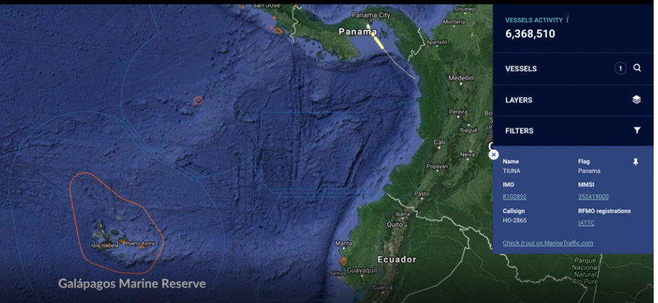
Overfishing illustrated
http://www.bbc.com/future/story/20180607-how-to-spot-the-secretive-activities-of-rogue-fishing-boats

Slide 53
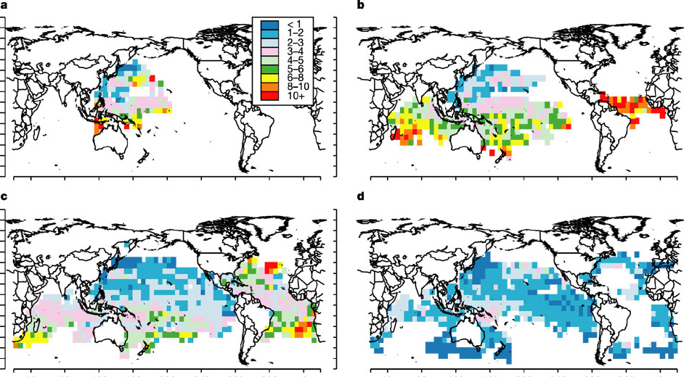
Decline in Large Fish Biomass
Data of the cause (fish/100 hooks on Japanese longlines)
1952
1958
1964
1980
Source: Myers, Ransom A., and Boris Worm. 2003. “Rapid worldwide depletion of predatory fish communities.” Nature 423, 280-283. http://www.nature.com/cgi-taf/DynaPage.taf?file=/nature/journal/v423/n6937/full/nature01610_fs.html

Slide 54
Fish Disappearance
Virtually all marine life other than jellyfish has disappeared from the Black Sea, because of hypoxia induced by discharges from the Danube, Dneiper, and Don Rivers (source: Woodward, 2000, Ocean’s End cited in Clark, 2006, World Fisheries)

Slide 55
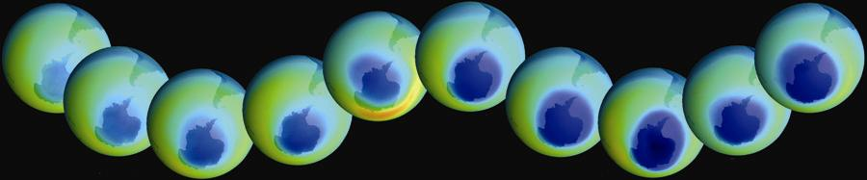
Ozone Depletion
Title
Body text
Growth of the Antarctic ozone hole over 20 years, as observed by the satellite
Darkest blue areas represent regions of maximum ozone depletion.

Slide 56
Impacts Vary Across Countries

Slide 57
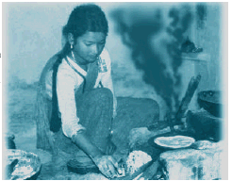
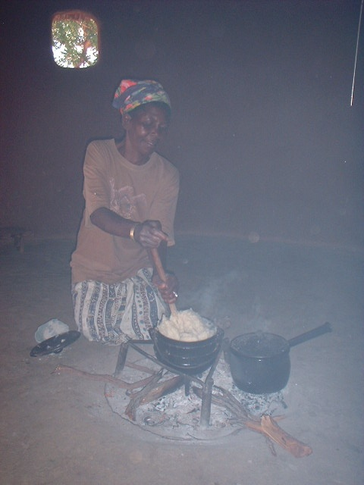
Indoor Air Pollution
“Exposure to indoor air pollution is one of the major contributing factors leading to acute respiratory infections which cause an estimated 4 million deaths of young children each year” – World Bank (1992, pp.52-53)

Slide 58
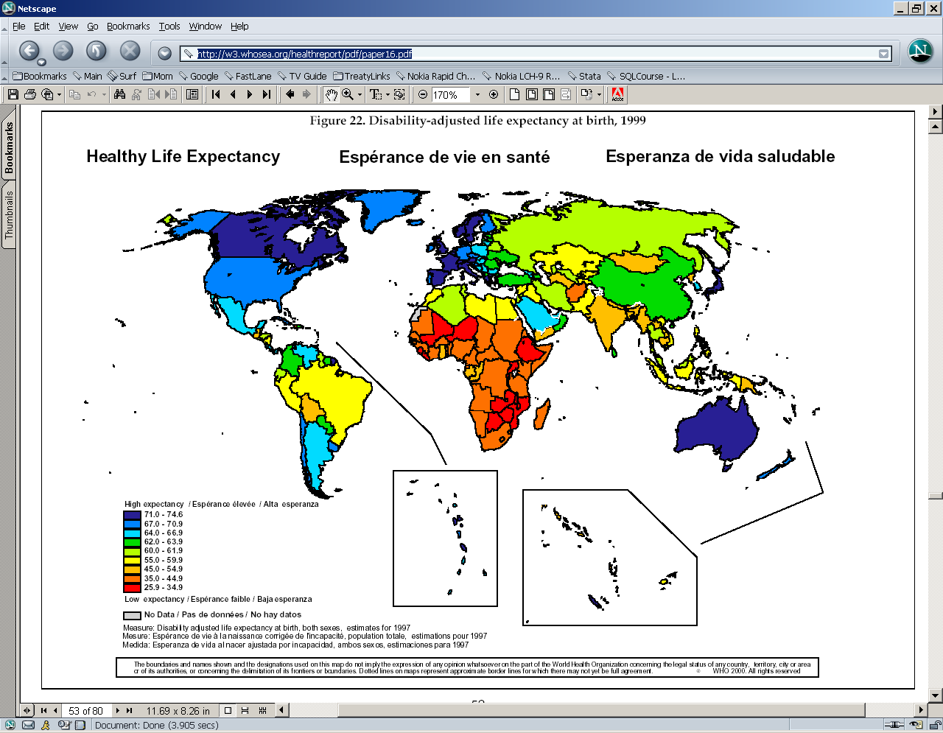
Healthy Life Expectancy
By Country
Source: Colin D Mathers, Ritu Sadana, Joshua A Salomon, Christopher JL Murray, and Alan D Lopez. 2000. "Estimates of DALE for 191 countries: methods and results." Global Programme on Evidence for Health Policy Working Paper No. 16 of the World Health Organization, June. http://w3.whosea.org/healthreport/pdf/paper16.pdf

Slide 59
Simple as Salt
Iodine deficiency
“One-third of the world’s people don’t get enough iodine from food and water”
Children of an iodine-deficient mother likely to have “an IQ that is 10 to 15 points lower than it would otherwise be”
Adding iodine to salt costs 2 to 3 cents per person per year
Source: Nicholas Kristof. Raising the World’s I.Q. New York Times. December 4, 2008. http://www.nytimes.com/2008/12/04/opinion/04kristof.html

Slide 60
The Epidemic Scorecard
Disease | Prevalence | Deaths | New Cases
AIDS/HIV | 32 million | 3 mil/yr – 300/hr | 5.5 million
Diarrheal diseases (unsafe H2O) | n/a | 2 mil/yr – 200/hr | 2.7 billion
Tuberculosis | 14 million | 2 mil/yr – 200/hr | 8 million
Hepatitis B | n/a | 1 mil/yr – 100/hr | 20 million
Malaria (mosquitoes) | n/a | 1 mil/yr – 100/hr | 400 million
Measles (preventable) | n/a | 900k/yr – 90/hr | 30 million
Denque fever (mosquitoes) | n/a | 24k/yr – 2/hr | 20 million
Influenza | n/a | 250k/yr – 25/hr | 4 million
Yellow fever | n/a | 30k/yr – 3/hr | 200,000
Source: Howard Markel, Stephen Doyle. 2003 (30 April). “The Epidemic Scorecard.” New York Times, A31 http://www.nytimes.com/packages/pdf/opinion/030430_edt_MARK.pdf.

Slide 61
Climate Change
We will go into this way more at the end of the course

Slide 62

Does the Columbia Freeze Over Anymore?
Colubmia River froze over in: 1830, 1833, 1840, 1842, 1847, 1849(2x), 1856, 1875, 1862, 1868, 1884, 1885, 1888, 1890, 1891, 1894, 1896, 1907, 1909, 1916, 1919, 1930 *
Picture: Hood River, Oregon, W. D. Rogers, 1/17/1907; Oregon Historical Society Photo OrHi 35431 (http://librarycatalog.ohs.org/)
Columbia “generally freezes up once in the winter” from a trial in 1882 at http://books.google.com/books?id=wZA8AAAAIAAJ (p. 1393)
*Data on freezes compiled from: http://www.pacificcohistory.org/columbia.htm; http://historyink.com/results.cfm?keyword=Weather&searchfield=topics; and http://www.nwmapsco.com/ZybachB/Thesis/05-081_Chapter_3b.pdf (p. 86)

Slide 63


Effects of Increased CO2 on
Glaciers (Loss in Last 100 Years)
Kärnten, Austria
Source: Gesellschaft für ökologische Forschung e.V. 2002. Das gletscherarchiv. http://www.gletscherarchiv.de/. Accessed on: 15 January 2003.

Slide 64
How should we distinguish
Important from less important problems
Real from false causes of problems
Effective from ineffective solutions

Slide 65
Class Summary
Class goal: think more systematically about problems, causes, and solutions so you can make a more effective difference in the world
Review Syllabus
Read Assignment Packet via online link
Do plagiarism assignment on Canvas for Thursday

