Slide 1
Lecture 3:
Causality, Causal Thinking, and Testing Theory

Slide 2
Assignment #1:
Due BEFORE Thursday’s Class: upload on Canvas
Tragedy of Commons Paper: 1500 words, 4 sections
  Description/definition
  Two examples
    Example of Tragedy of the Commons
    Example of NON-Tragedy of the Commons
  Two factors (causes) that make Tragedy of Commons likely
  Two solutions that actors can use to solve Tragedy of the Commons
PLUS
  Play “Optimizing a Private Farm”
  Strategize for in-class game

Slide 3
Start thinking about your final paper
Read Assignment packet cover to cover
How to get ideas for research paper
  Goal is to produce new knowledge rather than regurgitate existing knowledge
  Read GENERAL articles to find THEORETICAL questions of interest to field, not just you
  Question “did this treaty work?” AND “what part of treaty explains why it worked?”
    Compare treaty with a particular feature to one without
    Examine treaty that adopted feature (sanctions, rewards) after the treaty had been around
    Compare how different types of countries respond to a treaty
    Many other options we can discuss
  Data available on Canvas soon

Slide 4
Point of Today’s Lecture
How do we develop confidence that “X” caused something in the world?
If we can find evidence and build a compelling argument that things in the world turned out differently with X in the world than they would have otherwise?

Slide 5
Real Theories vs. Conspiracy Theories
Real theories: Claims about why the world is the way it is and how it works
Good theorists look for all evidence, especially evidence that might prove them wrong and accept their theory only if they CANNOT prove it wrong.
When theory and facts don’t match, they throw away their THEORY.
Benefit: Understanding how world works allows achieving desirable outcomes and avoiding undesirable outcomes.
~~~~~~~~~~~~~~~~~
Conspiracy theories: Claims about why the world is the way it is and how it works
Conspiracy theorists look for ONLY the evidence that supports their theory and always end up with the same theory they started with
When theory and facts don’t match, they throw away their FACTS

Slide 6
Theories, predictions, and testing theories with evidence
Theories
  Evolution or Intelligent design?
Predictions and observable implications
  Which direction should koala pouch face?
  How should nerve get from giraffe’s brain to its larynx?
  No changing prediction after know the facts (post-hocism)

Slide 7

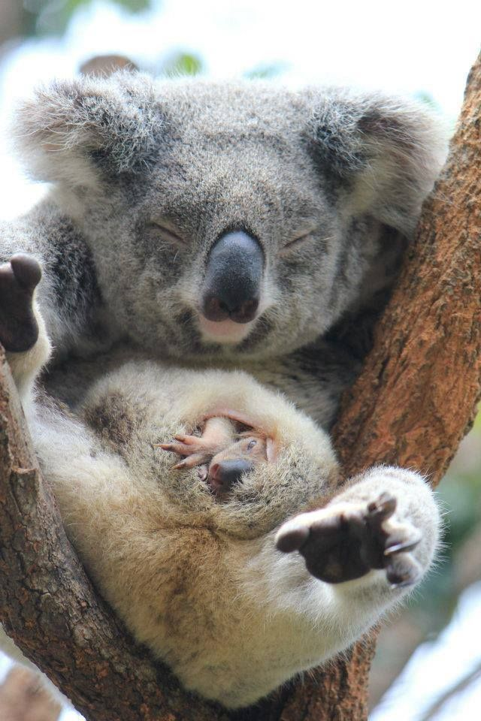
What direction should koala pouch face?

Slide 8
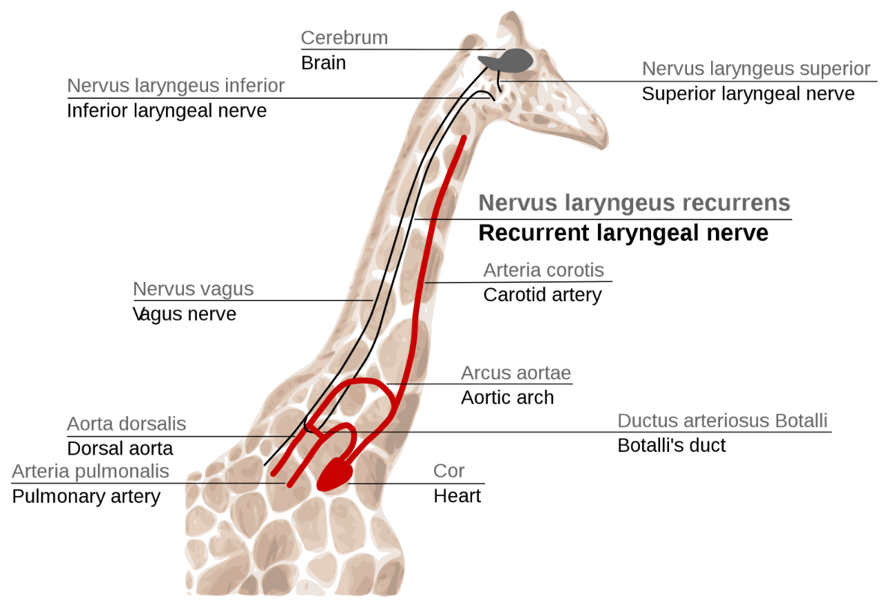
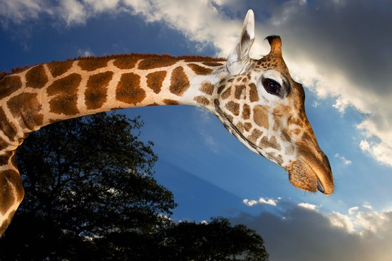
Evidence on koalas and giraffes

Slide 9
How do we know if a policy change had intended effect?

Slide 10
Video on Causation
Humans intervene in the environment
But are the consequences always as intended?

Slide 11
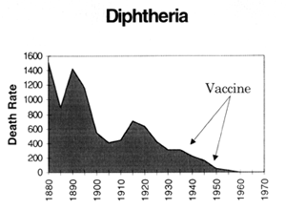
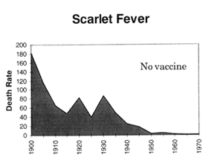
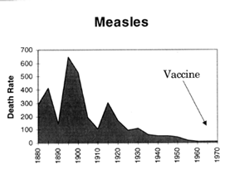
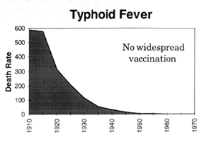
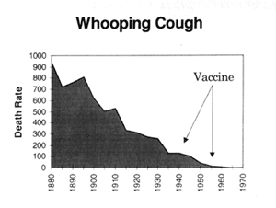
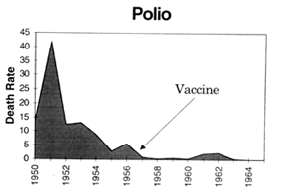
What caused the decline in these 6 diseases in developing countries?
What role did vaccines play in these declines?
How do you know?

Slide 12
Theories are Explanations of
Causal Relationships
Ask WHY to repeat success / avoid failure
We always have theories to explain things; only question is whether they are correct
Goal: test theories against facts to develop theories that better reflect true causality in world

Slide 13
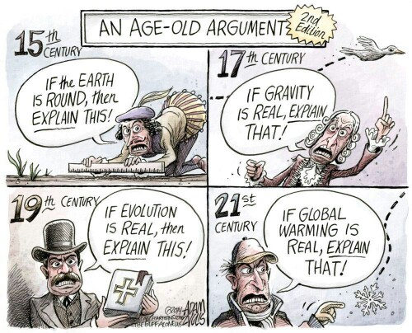

Slide 14
How do we know if X caused Y?
“X causes Y” implies that we should observe BOTH
  When X occurred, Y also occurred
    AND
  If X had NOT occurred, Y would not have occurred (either through evidence or plausible counterfactual arguments)

Slide 15
Variables and Values
Variables
  Things that can vary
  E.g., color, culture, level of development
  Easiest to think about if put “State of” in front
Values
  The things that variables vary between
  E.g., ROYGBIV, indigenous/non-indigenous, high/low
Make sure you identify both the variables you want to work with AND their possible values

Slide 16
Dependent Variables
Dependent variables (DVs) – things whose variation we want to explain
  DVs are simply EFFECTS
  Why are they dependent? because we want to explain them, that’s all
  What do they depend on? the Independent Variables

Slide 17
Independent Variables
Independent variables (IVs) – things we use to explain Dependent Variables
  IVs are simply CAUSES
  Usually many of them
  Most explanations require multiple variables
  BUT, we can try to control IVs through case selection or quantitative analysis so we can isolate the effect of each IV separately

Slide 18
Causality, IVs, and DVs
If an IV is a cause of change in a DV, then it must be true that
  The IV changed it’s value before the DV changed it’s value
  If the IV had not changed it’s value then the DV would not have changed it’s value (this is the counterfactual part)
What’s the “cause” depends on how we define the “causal field”, which, in turn, depends on how we are thinking about the counterfactual

Slide 19
Three types of causal questions
Focus on specific DV
  What causes something to vary?
  What are the causes of a given phenomena?
Focus on specific IV
  What are effects of variation in something?
Focus on specific IV and specific DV
  What are the effects of variation in one thing on another?

Slide 20
Theoretical Claim
 | Cases with evidence | Independent Variable | Prediction regarding Dependent Variable
Theoretical claim |  | Ind Var (A) Low tariff levels | Dep Var (B) Environment badly degraded

Slide 21
Counterfactual element of claim
 | Cases with evidence | Independent Variable | Prediction regarding Dependent Variable
Theoretical claim |  | Ind Var (A) Low tariff levels | Dep Var (B) Environment badly degraded
Counterfactual element of claim |  | Ind Var (not A) Higher tariff levels | Dep Var (not B) Environment less degraded

Slide 22
Evidence of Theoretical Claim
 | Cases with evidence | Independent Variable | Prediction regarding Dependent Variable
Theoretical claim | Post-NAFTA EU members after they join Cuba pre-embargo | Ind Var (A) Low tariff levels | Dep Var (B) Environment badly degraded
Counterfactual element of claim |  | Ind Var (not A) Higher tariff levels | Dep Var (not B) Environment less degraded

Slide 23
Evidence of Counterfactual
 | Cases with evidence | Independent Variable | Prediction regarding Dependent Variable
Theoretical claim | Post-NAFTA EU members after they join Cuba pre-embargo | Ind Var (A) Low tariffs | Dep Var (B) Degraded environment
Counterfactual element of claim | Pre-NAFTA EU non-members EU members before they join Cuba post-embargo | Ind Var (not A) HighER tariffs | Dep Var (not B) LESS degraded environment

Slide 24
Steps to a Convincing
Causal Argument
Identify important theoretical question
Develop hypotheses and identifying variables
Select cases to control variables (and thereby exclude rival hypotheses as explanations)
Link data to propositions
Examine correlations and causal pathways
Generalize to other cases

Slide 25
A Convincing Argument Requires
Evidence
that the ACTUAL value of the Dependent Variable
matches the PREDICTED value of the Dependent Variable for
your theoretical claim
AND
your counterfactual claim

Slide 26
Two Requests:
On Covid-19:
Act to protect yourself and others
On Democracy:
Vote

