Slide 1
Outline for class session
Response papers start next week
Final Paper discussion
Impacts of climate change

Slide 2
Response Papers
Make connections across readings you use
Provide evidence from articles to support your argument
Structure around ideas, not articles!
Use headings, even in short paper
How to do citations
Use bibliography at end

Slide 3
Final Paper Discussion

Slide 4
What are the Likely Impacts of Climate Change?

Slide 5
Complete Climate Impacts Lecture
Vulnerability – how much do particularly climate impacts hurt BEFORE your community responds, and what determines that?
Adaptive capacity – what resources does your community have to respond to the particular climate impacts it faces?
Resilience – how much pain remains after your community has adapted to those impacts and how robust is your community to a future in which those impacts will continue and continually change?

Slide 6
Impacts of climate change
National Geographic – impacts video
Kiribati video
If interested, also download this Powerpoint and watch
  Inuit film (start at 20:23)

Slide 7
Overview of climate change impacts
Widespread climate-related impacts are occurring now and are expected to increase
“Large and gradual” as well as “abrupt” changes in climate and ecosystems will occur
Harm will depend on types of impacts, exposure, vulnerability, adaptive capacity, and resilience
Source: USGCRP, 2009. Global Climate Change Impacts in the US.

Slide 8
Some impacts already
“on their way”
Inertia “in the system” due to:
  Some GHGs stay in atmosphere a long time
  Changing Earth system: slow to start and slow to stop
  We’ve “loaded” the system like twisting a rubber band
“Most aspects of climate change will persist for many centuries even if emissions of CO2 are stopped” (IPCC, 2013). Even if the concentrations of all GHGs and aerosols had been kept constant at year 2000 levels, a further warming of about 0.1°C per decade would be expected [for the next two decades]” (IPCC, 2007).
Temp increases to date are exceeding earlier predictions

Slide 9
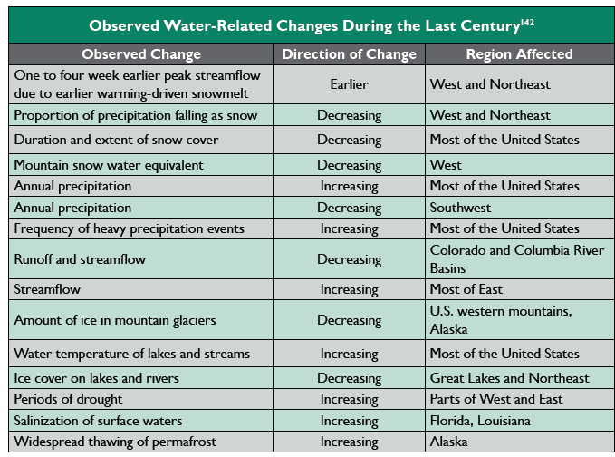
Source: USGCRP, 2009. Global Climate Change Impacts in the US. p. 43

Slide 10
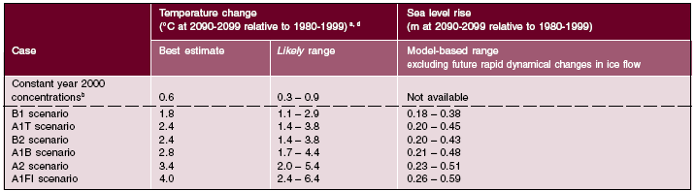
Other impacts depend on mitigation actions we take
“For the next two decades a warming of about 0.2°C per decade is projected for a range of SRES emissions scenarios. … Afterwards, temperature projections increasingly depend on specific emissions scenarios” (IPCC, 2007).

Slide 11
Major forecast climate changes
Temperature increases (4F), especially at the poles (16F)
Precipitation changes: more floods, more droughts, less snow, heavier rain
Hurricanes and other extreme events
Sea level rise
Ocean warming and acidification
Possible abrupt climate changes

Slide 12
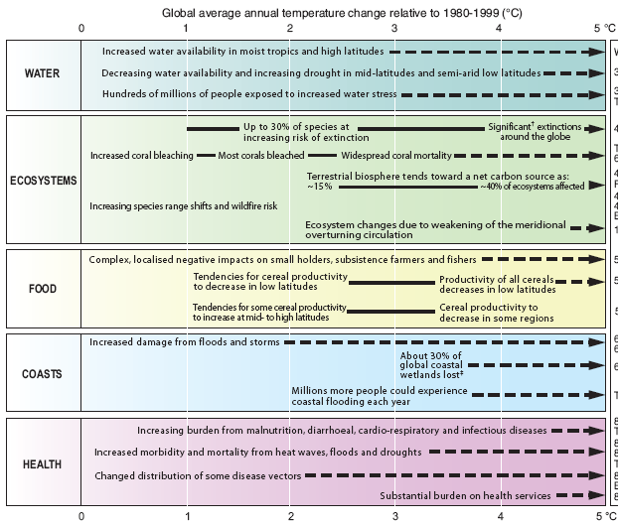
Categories of impacts

Slide 13
You will experience these impacts personally
“Changes in many extreme weather and climate events have been observed since about 1950. It is very likely that the number of cold days and nights has decreased and the number of warm days and nights has increased on the global scale. It is likely that the frequency of heat waves has increased in large parts of Europe, Asia and Australia. There are likely more land regions where the number of heavy precipitation events has increased than where it has decreased” (IPCC, 2013).
“It is now … likely that human influence has more than doubled the probability of occurrence of heat waves in some locations” (IPCC, 2013)

Slide 14
Impacts vary by region
Climate changes will vary by region
  Some areas warm more, others warm less
  Some areas get wetter, some dryer
Vulnerability varies by region
  Coastal vs. inland
  Rainfall vs. aquifer dependent
Adaptive capacity varies by region
  Poor vs. rich
  Ease of adaptation (e.g., small island states vs. US)

Slide 15
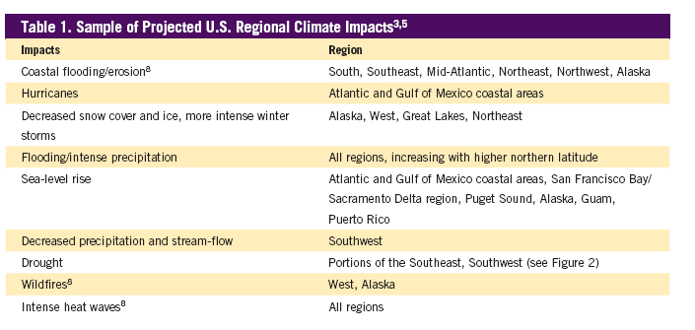
Source: Pew Center on Global Climate Change. 2009. Climate Change 101: Understanding and Responding to Global Climate Change. Arlington, VA.

Slide 16
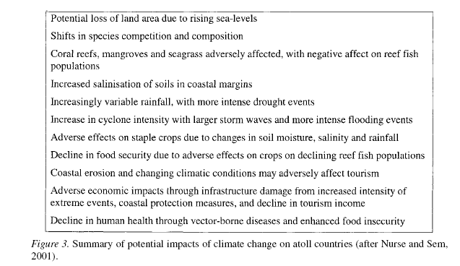
Source: Barnett and Adger.

Slide 17
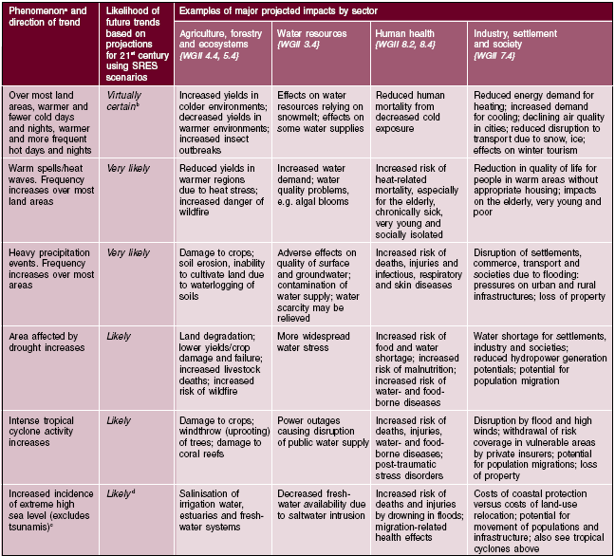
Impacts vary by sector

Slide 18
Who and what gets harmed?
What determines how bad it will be?
Non-human impacts
Climate outputs: how does climate respond to human-induced changes?
Exposure: is person likely to experience the impact?
Vulnerability: if person does nothing, how likely and how large is harm?
Adaptive capacity: what resources for reducing exposure vulnerability?
Resilience: can unavoidable damage be absorbed and new status quo established?
Harm experienced

Slide 19
Non-human impacts
Many plants and animals cannot adapt or mutate quickly enough
Southwest tortoises example
Plants can’t “migrate” fast enough
Animals can migrate but their ecosystem partners (their predators and prey) are unlikely to migrate at same speed, upsetting ecosystem balances
Ocean acidification

Slide 20
Non-human impacts
Forest degradation due to pests, precip, and temp
Invasive species changes
Coral reef bleaching
Habitat change and loss
Species and biodiversity loss
Killing off some species while making better niches for others, particularly disease vectors

Slide 21
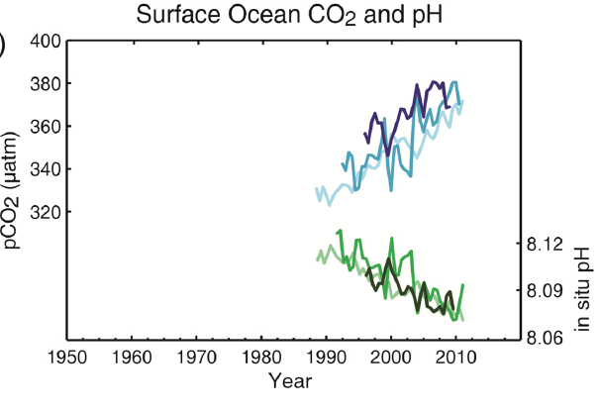
Ocean acidification
The other side of the CO2 coin
CO2 “absorbed” into ocean waters
Ocean acidifying, causing breakdown of shells of animals at bottom of food chain
Evidence that this is already occurring
Source: IPCC, 2013

Slide 22
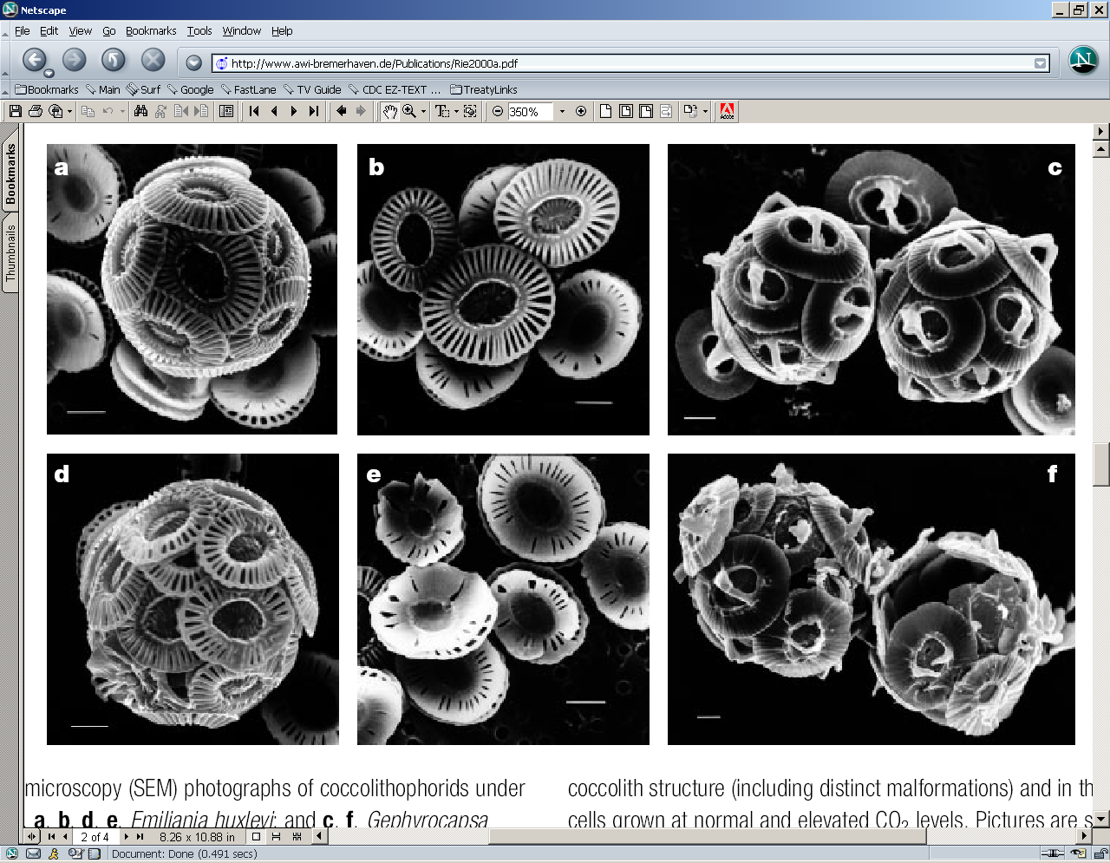
Ocean acidification
Low CO2
High CO2
Scanning electron microscope pictures of coccolithophorids under different CO2 concentrations. a, b, c: at 300 ppmv and d, e, f at 780-850 ppmv. Note the difference in the coccolith structure (including distinct malformations) and in the degree of calcification of cells grown at normal and elevated CO2 levels. (Source: Riebesell, U, I Zondervan, B Rost, P Tortell, R Zeebe, and F Morel. 2000. “Reduced calcification of marine plankton in response to increased atmospheric CO2.” Nature 407 (21 September), 364-367.)

Slide 23
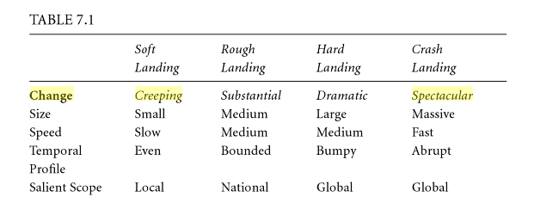
Climate outputs vary
Source: Gardiner, S. Perfect Moral Storm. Oxford UP, 2011, p. 224.

Slide 24
Examples
Shelter and location
Food and water
Health
War and conflict

Slide 25
Climate impacts influenced by:
Exposure – is your community exposed to climate change: Switzerland/Bolivia vs. Bahamas/Kiribati
Vulnerability – factors that influence how much a climate impact hurts BEFORE your community responds
Adaptive capacity –resources your community has to respond to climate impacts it faces
Resilience – how much “pain” does your community feel AFTER it has adapted and how robust is community to a future of expected and unexpected impacts

Slide 26
Exposure varies
Is person/country likely to experience a given impact?
  “Small islands: … high exposure of population and infrastructure” (IPCC Summary, p. 9)
  “Asian and African megadeltas: high exposure to sea level rise, storm surges and river flooding.” (IPCC Summary, p. 9)
Geographic location
  Switzerland/Austria: no sea level rise
  Tahiti: no glacial retreat
  Droughts/floods increase in some regions, decrease in others
Existing material infrastructure
  Seawalls; Dutch polders
  Reliance on rainfall vs. ground water

Slide 27
Vulnerability varies
If person/country does nothing, how large is harm?
  “Vulnerability is greater for those who have few resources and few choices” (USGCRP, 100)
Structural and infrastructural choices
  Dense population, near ocean
Knowledge of impending climate outputs and of how to respond can reduce vulnerability
  Privileged vs. marginalized matters: those with many resources/already advantaged socially are less vulnerable
Community resources

Slide 28
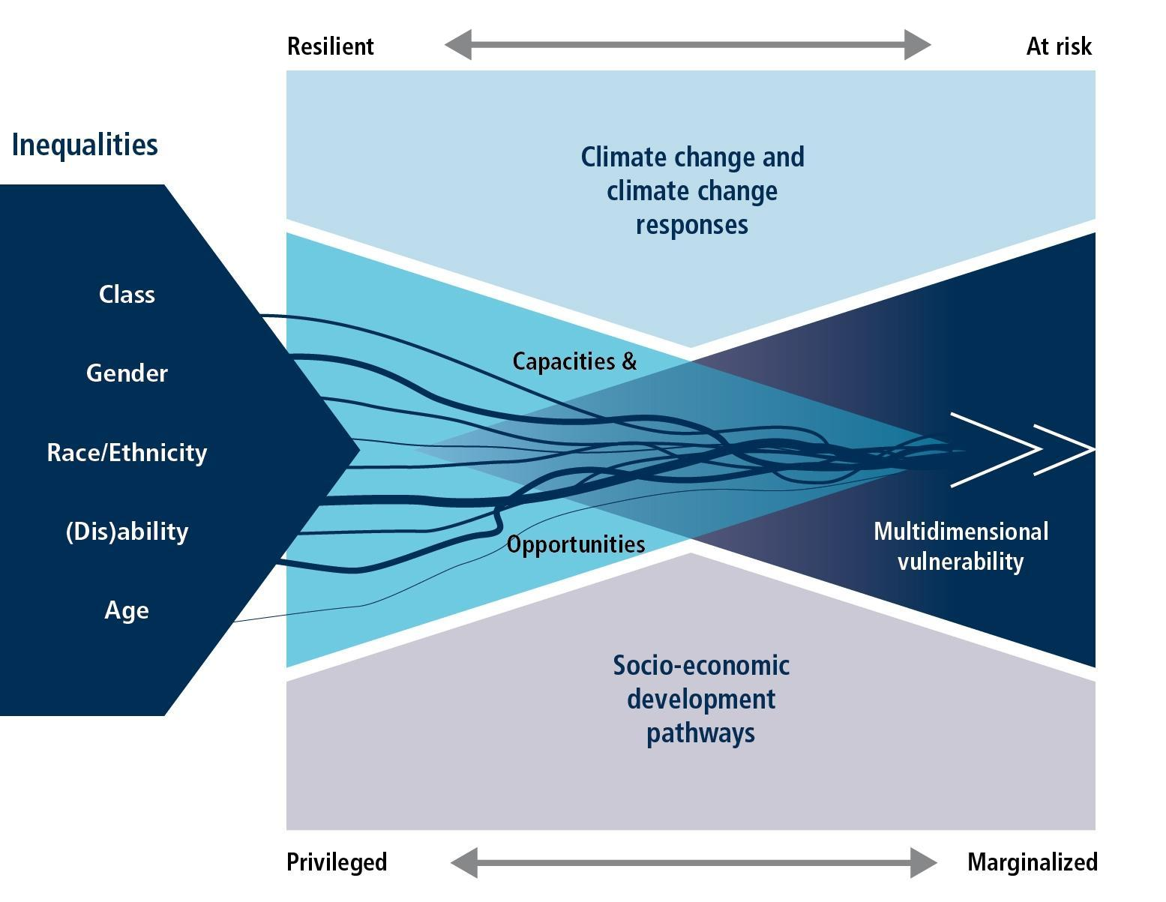
Vulnerability
Multidimensional vulnerability
AR5, WGII, Chapter 13
Tschakert

Slide 29
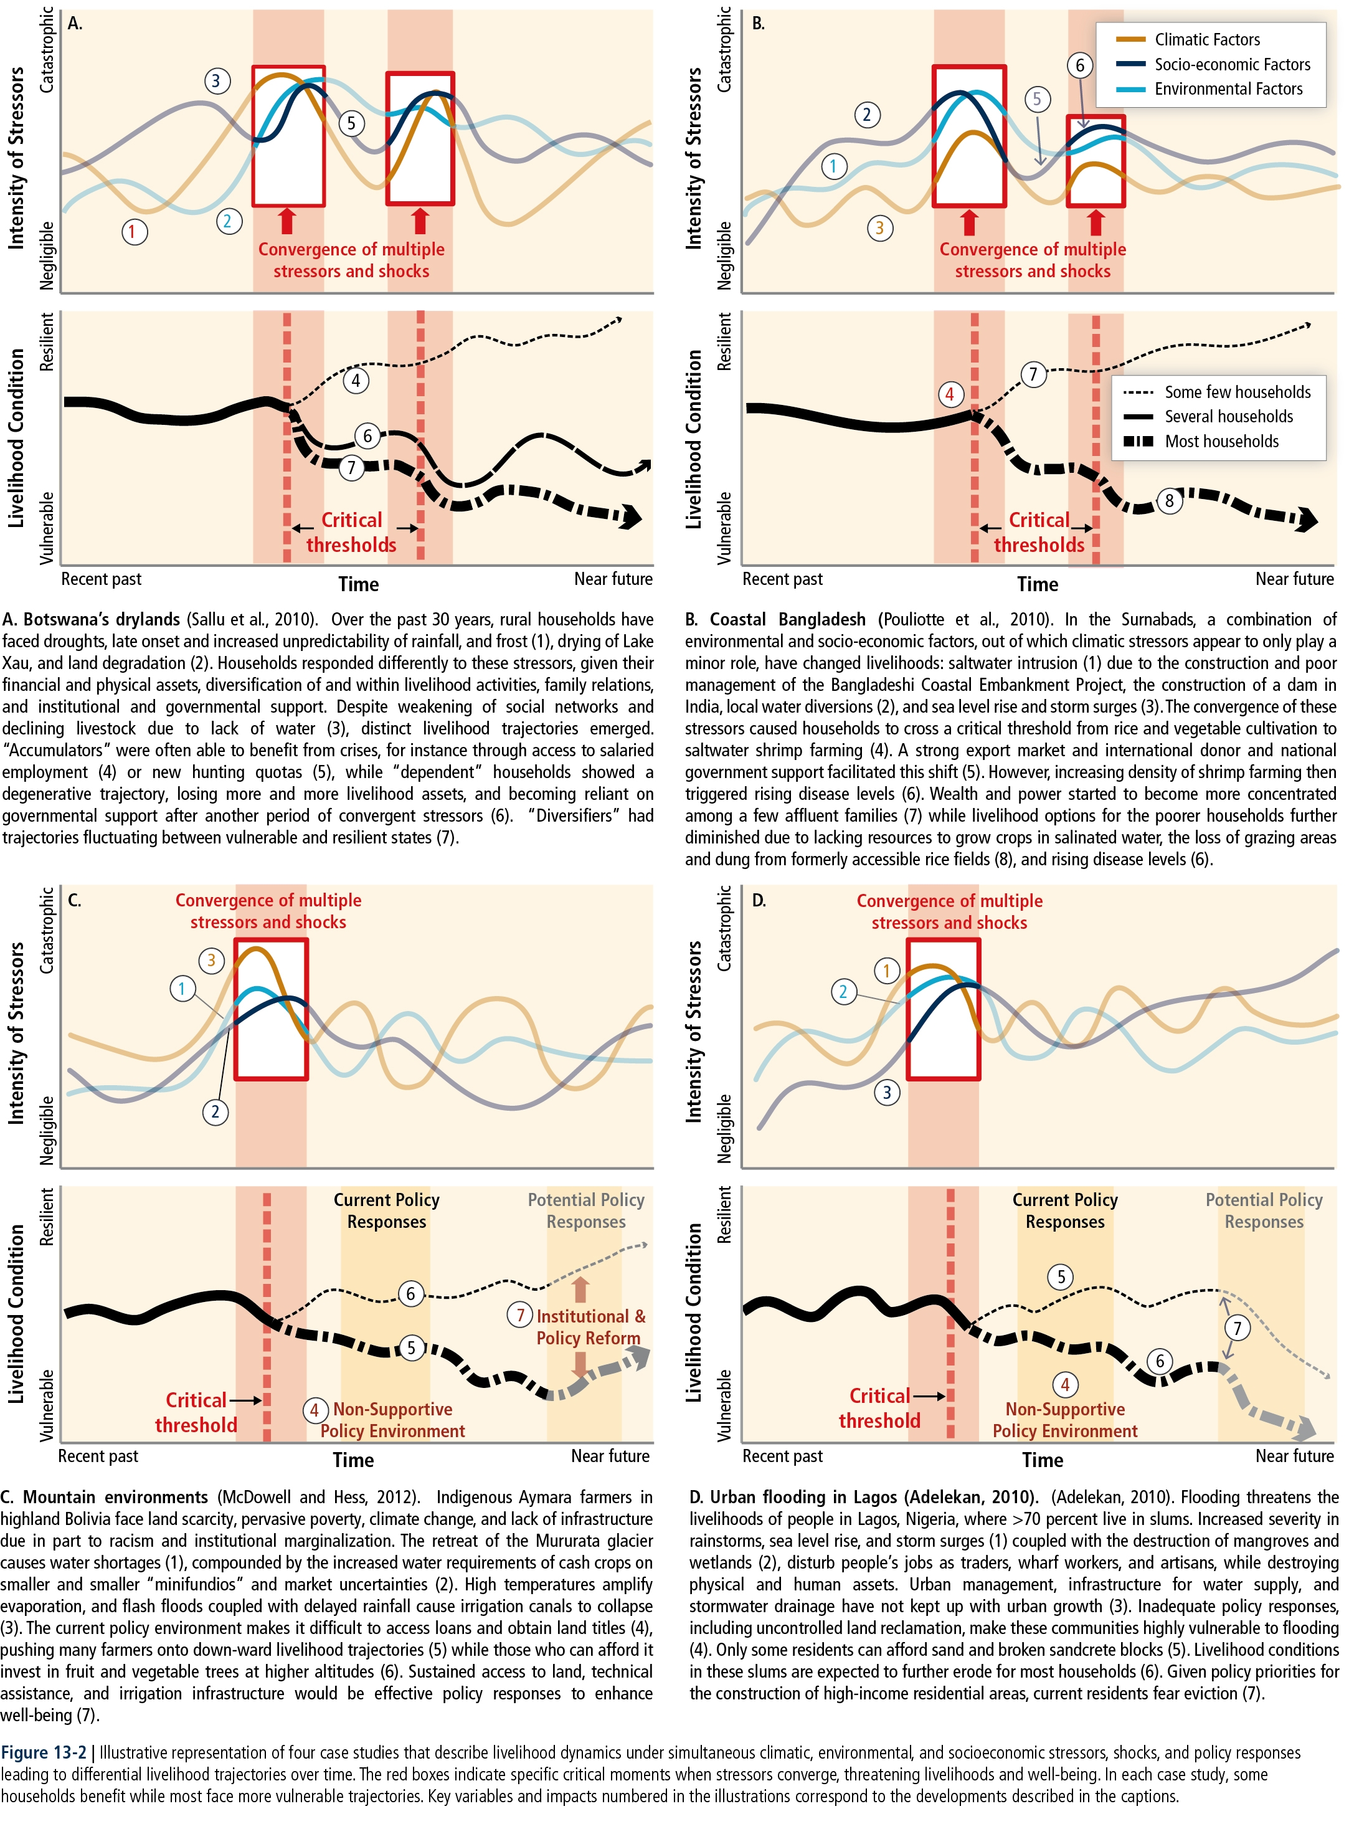
Vulnerability
Livelihood dynamics under simultaneous climatic, environmental, and socio-economic stressors and shocks leading to differential livelihood trajectories over time
AR5, WGII, Chapter 13
Tschakert

Slide 30
Adaptive capacity varies
What resources does person/country have to do something that reduces their exposure?
Can they “get out of the way” (e.g., migration)
More resources is better
How big is the adaptation “task”? Redesign a city?
Different types of resources (next slide)
Privileged vs. marginalized matters here too
  “Adaptive capacity is intimately connected to social and economic development but is unevenly distributed” (IPCC, 15).
  “Structural” vulnerabilities: NOT their fault but due to colonial history and current world economic structure
Some outputs cannot be adapted to: small-island states

Slide 31
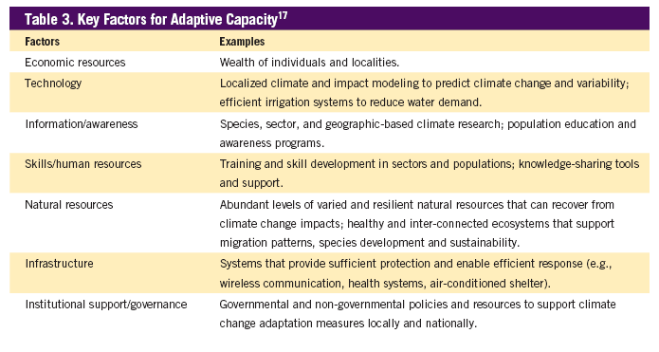
Adaptive capacity
Source: Pew Center on Global Climate Change. 2009. Climate Change 101: Understanding and Responding to Global Climate Change. Arlington, VA.

Slide 32
What vulnerability and adaptation look like.
676 villages identified in Fiji as vulnerable to climate change and, therefore, potentially needing to move
Video showing one village relocating

Slide 33
Resilience varies
How capable is person/country to absorb such damage as they can’t avoid, and adapt to the new status quo?
Cultural traditions matter
Personal traits matter
Ingenuity and flexibility

Slide 34
And some outcomes cannot be adapted to, so…
“Unmitigated climate change would, in the long term, be likely to exceed the capacity of natural, managed, and human systems to adapt” (IPCC, 2007)
Accept the losses and changes that we must live with because we can’t avoid or adapt to them
Injustice: “nations facing rising oceans and drought are those least responsible for the problem, and they have the least resources to cope with them” (Parks et al. 337)
  Some countries, like SIDS, will lose everything

Slide 35
Source: Pew Center on Global Climate Change. 2009. Climate Change 101: Understanding and Responding to Global Climate Change. Arlington, VA.

Slide 36
QUESTIONS?

Slide 37
Iclickers
What types of impacts are
MOST likely to motivate you to action?
  Declining human health
  Species going extinct
  People in developing countries
  Destruction of ecosystems

Slide 38
Iclickers
What types of impacts are you
MOST worried about?
  Long, gradual and continuous changes
  Abrupt, “non-linear” changes

