Slide 1
Grading / Final Paper

Slide 2
Some comments on grading and doing well in the course
Hand in all assignments and you will pass
Don’t hand them all in and you won’t, so turn in assignments, even if late
I start with low grades early in the term
Use of office hours is encouraged

Slide 3
Final Paper
Draft 1 due next Tuesday (week from today)
Write a research paper (15-20 double-spaced pages) evaluating whether a particular environmental treaty was effective.
Lots of details but here are basics: get to know your treaty
  Treaty name
  Membership rules
  Regulated behavior
  Non-treaty influences on behavior
  Monitoring
  Responses to “bad” behaviors
Don’t need to do more but, guess what, those who engage most will get better grades

Slide 4
Treaty Assignment #1 due start of NEXT Tuesday class
6 questions to answer
Name of the treaty?
What countries CAN become members (separately, who ARE members)?
What behavior does treaty regulate?
Before treaty, what causes “regulated behavior” to change over time?
Does treaty have mechanisms to monitor actor behavior?
What happens to governments that don’t change behavior? What processes might make it so this treaty could work?

Slide 5
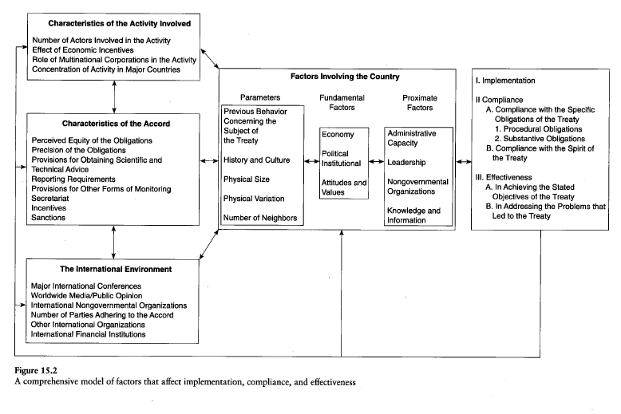

Slide 6
Tragedy of the Commons wrap-up

Slide 7
Tragedy of the Commons
Important points on paper
Create “thread” through your paper
  Defining aspects
  Choose examples carefully to illustrate; link/map to concepts
  Causes that make defining aspects more or less likely to arise
  Solutions that correct a cause or defining aspect
  Eg: open access = defining feature; examples of one open access / one not; why open access is cause; how privatizing (NOT open access) is solution
Have examples illustrate theory, don’t describe for own sake – private fish farm being overused example (hypothetical but good example)
Basics
  Use readings for theory
  Use headings
  Intro: what you will argue, not what you will argue about
  Cite appropriately and provide biblio (Author, Year, Page) (Hardin, 1968, 32)
  Run spellcheck and proofread
  Follow assignment (e.g., international example)
Structure essay so set up characteristics that show exist in examples that are caused by identifiable source, that solutions fix
E.g., “open access” is characteristic, caused by a lack of international regulation, solution is to restrict access (e.g,. through a treaty like ICCAT)

Slide 8
How Many Cows would YOU put on this PRIVATE Farm?
Cows | Milk per cow | Total Milk
1 | 100 | 100
2 | 100 | 200
3 | 94 | 282
4 | 88 | 352
5 | 82 | 410
6 | 76 | 456
7 | 70 | 490
8 | 64 | 512
9 | 58 | 522
10 | 52 | 520
11 | 46 | 506
12 | 40 | 480
13 | 34 | 442
14 | 28 | 392
15 | 22 | 330

Slide 9
How Many Cows Will GROUP put on this COMMON Farm?
Cows | Milk per cow | Total Milk
1 | 100 | 100
2 | 100 | 200
3 | 94 | 282
4 | 88 | 352
5 | 82 | 410
6 | 76 | 456
7 | 70 | 490
8 | 64 | 512
9 | 58 | 522
10 | 52 | 520
11 | 46 | 506
12 | 40 | 480
13 | 34 | 442
14 | 28 | 392
15 | 22 | 330

Slide 10
Tragedy of the Commons:
Defining aspects and solutions
Common/open access -- solution is privatize or limit access through user fees or laws that limit access to certain groups. Who can use.
Lack of regulation of the activity on the commons -- solution is regulation of level of activity. How much can use.
Existence of a finite resource with total demand exceeding carrying capacity of resource – solution: reduce demand for resource.
Private costs less than social costs -- solution is to increase the private costs (e.g. taxes or fines for overuse).
Everyone as perpetrator AND victim. Upstream/downstream problems -- some are perpetrators and others are victims – solution: convince those who think they aren’t victims that they are (education).
Actors are self-interested and do not count costs to others or env’t – solution “normative education” to worry about things beyond prices.

Slide 11
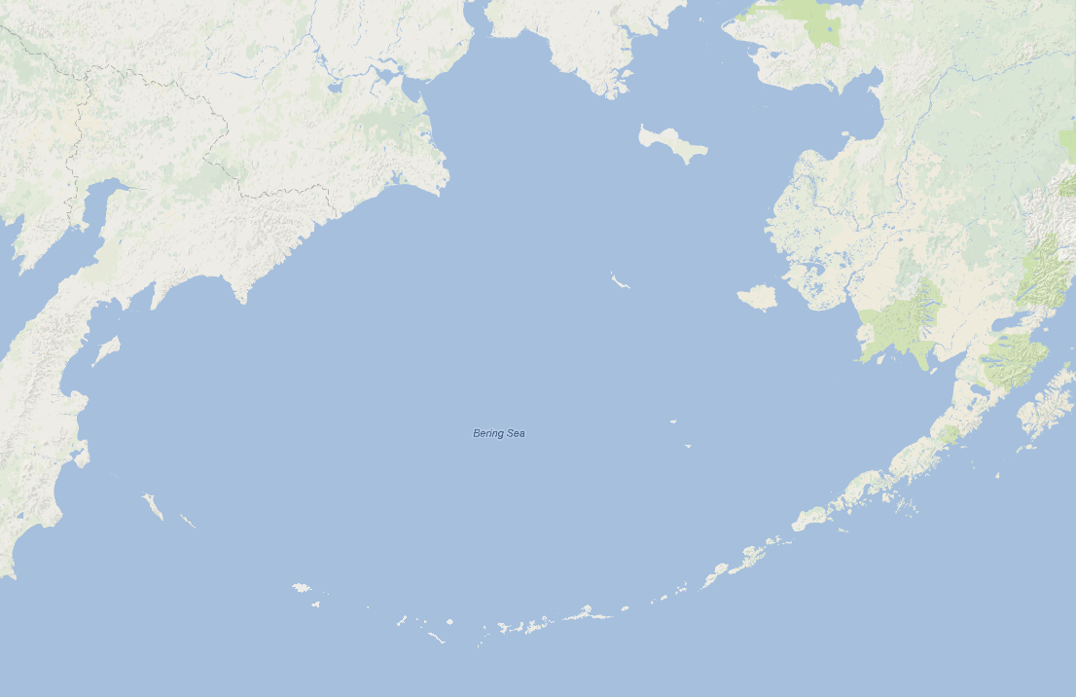
Fur Seal case
A Tragedy of the Commons solved
American rookery sealing
(Pribilof Islands)
Russian rookery sealing
(Commander Islands)
Canadian pelagic sealing
Japanese pelagic sealing

Slide 12
Terms of the Fur Seal Treaty
Ban pelagic sealing by all countries
US pays $200K to Japan and Canada immediately
US gives 15% of skins to Japan and 15% to Canada annually
Russia gives 15% of skins to Japan and 15% to Canada annually
Did it work?
  WHAT INFORMATION DO YOU NEED TO KNOW?

Slide 13
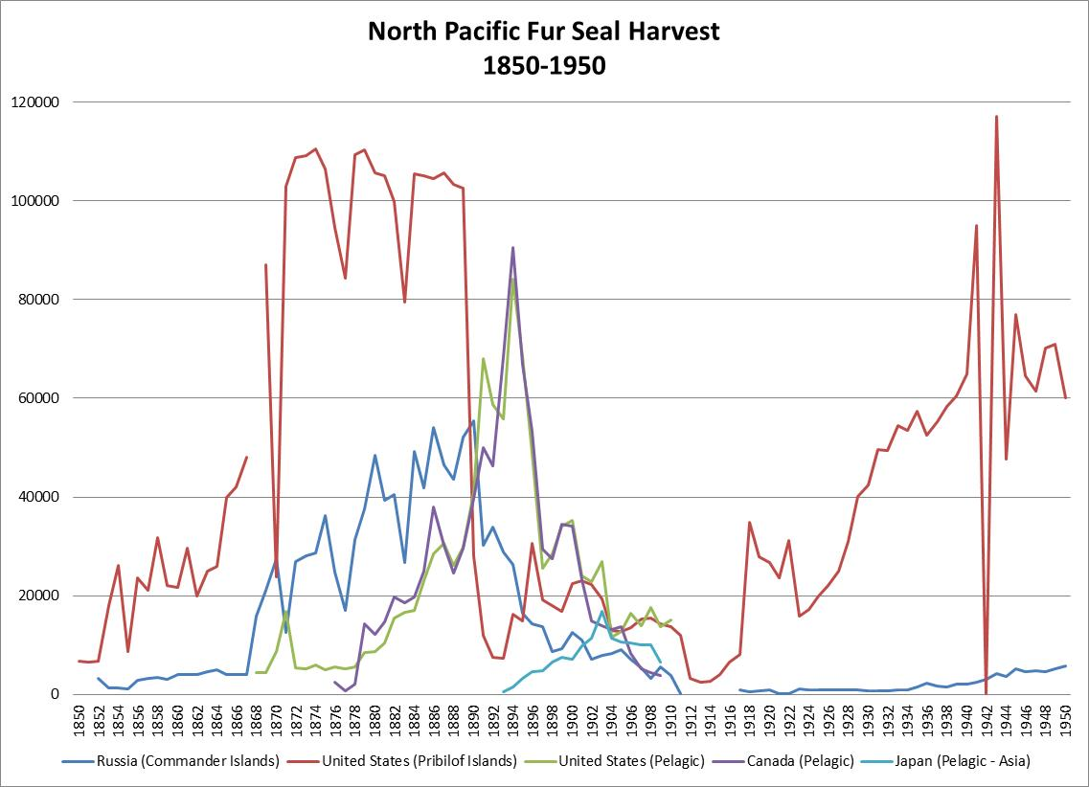

Slide 14
Breakout Room Discussion
What is the value of learning the concept of a Tragedy of the Commons? Do you think it has value?
What’s the difference between “teaching a racist concept” and “teaching a concept developed by a racist”?
Before you did readings for today, did racism of Hardin cross your mind? Does it surprise you?
Should I teach the Tragedy of the Commons next year or not? And why?
We get to disagree on this, but only if we do so civilly and respectfully!

Slide 15
Ecophilosophical and Political Perspectives on International Environmental Problems

Slide 16
5 Perspectives on causes of international environmental problems
Economic: prices/incentives not right
Legal: rights/obligations not right
Ecophilosophical: values not right
Political: distribution of power not right
Science: knowledge not right

Slide 17
Ecophilosophical Perspectives
Deep ecology
  Ethical obligation to other species, natural things
  All life forms have intrinsic value
Shallow ecology: environment has value only through its value to humans
Medium ecology: environmental harm is ‘bad’ b/c one more way powerful harm powerless

Slide 18
Ecophilosophical Perspectives
Ecofeminism
  Alienation of humans from earth
  Domination of nature by humans parallels domination of women by men and derives from same source
GAIA Principle

Slide 19
Political Perspective
Problem: those with power don't have incentives to conserve environment, and those with incentives to conserve environment don't have power
Solution: find ways to make it in interests of powerful to protect the environment
Countries' borders do not match environmental borders

