Slide 1
Problem Structure:
National Security

Slide 2
Midterm #1 – Next Thursday
Compare/Contrast THREE (you choose 3 from the 8) aspects of Problem Structure using examples from 2 of the 4 issue areas: Security, Trade, HR, Environment
Examine variation in problem structure. Use theory to categorize real-world examples

Slide 3
Midterm #1 – Next Thursday
Goal
  Demonstrate knowledge of problem structure
  Show some ability to compare across two issue areas
Pick 3 aspects of problem structure
Read syllabus readings on trade, security, HR, and envt
Choose 2 specific problems, NOT from same issue area
Discuss how 2 problems differ in 3 aspects
Include initial argument about how differences:
  make institution harder/easier to form
  make institution more/less likely to have certain features

Slide 4
Comparing Problem Structure Across Issue Areas
Rule #1 of Critical Thinking
COMPARING is easiest way to classify real-world problem structures. Easier to say
  “Issue area A more transparent than issue area B”
  than to say
  “Issue area A is transparent”

Slide 5
Four Types of
National Security problems
There are others: these show variation WITHIN issue area
Territorial disputes: Deadlock = Palestinian/Israeli conflict; Spratly islands
Arms races: Collaboration problems
  Different types of weapons have different features
Landmines: NGO made into normative problem
Precluding nuclear weapons development

Slide 6
How do these security issues differ with respect to 8 questions?
Conflict/Harmony/Cooperation
Actors
Capacities/Power
Incentives/Preferences
Information/Knowledge
Norms/Values
Inherent transparency
Response incentives

Slide 7
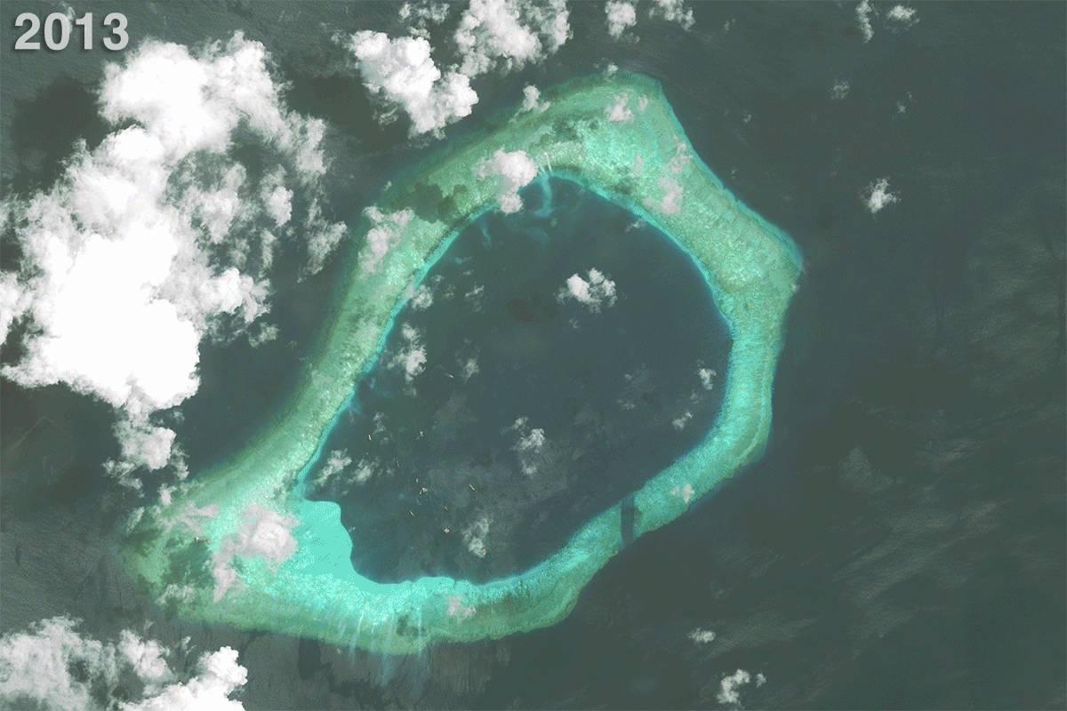
One Major Security Problem:
Spratly Islands

Slide 8

One Major Security Problem:
Spratly Islands

Slide 9
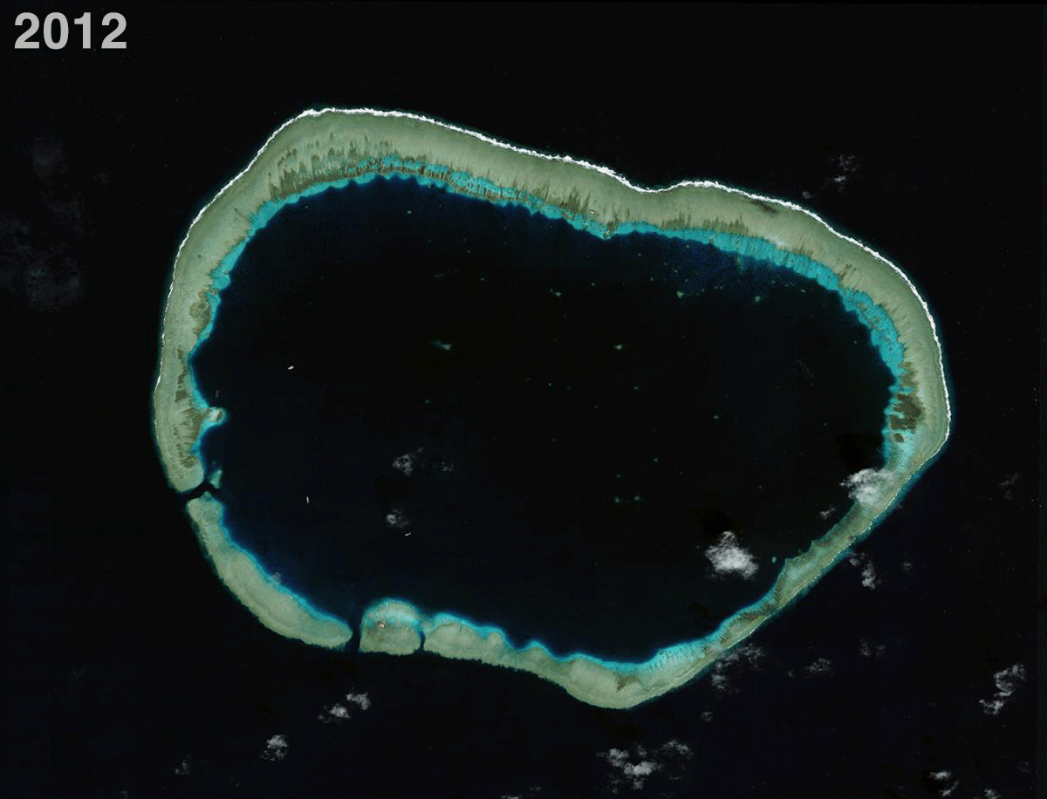
One Major Security Problem:
Spratly Islands

Slide 10
Q1: Conflict/harmony/cooperation
Often conflict but not always deadlock
Territorial disputes: deadlock
Arms races and security dilemma: countries develop/deploy weapons to increase security but, if both sides do it, they spend more but don’t increase security
Landmines: changed terms of debate

Slide 11
Deadlock
Palestinian/Israeli Conflict
Israel Palestinians . | Stop Fighting | Keep Fighting
Stop Fighting | Good (Major Concessions) Good | Best (Israel Wins) Worst
Keep Fighting | Worst (Palestinians Win) Best | Pretty Good (War Continues) Pretty Good
Both sides actually PREFER to keep fighting (because they hope to win) over the
alternative of making the major concessions they need to make to achieve piece.

Slide 12
Q2: Actors
Almost exclusively governments
Chem-bio-small arms: many
Nuclear: relatively few

Slide 13
Q3: Capacities/power
Nuclear: very few are capable and the “nuclear haves” can prevent have-nots from developing or buying them
Chem-bio-small arms: all states are capable of making
Wargames: all states are capable of conducting
Power varies and matters a lot

Slide 14
Nuclear export controls
Nuclear weapons are hard to develop
Countries that have nuclear weapons technology and “dual use” technology have economic incentives to sell to other countries
Major risks if they do so, however
Need to ensure NObody sells nuclear technology
Can preclude non-nuclear states from getting technology, if create “united front”

Slide 15
Removal of Soviet Nuclear
Weapons from Kazakhstan Territory
Kazakhstan
  Did not want weapons there
  Could not “return” them to Russia safely on their own – lacked the capabilities
US
  Had the capabilities to transport safely to Russia
  Wanted weapons back in “safe” Russian hands enough to pay to get it done
Nazarbayev told Secretary of State James Baker that “Kazakhstan had no aspiration to join the military club of nuclear powers” … but that he “wanted to know what Kazakhstan will get in return for dismantling these weapons.”

Slide 16
Positive Externality
Plagued by Incapacity
Incapable state . Capable state | Move nuclear weapons back to Russia safely | Keep nuclear weapons on Kazakh territory
Pay to move nuclear weapons back to Russia | Best Pretty Good | Pretty Bad Worst
Do NOT pay to move nuclear weapons back to Russia | Pretty Good Best | Worst Pretty Bad

Slide 17
Positive Externality
Plagued by Incapacity
Incapable state . Capable state | Move nuclear weapons back to Russia safely [Kazakh’s can’t] | Keep nuclear weapons on Kazakh territory
Pay to move nuclear weapons back to Russia | Best Pretty Good | Pretty Bad Worst
Do NOT pay to move nuclear weapons back to Russia | Pretty Good Best | Worst Pretty Bad
Capable state prefers getting nukes off Kazakh territory so much that they will pay,
if they have to, and Kazakhstan says “you have to.”

Slide 18
Q4: Incentives/preferences
Usually collaboration game
Insecure countries prefer own weaponry
But some countries opt for “economic security”
Alliance weapons development and “interoperability” is a coordination game – need same language, similar equipment, to fight a war together on the same side.

Slide 19
Collaboration
(Prisoner’s Dilemma)
 | China Stops arms race | China Continues arms race
US Stops arms race | Pretty Good (Arms control) Pretty Good | Best (China Takes Over US) Worst
US Continues arms race | Worst (US Takes Over China) Best | Pretty Bad (Arms Race) Pretty Bad
Both sides prefer to have arms control but their fear of other side taking over makes
arms control too scary to consider, so arms race results.

Slide 20
Q5: Information/knowledge
Most states believe more weapons equal more security but it’s costly (haves attempt to convince have-nots that not having is in their interests but this rarely works)
Wargames are “assurance” games in which improving information can reduce problems

Slide 21
Q6: Norms/values
Some weapons considered morally wrong but not all
Right to defend yourself but not with morally inappropriate weapons
Landmines were “re-framed” to make it a normative problem, where governments didn’t see it as such previously

Slide 22
Q7: Inherent transparency
& ability to cheat
Strong incentives and ability to keep weapons development and deployment secret
Nuclear arms control – very specific provisions to address fact that its relatively easy to keep their development secret

Slide 23
Q8: Response incentives
Strong incentives to make a response but not to reinforce the agreement but to respond to the threat
Can’t target response at single country (weapons threaten all)
Examples:
  Chem-bio-small arms: rather tolerant
  Nuclear: not tolerant at all
  Wargames: somewhat tolerant

Slide 25
Deadlock
Spratly Islands
China US . | Give up claim to Spratly’s | Continue claiming Spratly’s
Accept Chinese claim to Spratly’s | Good Best | Best Worst
Contest Chinese claim to Spratly’s | Worst Pretty Good | Pretty Good Pretty Bad

