Slide 1
Problem Structure:
Trade and IPE

Slide 2
Midterm #1 – Next Thursday
Compare/Contrast THREE (of 8) aspects of Problem Structure using examples from 2 of 4 issue areas: Security, Trade, HR, Environment
Examine variation in problem structure. Use theory to categorize real-world examples

Slide 3
Midterm #1 – Next Thursday
Goal
  Demonstrate knowledge of problem structure
  Show some ability to compare across two issue areas
Pick 3 aspects of problem structure
Read syllabus readings on trade, security, HR, and envt
Choose 2 specific problems, NOT from same issue area
Discuss how 2 problems differ in 3 aspects
Include initial argument about how differences:
  make institution harder/easier to form
  make institution more/less likely to have certain features

Slide 4
Some Trade and IPE problems
Tariffs and quotas
Non-tariff barriers and subsidies
Drug trafficking / Sex trafficking
Banking practices and government spending

Slide 5
Basics of Trade
Problem Structure
Protectionism: Policies that reduce flow of goods (or services) across borders
  Tariffs: taxes on imports; increase price of foreign goods; remove incentive to import
  Subsidies: payments to domestic producers; lower price they charge at market; remove incentive to import
  Quotas: limits on quantity can import; prevent imports
  Non-tariff barriers (NTBs): rules that block imports of goods made contrary to local processes
Free trade: absence of protectionism

Slide 6
How protectionism works
 | Actual cost | Subsidy | Tariffs | Cost at market
US producers | $0.36 | $0.12 | -- | $0.24
Mexican producers | $0.20 | -- | -- | $0.20
Non-Mexican producers | $0.15 | -- | $0.10 | $0.25

Slide 7
Pros and Cons of Free Trade
Benefits of free trade/costs of protectionism
  Lower costs of goods to consumers
  More goods due to specialization
  Export sector growth: more jobs
Costs of free trade and benefits of protectionism
  Uncompetitive local industries (import-competing sector) die, workers lose jobs, wages decline
  Loss of local market diversity
  Producing more stuff harms the environment

Slide 8
Why Protectionism Continues
Interactions among three sectors
  Import-competing sector: big benefits for few actors, so have incentives and capacity to mobilize politically
  Export sector: latent and uncertain benefits, and no workers to help mobilize
  Consumers: small benefits per person (large overall), so fail to mobilize

Slide 9
How do these trade / IPE issues differ with respect to 8 questions?
Conflict/Harmony/Cooperation
Actors
Capacities/Power
Incentives/Preferences
Information/Knowledge
Norms/Values
Inherent transparency
Response incentives

Slide 10
Comparing Problem Structure Across Issue Areas
Rule #1 of Critical Thinking
COMPARING is easiest way to classify real-world problem structures. Easier to say
  “Issue area A more transparent than issue area B”
  than to say
  “Issue area A is transparent”

Slide 11
Q1: Conflict/harmony/cooperation
Trade: Conflict with potential for cooperation
Trade wars: domestic political incentives to raise tariffs to protect import-competing sector lead to slower economic growth of country’s economy as a whole
States see opportunities for better outcomes.
Failure to address ag can be seen as deadlock

Slide 12
Q2: Actors
All countries involved, though trading partners and neighbors matter more than others
Governments of powerful states
Domestic politics
  Import-competing sector companies
  Export sector companies, often including multinationals
  Consumers
  Politicians

Slide 13
Q3: Capacities/power
All states can impose tariffs, subsidies, quotas, NTBs
Some countries have significant power through market attractiveness and competitiveness of products
Failure to address ag can also be as power issue

Slide 14
Q4: Incentives/preferences
Collaboration game
  Standard Tragedy of the Commons or Prisoners’ Dilemma
  How do we know? Incentives to cheat even after rules agreed to!
Distribution problem can be left to the market
Domestic pressure for protection from import-competing sector
Opposing pressure from export sector
Ag sector succeeds more than manufacturing

Slide 15
Trade as a
Collaboration Problem
 | China has Low Tariffs | China has High Tariffs
US has Low Tariffs | Pretty Good (Trade Agreement) Pretty Good | Best (China: No Job ∆s+Low Prices) Worst
US has High Tariffs | Worst (US: No Job ∆s+Low Prices) Best | Pretty Bad (Trade War) Pretty Bad
Freer trade lowers prices for consumers and requires people to “retool” for new jobs.
Both sides should prefer lower tariffs IF other side also lowers theres.

Slide 16
Q5: Information/knowledge
Trade does not have any serious knowledge or information problems. We generally understand how it works.
Most states believe free trade grows economy – theory supports free trade (but this is a recent idea)

Slide 17
Q6: Norms/values
No morality of high v. low tariffs
But norm against free trade: “Buy American”
Norms play a role in NTBs that they don’t play in other policies

Slide 18
Q7: Inherent transparency
& ability to cheat
Tariffs, quotas, non-tariff barriers (NTBs) “visible at the border”
Subsidies NOT visible at border
What is your expectation about trade treaties? Which of these types of policies do they address most?

Slide 19
Q8: Response incentives
Can target response: ability to target and calibrate response
Incentives to calibrate response to maintain broader agreement
Quite violation tolerant because can be “undone”
Enforcement problem is resolvable
Reputational concerns

Slide 20
Successes in Trade
Major successes in cooperation to overcome trade problems
GATT/WTO: Significant progress in lowering trade barriers over time
EU: Major levels of cooperation in trade and other realms of IPE

Slide 21
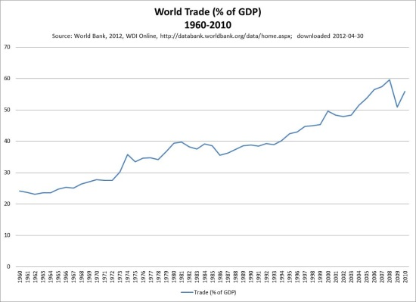
GATT and WTO influence

Slide 22
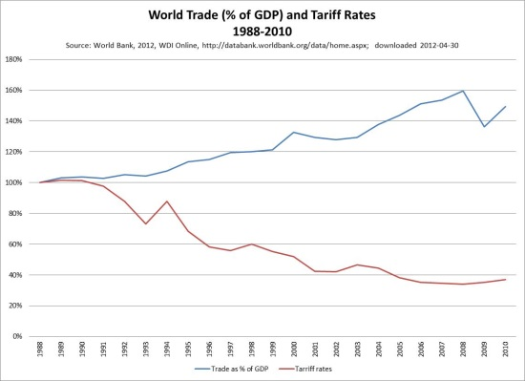
GATT and WTO influence

Slide 23
European Union
Removed all trade barriers and number of countries has grown significantly.
Economies of all have grown quickly
Stabilized countries via monetary cooperation
Has managed free trade to reduce more harmful impacts of on environment

Slide 24
Explaining success in forming trade institutions
Growing economies is important goal of countries
Some powerful economic interests support free trade (export sector companies)
Incapacity is not a problem
Lack of knowledge is not a problem or reason for inaction
Distribution problem can be left to market
Strong belief that growing economies is good
Most protectionism is inherently transparent
Strong incentives for enforcement, since coincides with interests of import-competing sector

Slide 25
Failure in reducing agricultural subsidies
Agricultural subsidies, price supports, tariffs:
  US ~$20 billion/year
  EU ~$60 billion/year
Subsidies aid farmers receiving them but at cost of developing country farmers that could grow same product cheaper and export it

Slide 26
Why free trade in manufacturing but not agriculture?
“Powerful” states have comparative advantage in manufacturing and disadvantage in agriculture. No need to protect manufacturing, need to protect ag.
Ag interests over-represented in key countries (e.g. the US) due to domestic institutions that give more weight to rural areas
Public afraid of food imports due to “food security”, health (e.g., mad cow disease), etc.

