Slide 1
Midway Student Experience Survey

Slide 2
Suggestions for improving future writing assignments
Ensure you analyze, not just describe
Compare things you expect to have the same DV value
Compare over time AND across countries
Compare using rate and trends more than levels
Compare 2 groups rather than 2 countries
Use tables and charts for data and analysis, but text for explanation (charts show lots of info in little space)
Avoid too much detail and look at big patterns
Use headings
Professional/scholarly voice: “its wacky…” / “it came to my mind that…” / “In doing this assignment…”
Use citations – and cite the readings!

Slide 3
Essay due Tuesday of next week:
Different things we believe
1,000 words: differences in 3 statements (syllabus has assignment)
  I believe that there is/is not a God.
  I believe that American government will work better if Republicans/Democrats win the next election.
  I believe that human-caused climate change is/is not already occurring.
Requires careful thought but NOT a response paper.
Goal: get you thinking about how beliefs on religion, politics, and science differ.
  Do NOT tell me what your beliefs are (God, Republican, etc).
  Write answers to yourself and think about them.
  How strong are your beliefs in each area?
  Where do beliefs come from in each area?
  Could your beliefs change in each area?
  What might make beliefs change in each area? Data, arguments?
  How do differences among beliefs influence politics?

Slide 4
Research Paper – Questions?

Slide 5
Ethics, Religion, and the Reframing of Climate Change

Slide 6
Numerous religious calls for action
Muslim: “The world is sweet and verdant, and verily Allah has made you stewards in it, and He sees how you acquit yourselves.” Aug 2015: Int’l Islamic Climate Change Symposium
Since 2013, many protestant churches have voted to divest of coal, or fossil fuels more generally
Evangelical Environmental Network: “Creation-care means caring for all of God’s creation”
Interfaith Power & Light (since 2000)
Jewish Environmental and Energy Imperative
Catholic: Pope’s 2015 Encyclical
Australian Religious Response to Climate Change network

Slide 7
Why reframing climate change in moral terms might work
What is framing and how does one reframe an issue?
What is logic of consequences vs. logic of appropriateness?
Why logic of consequences won’t work
Why logic of appropriateness might work

Slide 8
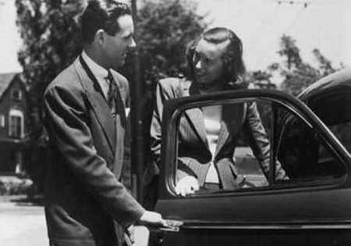
Framing: What do you see?

Slide 9
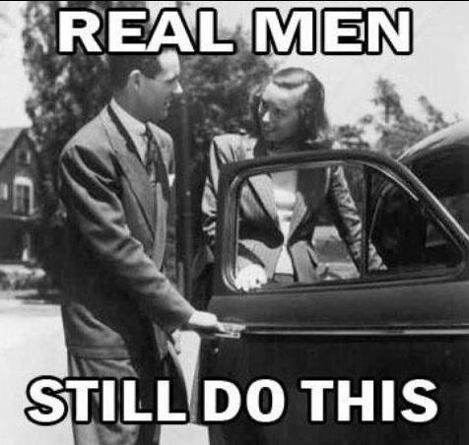
Framing: What do you see?
Chivalry or sexism
Memes are frames

Slide 10
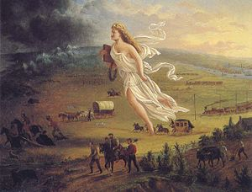
Framing:
American Progress or …
American Progress, John Gast (1872): “Columbia, a personification of the United States, leads civilization westward with American settlers. She brings light from the East into the darkness of the West” (wikipedia)

Slide 11
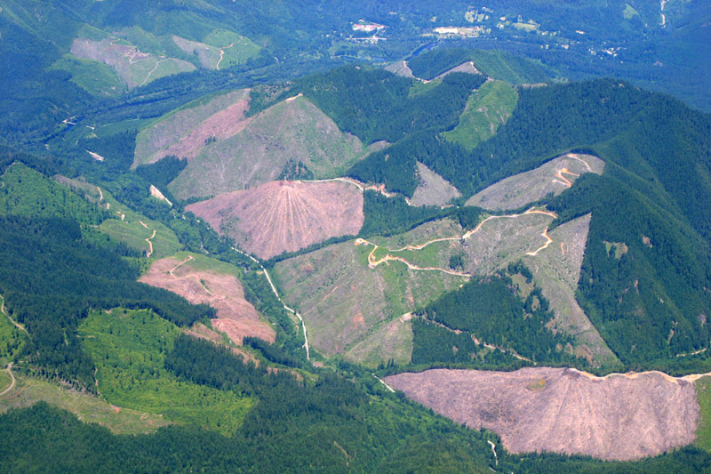
Framing:
American Progress or … Clear Cut
http://marlimillerphoto.com/timber.html

Slide 12
Successful RE-framings of issues in moral terms
Slavery – an economic strategy or morally repugnant?
Colonialism – “might makes right” or “people have rights”?
Landmines – cheap weapons of war or killers of innocent children?
FGM: “Disfiguring, Hurtful, or Wildly Festive”? – New York Times headline
Reframing tries to draw attention to certain facts and perspectives that we would otherwise ignore

Slide 13
Two “logics” of human and state action
Logic of consequences:
  Examine alternatives and, after calculation of costs and benefits, decide which has lowest costs and largest benefits for the individual decision-maker
  Dominant explanation of action
Logic of appropriateness:
  Act as appropriate, with little if any conscious thought – taken for granted what “correct” thing to do is
  Assess one’s desired identity/role in society and then look at social norms to identify what is the “right” thing to do in that social setting
  Less dominant, but equally valid in many circumstances

Slide 14
Papal Encyclical – a reframing
Earth a sister who “cries out to us because of the harm we have inflicted on her by our irresponsible use and abuse of the goods with which God has endowed her”
“We are part of nature”
Earth has been “entrusted to us”
No right to push other species (which “have value in themselves”) to extinction or to exploit them as resources
Required to respect and show special care to inalienable rights of all humans, incl. indigenous peoples and future

Slide 15
Stephen Gardiner:
Climate Change as a “Perfect Moral Storm”
Is climate change a moral issue?
  Yes, can’t discuss it without moral framing
Causes of the “perfect storm”
Features of the storm
Moral corruption that storm induces

Slide 16
The Storm’s Causes
Definition:
  “Unusual convergence of independently harmful factors where this convergence is likely to result in substantial, and possibly catastrophic, negative outcomes”
Six causes
  Dispersion of causes and effects: externalities
  Fragmentation of agency: collective action problem
  Institutional inadequacy: institutional lock-in
  Scientific uncertainty
  Carbon embedded in institutional infrastructure
  Skewed vulnerabilities

Slide 17
The Storm’s Features
Spatial dispersion
Temporal dispersion
All lead to inaction

Slide 18
The Storm’s Effects
Encourages “manipulative or self-deceptive behavior”
  Distraction
  Complacency
  Unreasonable doubt
  Selective attention
  Delusion
  Pandering
  False witness
  Hypocrisy

Slide 19
Addressing climate change may not be in our interests (LoC won’t work)
Individualism: Costs of action fall on individual taking action, benefits to others
Future benefits: Costs of action are today, benefits are tomorrow
Uncertainty: Costs of action are for sure, benefits are uncertain
Collective action: Costs of action depend on own action, benefits depend on actions of others
Rich can adapt: Costs of action are unavoidable, costs of INaction are avoidable for the rich
Beneficiaries face obstacles to mobilization: Beneficiaries of action lack resources to mobilize

Slide 20
How can we reframe climate change?
What facts do we highlight?
How do you “frame” those facts? What interpretations do you suggest when you talk?

Slide 21
Facts that foster successful re-framing
Non-religious re-framing:
  Focus on costs of INaction not costs of action
Better strategy?: shift terms of debate to logic of appropriateness from logic of consequences
  Highlight climate injustice, not costs
  Not “the Earth” but “God’s creation” or “God’s 2nd greatest gift” (Katharine Hayhoe)
  Focus on obligations to future generations rather than individualism
  Avoidance of harm as a right, rights are not negotiable

