Slide 1
Faith/Opinion/Knowledge
Why this assignment? Because gets at questions of:
  How do you know what you know about climate change?
  How did you learn it?
  Why do you feel unsure about other things?
  Why do you believe some sources?

Slide 2
Faith/Opinion/Knowledge
Three types of belief – how do they differ?
Why do you believe what you believe?
How likely are you to change that belief?
What evidence would cause you to change your belief?

Slide 3
1st Draft of Research Paper
Draft 1 involves a 1st draft that includes a clear statement of the research question and identifies a bibliography of at least 10 relevant scholarly sources.
But do more if you can!!!

Slide 4
Why Should we Believe the “Science” and Which Science Should we Believe?

Slide 5
Why should we trust the science and which science should we trust?
Credible sources: expertise and trustworthiness
Individuals using scientific method
Sociology of science and peer review; institutionally conservative IPCC
Strong social expectations of truth-telling
Confirmation of predictions from theory
Multiple independent sources of same info
Multiple indicators of same trend
Best explanation, not just a possible explanation
Accounting for all data, not just selected data
Trust the “preponderance of skeptically-evaluated evidence” not the consensus

Slide 6
Credibility
Expertise
Trustworthiness

Slide 7
The scientific method and Peer Review
Scientific method: critical eye to own work
  Evidence of this
  Training in it
  Difference between advocate and analyst
Peer review: critical eye to others’ work

Slide 8
Theories and predictions
Develop models using existing data
Apply them to “unlooked at” data
If consistent with new data, then more convincing

Slide 9
Multiple sources
Multiple independent sources of same piece of information
Multiple indicators of same trend or phenomenon
Multiple independently-arrived-at conclusions pointing in same direction

Slide 10
Best explanation
Best explanation, not just a possible explanation
Ability to account for all data, not just selected data
“Consistent with other known laws of nature and other bodies of accepted evidence”

Slide 11
Why should we trust the science and which science should we trust?
Credible sources: expertise and trustworthiness
Individuals using scientific method
Sociology of science and peer review; institutionally conservative IPCC
Strong social expectations of truth-telling
Confirmation of predictions from theory
Multiple independent sources of same info
Multiple indicators of same trend
Best explanation, not just a possible explanation
Accounting for all data, not just selected data
Trust the “preponderance of skeptically-evaluated evidence” not the consensus

Slide 12
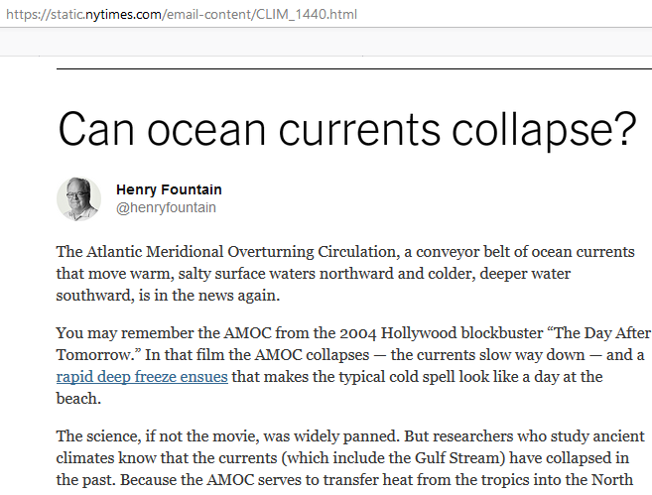
Let’s try it:
Can ocean currents collapse?

