Slide 1
Lecture 9:
Negotiations in Practice

Slide 2
Start Lecture Recording
Start Lecture Recording

Slide 3
Negotiations in practice

Slide 4
Questions in a negotiation
Who to involve – which states, which non-states
What to discuss and how to discuss it (framing)
How ambitious to be
Means of implementation
Response to compliance and noncompliance
Different general strategies of negotiation process

Slide 5
Variation in negotiation practice
Agreements reached or not
  No forest agreement; no nitrogen-fixing agreement
  Many agreements in other issue areas
    Marine pollution: 11 treaties, 4 protocols, 74 amendments
    Whaling – annual amendments since 1946
    LRTAP: 8 protocols; Montreal: 17 amendments/adjusts
    Desertification: no additional agreements
Strength of agreements
  Montreal vs. climate
Timing of agreements: why in 19xx vs. earlier/later?
Approach to agreements: fisheries v. regional v. global

Slide 6
How do choices about what’s in climate change agreement affect whether there is one?
Choice #1: Single gas or all gases - is linkage across issues good or bad?
Choice #2: Few actors or universal
Choice #3: Fixed targets or renegotiable
Choice #4: Binding treaty (hard law) or informal guidelines (soft law)
Choice #5: World Environmental Organization

Slide 7
General setup of research question

Slide 8
Why States Take Positions They Do in Int’l Negotiations
 | Ecological Yes | Vulnerability (EV) No
Low Abatement | Pusher | Bystander
Costs (AC) High | Intermediate | Dragger
Sprinz and Vaahtoranta, 1994.

Slide 9
Assess values of EV and AC for each country & place in predicted cell
 | Ecological Yes | Vulnerability (EV) No
Low Abatement | EV-Yes/AC-Low, e.g., AOSIS, Singapore | EV-No/AC-Low, e.g., France
Costs (AC) High | EV-Yes/AC-High, e.g., Bahrain | EV-No/AC-High, e.g., OPEC
Sprinz and Vaahtoranta, 1994.

Slide 10
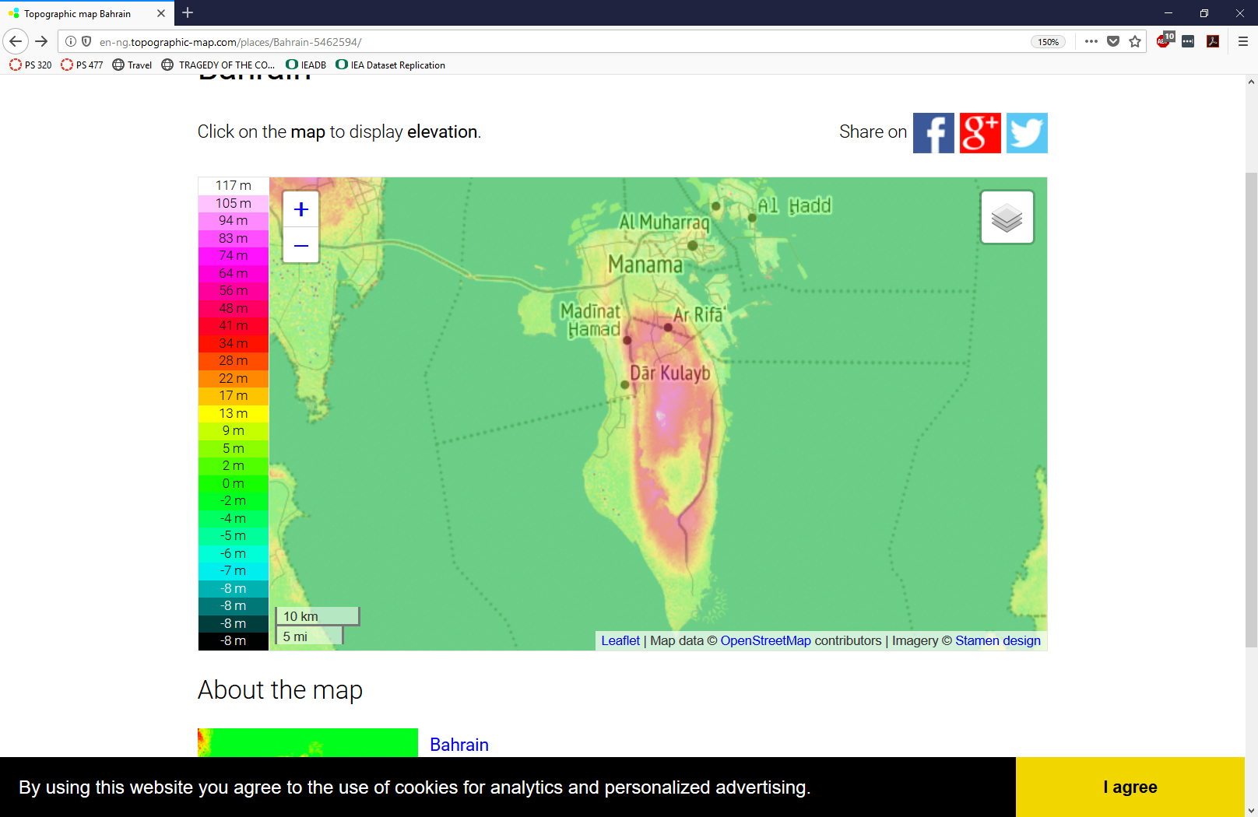
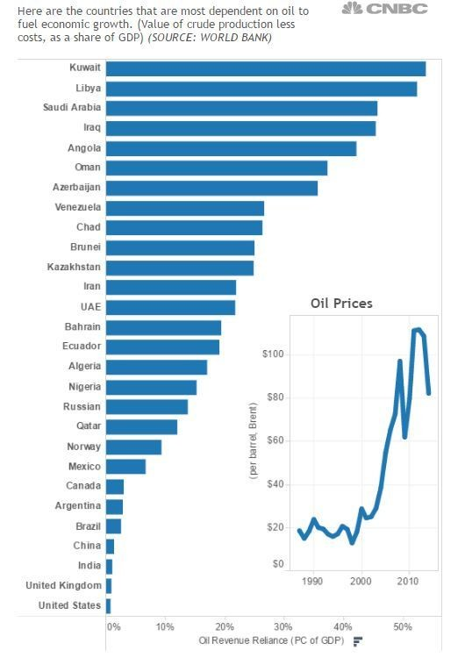
“Proxies” for EV and AC
Bahrain as example
Ecological vulnerability
  Specific: Sea Level Rise
  Proxy – meters above sea
  level
Abatement costs
  Specific: stopping production of fossil fuel
  Proxy – dependence of economy on oil (as % GDP)
http://en-ng.topographic-map.com/places/Bahrain-5462594/
https://www.weforum.org/agenda/2016/05/which-economies-are-most-reliant-on-oil/

Slide 11
S &V's argument on ozone negotiations:
Negotiations reflect interests and power
State positions determined by costs and benefits of ozone control, costs in terms of abatement costs and benefits in terms of skin cancers avoided
Data critique -- don't list alphabetically -- always by some other factor, since alphabetical is never interesting.
Notice how both costs and benefits change over time -- perceived benefits increase as knowledge of impacts and certainty reduces; perceived costs decrease as alternative technologies become available. Both lead to less resistance to international regulation by all states over time.

Slide 12
Haas argument on ozone negotiations:
Negotiations reflect role of scientists
Institutional setting: UNEP coordinated negotiations
Epistemic community (scientists) framed alternatives & advocated control
Scientists represent governments, so science-policy separation is not perfect
AMERICAN scientists had more power than others: power through science rather than science over politics
Problem structure made negotiations easier: few companies and Dupont dominated US
Theory matters: initial concern due to theory
BUT “discovery” of ozone hole in 1985, especially when summarized by scientists, “galvanized” negotiations (Haas, 1992, 202)
Role of industry: Dupont supported because wanted multilateralism and to develop alternatives
US took lead // Europe and Developing countries were laggards (Haas, 1992, 206)
Unilateral US action: threat to regulate unilaterally game them negotiation power
Treaty included provisions for different countries interests (Haas, 1992, 212)
Haas uses alternative explanations at end of article

Slide 13
Example of research in practice
Sullivan Schuster, award-winning undergrad honors thesis in Political Science, 2018
(Started with a paper for this course)

Slide 14
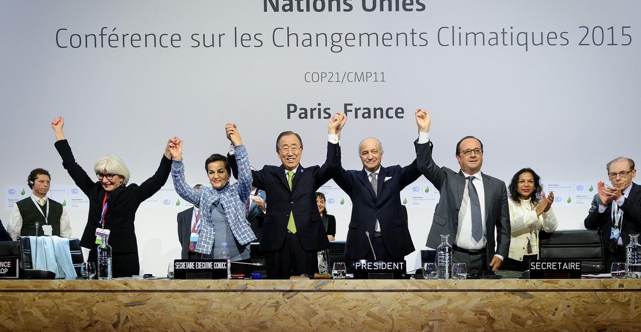
Why study international environmental politics?
https://www.carbonbrief.org/analysis-the-final-paris-climate-deal
Slides from Sullivan Schuster, UO Grad 2018

Slide 15
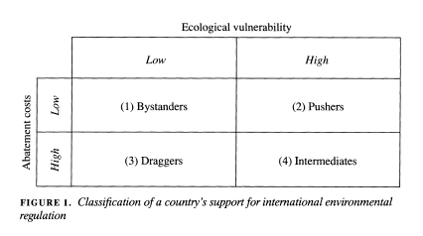
Research Questions
Why do countries take the negotiating positions they do within the context of the Paris agreement?
Are they primarily motivated by an interest-based approach? If not, what explains their behavior?
Sprinz and Vaahtoranta’s (1994) interest-based theory matrix.
Slides from Sullivan Schuster, UO Grad 2018

Slide 16
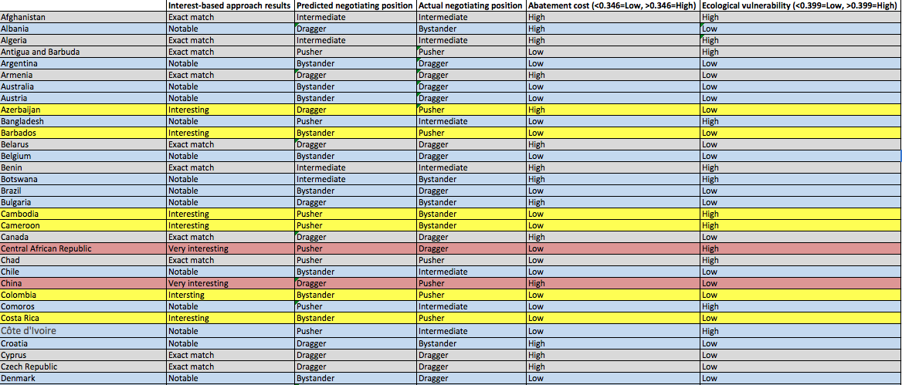
Analysis
Slides from Sullivan Schuster, UO Grad 2018

Slide 17
Case Studies and Theory Application
Why are the actual negotiating positions of these countries the complete OPPOSITE of their predicted positions? Is there a lack of data? Or do these cases represent exceptions to an interest-based theory? If so, what makes them different?
Central African Republic
China
South Africa
Thailand
Kazakhstan
Slides from Sullivan Schuster, UO Grad 2018

Slide 18
Building a Convincing
Causal Argument for your Final Paper

Slide 19
Building a Convincing
Causal Argument
Identify important theoretical question
Develop hypotheses and identify the variables
Select cases to control variables (and thereby exclude rival hypotheses as explanations)
Link data to hypotheses
Examine correlations and causal pathways
Generalize to other cases

Slide 20
A Convincing Argument Requires
Evidence
that the ACTUAL value of the Dependent Variable
matches the PREDICTED value of the Dependent Variable for
your theoretical claim
AND FOR
your counterfactual claim

Slide 21
Treaty 1 – overarching thoughts
Suggested strategy: look at analysis of similar treaty in chapters in any of the many books I have put on reserve in the library for the course. Imitate that analysis
Polar bears
Fisheries
Tropical Timber
Fur Seals
Rhine

Slide 22
Good general process for writing paper
Read Brown Weiss and Jacobson (BWJ) intro and conclusion from syllabus
  Try to figure out what are features of treaty that might be interesting to assess
Read an article or two on the treaty you think you have selected
  Notice how scholars evaluate the treaty – try to imitate them in your paper
  Get familiar with treaty and see if feature from BWJ theory can be assessed here
See if your treaty has something to compare
  Over time
  Across countries
  Across regions
  Across treaties

Slide 23
Start your paper by thinking
Read prior analyses to start: reading prior research gives you a BETTER analysis with MUCH less work
Try to have a theory to “test” with your case
Determine what your ideal Dependent Variable (DV) would be BEFORE you look at your data. Figure out what you want to use to evaluate influence first.
Graph by hand (try glitter pens!)
  How many years do you want to display to effectively demonstrate treaty influence?
  What lines do you want on your graph?
  What would those lines look like if the treaty was effective?
  What would those lines look like if the treaty was NOT effective?
Identify best “indicators” of DV is close your ideal and start with that one. If you have more than one, do the best one first and move on from there later.

Slide 24
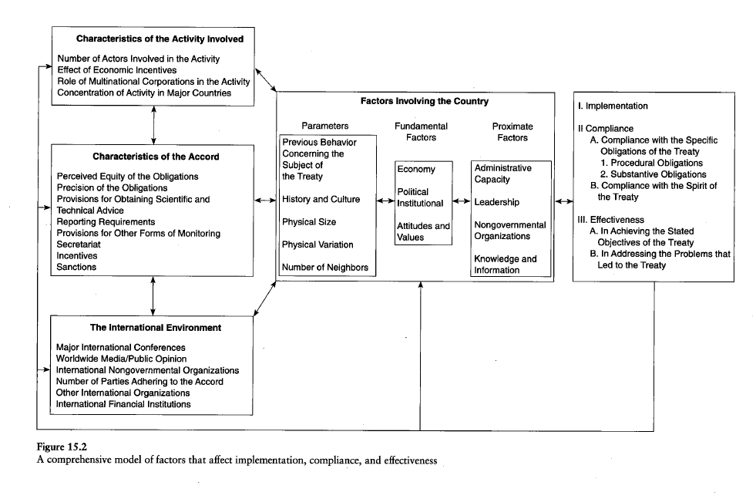
Potential Independent variables

Slide 25
Goal: compare behavior regulated by treaty with similar behavior that was not regulated
Actors: Members (regulated actors) to non-members (non-regulated actors),
  Members vs. non-members after treaty
  Treaty members Before and After treaty “Enters into force”
Activity: Members regulated activity to members non-regulated activity
  Catch of regulated yellowfin tuna vs. non-regulated bluefin tuna
  Sulfur dioxide pollution vs. carbon monoxide pollution
Location: Members in regulated location to members in non-regulated location
  Catch of yellowfin tuna in regulated area (Indian Ocean) vs. non-regulated area (Western Pacific)
  Pollution of regulated river vs. pollution of non-regulated river

Slide 26
Goal: compare behavior regulated by treaty with similar behavior that was not regulated
Compare regulated behavior to otherwise-similar non-regulated behavior to see if they are different
If they do NOT differ, there’s nothing to explain (BUT you may want to explain why you expected them to be different)
If they DO differ, try to exclude other explanations, leaving the treaty as only remaining explanation
  Develop counterfactuals to evaluate whether changes were due to treaty or other factors
HOW TO GRAPH == next week!!!

Slide 27
Two Requests:
On Covid-19:
Act to protect yourself and others
On Democracy:
Vote

