Slide 1
Lecture 11:
Compliance and Effectiveness

Slide 2
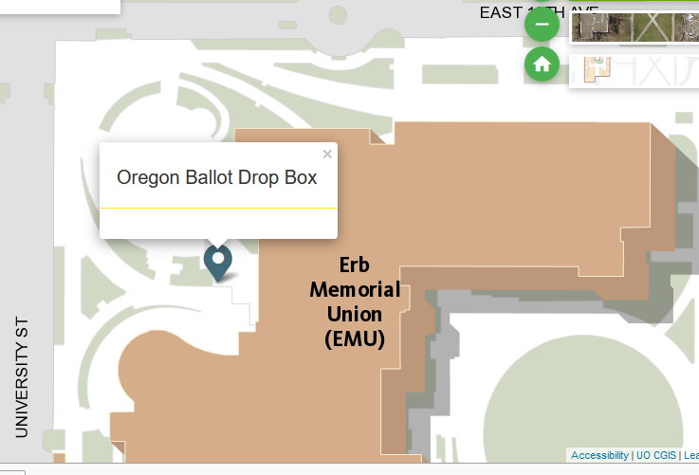
https://tiny.cc/ballotboxes
TODAY is ELECTION DAY
To ensure your vote is counted, put your OREGON ballot in a drop box BEFORE 8pm
If out of state, put your ballot in a drop box

Slide 3
In the news: Trump withdraws from Paris
What belief do you share with climate skeptics?
Trump Serves Notice to Quit Climate Accord, as Diplomats Work to Save It
“The United States formally notified the United Nations that it would leave the Paris climate agreement, starting the clock on a yearlong withdrawal process. The move, coming on the first day possible under the accord’s rules, leaves diplomats to plan a way forward without the cooperation of the world’s largest economy.”
Some people are mad/sad about this; some are happy
  What belief do they share
Source: NYTimes, https://www.nytimes.com/2019/11/04/climate/trump-paris-agreement-climate.html

Slide 4
Outline
Institutional effects and terminology
Compliance vs. effectiveness
Institutional effectiveness in the real world
Why nations DO change their behavior
Why nations DON’T change their behavior
Sources of behavior change in face of incentives not to do so
Six types of social control

Slide 5
Discussion paper Thurs, this week, by class
Relative Effectiveness
Fully described in assignment packet
Goals of exercise
  Compare problem effect/effectiveness in light of differences in problem structure – a REALLY hard thing to think about
  Practice THINKING about graphing
  Practice GRAPHING
  Lay foundation for Treaty Assignment 2
How to develop a counterfactual - discussion

Slide 6
Institutional effects and terminology
Terms: implementation, monitoring, enforcement
Compliance – behavior <> legal rules
Effectiveness
  Counterfactual
    Behavioral
    Environmental quality
  Goal achievement
    Behavioral
    Environmental quality
Other effects

Slide 7
Compliance vs. Effectiveness
Choosing an INDICATOR of influence
  Outputs (laws)
  Outcomes (behavior)
  Impacts (environmental quality)
Choosing a COMPARATOR of influence (what do we compare the OBSERVED indicator to)
  Legal standard (compliance) is not causal in nature
  Goal achievement is simply unlikely to occur
  Counterfactual: this gets at causation explicitly
BUT ALSO, want to look at other effects we care about

Slide 8
Compliance vs. Effectiveness
 | Effectiveness: Behavior influenced by IEA | Non-effectiveness: Behavior NOT influenced by IEA
Compliance: Behavior meets agreement standards | Treaty-induced compliance | Coincidental compliance
Non-compliance: Behavior does NOT meet agreement standards | Good faith non-compliance | Intentional non-compliance

Slide 9
Evaluating Effectiveness
Institutions/regimes/treaties can always be evaluated against TWO definitions of success
  #1: “Was goal achieved?” Or “How close did institution come to achieving its goal?”
    Compare actual behavior to goal
  #2: “Did institution cause behaviors or outcomes different than would have occurred otherwise?”
    Compare actual behavior to counterfactual

Slide 10
Institutional effectiveness in the real world
Kyoto and compliance
Fisheries and compliance

Slide 11
Why nations DO change their behavior
Independent self-interest (narrow)
Independent self-interest (broad)
Interdependent self-interest

Slide 12
Why nations DON’T change their behavior
Intention
Incapacity
Inadvertence

Slide 13
Evaluating Effectiveness

Slide 14
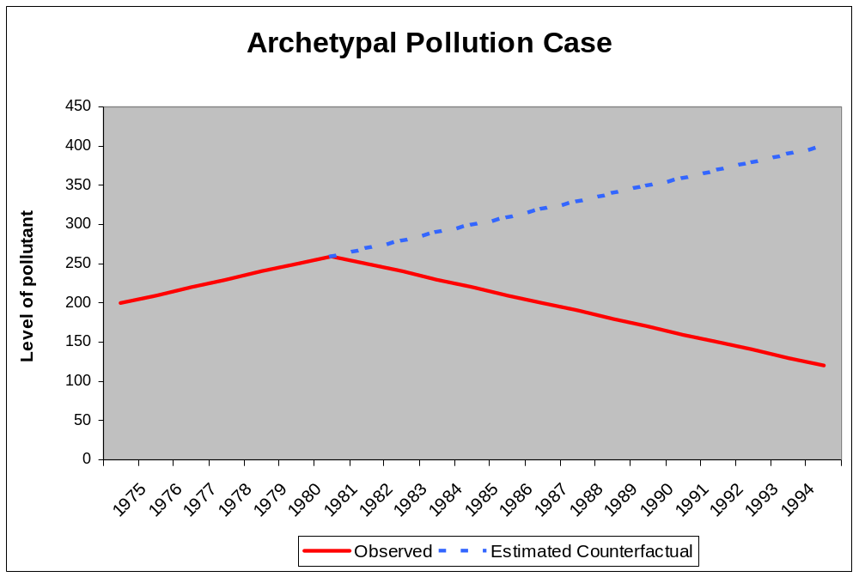
Pollution Agreements:
Evaluating Effectiveness
Treaty In Force
Notes:
Take the Montreal Protocol. Was the Montreal Protocol effective at changing the behavior of industrialized countries? If so, what aspect of the treaty should receive credit for the success? Was it the sanctions threatened under the treaty? Or was the decline in their CFC production due to availability of alternatives that might have happened anyway?
What about the developing countries? Were the rules offering them incentives to reduce CFC production less effective than the sanctions?
And, do the Montreal Protocol’s provisions appear more or less effective than those of the Nitrogen Oxide Protocol of the Convention on Long Range Transboundary Air Pollution?
Questions:
Was either really influential?
If so, what explains their effects and influence?
Is it something about the rules? Or something about regulating CFCs which is different than regulating NOx?
And, if we can identify which of the many possible explanations is the true one, how do we determine how to apply those lessons to other treaties?
These questions apply to the whole range of environmental treaties from climate change and energy use to stratospheric ozone loss to acid rain in Europe to endangered species protection to biodiversity loss to wetlands protection and water quality. Later on in the talk I will be looking at fisheries as one arena in which we can develop some of the theory and methodology so that it can be applied across all these arenas.

Slide 15
Pollution Agreements:
Evaluating Effectiveness
Treaty In Force
Notes:
Take the Montreal Protocol. Was the Montreal Protocol effective at changing the behavior of industrialized countries? If so, what aspect of the treaty should receive credit for the success? Was it the sanctions threatened under the treaty? Or was the decline in their CFC production due to availability of alternatives that might have happened anyway?
What about the developing countries? Were the rules offering them incentives to reduce CFC production less effective than the sanctions?
And, do the Montreal Protocol’s provisions appear more or less effective than those of the Nitrogen Oxide Protocol of the Convention on Long Range Transboundary Air Pollution?
Questions:
Was either really influential?
If so, what explains their effects and influence?
Is it something about the rules? Or something about regulating CFCs which is different than regulating NOx?
And, if we can identify which of the many possible explanations is the true one, how do we determine how to apply those lessons to other treaties?
These questions apply to the whole range of environmental treaties from climate change and energy use to stratospheric ozone loss to acid rain in Europe to endangered species protection to biodiversity loss to wetlands protection and water quality. Later on in the talk I will be looking at fisheries as one arena in which we can develop some of the theory and methodology so that it can be applied across all these arenas.

Slide 16
Pollution Agreements:
Evaluating Effectiveness
Treaty In Force
COUNTERFACTUAL:
Predicted Emissions if Treaty Wasn’t Signed
Notes:
Take the Montreal Protocol. Was the Montreal Protocol effective at changing the behavior of industrialized countries? If so, what aspect of the treaty should receive credit for the success? Was it the sanctions threatened under the treaty? Or was the decline in their CFC production due to availability of alternatives that might have happened anyway?
What about the developing countries? Were the rules offering them incentives to reduce CFC production less effective than the sanctions?
And, do the Montreal Protocol’s provisions appear more or less effective than those of the Nitrogen Oxide Protocol of the Convention on Long Range Transboundary Air Pollution?
Questions:
Was either really influential?
If so, what explains their effects and influence?
Is it something about the rules? Or something about regulating CFCs which is different than regulating NOx?
And, if we can identify which of the many possible explanations is the true one, how do we determine how to apply those lessons to other treaties?
These questions apply to the whole range of environmental treaties from climate change and energy use to stratospheric ozone loss to acid rain in Europe to endangered species protection to biodiversity loss to wetlands protection and water quality. Later on in the talk I will be looking at fisheries as one arena in which we can develop some of the theory and methodology so that it can be applied across all these arenas.

Slide 17
Pollution Agreements:
Evaluating Effectiveness
Treaty In Force
COUNTERFACTUAL:
Predicted Emissions if Treaty Wasn’t Signed
Success of Treaty Relative to COUNTERFACTUAL
Notes:
Take the Montreal Protocol. Was the Montreal Protocol effective at changing the behavior of industrialized countries? If so, what aspect of the treaty should receive credit for the success? Was it the sanctions threatened under the treaty? Or was the decline in their CFC production due to availability of alternatives that might have happened anyway?
What about the developing countries? Were the rules offering them incentives to reduce CFC production less effective than the sanctions?
And, do the Montreal Protocol’s provisions appear more or less effective than those of the Nitrogen Oxide Protocol of the Convention on Long Range Transboundary Air Pollution?
Questions:
Was either really influential?
If so, what explains their effects and influence?
Is it something about the rules? Or something about regulating CFCs which is different than regulating NOx?
And, if we can identify which of the many possible explanations is the true one, how do we determine how to apply those lessons to other treaties?
These questions apply to the whole range of environmental treaties from climate change and energy use to stratospheric ozone loss to acid rain in Europe to endangered species protection to biodiversity loss to wetlands protection and water quality. Later on in the talk I will be looking at fisheries as one arena in which we can develop some of the theory and methodology so that it can be applied across all these arenas.

Slide 18
Pollution Agreements:
Evaluating Effectiveness
Treaty In Force
GOAL:
Emissions Level Treaty Sought to Achieve
Notes:
Take the Montreal Protocol. Was the Montreal Protocol effective at changing the behavior of industrialized countries? If so, what aspect of the treaty should receive credit for the success? Was it the sanctions threatened under the treaty? Or was the decline in their CFC production due to availability of alternatives that might have happened anyway?
What about the developing countries? Were the rules offering them incentives to reduce CFC production less effective than the sanctions?
And, do the Montreal Protocol’s provisions appear more or less effective than those of the Nitrogen Oxide Protocol of the Convention on Long Range Transboundary Air Pollution?
Questions:
Was either really influential?
If so, what explains their effects and influence?
Is it something about the rules? Or something about regulating CFCs which is different than regulating NOx?
And, if we can identify which of the many possible explanations is the true one, how do we determine how to apply those lessons to other treaties?
These questions apply to the whole range of environmental treaties from climate change and energy use to stratospheric ozone loss to acid rain in Europe to endangered species protection to biodiversity loss to wetlands protection and water quality. Later on in the talk I will be looking at fisheries as one arena in which we can develop some of the theory and methodology so that it can be applied across all these arenas.

Slide 19
Pollution Agreements:
Evaluating Effectiveness
Treaty In Force
GOAL:
Emissions Level Treaty Sought to Achieve
Failure of Treaty
Relative to GOAL
Notes:
Take the Montreal Protocol. Was the Montreal Protocol effective at changing the behavior of industrialized countries? If so, what aspect of the treaty should receive credit for the success? Was it the sanctions threatened under the treaty? Or was the decline in their CFC production due to availability of alternatives that might have happened anyway?
What about the developing countries? Were the rules offering them incentives to reduce CFC production less effective than the sanctions?
And, do the Montreal Protocol’s provisions appear more or less effective than those of the Nitrogen Oxide Protocol of the Convention on Long Range Transboundary Air Pollution?
Questions:
Was either really influential?
If so, what explains their effects and influence?
Is it something about the rules? Or something about regulating CFCs which is different than regulating NOx?
And, if we can identify which of the many possible explanations is the true one, how do we determine how to apply those lessons to other treaties?
These questions apply to the whole range of environmental treaties from climate change and energy use to stratospheric ozone loss to acid rain in Europe to endangered species protection to biodiversity loss to wetlands protection and water quality. Later on in the talk I will be looking at fisheries as one arena in which we can develop some of the theory and methodology so that it can be applied across all these arenas.

Slide 20
Wildlife Agreements:
Evaluating Effectiveness
Contrast what agreement seeks to accomplish and methods needed to evaluate
Political lifecycle not straightforward or linear
Change in behavioral trajectory can be evidence of influence or lack of influence
Counterfactual more challenging to estimate

Slide 21
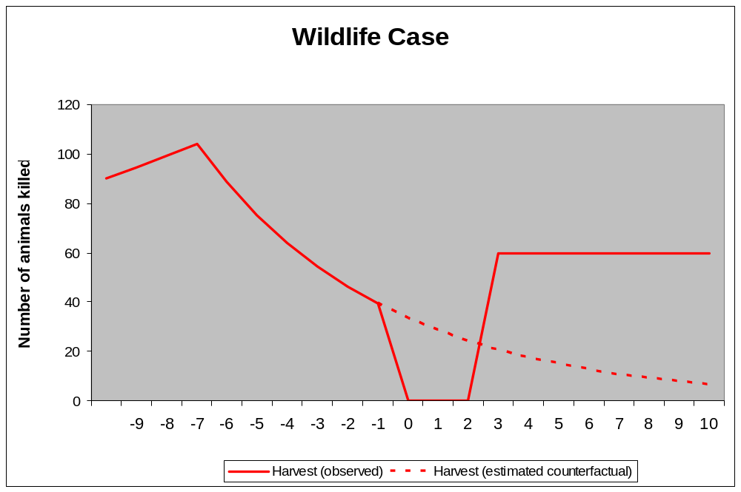
Identifying Wildlife Treaty Effects:
What We Observe
Population Crash
Overexploitation
Levels if Effective
Treaty Signature
Estimate of Counterfactual

Slide 22
Identifying Wildlife Treaty Effects:
What We Observe
Population Crash
Overexploitation
Levels if Effective
Estimate of Counterfactual

Slide 23
Identifying Wildlife Treaty Effects:
What We Observe
Population Crash
Overexploitation
Levels if Effective
Treaty Signature
Estimate of Counterfactual

Slide 24
Identifying Wildlife Treaty Effects:
Estimating the Counterfactual
Population Crash
Overexploitation
Treaty Signature
Estimate of Counterfactual

Slide 25
Identifying Wildlife Treaty Effects:
Inferring Treaty Effects
Population Crash
Levels if Effective:
Subsequent Recovery
Overexploitation
Levels if Effective:
Initial Restraint
Treaty Signature
Estimate of Counterfactual

Slide 26
Identifying Wildlife Treaty Effects:
Inferring Treaty Effects
Population Crash
Overexploitation
Levels if Effective
Treaty Effects
Treaty Signature
Estimate of Counterfactual

Slide 27
Identifying Wildlife Treaty Effects:
Inferring Treaty Effects
Population Crash
Overexploitation
Levels if Effective
2 Treaty Effects
Treaty Signature
Estimate of Counterfactual

Slide 28
Methods of inducing
Behavior change

Slide 29
How do we change behavior when actors have incentives NOT to change behavior
Specificity
Transparency
Reciprocity and iteration
Compliance/effectiveness subsystems
  Primary rule subsystem
  Information subsystem
  Response subsystem

Slide 30
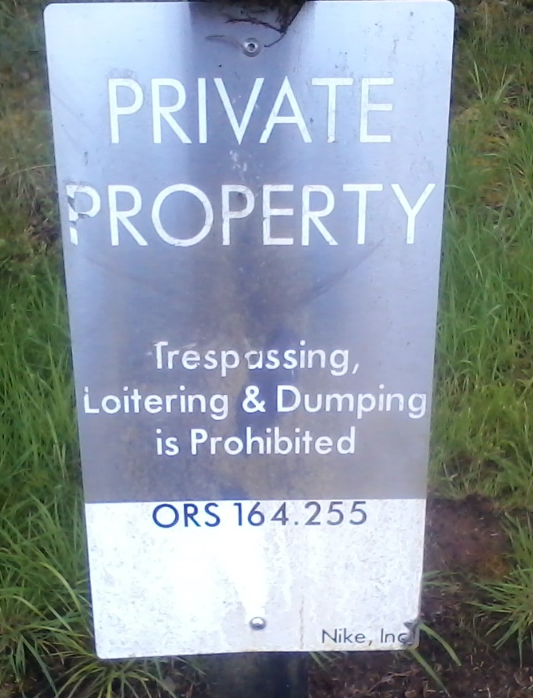
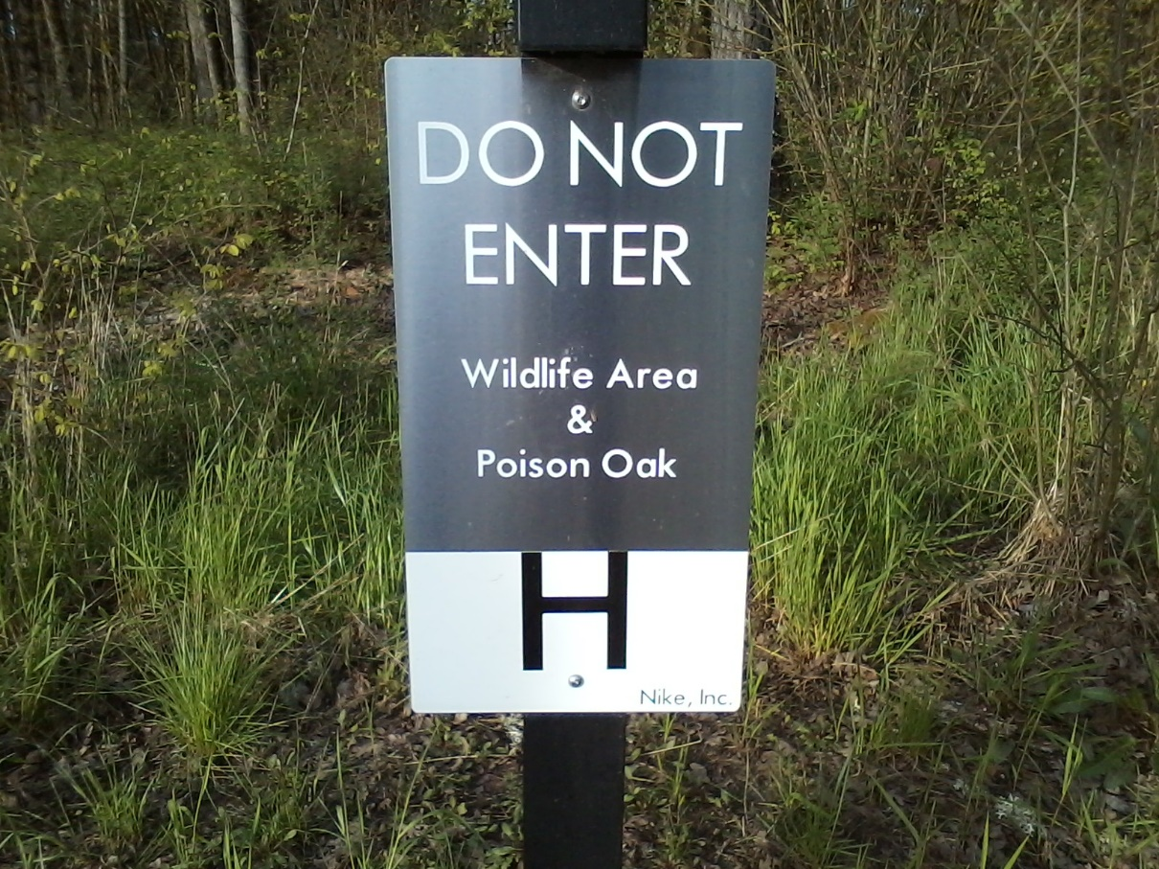
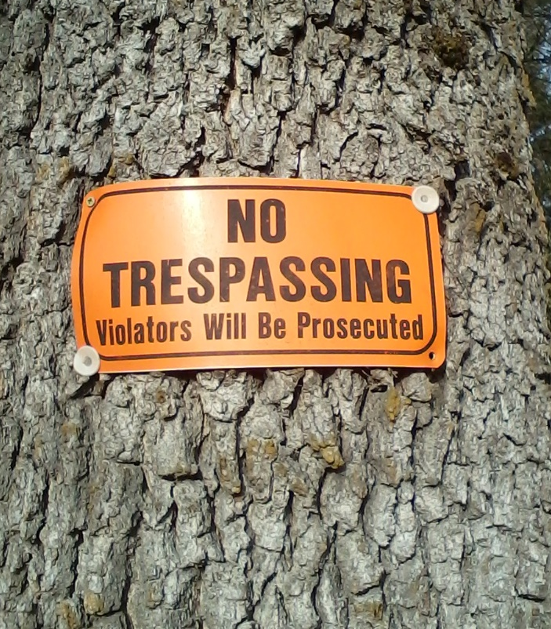
Which of these would influence YOU?

Slide 31
Which of these would influence YOU?
Punitive:
threat of sanction
Normative:
private property
Cognitive:
effects of action

Slide 32
Six types of social control
Consequences: change costs of HAVING engaged in behavior
  Deterrence – increase expected costs of violation
  Remuneration – increase expected benefit of compliance
Opportunities: change costs/options OF engaging in behavior
  Generative – new capacities and opportunities
  Preclusive – remove opportunities
Perceptions: change perceived costs of engaging in behavior
  Cognitive – new information
  Normative – new values
Which strategies are available depends on type of problem

Slide 33
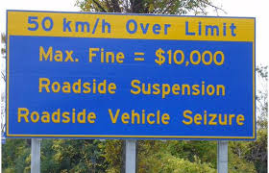
Deterrence (“make it costly”) increase expected costs of bad
How do we make people
drive slower?

Slide 34
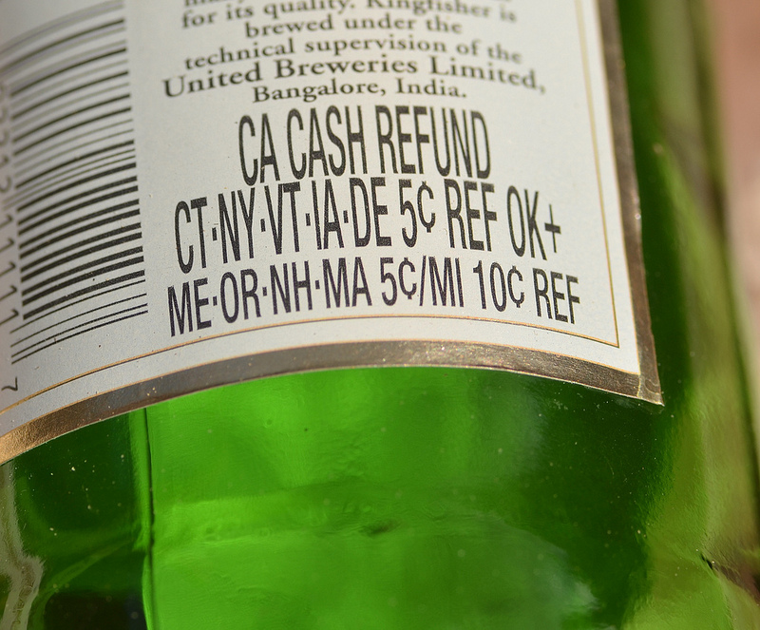
Remuneration (“make it beneficial”) increase expected benefits of good
How do we make people
recycle bottles?

Slide 35
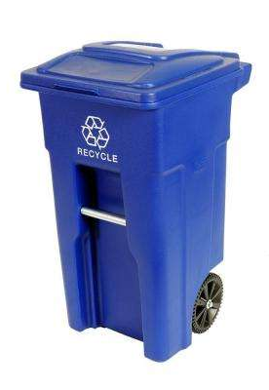

Generative (“make it possible/easy”) new capacities and opportunities
How do we make people
recycle other stuff?

Slide 36
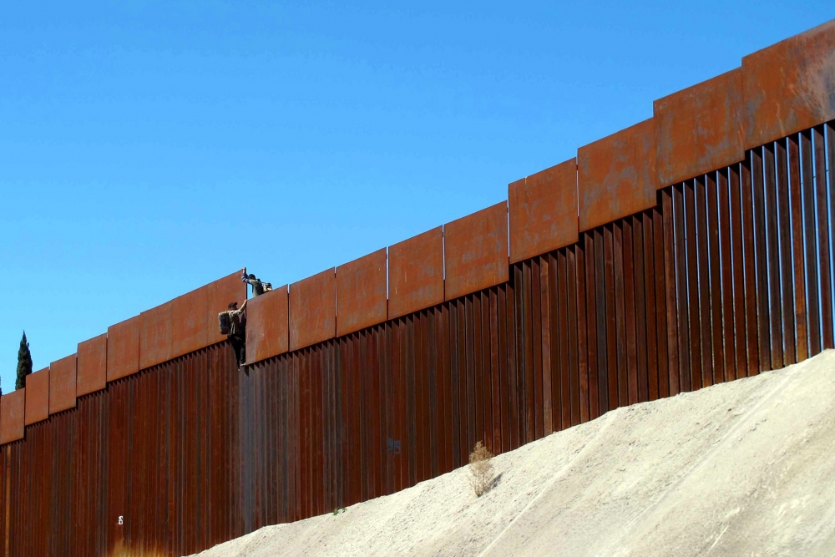

Preclusive (“make it difficult”) remove opportunities
How do we make people
not steal money or enter the US?

Slide 37
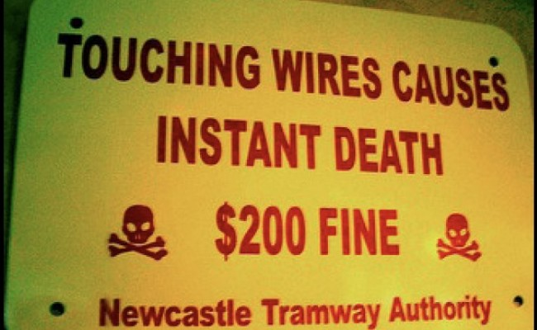

Cognitive (“make people aware”) new information
How do we make people
buy organic or be safe?

Slide 38
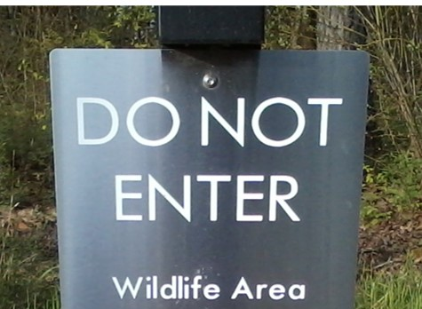
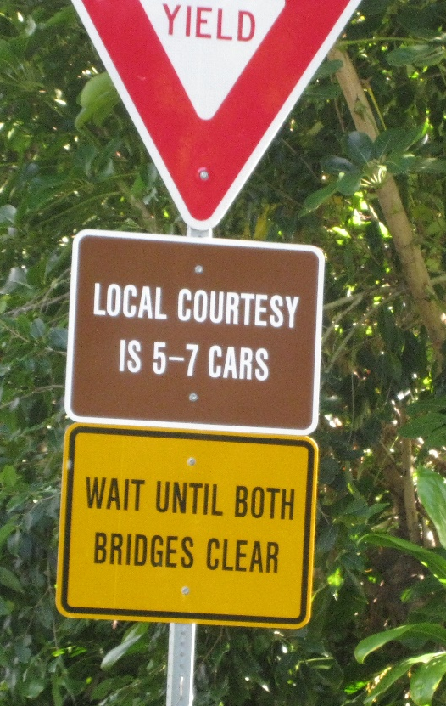
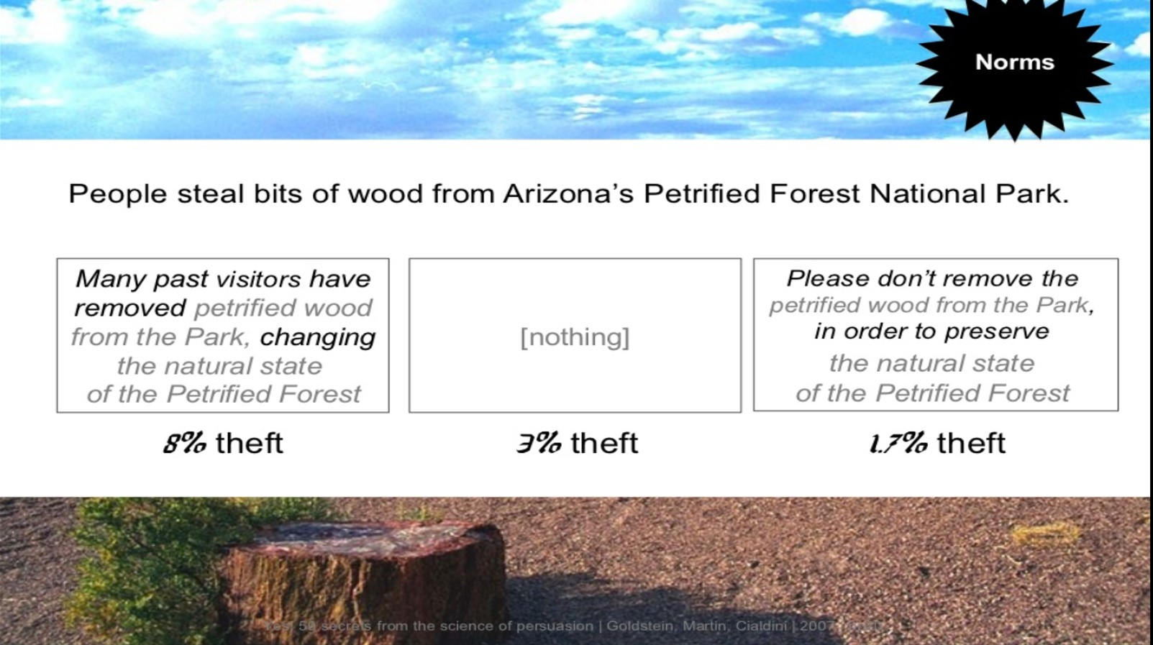
Normative (“make people be good”) new values
How do we make people
protect natural areas or
be respectful?

