Slide 1
Different Explanations of
Climate Change
Economics (last class)
  Explanations of human responses to climate change arise due to factors related to economic structures
Psychology (today)
  Explanations of human responses to climate change arise due to factors related to individuals
Sociology (Thursday):
  Explanations of human responses to climate change arise due to factors related to social groups

Slide 2
Final Paper Discussion
Intro
Theory
  How scholars discuss the DV (negotiating position and emissions trajectory in the future)
  What IVs scholars suggest cause variation in the DV (e.g., S&V: abatement costs and ecological vulnerability)
Describe countries you selected & negotiating positions
Assess which IVs best explain differences in negotiating position
Conclusion

Slide 3
Comparing countries
Country | What reduced | % decrease | Base year | Target year | Compare
Mali | All GHG | 20% | 2005 | 2045 | 0.5%
Ghana | All GHG | 20% | 2005 | 2025 | 1.0%
Malawi | All GHG | 60% | 1995 | 2025 | 2.0%
S. Africa | All GHG | 10% | 2005 | 2025 | 0.5%
Mali less aggressive than Ghana: same decrease in longer time
Malawi more aggressive than Ghana: much bigger decrease in only slightly longer time
S. Africa less aggressive than Ghana: less decrease in same time

Slide 4
Comparing countries
Country | What reduced | % decrease | Base year | Target year | Compare
Mali | All GHG | 20% | 2005 | 2045 | 0.5%
Ghana | All GHG | 20% | 2005 | 2025 | 1.0%
Malawi | All GHG | 60% | 1995 | 2025 | 2.0%
S. Africa | All GHG | 10% | 2005 | 2025 | 0.5%
Mali less aggressive than Ghana: same decrease in longer time
Malawi more aggressive than Ghana: much bigger decrease in only slightly longer time
S. Africa less aggressive than Ghana: less decrease in same time
But why not calculate rate of decrease?
  Count number of years (Target–Base)
  % decrease by years
  Voila: a way to compare!!!
Country | What reduced | % decrease | Base year | Target year | Compare
S. Africa | All GHG | 10% | 2005 | 2025 | 0.5%
Mali | All GHG | 20% | 2005 | 2045 | 0.5%
Ghana | All GHG | 20% | 2005 | 2025 | 1.0%
Malawi | All GHG | 60% | 1995 | 2025 | 2.0%

Slide 5
Introduction to psychology of climate change
Many slides courtesy of Ezra Markowitz
Used with permisson

Slide 6
I>clicker: “Reuse towels” message in hotel: Which do you think will work best?
"Help our hotel save energy"
"Help save the environment"
"Partner with us to help save the environment"
"Help save resources for future generations"
"Join your fellow citizens in saving the environment“
Source: Shaping Pro-Environment Behaviors, Research in Action American Psychological Association https://www.apa.org/research/action/shaping

Slide 7
Psychology and Climate Change
People are not as “rational” as you might think
People use 2 types of thinking (Kahneman, 2011)
  Associative/affective reasoning: fast, intuitive, emotional, personal
  Analytic/intellectual reasoning: “slower, deliberative, logical, statistical
Psych and what we understand:
  Availability heuristics
Psych and what we worry about:
  Finite pool of worry
Psych and what we do
  Single action bias
  Status quo bias
  Social norms

Slide 8
People not as “rational” as you think
Three myths of Behavior Change
“Education will change behavior”
  More/better information => better decision-making
  We seek confirming info, ignore other info, & decide in ways that don’t reflect info
“You can’t change attitudes unless you change behavior”
  Attitudes follow behavior, they do not predict it
  So, set behavioral expectations
“People know what motivates them to take action”
  Buskers and tip jars – social norms not your generosity
  So, “seed your tip jar”
Source: Jeni Cross, 2013, TEDxCSU Three Myths of Behavior Change, https://www.youtube.com/watch?v=l5d8GW6GdR0

Slide 9
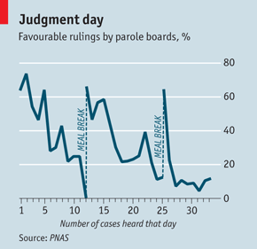
Lots of evidence that we do not act rationally
  Game presented you with information that is objectively the same, but often people make different decisions in the two cases
  Small, irrelevant, things often influence our decisions (parole judges)
  We overestimate risks of certain TYPES of
  actions, unrelated to their actual risks

Slide 10
Psychological insight:
Experience more important than description
Learn about risks from description vs. experience
Descriptions of climate change generally from scientists
Experience of climate change is more important driver of how risky things seem
  But we experience weather, not climate
So, we tend to underestimate the risks of climate change

Slide 11
I>Clicker
Lifetime risk of death by type of vehicle
 | Highest Risk | Medium Risk | Lowest Risk
A | Car | Plane | Bike
B | Car | Bike | Plane
C | Plane | Car | Bike
D | Bike | Plane | Car
Source: National Safety Council https://injuryfacts.nsc.org/all-injuries/preventable-death-overview/odds-of-dying/

Slide 12
I>Clicker
Lifetime risk of death by type of vehicle
 | Highest Risk | Medium Risk | Lowest Risk
A | Car | Plane | Bike
B | Car | Bike | Plane
C | Plane | Car | Bike
D | Bike | Plane | Car
 | CAR 1 in 100 | BIKE 1 in 4,000 | PLANE 1 in 180,000
Source: National Safety Council https://injuryfacts.nsc.org/all-injuries/preventable-death-overview/odds-of-dying/

Slide 13
Two systems of assessing the world and making choices for action
Affective system:
  Fast, automatic, associative, emotional
Cognitive or rational system:
  Slower, deliberative, “cold and calculating”
Two systems operate in parallel to interpret information about climate change
We all use both (in different situations) but when two systems lead to different assessments (e.g., Affect says CC isn’t a problem but Cognitive says it is), we tend to act in ways that match Affective System

Slide 14
Psychological insights:
People look for information selectively
Decision-makers only pay attention to certain sources, types of info
  Republicans go to FoxNews, Democrats go to MSNBC
We tend to reject information that goes against core beliefs, values
  Or that suggests something be done that we disagree with (motivated reasoning)

Slide 15
Psychological insight:
How information is “framed” matters
Humans are sensitive to how information is presented
CC can be “framed” in multiple ways:
  Content frames: public health, national security, environmental conservation
  Structure frames: loss vs. gain; present vs. future
We generally accept risk if thinking about possible losses; but avoid risk if thinking about possible gains
  So, take more risks when think we are going to lose something
Climate change generally presented as losses frame but better to frame it in a “gains” frame: “if we invest, here is the better things we would have”

Slide 16
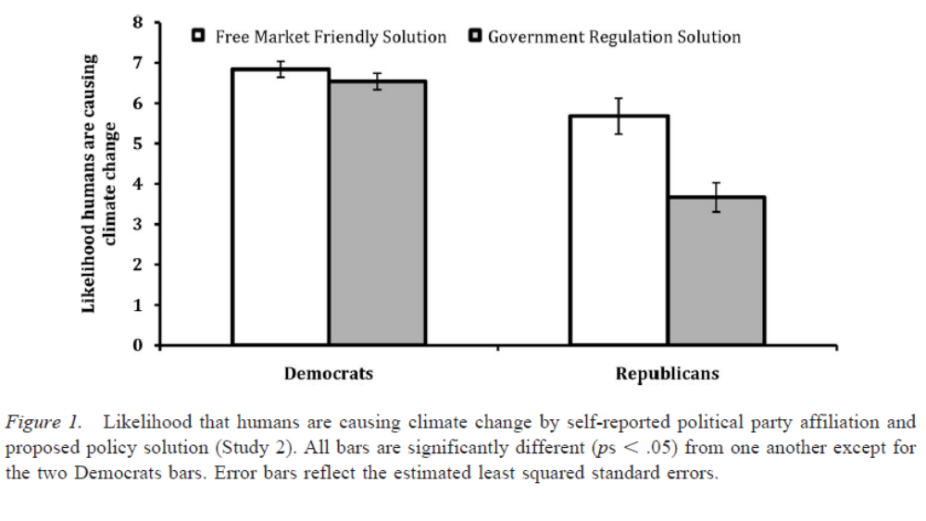
Framing: how we frame climate solutions influences skepticism of climate science
Costs of climate solutions lead Republicans to disbelieve climate science
  Climate solution of “promoting green tech” vs. “regulating industry”
“I don’t like the solution, so I discount that there’s a problem.”
Solve climate change by promoting green tech
Solve climate change by regulating industry
Soure: Campbell, T. H. and A. C. Kay. 2014. Solution aversion: On the relation between ideology and motivated disbelief. Journal of Personality and Social Psychology 107(5): 809-824.US: American Psychological Association.

Slide 17
Psychological insight:
Barriers to understanding climate change
Beliefs influence perceptions, not vice versa
  Farmers see what they believe, not believe what they see
We believe personal experience, not the statistics
Perceptions about climate change causes and consequences are socially constructed within communities and lead us to “attend to, fear, and socially amplify some risks while ignoring, discounting, or attenuating others” (Weber 2010)

Slide 18
Psychological insight:
Barriers to worrying about climate change
Availability heuristic: whether we believe something depends on whether we can think of examples
  Use easily-available and recent memories to estimate likelihood of things happening, regardless of how rare we know them to be
  OVER-worry about things that have happened recently
  UNDER-worry about rare things that haven’t happened for awhile
Not scared enough by rare events, but scared too much when they happen (Sandy/Katrina; Fukushima; earthquakes). Overreact after major event but then “falls off radar”

Slide 19
Psychological insight:
Barriers to worrying about climate change
Finite pool of worry
  Can only worry about so much: if worry more about climate change, we worry less about other things
  If worry more about other things (like the economy), we worry less about climate change, with no change in the objective risks

Slide 20
Psychological insight:
Barriers to taking action on climate change
Single action bias
  “Regardless of which single action is taken first, decision makers have a tendency not to take any further action, presumably because the first action suffices in reducing the feeling of worry or vulnerability.”

Slide 21
Psychological insight:
Barriers to taking action on climate change
Status quo bias
  “People do not move away from hazards even when they are aware of them”
  Won’t move into bad situation but will stay in one
“Nudge” issues: wherever we start, there we stay
  Netflix subscriptions
  Policies can make a difference – UK auto-enrollment in retirement plan
  Env’l options: EWEB could make green (not brown) energy the “default”
    People retain freedom but behave differently
    Sometimes people prefer the default, even if they won’t choose it

Slide 22
Psychological insight:
Barriers to taking action on climate change
Optimistic biases (Weinstein, 1980): Uncertainty promotes optimism
Not my fault
Commons dilemma
  Undercuts responsibility and action
  Lack of “efficacy” – feeling that you can make a difference
Moral judgment system ill-equipped to recognize and deal with unintended outcome of our own behavior (Markowitz & Shariff, 2012)
  No obvious villain to blame
  Unintentional side-effect of modern life

Slide 23
Psych discussion
How can we use these insights to address the problem of climate change?
  Default options: e.g., green energy
  Framing: risk seeking

