Slide 1
When will States form institutions:
Human rights and environment

Slide 2
When do states form institutions?
Some key ideas
Changes in interests or perspectives of powerful states
  Bretton Woods institutions – US interests in benefits of improved world economy after WWII
  Civil rights and women’s rights in US
  BUT exceptions: 1951 Convention on Equal Pay BEFORE 1963 US Equal Pay Act
“Crises” or exogenous shocks that harm powerful states
  1948 Genocide Convention: Holocaust not 1915 Armenian genocide
  Oil spills off developed states
  Basel I, II, III and global financial crises
Issues put on agenda of states by NGOs
When things get “bad enough”

Slide 3
Human Rights:
Carpenter, Setting Advocacy Agenda
Why do some issues get on agenda but others don’t?
  Nature of problems, e.g., identifiable actor, deliberate action, bodily harm
  Resonate with larger norms: e.g., rights, similar weapons, etc.
  Individuals championing an issue: problems are socially constructed by real people
Examples:
  No action on children born of wartime rape but action on child soldiers and girls in war; also landmines vs. cluster munitions
  There are “gatekeepers” who make a difference
  Advocates are “highly selective” about what they champion

Slide 4
Human Rights and Transnational Activist Networks
Transnational advocacy networks: “actors working internationally on an issue, who are bound together by shared values, a common discourse, and dense exchanges of information and services” (Keck and Sikkink, 89).
  “What is novel [is their ability] to mobilize information strategically to help create new issues and categories, and to persuade, pressurize, and gain leverage over much more powerful organizations and governments” (Keck and Sikkink, 89).

Slide 5
How TANs Work
Rights claims
Boomerang processes
Tactic 1: Information politics
Tactic 2: Symbolic politics
Tactic 3: Leverage politics (material or moral leverage)
Tactic 4: Accountability politics - rhetorical entrapment
Framing and discourse: Fancy words --- what do they mean?
  Core idea of framing
  States are not the only ones in control of how we talk about things
  Frame alignment and resonance
  Causal stories
Timing matters

Slide 6
When will TANs Emerge
When domestic groups can’t get satisfaction from own government
When ‘political entrepreneurs’ see networking as helping their goals
When “international conferences and other forms of international contacts create arenas for forming and strengthening networks”

Slide 7
Environmental problems
All environmental problems are not alike
  Some are Tragedies of the Commons, some are not
Basic argument:
  Collaboration (ToC) symmetric externality: All states prefer cooperation so issue-specific reciprocity works. Coercion/incentives unnecessary.
  Upstream/Downstream asymmetric externalities: harder distribution & enforcement problems. Requires linkage, either incentives or coercion. Choice depends on power balance between up and down states.

Slide 8
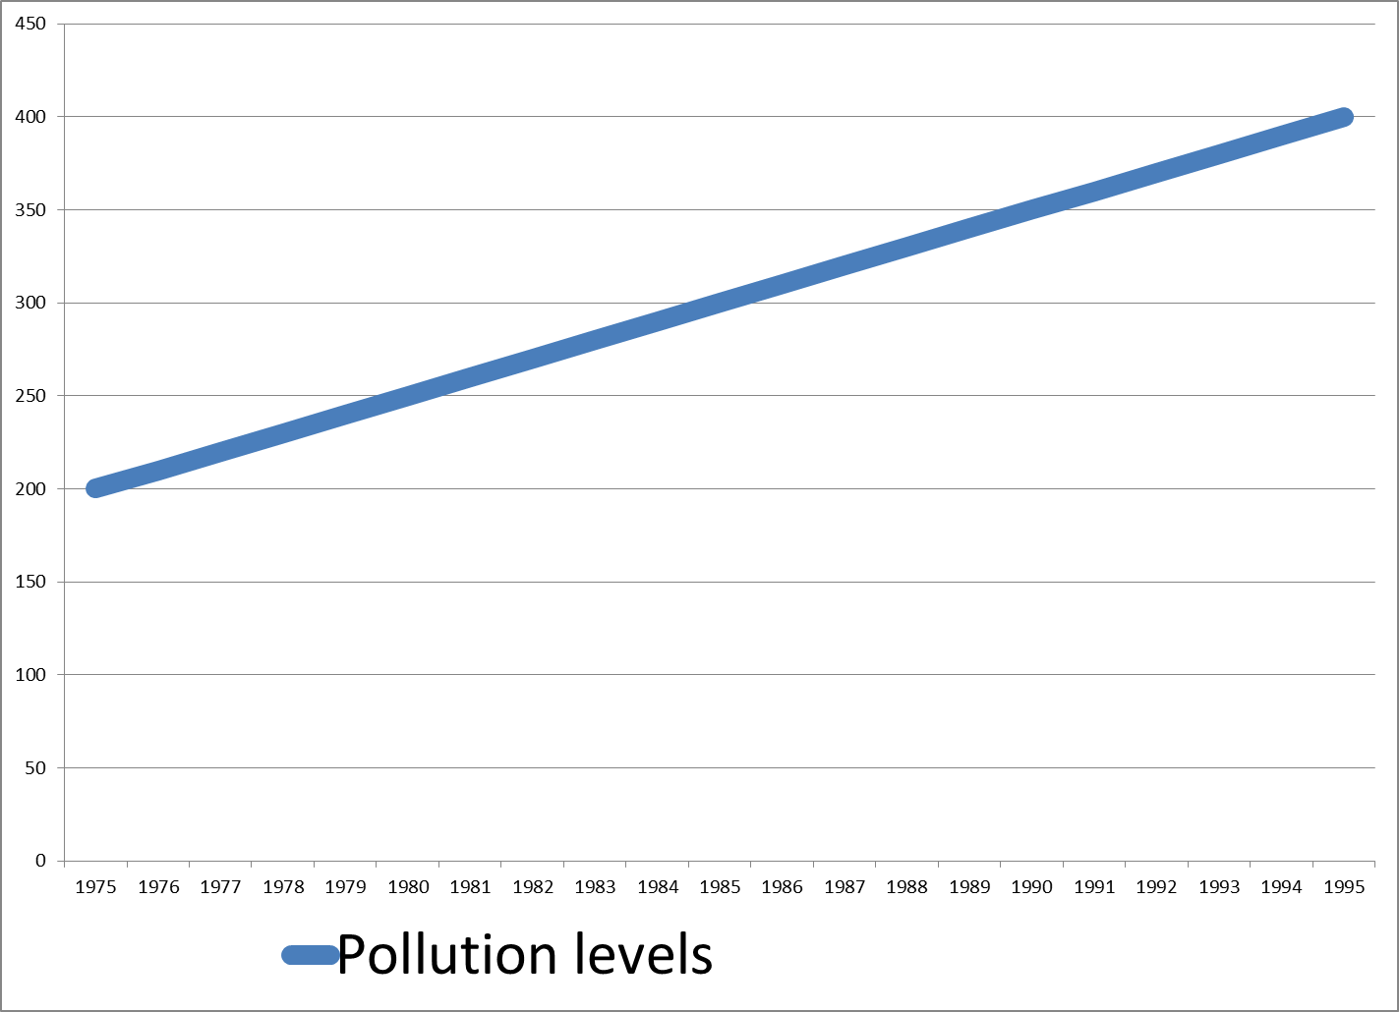
When do states form institutions?
It depends on the type of problem

Slide 9
When do states form institutions?
It depends on the type of problem
At what point should we expect to see an international institution form?
What would be needed to prompt efforts to form an international institution?

Slide 10
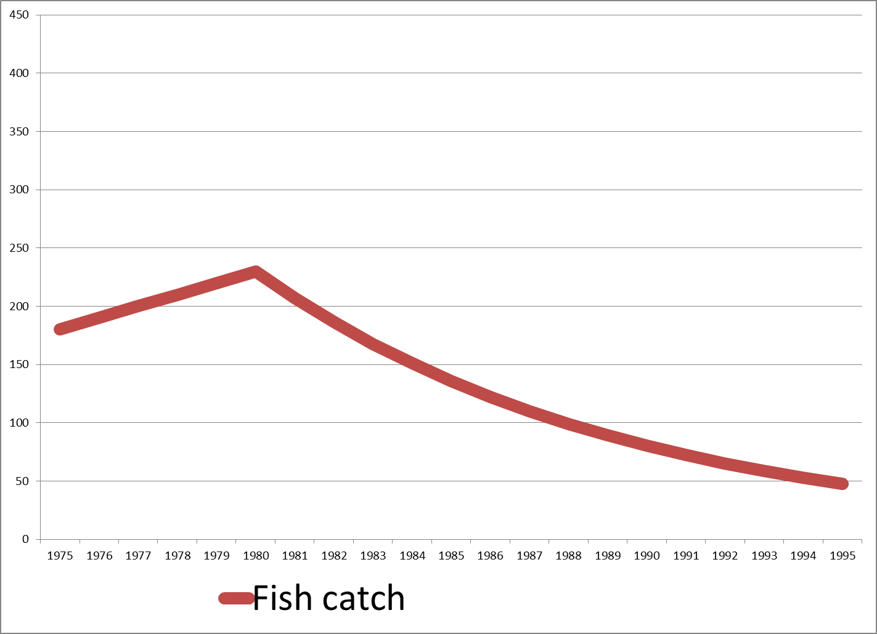
When do states form institutions?
It depends on the type of problem

Slide 11
When do states form institutions?
It depends on the type of problem
At what point should we expect to see an international institution form?
What would be needed to prompt efforts to form an international institution?

Slide 12
How will states design institutions:
Revisiting Hypotheses

Slide 13
Hypotheses re:
Problem Structure / Institutional Design
Conflict/cooperation: if relevant actors prefer outcomes of conflict more than viable alternatives: NO institution
Capacities 1: if capacity for BAD behavior depends on others: REGULATORY institution which LIMITS membership to capable states and COMMON obligations to ban behaviors that would allow others to engage in bad behavior
Capacities 2: if some actors lack CAPACITY for GOOD behavior: PROGRAMMATIC institution which EXPANDS membership and DIFFERENTIATED obligations (donors/recipients) and RESPONSE of capacity enhancements (not rewards/sanctions)

Slide 14
Hypotheses re:
Problem Structure / Institutional Design
Incentives 1:
  Coordination: REGULATORY institution with COMMON obligations and NO response system
  Up/Downstream: REGULATORY institution with DIFFERENTIATED obligations and LINKAGE response system
  Collaboration: REGULATORY institution with COMMON obligations and RETALIATORY (“reversion”) response system
Incentives 2: if strong incentives to cheat: clearly specified INSPECTION and RESPONSE rules (likely for collaboration & upstream/downstream but NOT coordination)

Slide 15
Hypotheses re:
Problem Structure / Institutional Design
Information: if little INFORMATION about consequences of behavior: PROGRAMMATIC or PROCEDURAL institution with weak information / response systems
Norms: if effort by some to instill NORMS in others; GENERATIVE institution has WEAK information/response system (or sanctions if strong pre-institutional norm against behavior)

Slide 16
Hypotheses re:
Problem Structure / Institutional Design
Inherent Transparency: if easy to know what other actors have done: WEAK INSPECTION procedures
Response Incentives 1: Strong concern about violations: STRONG and SPECIFIC inspection and response system (or easy withdrawal)
Response Incentives 2: Low concern about violations: WEAK INSPECTION and RESPONSE procedures

Slide 17
How will states design institutions:
Human rights and environment

Slide 18
Problem Structure, Institutional Design, & Human Rights / Environment
 | Human Rights | Environment
Q1: Conflict/deadlock | Cooperation possible usually | Cooperation possible usually
Q2: Number of actors | Usually attempt to be universal but only some states must change | Range from 2 to global depending on issue
Q3: Capacity | Civil/political: regulatory Economic/social: programmatic | Overfishing: regulatory Habitat protection: programmatic
Q4: Incentives | Common obligations because of nature of normative obligations | Collaboration or upstream/downstream problem: common vs. differentiated
Q5: Information | Problem well understood so no need for research | Some problems not understood and research is central component
Q6: Values | Often value conflicts, resolved in favor of values of more powerful | Generally little value conflict but some cases that is important (whaling)
Q7: Inherent transparency | Civil/political: some transparent, some not Economic/social: usually transparent Weak inspection b/c high violation tolerance | Some transparent, some not, with type of monitoring reflecting that (pollution inspections but self-reporting for fishing)
Q8: Response incentives | Low: little reason to create strong response | Depends on type: some strong response, especially when financing involved

Slide 19
Responding to Violations
Three Possible Options
Issue-specific reciprocity – Tit for Tat
  Excellent for Tragedy of the Commons problems
Coercion (negative linkage)
  Seems to make sense for upstream/downstream problem but why would upstream state every agree to “legitimize” such punishment?
Exchange (positive linkage)
  Makes sense for upstream/downstream problem but can also be used for Tragedy of the Commons (like overharvest of fur seals)
Need to think about the logic of how these things work

Slide 20
Regulating the Fur Seal Trade:
Collaboration (ToC) so 3 Options
Typical Tragedy of the Commons
US and Russia: land sealing; Canada and Japan: ocean (“pelagic”) sealing
Options for addressing
  Reciprocity (common obligations): all 4 countries reduce
  Coercion (by US/Russia): possible but not in treaty
  Exchange (positive incentives): C&J get 15% for free
What actually happened? Look at real treaty terms

Slide 21
Regulating Pollution of the Rhine
Up/Downstream so only 1 VIABLE option
France/Germany polluting Rhine; Dutch being polluted
Typical upstream/downstream problem
Options for addressing
  Coercion (by Dutch): not possible (Dutch lack power)
  Reciprocity (common obligations): France/Germany reject
  Exchange (positive incentives): agreement only after cost-sharing proposed
Risks of exchange: French “extortion”
Institutional inertia: French, German, Swiss contribute to Dutch cleanup of IJsselmeer

