Slide 1
Writing an ANALYTIC paper
QUICK REVIEW BEFORE ITS DUE

Slide 2
Basics
Key: Start with a good hypothesis or research question, from the literature
What I mean by Hypothesis (taken from an article or three):
  Treaties with X cause bigger behavior changes than treaties (without X or with Y)
What is your DV?
  Conceptual variable?
  Proxy for this conceptual variable?
What are alleged IVs?
  Non-treaty variables?
  Treaty variables?
    General – membership, area regulated, species
    Features – sanctions, monitoring, financing
Differences across member countries?
What’s the causal STORY of HOW treaty influenced behavior?

Slide 3
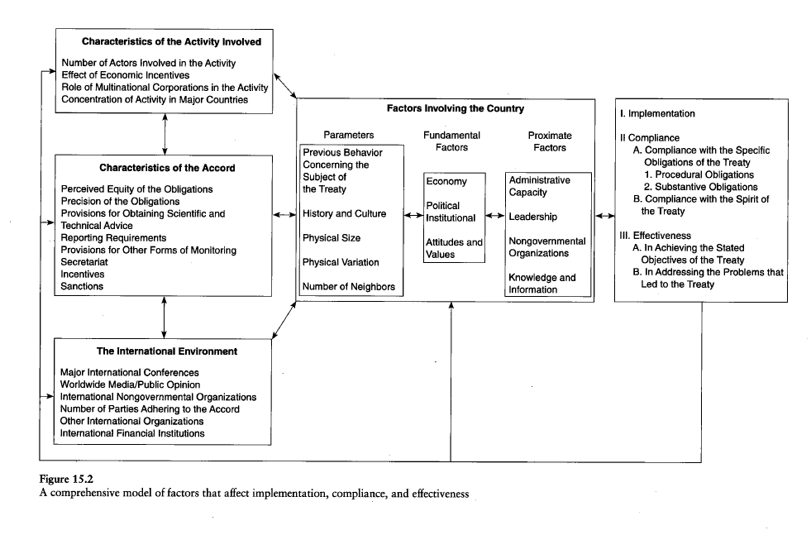
Potential Independent variables

Slide 4
Structure
Intro
Definitions/background
Theory section
Case selection
Analysis
Generalizations
Conclusion

Slide 5
Questions
Data problems – short time periods
Big data gaps – countries / years
Number of DVs? Imports/exports/generation
How to assess an argument’s quality?
Comparative data from another treaty?
Inaccuracies, caveats, holes in data, flaws in argument?
Adjudicating between multiple Ivs
Outliers

Slide 6
More questions
Other data?
Alternative explanations/rival hypotheses?

Slide 7
Free Trade and the Environment

Slide 8
Overview
Lessons about free trade and the environment
Effects of free trade depend
  Consider all, not just selected, consequences of free trade
  Have MANY theories of how free trade harms or helps environment. Net effect matters. And evidence matters.
“Not This NAFTA”: Free trade will happen but need not be completely free

Slide 9
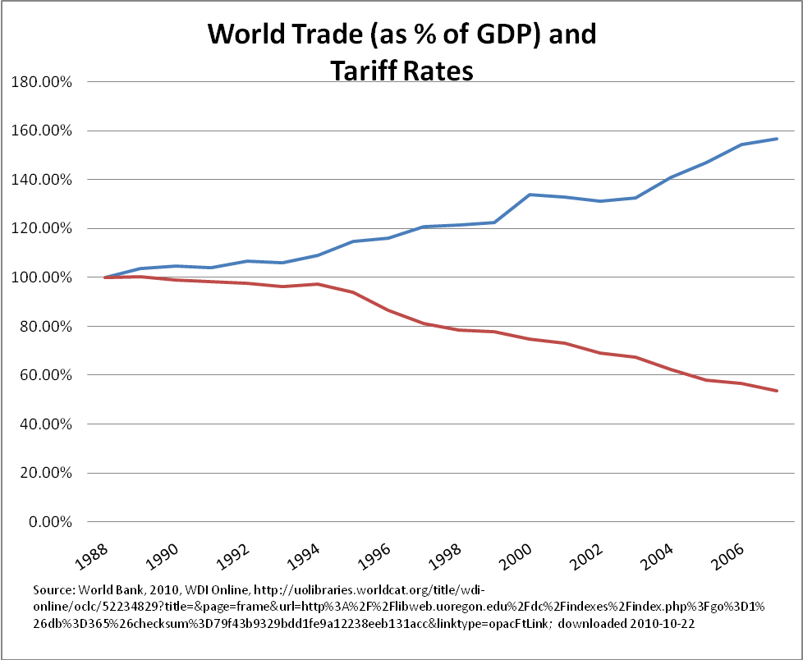
Free Trade is Happening
How do we make it less environmentally harmful?

Slide 10
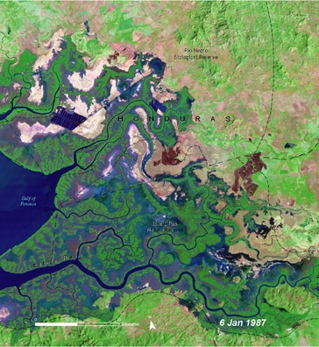
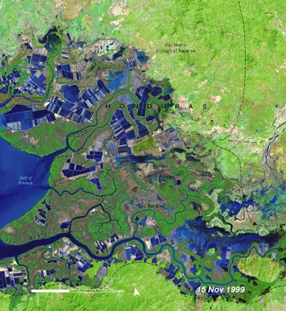
Trade may be the cause of environmental harm
From 1987 to 1999, shrimp farms expanded to cover Honduras shoreline
Honduras is second largest exporter of shrimp from Latin America
Damage would be less if no int’l trade in shrimp
BUT effects of trade on environment are particularly complex

Slide 11
Free Trade and the Environment
What is the relationship between these?
Frequent argument: free trade harms the environment
  "Since trade pollutes the earth, it is essential that it be kept to the minimum" (Batra in Esty, 1994, 62).
  Research question: how could we check this out?
  What cases might we use?
Discussion

Slide 12
Free trade: computers and your morning coffee
 | United States (cheap computers & milk) | Brazil (cheap coffee & sugar)
Consumers | different stuff (coffee) prices (coffee & sugar) | different stuff (computers) prices (computers)
Competitive sector | Computer jobs Computer wages Milk jobs unaffected | Coffee / sugar jobs Coffee / sugar wages Milk jobs unaffected
Non-competitive sector | Sugar jobs & wages O | Computer jobs & wages O
Mono-cropping | Reduced in sugar | Increased in coffee & sugar
Resource use | Computers: less per unit; more total units | Sugar/coffee: less per unit; more total units
Environmental policies | Driven by domestic politics in North | Influenced by economic factors in South

Slide 13
Free Trade and the Environment
Discussion of different causal pathways by which trade influences environmental quality
Some are positive, some are negative
We can only determine the size of each effect empirically, not theoretically.
So, whether NET effect of free trade on the environment is positive or negatives depends on the size and sum of each

Slide 14
Free Trade and the Environment
Technique effects: competition ➔ more efficient resource use
Scale effects: lower costs ➔ more resource use
Income effects: more wealth ➔ demand cleaner envt
Composition effects: change in preferences
Increased taxes
Externalities uncorrected
Environmental standards up/down/both
Growth generally

Slide 15
Discussion of US imposing tariffs on Solar Panels
On prices of solar panels in the US
On number of people who install solar panels on their houses in the US
On jobs in solar panel manufacturing in the US // in China
On jobs in solar panel installation on homes in the US
Other impacts
What do we EXPECT? Need to do this first, based on theory!!
To understand impacts, we need to know when they were imposed
  2012: International Trade Commission (ITC) tariff on Chinese solar cells
  2015: ITC tariff on solar cells imported from Taiwan
  2018: 30% and declining 5% per year, ending after 4 years

Slide 16
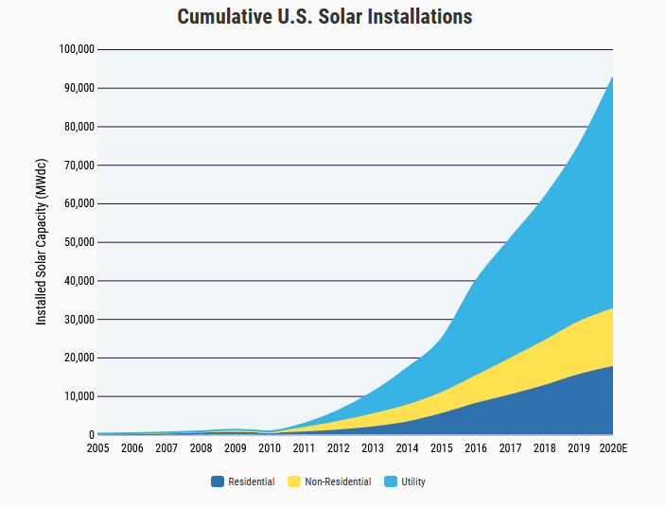
Solar Data
  “In 2017 and 2018, solar employment declined by some 18,000 jobs.”

Slide 17
What conditions might we impose on Free Trade?
Countries involved must have internalized environmental costs and thereby priced resources correctly, otherwise, externalities are exacerbated
Sustainable scale of resource use – NOT all economic growth is good

Slide 18
Free Trade and Environment
Lessons about free trade and the environment
Effects of free trade depend
  Consider all, not just selected, effects of free trade
  Have MANY theories of how free trade harms or helps environment. Net effect matters. And evidence matters.
"Not This NAFTA“: Free trade will happen but need not be completely free

