Slide 1
Writing an ANALYTIC paper

Slide 2
Basics
Key: Start with a good hypothesis or research question, from the literature
What I mean by Hypothesis (taken from an article or three):
  Treaties with X cause bigger behavior changes than treaties (without X or with Y)
What is your DV?
  Conceptual variable?
  Proxy for this conceptual variable?
What are alleged IVs?
  Non-treaty variables?
  Treaty variables?
    General – membership, area regulated, species
    Features – sanctions, monitoring, financing
Differences across member countries?
What’s the causal STORY of HOW treaty influenced behavior?

Slide 3
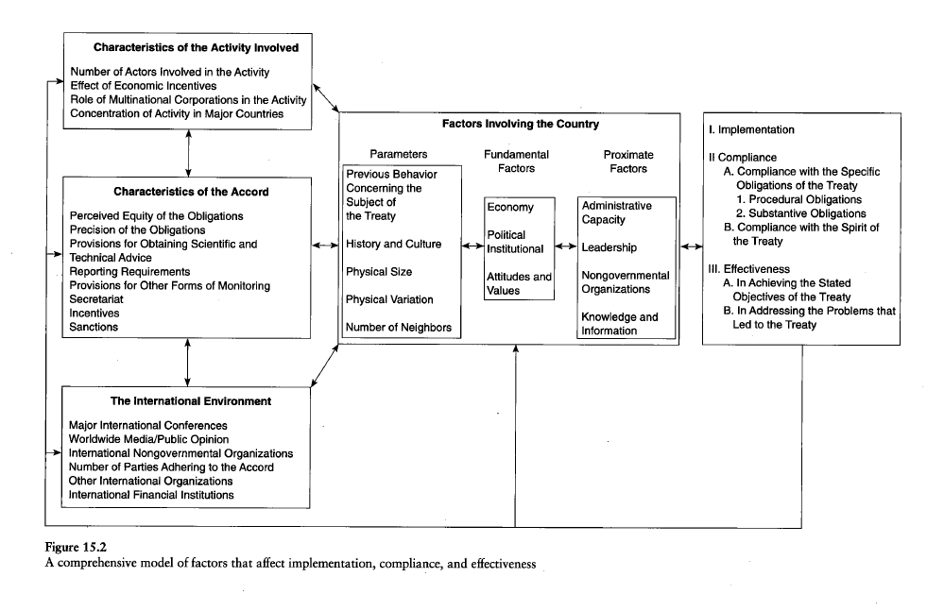
Potential Independent variables

Slide 4
Structure
Intro
Definitions/background
Theory section
Case selection
Analysis
Generalizations
Conclusion

Slide 5
Questions
Data problems – short time periods
Big data gaps – countries / years
Number of DVs? Imports/exports/generation
How to assess an argument’s quality?
Comparative data from another treaty?
Inaccuracies, caveats, holes in data, flaws in argument?
Adjudicating between multiple Ivs
Outliers

Slide 6
More questions
Other data?
Alternative explanations/rival hypotheses?

