Slide 1
Effectiveness of
International Institutions:
What IS it?
How do we EVALUATE it?
What EXPLAINS it?

Slide 2
Terminology
Implementation - passing domestic legislation for legal conformity with rules
Compliance - behavior on the ground that conforms to rules
Monitoring, verification, & transparency - determining whether actors are complying. Information from whom? Information about what? Different uses of info: Check compliance, environmental status, treaty feedback
Enforcement - process by which those with incentives to not comply are nonetheless induced to do so.
Effectiveness - two major ways to think about it

Slide 3
Institutional Influence
Realist view: no influence of institutions
Behavior and Outcomes
Power and Interests
International Institutions

Slide 4
Institutional Influence
Realist view: no influence of institutions
Institutionalist view: institutions may influence
Behavior and Outcomes
Power and Interests
International Institutions
Behavior and Outcomes
Power and Interests
International Institutions

Slide 5
Enforcement
Logic of consequences – central
Expects: High Compliance/Low Effectiveness
Why states comply?
  Institutions in SHORT term / INDEPENDENT interest
  Shallow cooperation
  Members differ from nonmembers by being willing
When do states violate?
  When in short-term interests
  Neither rules nor norms have influence
  Violations primarily due to intention

Slide 6
Management
Logic of consequences AND appropriateness
Expects: Compliance may he hard to identify; High effectiveness, if properly designed institution
Why states comply?
  Institutions in LONG-term / INTERDEPENDENT interest
  Norms of rule-abiding behavior and social pressures
  What’s proper role? Habits?
When do states violate?
  Not often // Rule ambiguity
  Incapacity
  Inadvertence

Slide 7
Evaluating Institutional Effects
Institutions can always be evaluated against TWO definitions of success
  Goal achievement: Compare actual behavior (or outcomes) to
  STATED GOAL
  Counterfactual: Compare actual behavior (or outcomes) to
  WHAT WOULD HAVE OCCURRED OTHERWISE

Slide 8
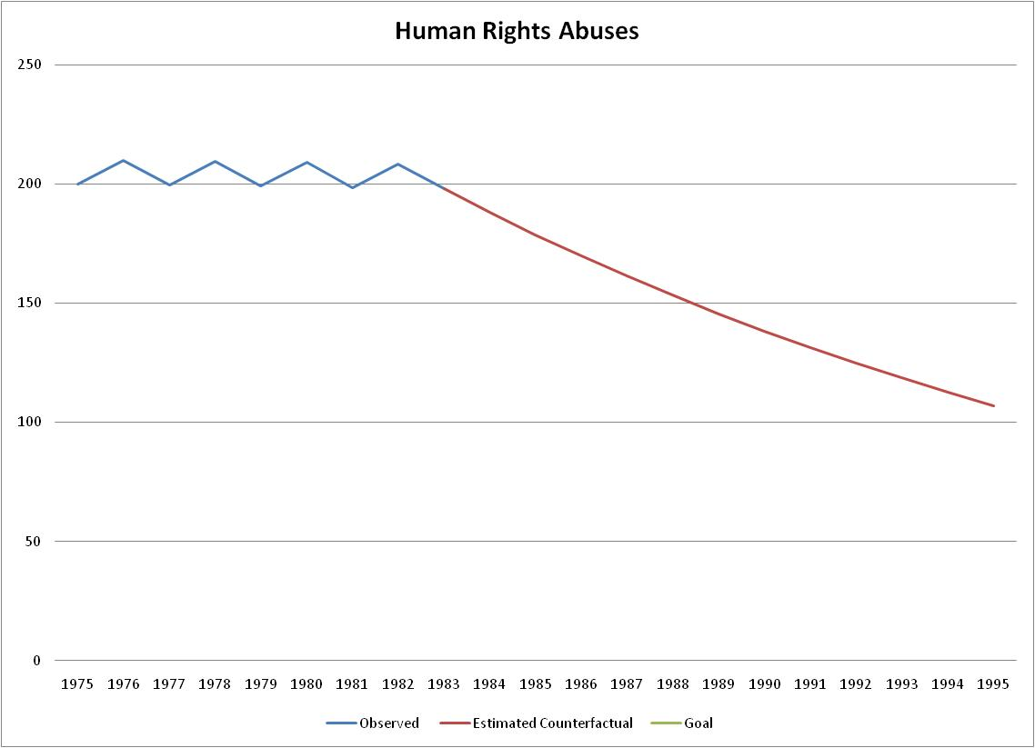
Observed behavior

Slide 9
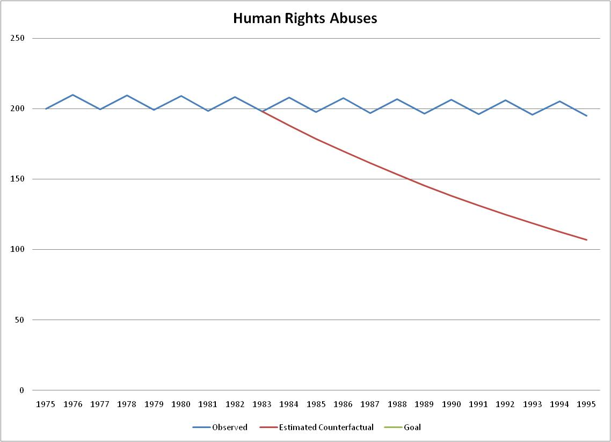
ESTIMATE of
Counterfactual
Observed behavior

Slide 10
ESTIMATE of
Counterfactual
Observed behavior
Success relative to counterfactual

Slide 11
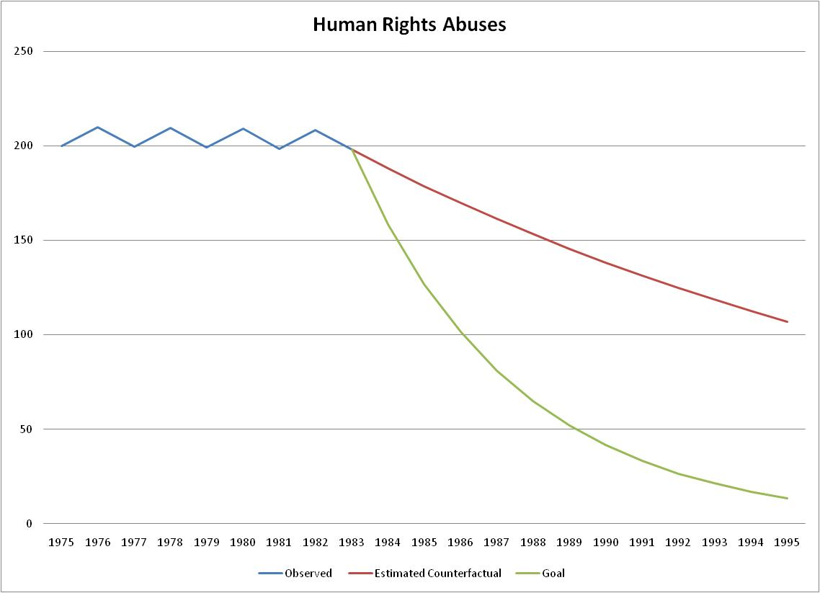
Observed behavior
Goal

Slide 12
Observed behavior
Failure relative to goal
Goal

Slide 13
Evaluating Institutional Effects
Institutions can always be evaluated against TWO definitions of success
  Goal achievement: Compare actual behavior (or outcomes) to
  STATED GOAL
  Counterfactual: Compare actual behavior (or outcomes) to
  WHAT WOULD HAVE OCCURRED OTHERWISE

Slide 14
Effectiveness of institutions
Where should we look? Identify indicators
How should we look? Identify counterfactual (before/after; member/nonmember; regulated/nonregulated)
Is there a difference? Compare actual to counterfactual
Is difference due to treaty? Consider alternative explanations
Is difference impressive? Consider difficulty of problem

Slide 15
Education of Women:
Effects of CEDAW
Signed 1979
Took effect after 20 ratifications in 1981
Currently, 187 countries are members
One clause: “States Parties shall take all appropriate measures to eliminate discrimination against women in order to ensure to them equal rights with men in the field of education”

Slide 16
Effectiveness of institutions
Where should we look? % of women educated
How should we look? Graph before/after; member/nonmember; more/less challenging
Is there a difference? Graph counterfactuals
Is difference due to treaty? Economic growth, non-treaty norm
Is difference impressive? WAS this a hard problem? Are other factors fostering or inhibiting progress?

Slide 17
Members appear to have changed behavior:
Before/After Comparison

Slide 18
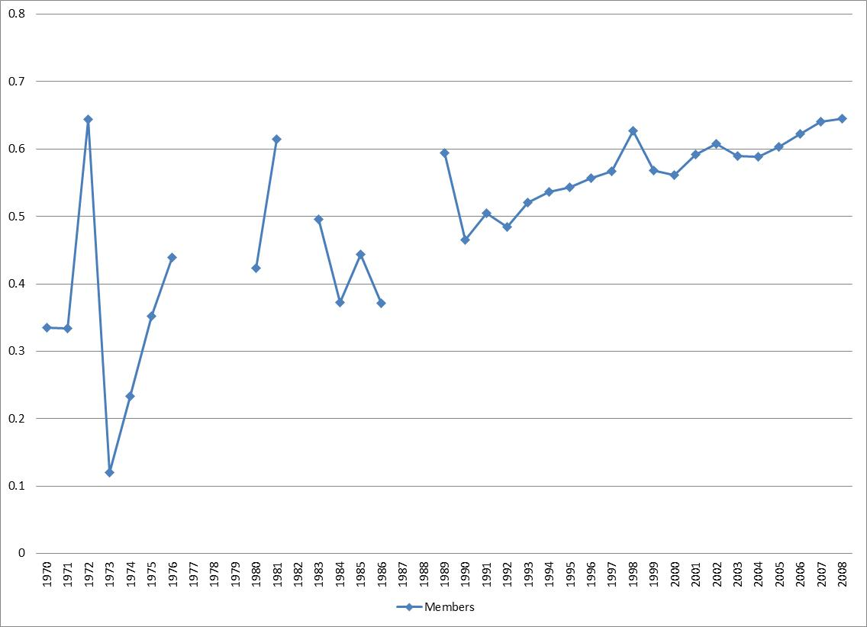
Members appear to have changed behavior:
Before/After Comparison

Slide 19
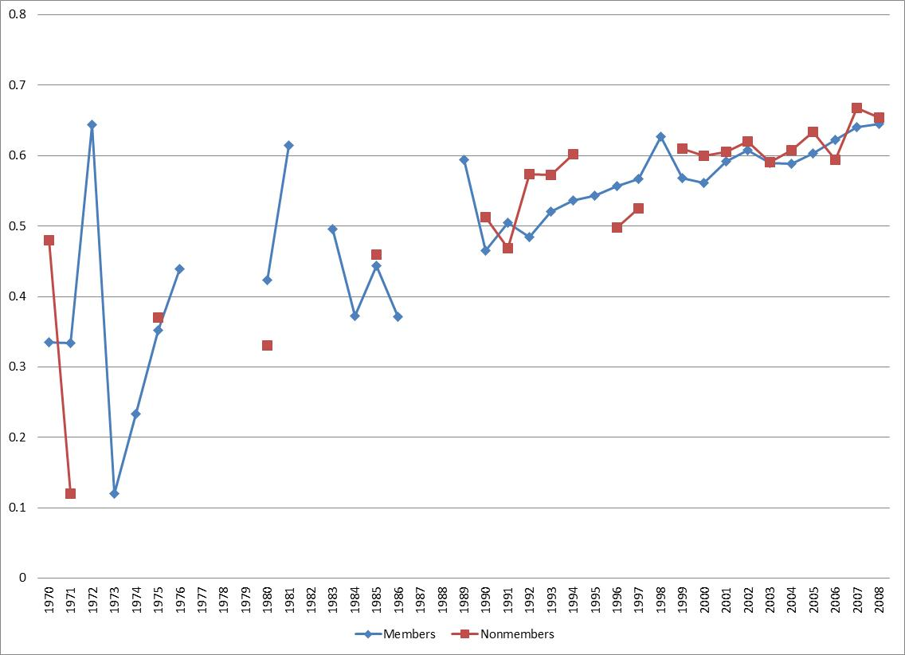
But Members/Nonmembers taken together:
Not Much Difference

Slide 20
But Hypothesis that 2 types of Members:
Islamic / Non-Islamic

Slide 21
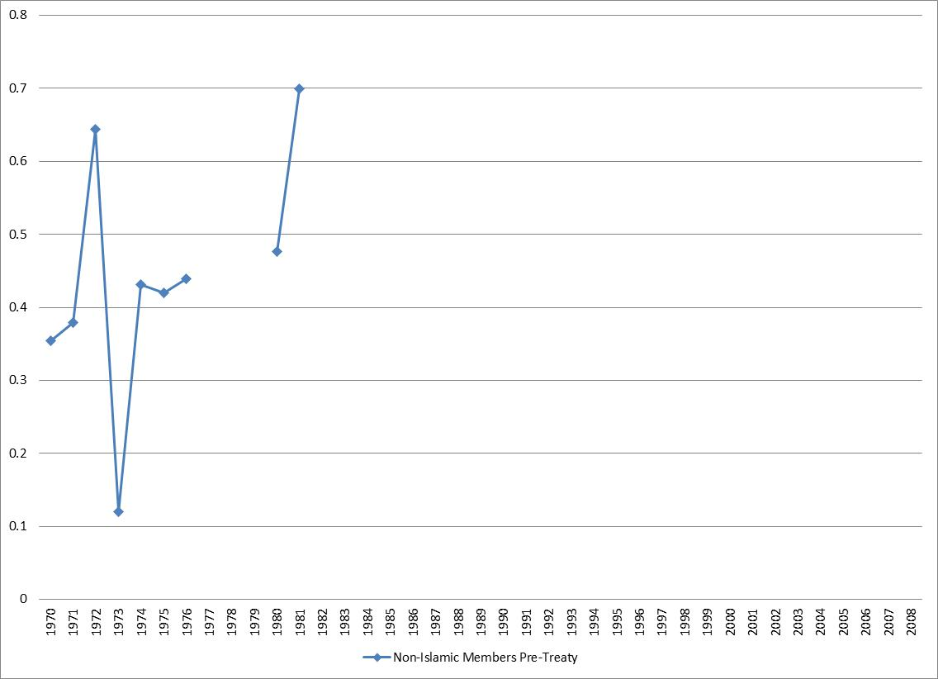
Institutional Effect on Non-Islamic States?
Before/After Comparison

Slide 22
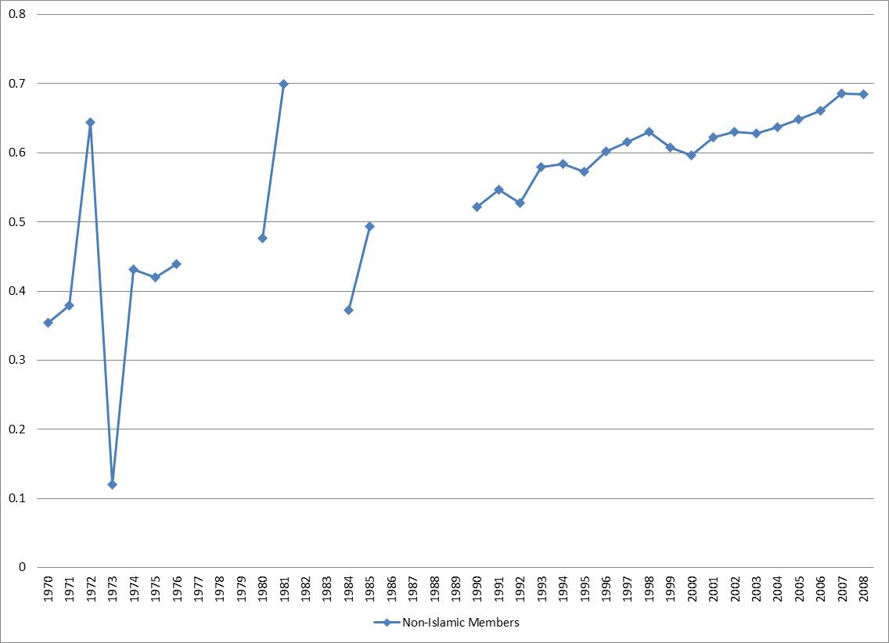
Institutional Effect on Non-Islamic States?
Before/After Comparison

Slide 23
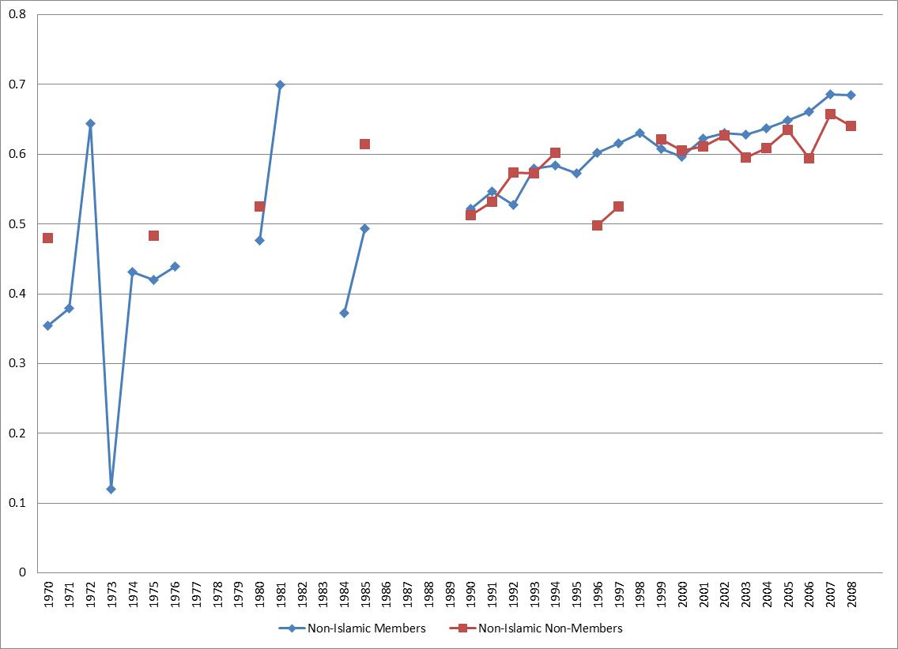
Institutional Effect on Non-Islamic States?
Member/Non-member Comparison

Slide 24
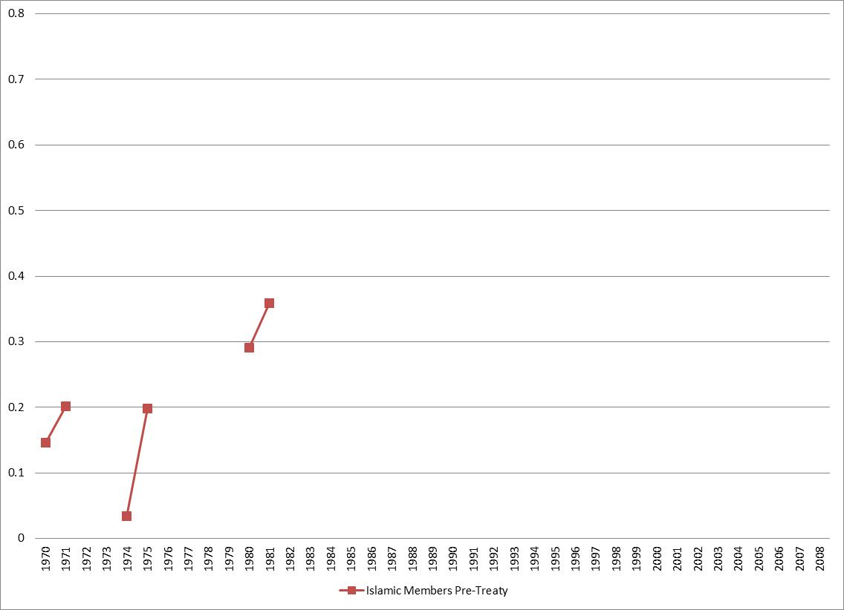
Institutional Effect on Islamic States?
Before/After Comparison

Slide 25
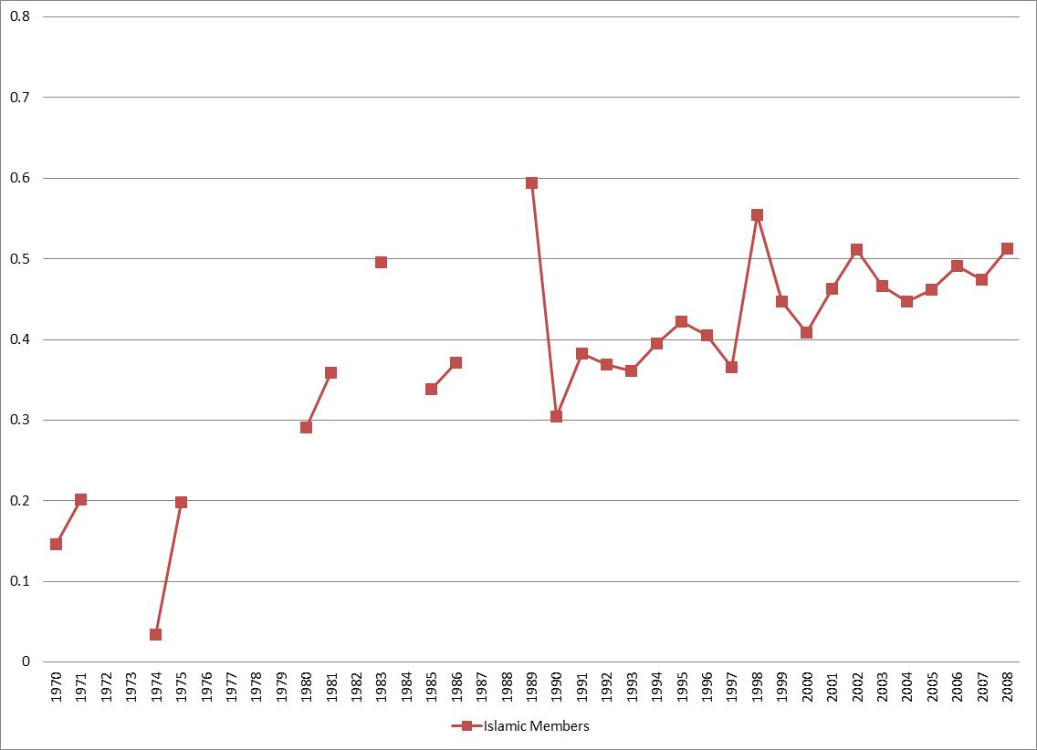
Institutional Effect on Islamic States?
Before/After Comparison

Slide 26
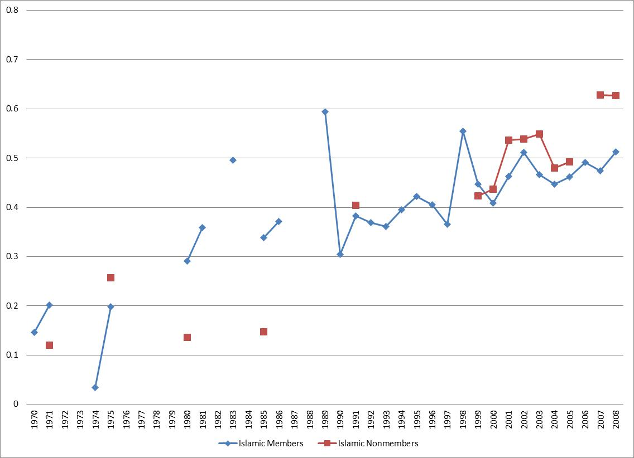
Institutional Effect on Islamic States?
Member/Nonmember Comparison

Slide 27
Effectiveness of institutions
REVIEW
Where should we look? % of women educated
How should we look? Graph before/after; member/nonmember; more/less challenging
Is there a difference? Graph counterfactuals
Is difference due to treaty? Economic growth, non-treaty norm
Is difference impressive? WAS this a hard problem? Are other factors fostering or inhibiting progress?

Slide 28
Brown Weiss and Jacobson
Influences on treaty effectiveness
Overall model linking 4 sets of factors
Characteristics of activity
  Same as my “Problem structure”
Characteristics of institution
  Same as my “Institutional design”
Characteristics of international context
Characteristics of the country
  Country variables

Slide 29
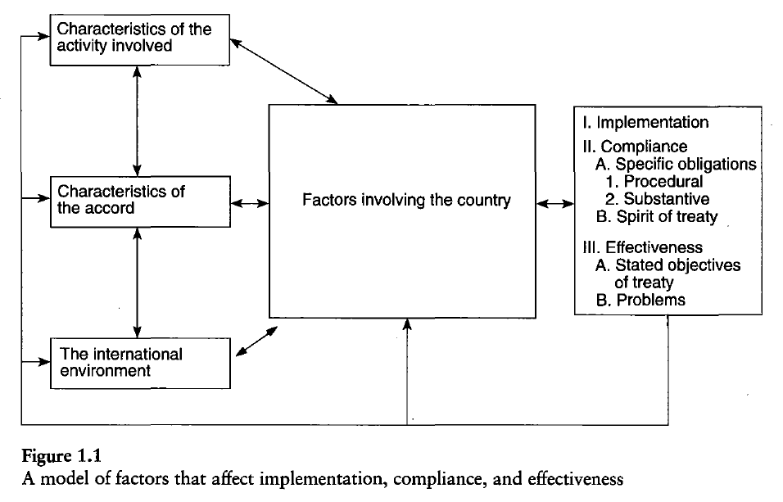
Brown Weiss and Jacobson
Influences on treaty effectiveness

Slide 30
Brown Weiss / Jacobson
Characteristics of Activity
Number of actors involved in activity
Effect of economic incentives
Role of multinational corporations in activity
Concentration of activity in major countries

Slide 31
Problem Structure and
Institutional Effectiveness
HARDER problems = institution less likely to be effective
Easy:
  COORDINATION: Big effect on shallow problems
  EPISTEMIC: pooling informational resources that are cheap AND states have interests in pooling
Medium:
  UPSTREAM/DOWNSTREAM: hard to resolve but structure generates careful rules that make likely to succeed
  PEPI: structure leads to careful rules that tend to be “incentive-compatible”
Hard group:
  COLLABORATION: all have incentives to contribute AND cheat
  NORMATIVE problem: changing norms is very hard

Slide 32
Problem Structure and
Institutional Effectiveness
Inherent transparency
  LESS inherent transparency, more likely institution will NOT be effective
Response incentives
  LESS violation tolerance, more likely institution WILL be effective
  STRONGER response incentives, more likely institution WILL be effective

Slide 33
Problem Structure and
Institutional Effectiveness
More/Fast Effective Less/Slow Effective
Type
Epistemic & Coordination
Up/Down & Positive Externalities
Collaboration Normative
Inherent Transparency
High Transparency Low Transparency
Violation Tolerance
Low Violation Tolerance High Violation Tolerance
Response Incentives
Strong Response Incentives Weak Response Incentives

Slide 34
Brown Weiss / Jacobson
Characteristics of Institution
Perceived equity of obligations
Precision of obligations
Provisions for obtaining scientific advice
Reporting requirements
Provisions for other forms of monitoring
Secretariat
Incentives
Sanctions

Slide 35
Institutional Design and
Institutional Effectiveness
Institutional type from most/fast to least/slow effective
  Procedural/programmatic – regulatory – generative
Membership: more states, LESS effective
Primary rule system
  MORE specific, MORE effective
  Common MORE effective than Differentiated (??)
Information system: clearer, MORE effective
Response systems:
  Facilitative, MORE effective than
  Clear/specific MORE effective

Slide 36
Institutional Design and
Institutional Effectiveness
More/Fast Effective Less/Slow Effective
Type
Procedural & Programmatic Regulatory Generative
# of States
Few Many
Specific Vague
Primary Rules
Primary Rules
Common ??? Differentiated
Inspections
Clear / Demanding Vague / General
Response
Rewards/Capacity-Enhancing Sanctions

Slide 37
Brown Weiss / Jacobson
Characteristics of International Context
Major international conferences
Worldwide media/public opinion
International NGOs
Number of parties as members
Other international organizations
International financial institutions

Slide 38
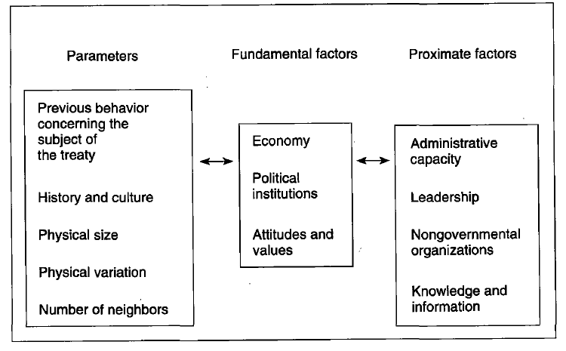
Brown Weiss / Jacobson
Characteristics of the Country

