Slide 1
Final Paper Guidance

Slide 2
Basic structure
Introduction –
  “Why do countries take the positions they do in international climate negotiations?”
Theory review: GENERAL idea – yours should be more detailed
  DV (What needs to be explained): negotiating positions
  IVs (many): organize what scholars have said about why states take positions they do by VARIABLE, not author!
Dependent variable: Positions of countries I will study
  Provide a table of positions and summarize them
Independent variables: go through IVs and see if they explain what you see
Conclusion

Slide 3
Other Important things
Clear Dependent and Independent Variables
  One Dependent Variable
  3 to 4 Independent Variables (more than 1, less than 6)
  IVs come from articles
Number of countries
  Start with 7 to 10 so you can make sure you get 3 to 6 good ones to compare
  Easiest option: compare some with really strong INDCs and some with weak INDCs
Good Use of Theory Throughout Entire Paper
  Read several articles and take notes by article
  Then reorganize ideas from articles DV, then IV1, then IV2, then IV3

Slide 4
Finally……
Be Professional
  Use headings and subheadings that make sense
  Format Appropriately
  Write so theory, analysis, methods, come through clearly
  Cite Sources Not Hyperlinks
Visit office hours or Email
  Use office hours to discuss research question or paper
  Email GEs or Ron questions if can’t make office hours

Slide 5
International Climate Negotiations

Slide 6
Thinking Theoretically about Climate Change Negotiations
What are the characteristics of the problem?
Type & strength of actor motivations to address it?
Negotiation Theory overview
Type of agreement
Terms of agreement
Three elements of Regulatory System

Slide 7
Type & strength of actor motivations to address it?
Unilateral interest-based
Interdependent interest-based
Normative-based
BATNA (Best Alternative to a Negotiated Agreement)

Slide 8
Where National Negotiating
Positions Come From
 |  | Ecological Vulnerability (benefits of action)
 |  | Low | High
Abatement Costs (costs of action) | Low | Bystanders | Pushers
 | High | Draggers | Intermediates

Slide 9
Where National Negotiating
Positions Come From
 |  | Ecological Vulnerability (benefits of action)
 |  | Low | High
Abatement Costs (costs of action) | Low | Bystanders | Pushers AOSIS, EU
 | High | Draggers OPEC, US | Intermediates

Slide 10
Negotiation Theory Overview
ZOPA (Zone Of Possible Agreement)
Finding the existing ZOPA
  Interests as exogenously “given”
  Can’t do more than countries involved want to do
Creating a new ZOPA
  Interests as endogenously created
  Leadership
  Argument and persuasion
Bringing external pressure to bear
  Engaging NGO community
  Creating deadlines and expectations
Ensuring agreement but also follow through

Slide 11
Type of Agreement
Type of obligations
  Top-down (imposed commitments)
  Bottom up (voluntary commitments)
Level of ambition/stringency
Breadth of membership: Universal or Climate club
Legal status: Binding or non-binding

Slide 12
Terms of agreement
Substantive topic areas
  Mitigation
  Adaptation
  Loss and Damage

Slide 13
Three elements of
Regulatory System
Primary rule system
  Mitigation Obligations
  Financial Mechanisms
Information system
Response system

Slide 14
Lead-in to the Paris Climate Negotiations
International Climate Governance

Slide 15
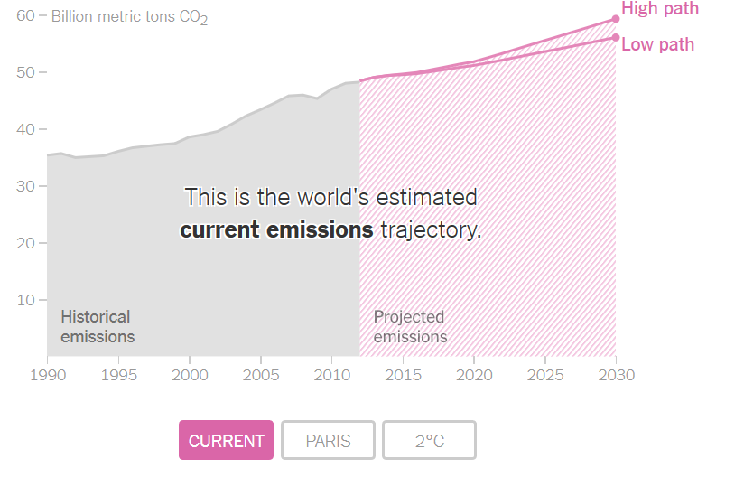
Paris Agreement, Where we are, and Where we need to be

Slide 16
How Paris was negotiated:
Background mattered
“By the opening of the Paris conference, 186 governments had declared national plans covering 94 percent of global emissions (UNFCCC 2015b). These policy pledges laid an important foundation for a global UN agreement” (Dimitrov, 2016).
2014 US/China agreement on climate emission reductions

Slide 17
How Paris was negotiated:
Process mattered
“Social learning” from previous experience (failures and successes)
French leadership of negotiations and use of various tactics to foster agreement
Framing issues in certain ways

Slide 18
How Paris was negotiated:
Secrecy and few actors
All states present at Paris but Paris Agreement reflects “heavy use of secrecy. … [Key issues] were resolved in Paris in secret meetings among a few countries. … The value of secrecy was in reducing the number of actors” (Dimitrov, 2016).

Slide 19
How Paris was negotiated:
Paper over differences
“‘Developed country Parties shall provide financial resources to assist developing countries” while “other Parties are encouraged’ to provide such support voluntarily (Art. 9). … After entry into force, Parties shall set a new collective financial goal ‘from a floor of USD 100 billion per year’ (para. 54)” (Dimitrov, 2016).

Slide 20
Legal Status:
Why Paris is NON-binding
“If we insist on legally binding, the deal will not be global because we will lose the US” (top EU official). In the end, it was the US that weakened mitigation commitments for developed countries in the new agreement. Literally in the last minutes before the final session that adopted the agreement on December 12, the US demanded a single word change: Developed countries “should” rather than “shall” undertake economy-wide quantified emission reductions” (Dimitrov, 2016).

Slide 21
Level of ambition/stringency:
Why Paris has weak goals
Goal: Most states wanted 1.5°C goal: “It was politically inexpedient to oppose publicly 1.5°C. Hence, industrialized countries engaged in a political exercise of linguistic gymnastics: how to craft ‘creative language’ that mentions 1.5 °C without making it the official operational goal” (Dimitrov, 2016).
Commitments: “The weaknesses of the agreement and a lack of political commitment may undermine its environmental effectiveness The aggregate effect of current national pledges is expected to be a global mean temperature rise of 3.7–4.8 degrees this century (UNFCCC 2015b, 8)” (Dimitrov, 2016).

Slide 22
Monitoring and Compliance:
Why Paris has weak follow through
Global “stocktake” every five years
“Compliance mechanisms are weak, with a ‘facilitative’ committee whose work is ‘non-adversarial and non-punitive’ (Art. 15)” (Dimitrov, 2016).

Slide 23
Loss and Damage:
Why Paris is not fair
… “important to many countries who hold the North historically responsible for negative climate impacts. Island states wanted an institutional process to address permanent loss and irreversible damage. All developed countries closed ranks, strongly united against provisions that could lead to liability and compensation, and blocked the creation of institutional arrangements. In closed consultations, rich countries carefully strategized to formulate text that gives nominal recognition to the issue, while precluding legal obligations” (Dimitrov, 2016).

Slide 24
Ratification and Implementation
Ratification process explained
  Executives sign agreement
  Then Legislatures ratify them
  All memberships are voluntary
Implementation matters too
  What happens if states don’t meet their commitments?

Slide 25
But is it meaningless?
It may have some instrumental influence
AND
The power of norms may matter

