Slide 1
Treaty Assign 2
Important points for all
Read the literature –make stronger argument by building on others! I.e., regular research paper style
Show WHY you drew counterfactuals as you did
  If no-treaty counterfactual differs from actual, you think treaty worked
  Ex: “When compared to the counterfactual, both Greenland and Canada would have killed more polar bears overall had there not been a treaty.” This works only if you have shown why you drew counterfactual as you did.
If declines occur before treaty, did treaty cause it? Did declines cause treaty to be signed or vice versa? Were some countries leaders with different counterfactual than laggards? Did treaty effect countries differently?
Understand mechanisms of treaty
Use answers and feedback from earlier assignments/discussion papers
Talk to reference librarians (or see me) if need help

Slide 2
Sustainable Development

Slide 3
Start Lecture Recording
Start Lecture Recording

Slide 4
The State of Development
(as presented by an expert)
Hans Rosling talk

Slide 5
Word clouds in breakout groups
Groups 1 and 2: Development – write down 20 words that come up when you think about “human development” – improving the human condition
Groups 3 and 4: Sustainable – write down 20 words that come up when you think about sustainability – improving the environmental condition

Slide 6
What is human development?
What does human development “look like” to you?
What does a “better” life look like to you?
What do you think a “better” life looks like to others on the planet?
Are your better life and their better life compatible or competitive? If competitive, what % of your income will you sacrifice to make it happen?

Slide 7
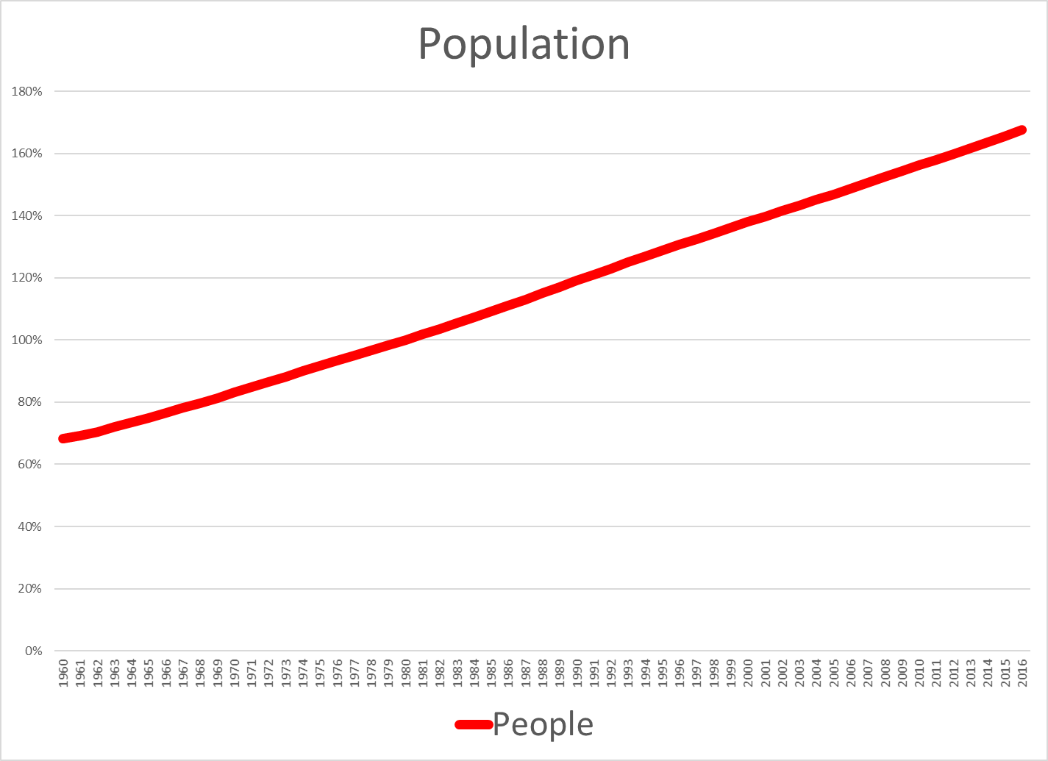

Slide 8
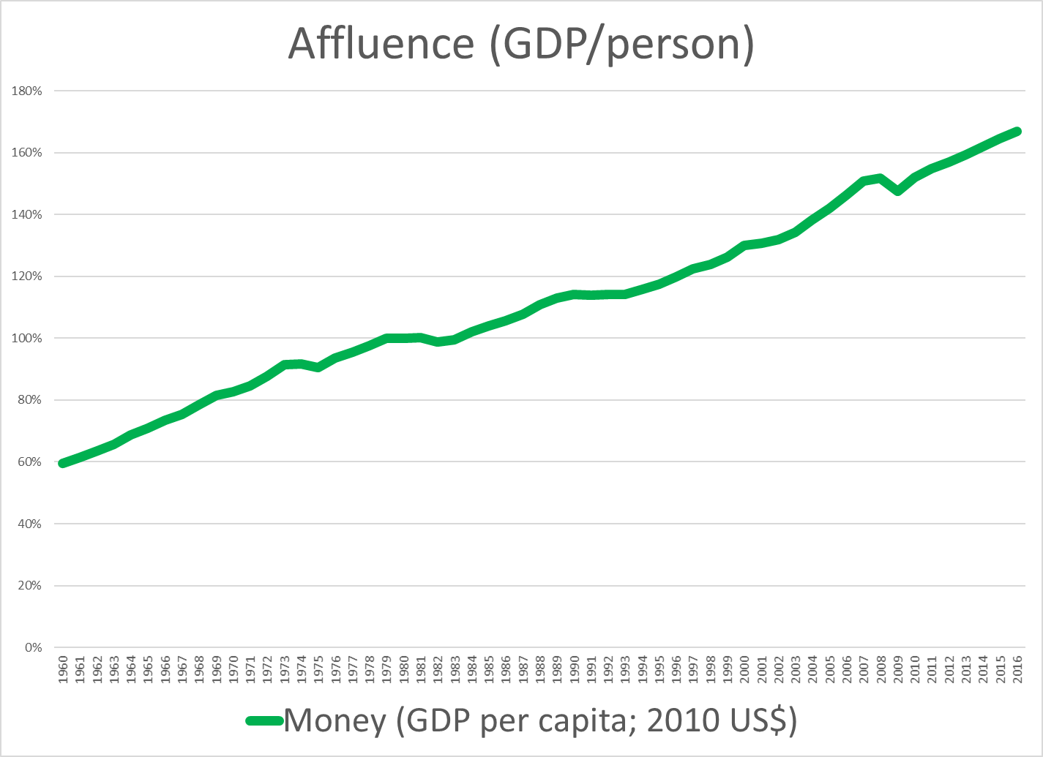

Slide 9
What is environmental sustainability?
What does a world that is sustainable look like?
What “limits” are their on resource use?
  Non-renewable resources
  Renewable resources
How do we distinguish “different” from “lesser”? Who’s the judge?

Slide 10
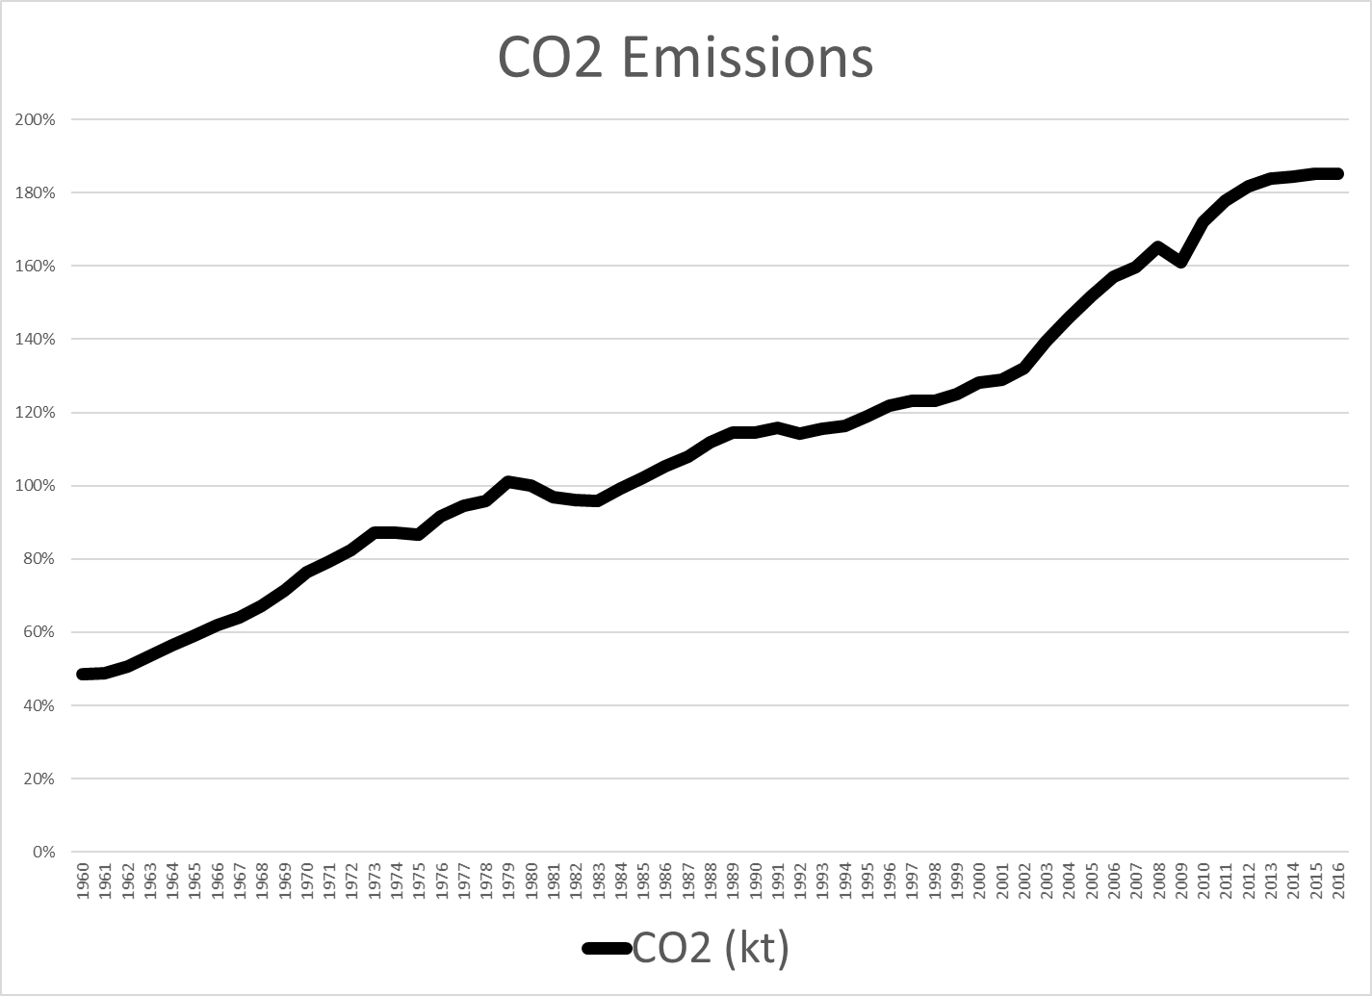

Slide 11
Socio-economic causes of environmental damage
IPAT Identity
Environmental Impact = Population * Affluence * Technology
Impact: environmental harm
Population: # of people
Affluence: $ per person (income)
Technology: impact per $ (carbon intensity)

Slide 12
Sustainable development:
Synergies? Conflicts?
Synergies?
  Are compatibilities natural or do they have to be manufactured?
Conflicts?
  Are these practical conflicts that can be overcome?
  Or are they inherent incompatibilities?
  Are their problems in believing they are compatible if they aren’t?

Slide 13
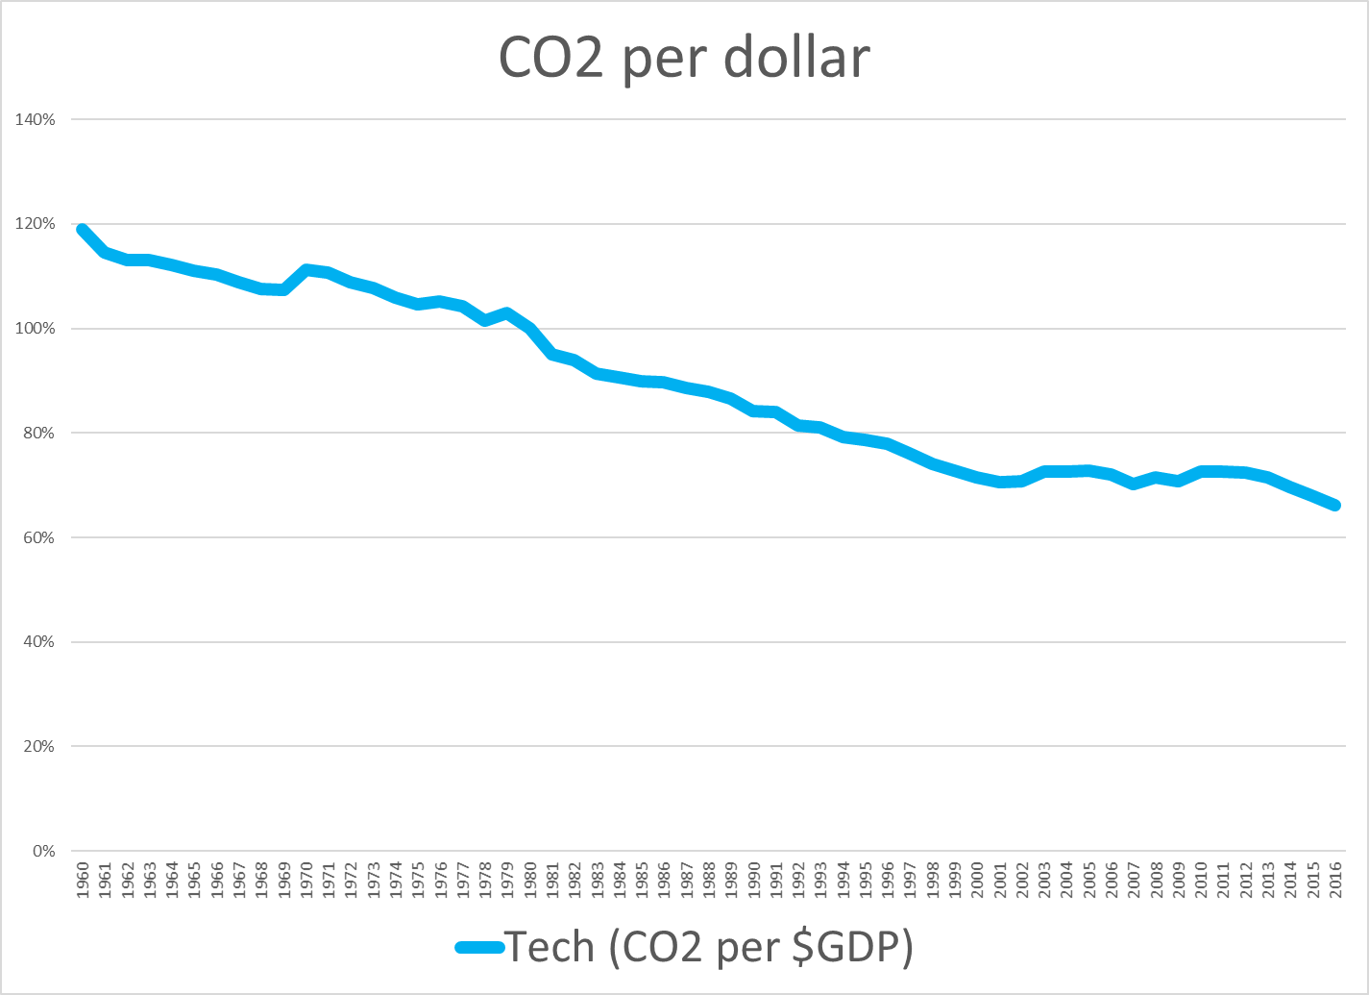

Slide 14
Problems with the concept of Sustainable development
Scientific perspective – technophilic optimism
Averts attention from deeper changes needed
Theoretically compatible but hard to achieve in practice
Assumes some push toward inter- and intra- generational equity? Where will this push come from?
Is development without growth possible? What would it look like?

