Slide 1
Basics
Write a paper
Make it look like you were paying attention
Turn it in on time
Get citations other than those I provide
SERIOUSLY => Don’t plagiarize
  Exact words: Quote and Citation
  Paraphrase: Citation4

Slide 2
A word on citations
“Quoted phrase” (Lastname Year, page #).
Basic concept from an article (Lastname Year).

Slide 3
Was the Kyoto Protocol Effective?

Slide 4
Iclicker
Did states mostly comply with Kyoto?
Yes
No

Slide 5
Iclicker
Did states reduce because of Kyoto?
Yes
No

Slide 6
Iclicker
Did Kyoto achieve its goals?
Yes
No

Slide 7
How should we assess Paris?
Use Kyoto for practice
What are goals? How are goals in tension with each other?
  Are these realistic?
  Are they sufficiently ambitious
What are metrics of effectiveness? Compliance, Counterfactals, or Goal Achievement
What evidence of influence should we collect? How should we analyze it?
  Correlational evidence
  Process tracing evidence

Slide 8
Climate Change Treaties and Protocols and Amendments
1992 UN Framework Convention on Climate Change (no targets)
1997 Kyoto Protocol (agreed-upon targets from 1990
for developed countries for 2008 to 2012)
2012 Doha Amendment (agreed-upon targets from 1990 for developed countries for 2013 to 2020)
2015 Paris Agreement (voluntary targets for 165 countries for 2030 but different base years)

Slide 9
Was it effective? And why?
DID work, evidence:
Why DID it work?
  Design
  Problem structure
  Contextual change
Did NOT work, evidence:
Why didn’t work?
  Design
  Problem structure
  Contextual change

Slide 10
Using Kyoto as a model:
Can we evaluate success in terms of Compliance?

Slide 11
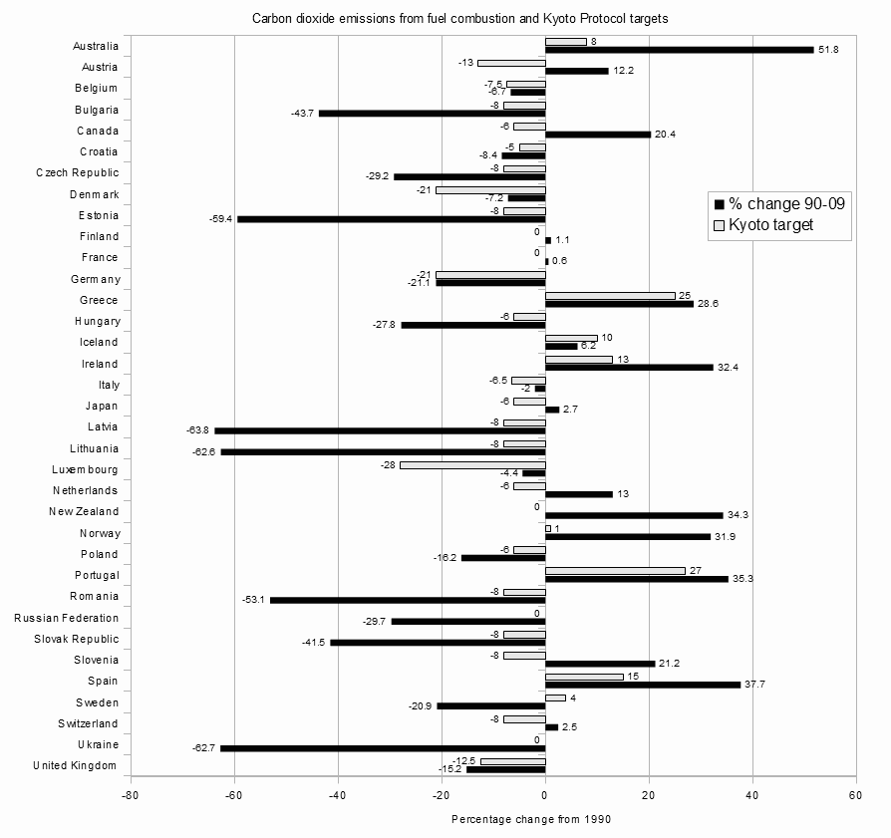
Kyoto Success and Failure
BADLY presented!
https://upload.wikimedia.org/wikipedia/commons/4/4b/Kyoto_Parties_with_first_period_%282008-2012%29_greenhouse_gas_emissions_limitations_targets_and_the_percentage_change_in_their_carbon_dioxide_emissions_from_fuel_combustion_between_1990_and_2009.png

Slide 12
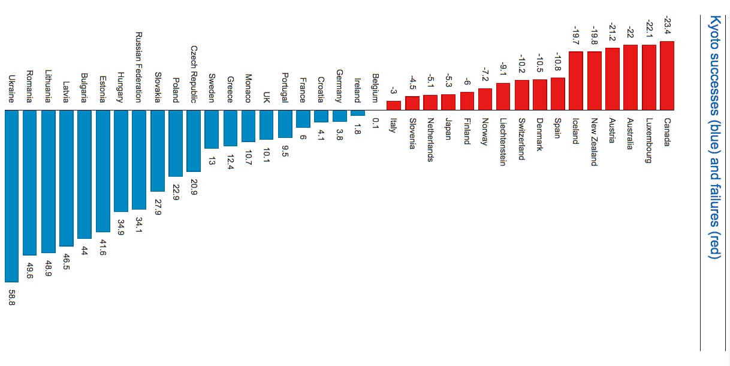
Kyoto Success and Failure
Put in ascending order of DV
Actual Reductions Above or Below Target
e.g., Blue 10% = 15% cut – 5% goal
https://www.theguardian.com/environment/blog/2012/nov/26/kyoto-protocol-carbon-emissions

Slide 13
Kyoto Success and Failure
Group by some IV to see “causes”
Eastern Europe
Western Europe
Non-Europe
Actual Reductions Above or Below Target
e.g., Blue 10% = 15% cut – 5% goal
https://www.theguardian.com/environment/blog/2012/nov/26/kyoto-protocol-carbon-emissions

Slide 14
Using Kyoto as a model:
Can we evaluate success in terms of Counterfactuals?

Slide 15
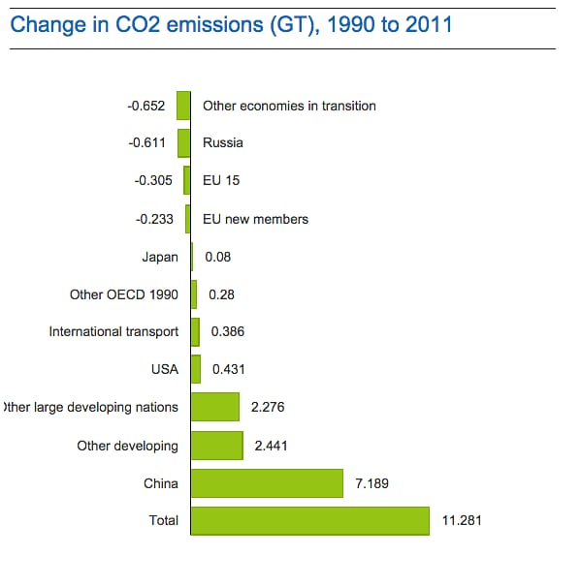
Step 1:
Note: China grew a lot due to production “on behalf of” other countries

Slide 16
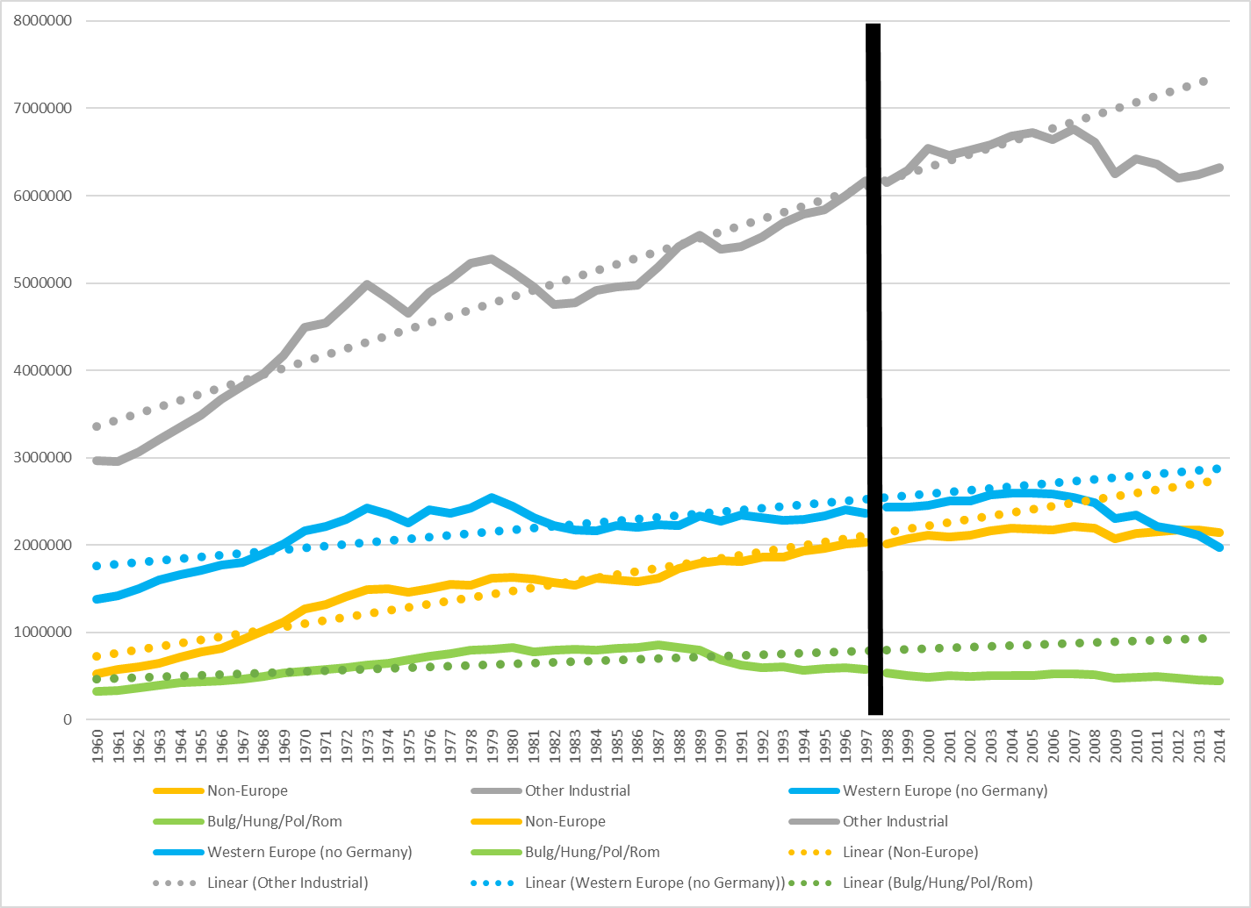
Step 2: Compare Before Trend to After

Slide 17
Step 2: Compare Members/Non-Members
Non-Members
US, Korea, Mexico
Members
Western Europe

Slide 18
Kumazawa and Callaghan
Statistical version of “eyeball test”
Environmental Kuznets Curve model
RQ: does relationship of income to emissions change dependent on Kyoto requirements
Finding: “industrialized countries … subject to emission reduction targets [under] Kyoto Protocol, have different patterns of carbon dioxide emissions from other countries that do not have any targets.”
“For Annex B countries, since the signing of the agreement, there were significant reductions in carbon dioxide emissions, a desirable outcome of the protocol. The reduction was larger for the second period when the protocol entered into force. However, non-Annex B countries did not experience any changes in emissions in both periods.”

Slide 19
Using Kyoto as a model:
Can we evaluate success in terms of Goal Achievement?

Slide 20
What goal should we use?
Political goal that states set for selves (4.7% decrease)
Political goal of what might have been possible (??)
Environmental goal of protecting the planet (drastic and rapid decrease)
  “There are presently no binding obligations for countries with 85 per cent of total emissions.” (Andresen, 2014) == about “Kyoto 2” but still true today

Slide 21
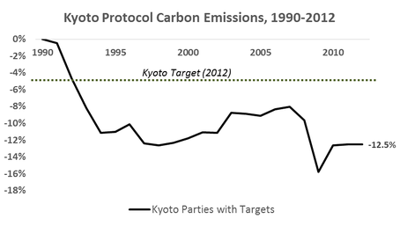
Headline
“The headline results tell us that between 1990 and 2012 the original Kyoto Protocol parties reduced their CO2 emissions by 12.5%, which is well beyond the 2012 target of 4.7%. The Kyoto Protocol was therefore a huge success. Well, at least that’s what the politicians will boldly tell us. But does digging deeper reveal the same story?”
http://www.circularecology.com/news/the-kyoto-protocol-climate-change-success-or-global-warming-failure

Slide 22
But question is not what HAPPENED but what CAUSED it to happen!
Switch question
  From: Was Kyoto the cause of the decrease?
  To: What were emission changes and what caused them?
When were changes?
How much were changes?

Slide 23
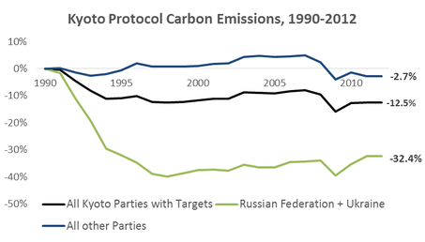
But question is not what HAPPENED but what CAUSED it!
Take out Russia/Ukraine change that was due to collapse of Soviet Union

Slide 24
Climate Change Talks:
Do Pledges matter?
Paris Climate Talks
Pledges and their Influence?

Slide 25
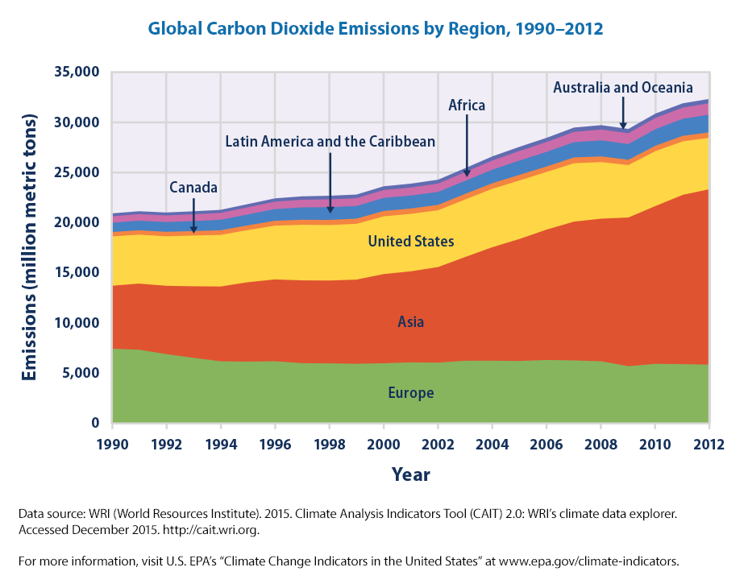
But Earth doesn’t care about Kyoto Parties, it cares about ALL countries

Slide 26
And what was the PROCESS of Kyoto influence

Slide 27
Process-tracing and looking for fingerprints
“Through careful process tracing, we need to establish that key target groups reduce emissions as a result of rules and regulations laid down by the climate regime” (Andresen 2014)

Slide 28
Flexibility mechanisms
(Andresen 2014)
Pledge-and-review process (look at reviews conducted)
Copenhagen climate fund but money never came
Joint implementation but little used
CDM increased emissions
Emissions trading system of Protocol never applied
Need to compare actual emissions to a “business-as-usual scenario” (i.e., counterfactual): “Emissions would in all likelihood have been somewhat higher in their absence” (Andresen 2014)

Slide 29
Alternative Explanations
(Andresen 2014)
“Economic ups and downs of the world economy as well as switches in the energy base, both unrelated to climate policies, have been far more important for emission trajectories.”

Slide 30
Andresen
Looking much more at process and details
Looking at “problem structure” – maybe no progress because it’s a hard (‘malign’) problem
“UNFCCC regime is weak and the main reason is the malign problem-structure” – true but doesn’t preclude it from having been effective

