Slide 1
Climate Change

Slide 2
Start Lecture Recording
Start Lecture Recording

Slide 3
Climate change:
An introduction
Climate change is challenging
What are we doing and what gases do they emit?
How do those gases raise global temperatures?
Why should we trust the science?
What are the impacts of climate change?
Who’s responsible?
What do we need to do?
What are we doing?
What are some policy options?

Slide 4
5 things to know about climate change
(from Tony Leiserowitz, Yale School of Env’t)
Scientists agree …
It’s real
It’s us
It’s bad …
… but there’s hope.

Slide 5
Scientists agree …

Slide 6
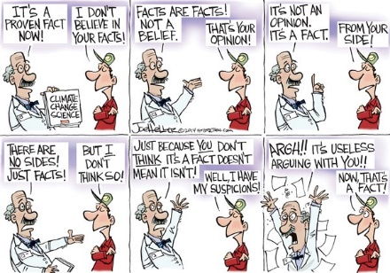

Slide 7
You already know how to identify and evaluate sources of information
You wake up and start coughing up blood. Who do you seek out?
  Degree? Where from? Age? Gender? Race? Political party? Religion?
You want someone to build your house. Who do you seek out?
  Degree? Where from? Age? Gender? Race? Political party? Religion?
You want to bring a legal suit about climate change? Who do you seek out?
  Degree? Where from? Age? Gender? Race? Political party? Religion?
You want to learn about love, compassion, the afterlife? Who do you seek out?
  Degree? Where from? Age? Gender? Race? Political party? Religion?
So, what are GENERAL rules about “what kind of information should I trust?”

Slide 8
Why should we trust the science and which science should we trust?
Distinguish fact-­‐based from value-­‐based claims
Credible sources: expertise and trustworthiness
Individuals using scientific method
Sociology of science and peer review; institutionally conservative IPCC
Strong social expectations of truth-telling
Confirmation of predictions from theory
Multiple independent sources of same info (many scientists, thermometers, etc.)
Multiple indicators of same trend (ice cores, tree rings, fossil record, etc.)
Best explanation, not just a possible explanation
Accounting for all data, not just selected data
Trust the “preponderance of skeptically-evaluated evidence”
NOT the scientific consensus

Slide 9
Credibility
Expertise
Trustworthiness

Slide 10
The scientific method and Peer Review
Scientific method: critical eye to own work
  Evidence of this
  Training in it
  Difference between advocate and analyst
Peer review: critical eye to others’ work

Slide 11
Theories, predictions, and testing theories with evidence
Develop models using existing data
Apply them to “unlooked at” data
If consistent with new data, then more convincing
Example: Evolution or Intelligent design?
Predictions and observable implications
  Which direction should koala pouch face?
  How should nerve get from giraffe’s brain to its larynx?
  No changing prediction after know the facts (post-hocism)

Slide 12

What direction should koala pouch face?
Predict
I>clicker
Up
Down
Left
Right
They don’t have a pouch

Slide 13
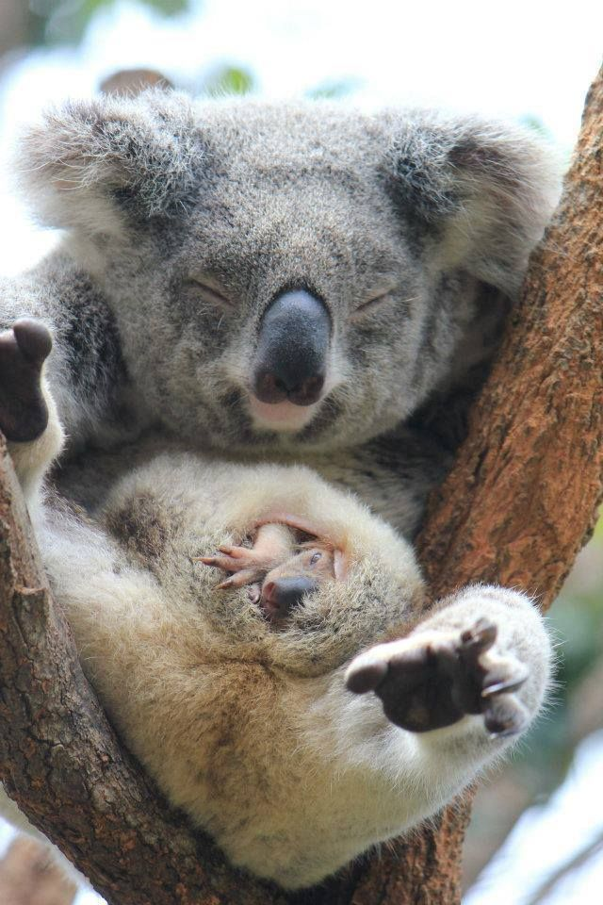
What direction should koala pouch face?
Predict
Observe

Slide 14
Multiple sources
Multiple independent sources of same piece of information
  Water getting warmer
  Your thermometer, my thermometer, their thermometer
Multiple indicators of same trend or phenomenon
  Water getting warmer
  Your thermometer, expanding water, fish swimming lower in lake to stay cool
Multiple independently-arrived-at conclusions pointing in same direction
  Water getting warmer
  Air getting warmer
  Soil getting warmer

Slide 15
Best explanation
Best explanation, not just a possible explanation
Ability to account for all data, not just selected data
“Consistent with other known laws of nature and other bodies of accepted evidence”

Slide 16
It’s real

Slide 17
Some starting points
Weather vs. climate
Climate = the average weather.
Weather is chaotic, climate is not.
  “Climate is what you expect, weather is what you get.”
Why can we predict climate but not weather?
  Can predict June “climate” but not June weather
  Know Eugene is wetter than Phoenix even though it may rain in either & can’t predict perfectly if it will tomorrow
  Always easier to predict an average

Slide 18
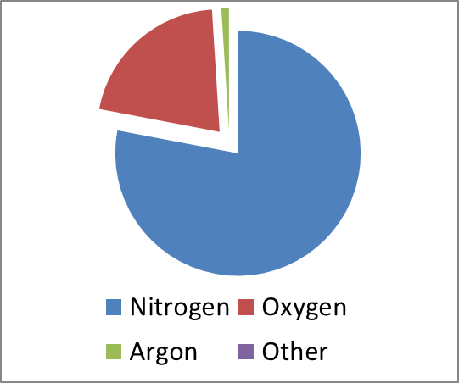
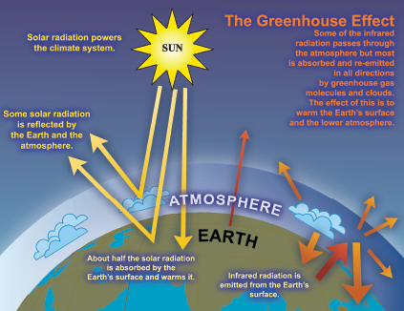
The basics of climate science involve well-known physics & chemistry
Atmosphere:
N2: 78%; O2: 21%; Ar: 1%;
CO2: 0.04%; CH4: 0.0002%
Physics & atmospheric chemistry say more GHGs= more temp
Established science that earth temperature correlates with levels of CO2, CH4 and a few other chemicals
CO2/CH4 allow short wavelength light through but block long wavelength light
IPCC: http://www.ipcc.ch/publications_and_data/ar4/wg1/en/faq-1-3-figure-1.html

Slide 19
Climate CHANGE can occur from small changes in chemistry because Earth is in equilibrium
CO2 and CH4 are VERY small fraction of atmosphere
CO2: 0.04%; CH4: 0.0002%
BUT small changes in inputs can make big changes in outputs.
  Delicate balance is in equilibrium: 500 pounds on each side, grain of sand can unbalance.
  Human body: 5 beers = (5* 12 * .05) 3 ounces of alcohol can influence a 2400 ounce person (150 pounds)

Slide 20
Climate CHANGE has many impacts and we are seeing them already
Temperature: most areas warmer; some colder; many different
Precipitation: some areas more; some less; some different
Sea level rise and wave heights
More extreme weather: drought, floods, hurricanes
Economic losses
Species loss
Disease “vectors”
Some abrupt changes or “surprises”

Slide 21
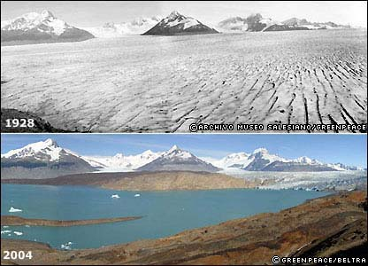
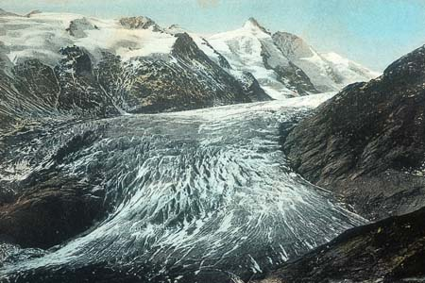
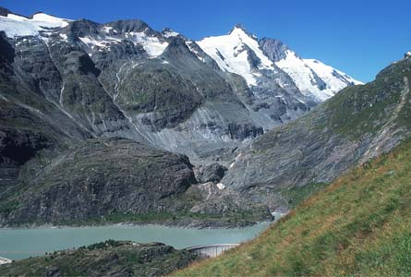
Impacts: Glacial Retreat
Argentina
Austria
Free water storage
1900
Costly water storage
2000
Source: Argentina: http://news.bbc.co.uk/2/shared/spl/hi/picture_gallery/05/sci_nat_how_the_world_is_changing/html/1.stm Gesellschaft für ökologische Forschung 2002. Das gletscherarchiv. http://www.gletscherarchiv.de/.

Slide 22
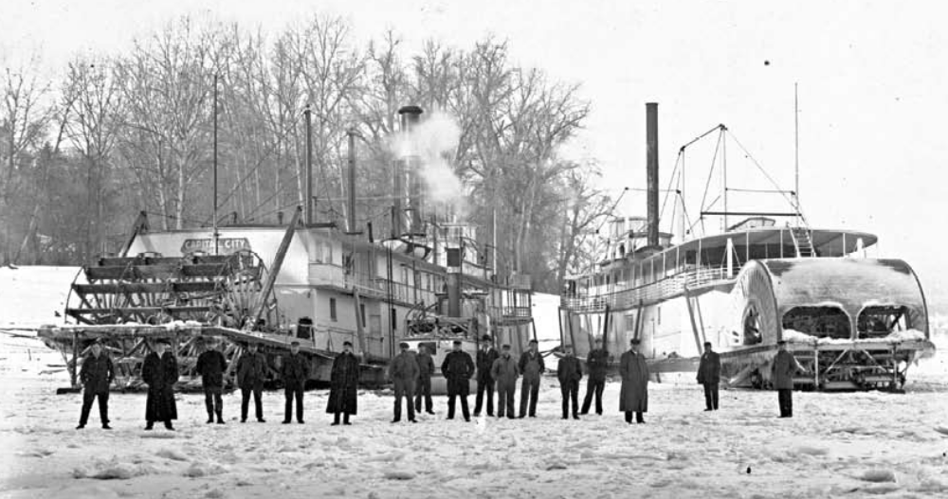
Impacts: Thawing Rivers
The Columbia River froze over 23 times between 1830 & 1930 but has not frozen over since.
Picture: Hood River, Oregon, W. D. Rogers, 1/17/1907; Oregon Historical Society Photo OrHi 35431 (http://librarycatalog.ohs.org/)
Columbia “generally freezes up once in the winter” from a trial in 1882 at http://books.google.com/books?id=wZA8AAAAIAAJ (p. 1393)
*Data on freezes compiled from: http://www.pacificcohistory.org/columbia.htm; http://historyink.com/results.cfm?keyword=Weather&searchfield=topics; and http://www.nwmapsco.com/ZybachB/Thesis/05-081_Chapter_3b.pdf (p. 86)

Slide 23
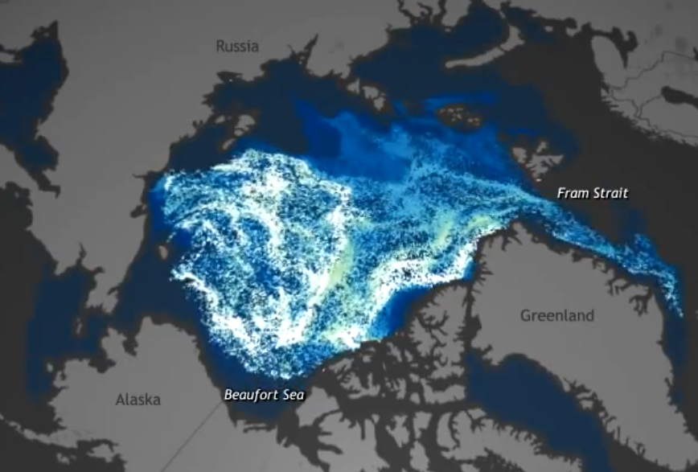
How fast is it happening?
Arctic ice changes in last 30 years

Slide 24
IPCC Summary’s of research:
Evidence of CC is Getting Stronger
1st report (1990): unequivocal detection of enhanced greenhouse gas effect not likely for decade or more
2nd report (1995): balance of evidence suggests a discernible human influence on global climate
3rd report (2001): new, stronger evidence that most warming observed of last 50 years is due to humans
4th report (2007): most of increase in global average temps since 1950 is likely due to anthropogenic greenhouse emissions
5th report (2014): “It is extremely likely that human influence has been the dominant cause of the observed warming since the mid-20th century”
Slide courtesy of Greg Bothun, U of Oregon

Slide 25
It’s us

Slide 26
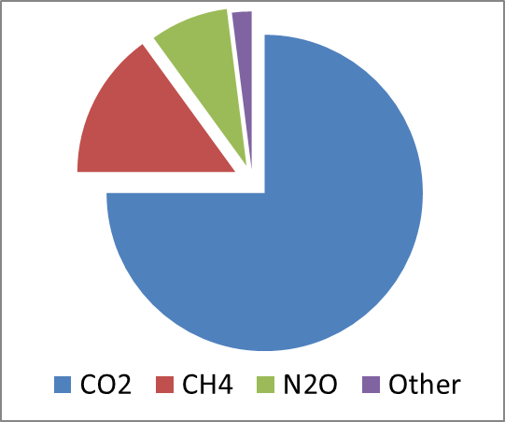
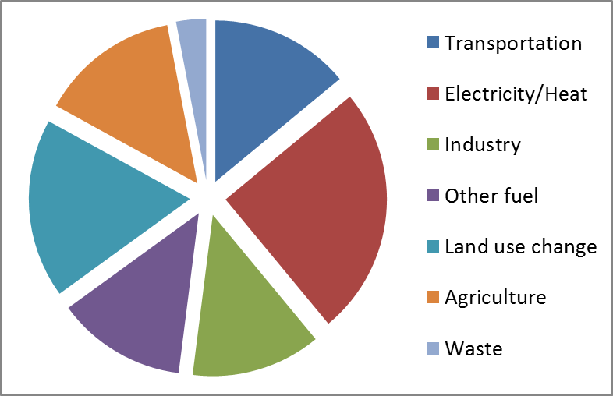
Increases in culprit chemicals in atmosphere can come from humans
75%: Carbon Dioxide (CO2)
  Fossil fuels for manufacturing,
  transport, heat/cool, electricity
  Deforestation
15%: Methane (CH4)
  Livestock and manure
  Rice cultivation
8%: Nitrous Oxide (N2O)
  Agricultural fertilizer

Slide 27
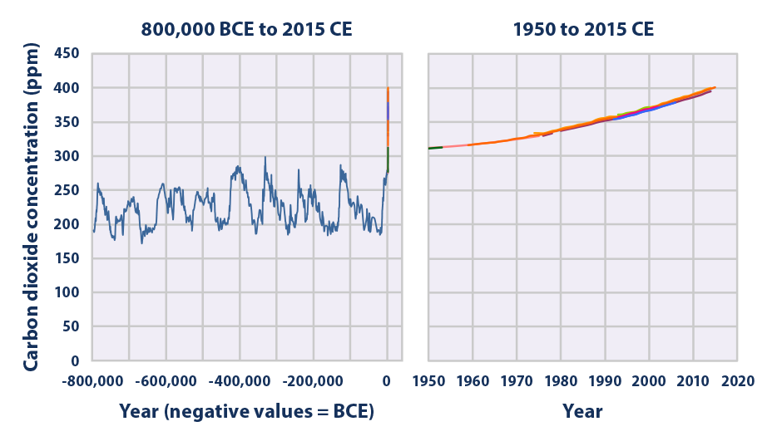
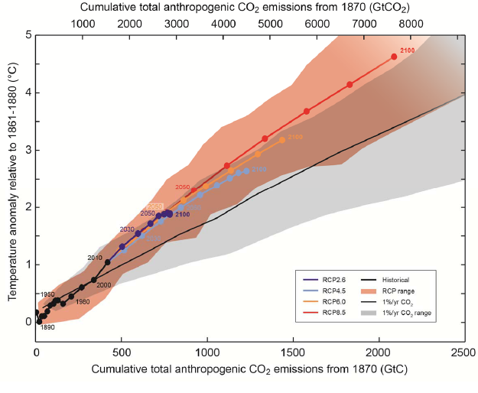
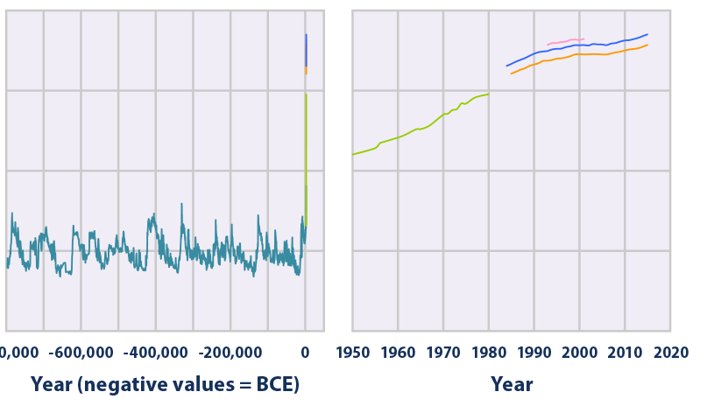
Increases in culprit chemicals in atmosphere have come from humans & correlate with temp
CO2: pre-human <300; now 410 & growing
CH4: pre-human <800; now 2,000 & growing
Changes correlate with temperature
Carbon Dioxide (CO2
Methane (CH4)
IPCC, 2013
Temperature Change
CO2 emissions
EPA, 2020

Slide 28
Increases in culprit chemicals in atmosphere cause climate change
Many causes of greenhouse effect
Measurements show sources mainly over land in populated areas
Chemical fingerprints (isotopes) differ and show
  Most increased carbon dioxide from fossil fuels
  Most increased methane and nitrous oxide from agriculture & fossil fuels
Because Earth in equilibrium, small changes can have observed effects
Without human factors can’t explain observed increases in temp

Slide 29
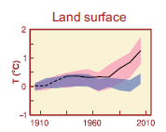
Without human factors can’t explain observed increases in temperature
Correlation over time of changes in temp with human activities
Computer models do not match observations of temperature unless human factors are included

Slide 30
Where we need to be:
450ppm=2 t/person
CO2:
  Pre-industrial: ~280ppm
  Current: ~380ppm
  Trajectory to 550ppm by 2100
But major impacts at 450ppm ~4ºF
And stopping at 450ppm is “likely ... unachievable with current & foreseeable technologies” (Stern report)
Sources: T. Wang. 2007. China’s Cumulative Carbon Emission & Pathways over the 21st Century. Accessed: 19 March 2009. At: http://www.sussex.ac.uk/sussexenergygroup/documents/tao_wang_china_s_carbon_emission_pathways_20070902.ppt and US EPA, Recent Atmospheric Changes. Accessed 19 March 2009. At: http://www.epa.gov/climatechange/science/recentac.html

Slide 31
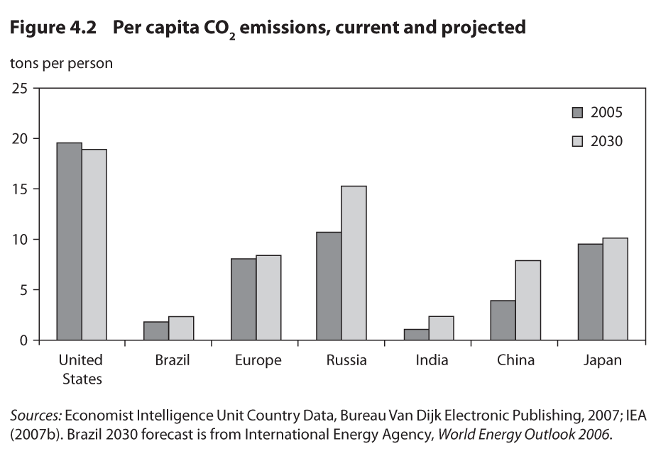
Who’s responsible?
Depends on how you count
% of total global emissions
20%
2%
15%
5%
5%
20%
5%
http://www.wri.org/image/view/9255/_original

Slide 32
Where we need to be:
450ppm=2 t/person
http://www.wri.org/image/view/9255/_original

Slide 33
Human causes of climate change emissions
IPAT
Impact = Population * Affluence * Technology
Impact: environmental harm
Population: # of people
Affluence: $ per person (income)
Technology: impact per $ (carbon intensity)

Slide 34
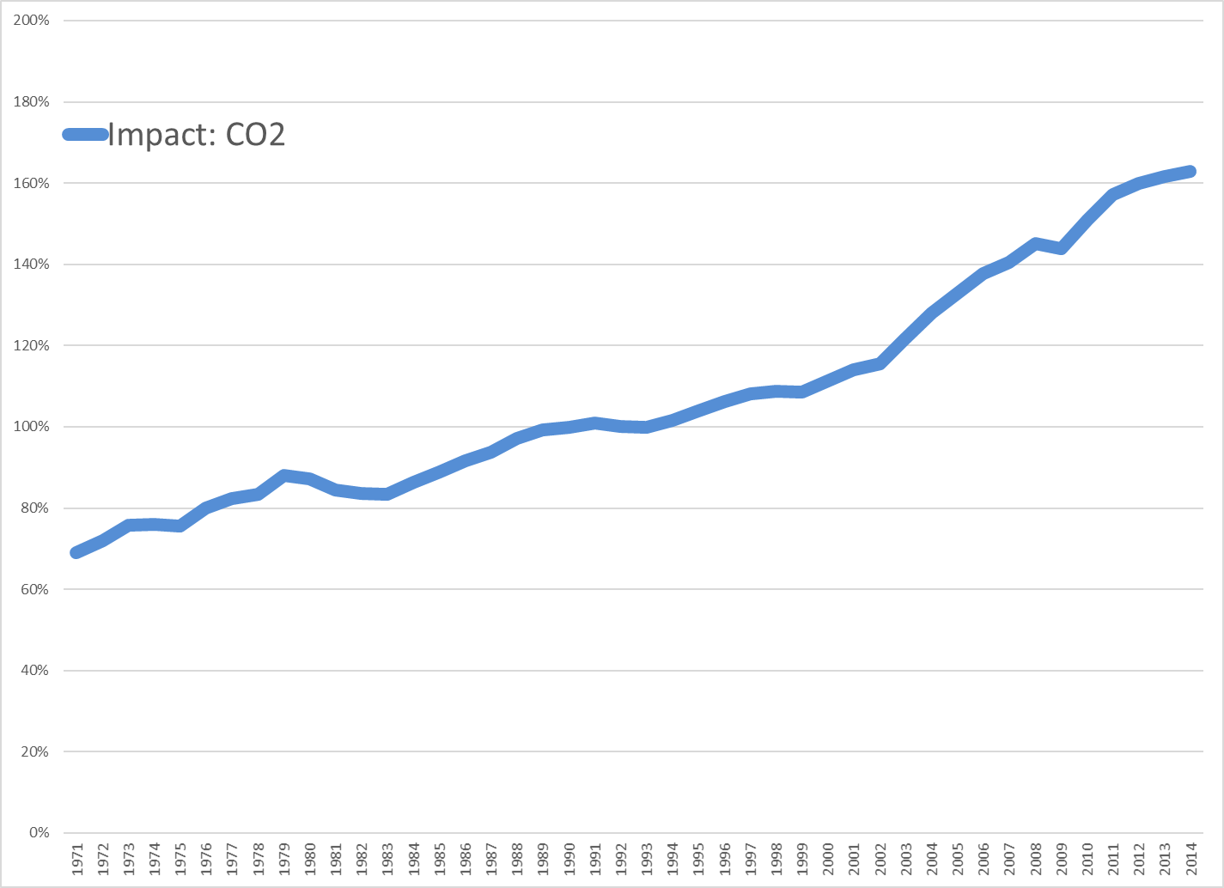
Sources: Calculated using data from World Development Indicators, 2018

Slide 35
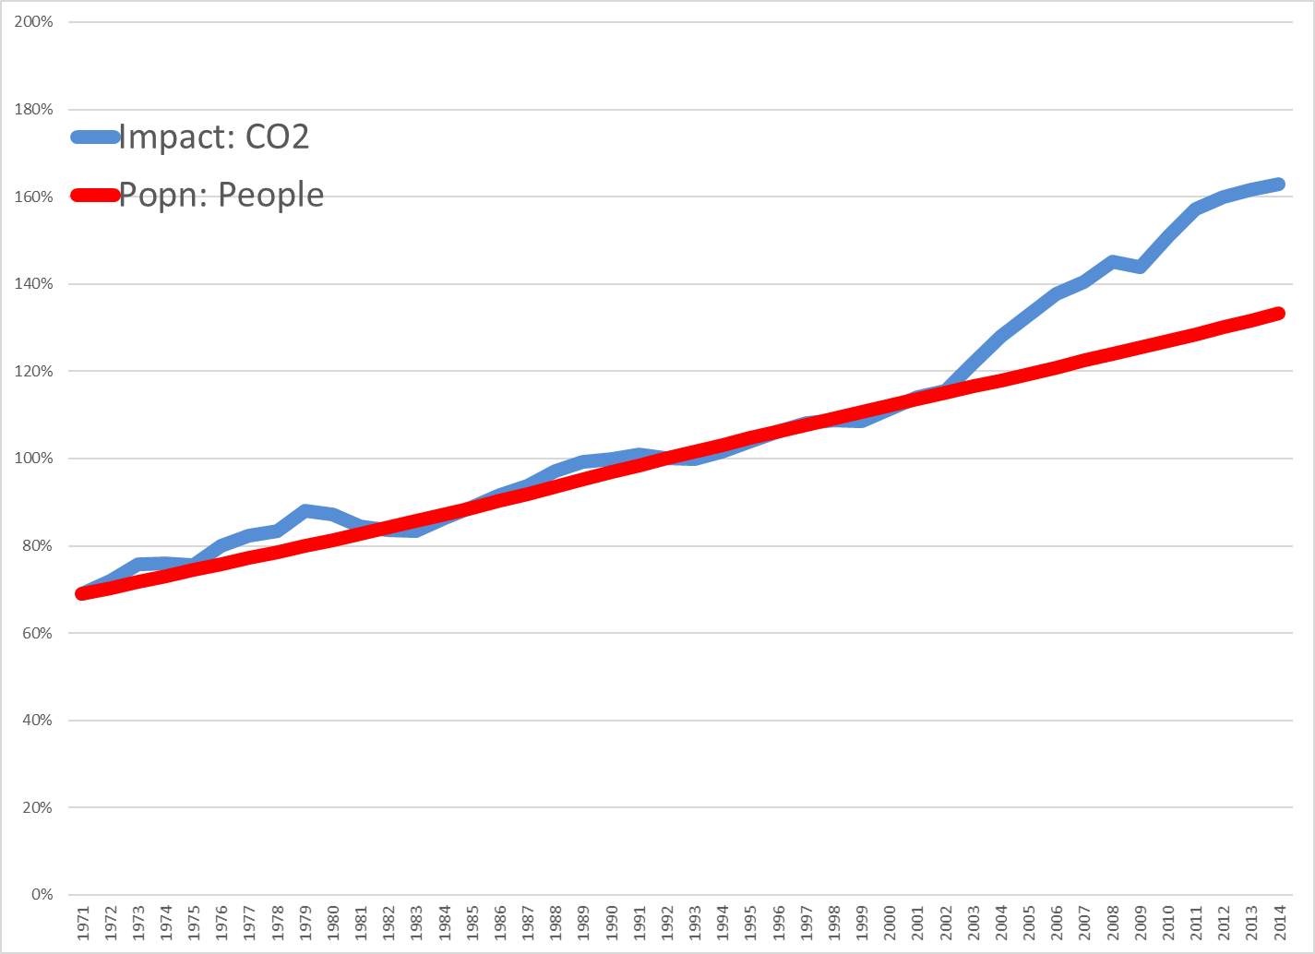
Sources: Calculated using data from World Development Indicators, 2018

Slide 36
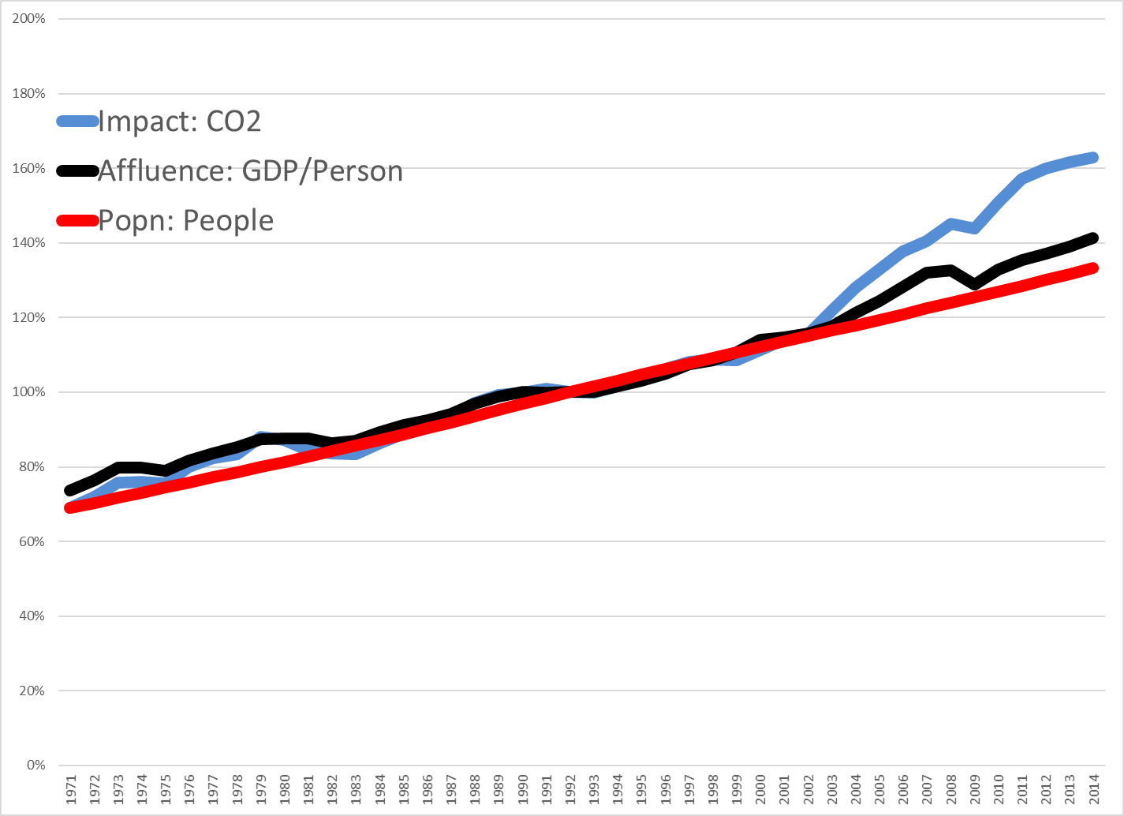
Sources: Calculated using data from World Development Indicators, 2018

Slide 37
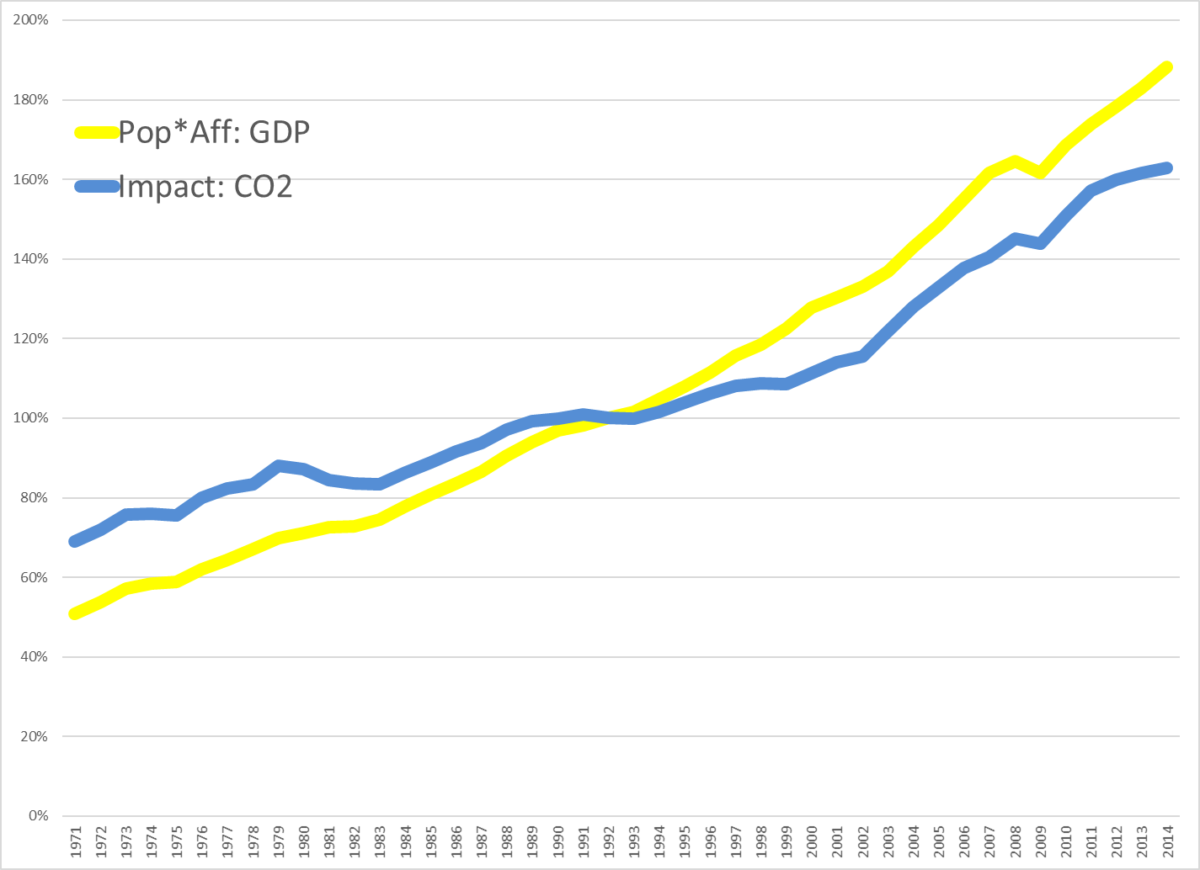
Sources: Calculated using data from World Development Indicators, 2018

Slide 38
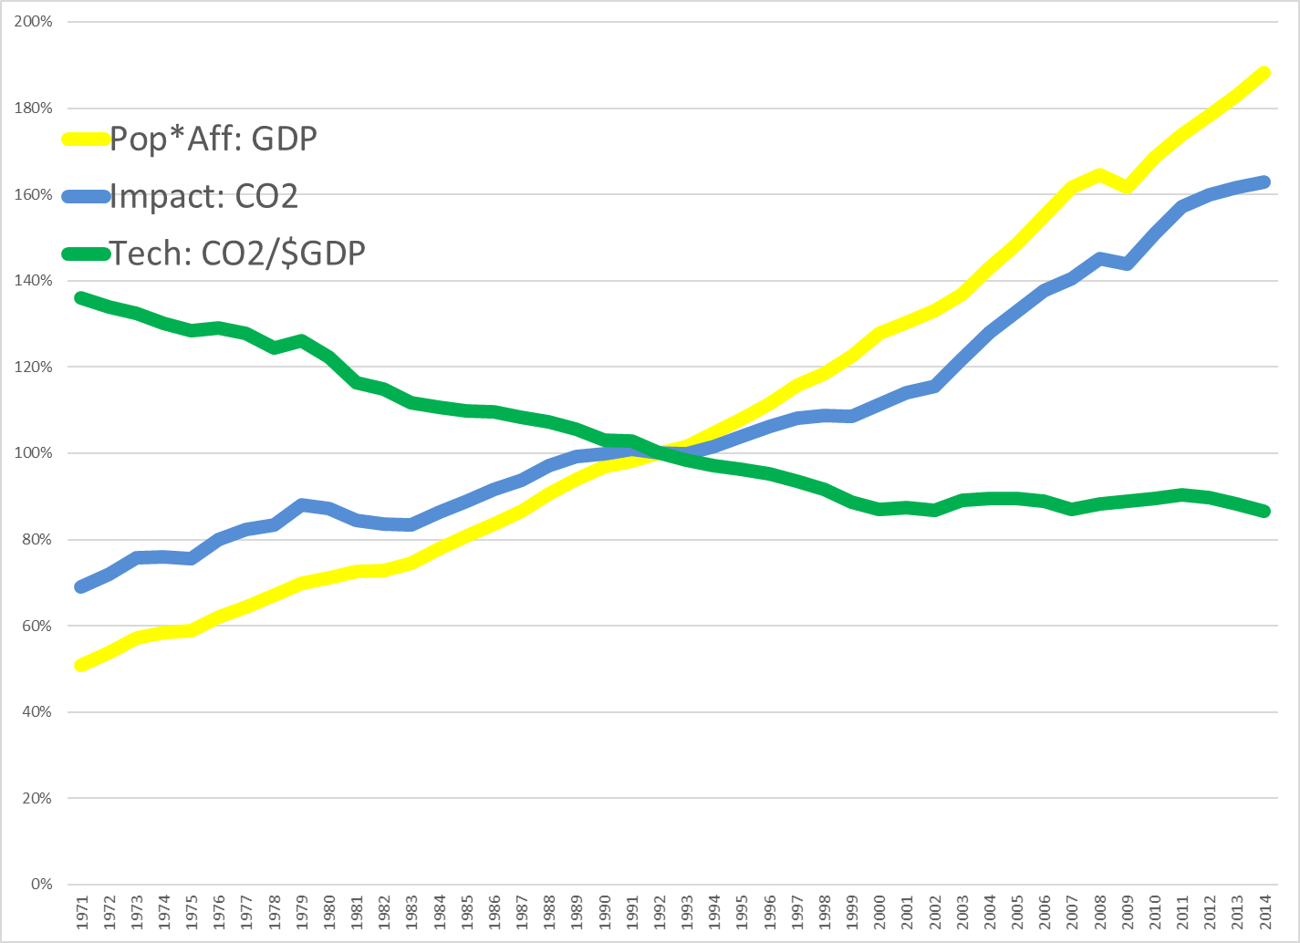
Sources: Calculated using data from World Development Indicators, 2018

Slide 39
It’s bad … (and it’s here)

Slide 40
Is climate changing?
Yes. What’s the evidence?
Temperatures as measured are increasing over time, with various measurement types consistent with each other: thermometers / ice cores / corals / tree rings / land and ocean temps / satellites
Other direct indicators that warming has occurred: glaciers / ice sheets / Arctic ice / sea level rise / date of river-ice breakup / precipitation changes
  CanNOT attribute single events to climate change but can attribute probability shifts to it
Indirect indicators of warming also consistent with warming: bird migration days / plant blooming days
Amount of warming appears to be outside natural variation
Rate of warming appears to be faster than natural variation

Slide 41
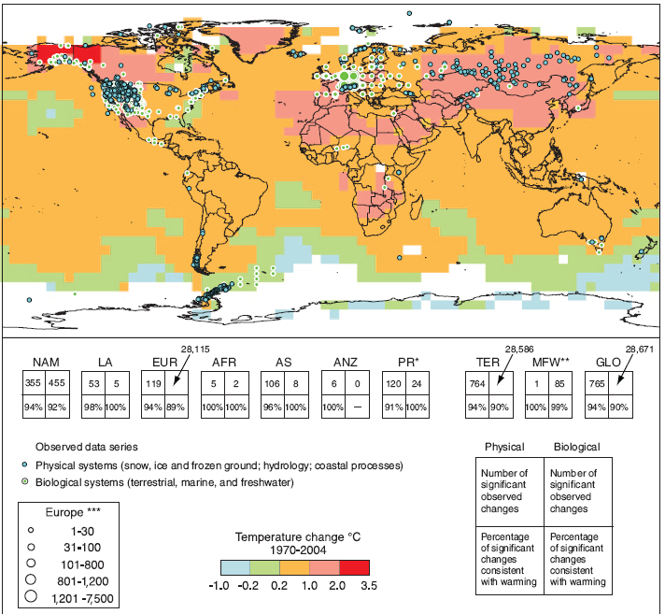
Observed effects of climate changes
“Of the more than 29,000 observational data series, from 75 studies, that show significant change in many physical and biological systems, more than 89% are consistent with the direction of change expected as a response to warming” IPCC, 2007)

Slide 42
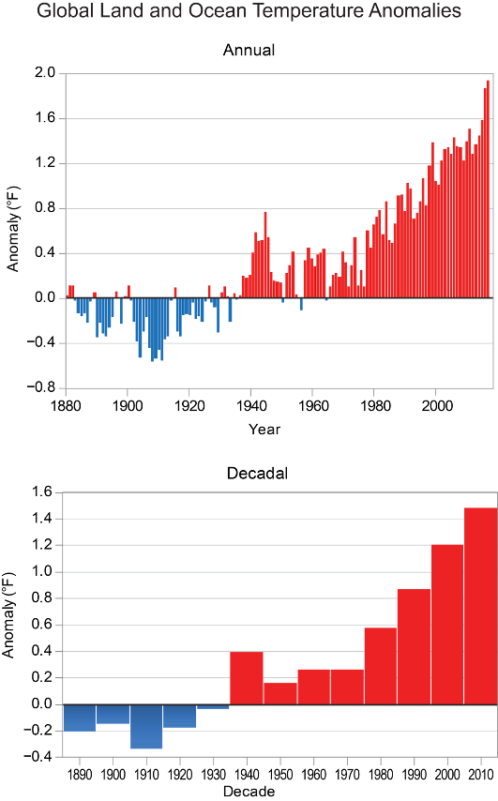



It’s Here:
Climate Change Impacts in the US
The planet is continuing to warm. There has been no “hiatus” in warming
Temperatures have never stopped increasing since 1900, even though the rate of increase sped up and slowed down at various times as natural variability affected the rate of increase.
Focusing on short periods of slower warming can lead to false conclusions about longer-term impacts.
The Climate Science Special Report

Slide 43
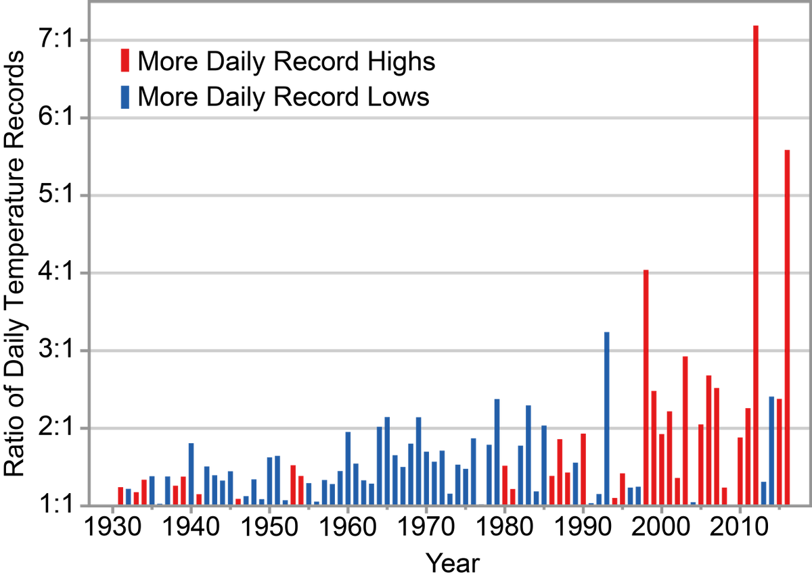
It’s Here:
Climate Change Impacts in the US
The Climate Science Special Report

Slide 44
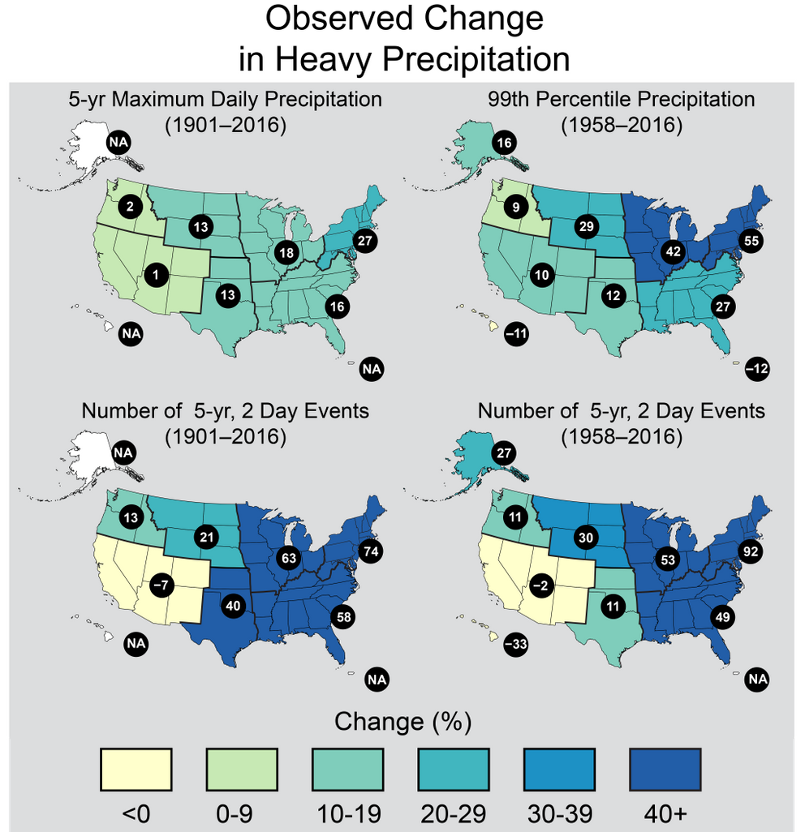
It’s Here:
Climate Change Impacts in the US
Heavy rainfall is increasing in intensity and frequency across the U.S. and globally and is expected to continue increasing.
The Climate Science Special Report

Slide 45
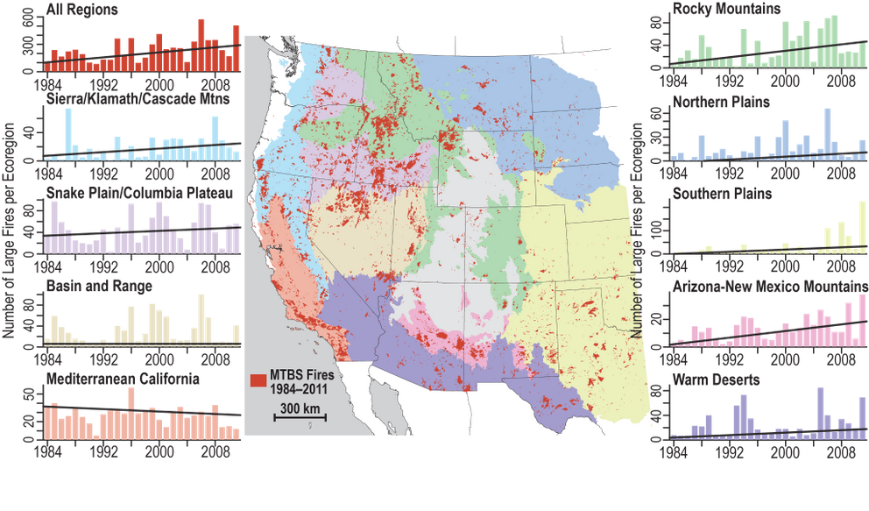
It’s Here:
Climate Change Impacts in the US
The number of large forest fires in the West and Alaska has increased and are projected to happen more often with rising temperatures.
The Climate Science Special Report

Slide 46
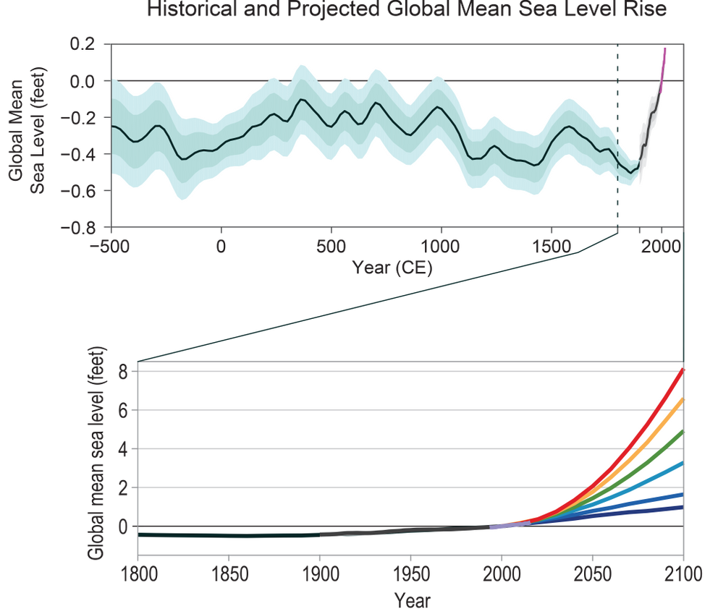
It’s Here:
Climate Change Impacts in the US
Sea-level rise has already affected the U.S. with tidal flooding
accelerating in more than 25 Atlantic and Gulf Coast cities. Global average sea-level has risen by 7-8 inches, with almost half since 1993. Human-caused climate change has added greatly to sea-level rise since 1900.
The Climate Science Special Report

Slide 47
Climate change is challenging
Responsible behaviors: numerous & deeply embedded in all aspects of life
Magnitude: impacts of inaction and costs of action are large
Trends and timelines: population and affluence (IPAT) growing by 1.8% and 1.3% per year, technology declining by 0.7% per year
Alternatives: not available or economically unattractive
Evidence that its hard: 30 years of knowledge, 20 years of policy, yet little progress

Slide 48
Climate impacts influenced by:
Exposure – is your community exposed to climate change: Switzerland/Bolivia vs. Bahamas/Kiribati
Vulnerability – factors that influence how much a climate impact hurts BEFORE your community responds
Adaptive capacity –resources your community has to respond to climate impacts it faces
Resilience – how much “pain” does your community feel AFTER it has adapted and how robust is community to a future of expected and unexpected impacts

Slide 49
… but there’s hope.

Slide 50
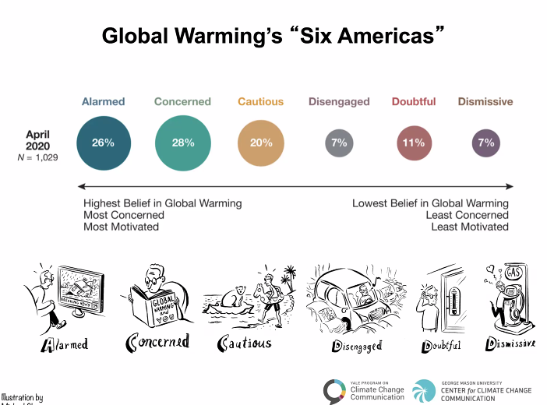
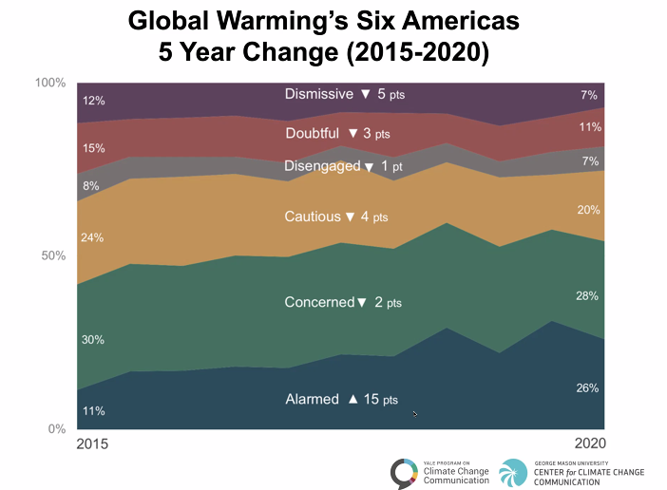
More US citizens accept and are concerned about climate change (in 5 years, 41% → 54%)

Slide 51
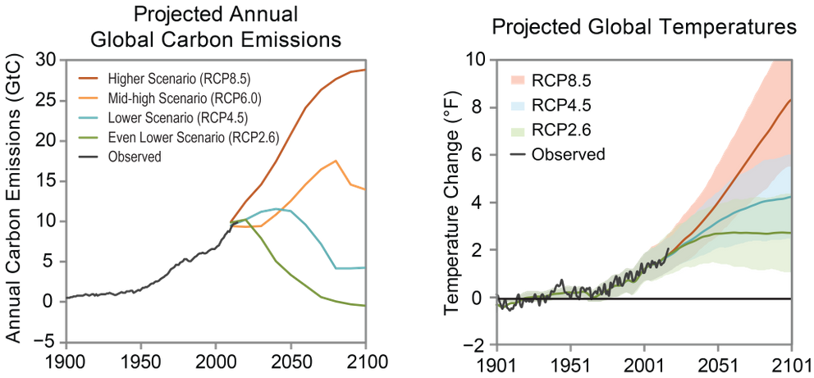
Our choices CAN make a diffference
Size of future climate impacts depends on our emissions now.
We canNOT prevent some warming but, with action now, we CAN keep 2100 temperatures to only 4° F above now instead of 9° F above now
The Climate Science Special Report

Slide 52
Models of Human causes of Climate Change and implications for action
???
Population
(people)
???
???
???
Affluence
($GDP/person)
Impact
(CO2 Emissions)
???
???
???
Technology
(CO2/$GDP)
???
???

Slide 53
Technological solutions alone may be inadequate
3% per year net growth due to population and affluence requires 3% per year net decline from technology (CO2/$) to stabilize emissions
Meeting 80% reduction by 2100 requires 2% per year further reduction in emissions
Technology must generate ongoing 5% per year emission reductions to achieve required reductions but currently below 1% per year

Slide 54
Changing Population Growth
Some policies do influence population size, fertility
  Educating women
  Chinese one child policy (China 1.7/woman)
  French pro-natalist policy (France 1.98/woman vs. UK 1.66/woman)
  Catholic position on contraception
So do social norms
  “When are you going to have kids?”
  “I wonder why they don’t have any kids?”
  “Congratulations on your new baby!”
  “I want to live a nice long life.”
Yet population appears “off limits” politically (not mentioned at Copenhagen)
Sources: http://newedexcelgeography.blogspot.com/2008/01/france-pro-natalist-policy.html
http://www.vatican.va/holy_father/paul_vi/encyclicals/documents/hf_p-vi_enc_25071968_humanae-vitae_en.html

Slide 55
Changing Affluence Growth
Some policies do influence consumption patterns
  Buddhist monks
  Jewish observance of Shabbat
  Mormon tithing
  Voluntary simplicity: “frugality of consumption”
So do social norms
  “More, More, More said the baby.”
  “I want a better life for my kids.”
  “I need a raise.”
  “I need a vacation.”
Yet affluence also appears “off limits” politically (though see “Confronting Consumption”)
Source: http://www.simpleliving.net/voluntary_simplicity_part_1.asp

Slide 56
What are policy options?
Mitigation
Adaptation
Geo-engineering
Grieving and loss

Slide 57
What is being done?
Mitigation
UN FCCC of 1992 and Kyoto Protocol of 1997
2015 Paris Agreement – all countries made commitments
Governments: India, China, US, Europe, Japan; Costa Rica: 3.5% carbon tax since 1997
States: Regional Greenhouse Gas Initiative; Western Climate Initiative
Cities: ICLEI-Local Governments for Sustainability: >1000 cities, towns
NGOs/Corporations: WWF, Greenpeace, Nike, Levi’s, etc.
Multinational corporations
Religions: Faith Action on Climate Change, Interfaith Power & Light, Evangelical Environmental Network,
Individuals: Voluntary Simplicity, direct action

Slide 58
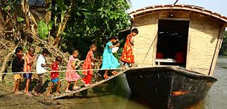
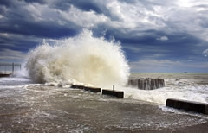
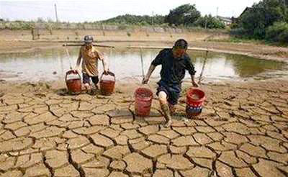
What is being done?
Adaptation
Relocate and displace
Protect infrastructure
Change behaviors

Slide 59
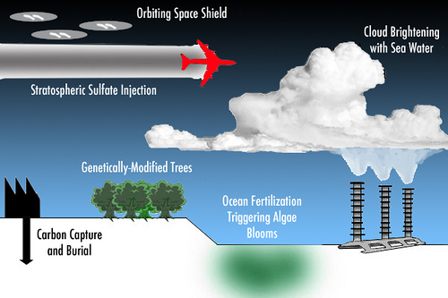
What may be done?
Geo-engineering

Slide 60
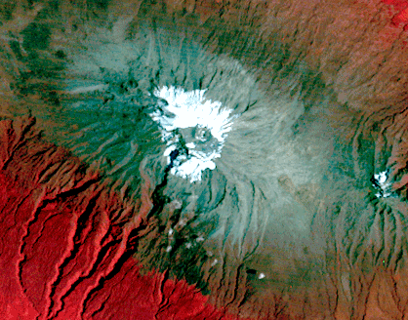
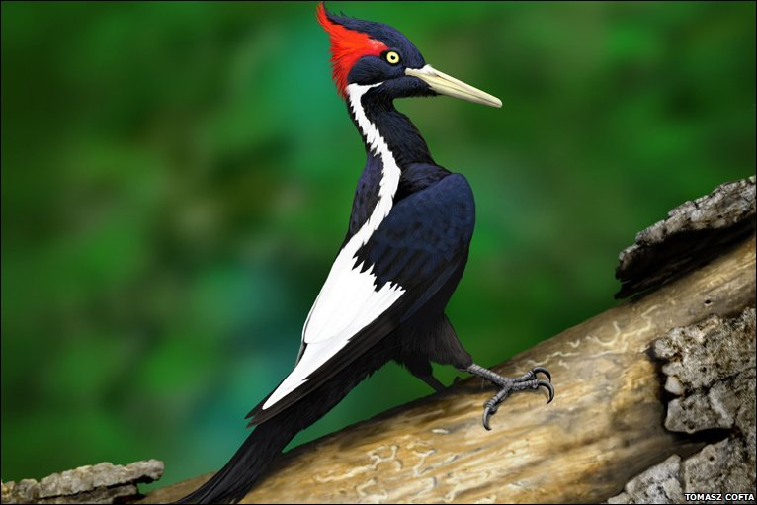
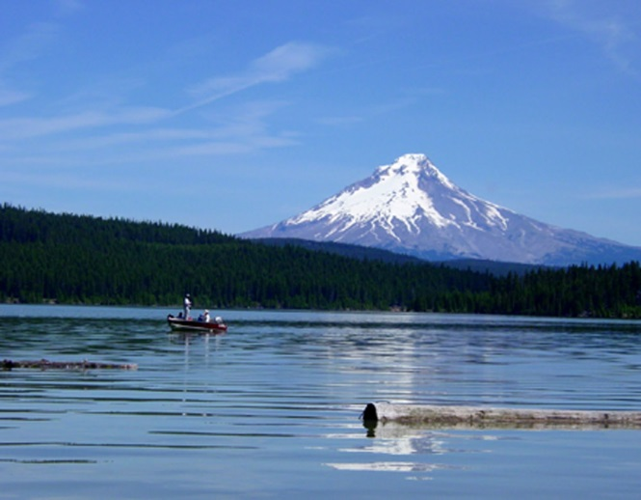
What has been lost?
Grieving and loss
The Snows of Kilimanjaro
1976
Ivory-billed Woodpecker:
Killed by Hurricane Katrina?
http://earthshots.usgs.gov/earthshots/Mount-Kilimanjaro
Mt.Hood:
Like this in Winter?
http://www.gambassa.com/public/project/profile/0/0/2771/AveryHorne%27sIvoryBilledWoodpeckerreport.jpg
http://mthoodrentals.blogspot.com/2011/05/schools-almost-out-have-you-planned.html

Slide 61
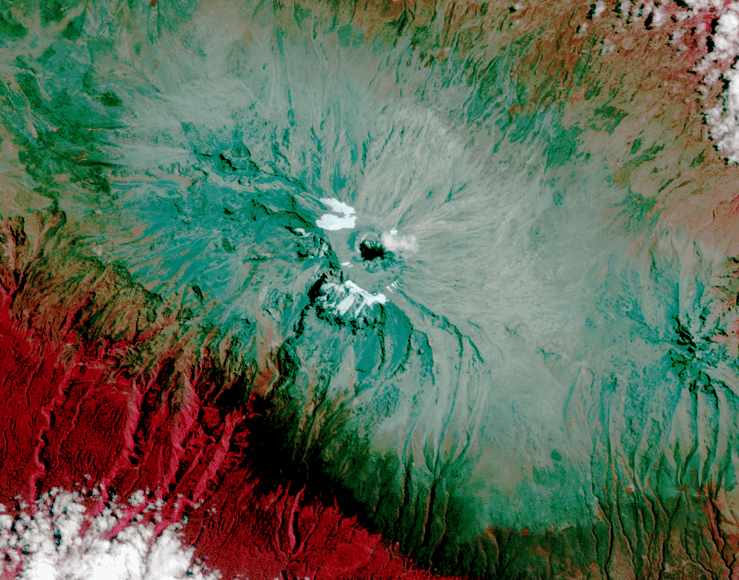
What has been lost?
Grieving and loss
The Snows of Kilimanjaro
2010
Ivory-billed Woodpecker:
Killed by Hurricane Katrina?
http://earthshots.usgs.gov/earthshots/Mount-Kilimanjaro
Mt.Hood:
Like this in Winter?
http://www.gambassa.com/public/project/profile/0/0/2771/AveryHorne%27sIvoryBilledWoodpeckerreport.jpg
http://mthoodrentals.blogspot.com/2011/05/schools-almost-out-have-you-planned.html

Slide 62
This is a hard and scary problem
So, some words to live by
Anybody who thinks they are too small to make a difference has never been in bed with a mosquito. ~ Somebody
Everyone thinks of changing the world, but no one thinks of changing himself. ~Leo Tolstoy
Nobody made a greater mistake than he who did nothing because he could only do a little. ~Edmund Burke
The true meaning of life is to plant trees, under whose shade you do not expect to sit. ~Nelson Henderson
Unless someone like you cares a whole awful lot, nothing is going to get better. It's not. ~Dr. Seuss

Slide 63
5 things to tell others about climate change
(from Tony Leiserowitz, Yale School of Env’t)
Scientists agree …
It’s real
It’s us
It’s bad …
… but there’s hope.

Slide 64
Student Experience Survey
10 minutes
The Student Experience Survey … is your chance to provide feedback about your learning experience in this class. Instructors change and improve courses thanks to feedback from students like us. The learning process is collaborative and requires significant effort from the instructor, from you, and from the class as a whole. Please provide specific reflections on your experience. The most helpful feedback is actionable, thoughtful, and concrete. Comments regarding personal characteristics of the instructor are not appropriate and will not be considered. For this feedback to be as comprehensive as possible, all students are asked to complete the Student Experience Survey.
To do survey:
  Login to Duckweb (https://duckweb.uoregon.edu/)
  Click on Course Surveys
  Click again on Course Survey link at the top of the next page

