Slide 1
Final Exam
Take home format
Cite appropriately!! Remember, no plagiarism!!!! Plagiarizing is the only way (and a SURE way) to fail on your final exam, so make sure to cite.
Due NO LATER THAN 10:00am Friday, December 7!!
STUDY with others but WRITE your own paper
No more than 2,000 words

Slide 2
Final Exam Question
International organization involves efforts by states to resolve the problems they face. Select TWO (2) examples of international problems, 1 from each of 2 different issue areas: security, international political economy, human rights, and environment. Describe differences and similarities between your two examples in terms of a) their problem structures, b) how those problems influence the international institutions states create, and c) how both of those sets of factors influence the effectiveness of those institutions. Write a well-structured and coherent essay that uses the theories, concepts, analytic techniques, and evidence from readings & lectures.

Slide 3
Environmental Institutions
Analysis of Influence
Will look at multiple cases
Goal: Seek to have MULTIPLE evidence of what counterfactual will be
  Counterfactuals: you HAVE to make them up
  BUT you can provide evidence for them, to make them more plausible
  AND it is more convincing if you have multiple sources of evidence

Slide 4
Aral Sea Agreement
Analysis of Influence
Actual Performance – Counterfactual Performance
Performance = ----------------------------------------------------------
Optimal Performance – Counterfactual Performance
Counterfactual: under what conditions should we expect problems in water delivery?
Upstream/downstream problem with expected barter (energy for water)
High compliance but low effectiveness
What’s optimal performance? (natural, Soviet, sustainability): “Performance over time … has been very low and highly variable.”

Slide 5
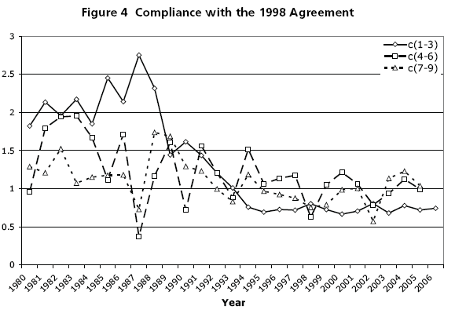
Aral Sea Analysis

Slide 6
Aral Sea Analysis
Look at compliance; compare actual releases to rules. Compliance is high but may not be due to institution
Use post-Soviet/pre-treaty behavior (1991-1997) as counterfactual baseline for period after 1998.
Dispose of one counterfactual by expert opinions that it’s unlikely – need PLAUSIBLE counterfactuals.
Course takehomes:
  Compliance high / Effectiveness low (see article)
  Problem structure changed: end of Soviet Union

Slide 7
Fur seal case
Ban fur sealing at sea by Canada and Japan and US
Allow stocks to recover on islands
Problem structure
  Collaboration (Tragedy of Commons)
  Inherent transparency because of single market for skins
Institutional design
  Even though collaboration, used rewards – surprising
  No significant monitoring
  Convention does not apply to Indians, Ainos, Aleuts
  Regulatory but some procedural elements to deal with changes in population
“Pelagic sealing” = killing seals in ocean, not on land
Outcome – it worked!

Slide 8
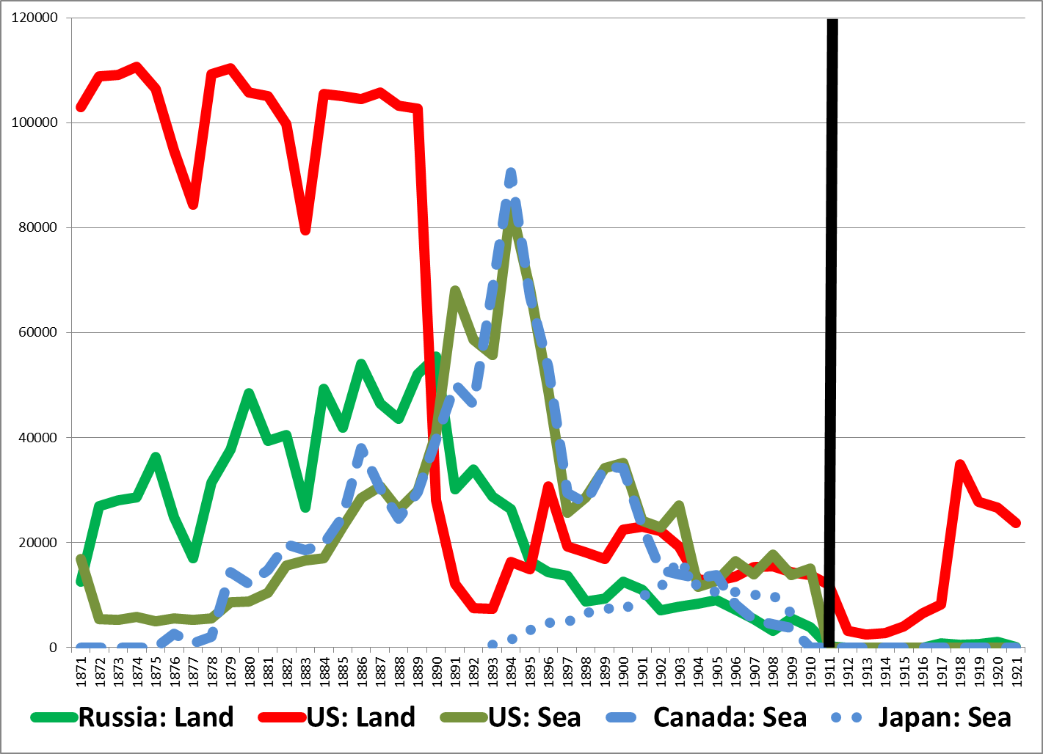

Slide 9
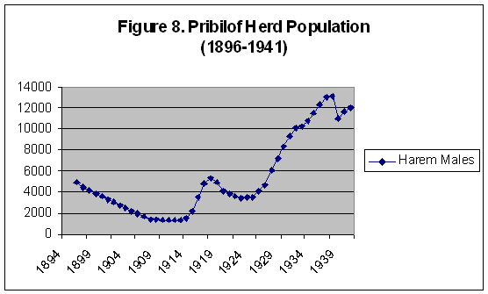

Slide 10
Fur seal case
Course takehomes:
  Problem structure was a Tragedy of the Commons, so expect continuation of fur seal kills (basis for counterfactual)
  Pelagic sealing stops permanently but land sealing stops only temporarily – pelagic is counterfactual for land
  Institutional design (payments to Canada/Japan) worked to change behavior of those it targeted (pelagic)
  Goal achievement: population recovered enough to continue making money

Slide 11
Convention for the Conservation of
Salmon in the North Atlantic Ocean
We observe: catch by NASCO members of salmon in the North Atlantic after 1980 with treaty having taken effect
To estimate treaty effect, we want: unobservable catch by NASCO members of salmon in the North Atlantic after 1980 had treaty NOT taken effect
How many counterfactuals can we generate for it that we can use to estimate its effect?

Slide 12
NASCO Counterfactuals
Observe: catch by NASCO members of salmon in the North Atlantic after 1980 with treaty having taken effect
Counterfactuals
  Members, salmon, North Atlantic, before 1980
  Non-members, salmon, North Atlantic, after 1980
  Members, salmon, SOUTH Atlantic, after 1980
  Members, NON-salmon, North Atlantic, after 1980

Slide 13
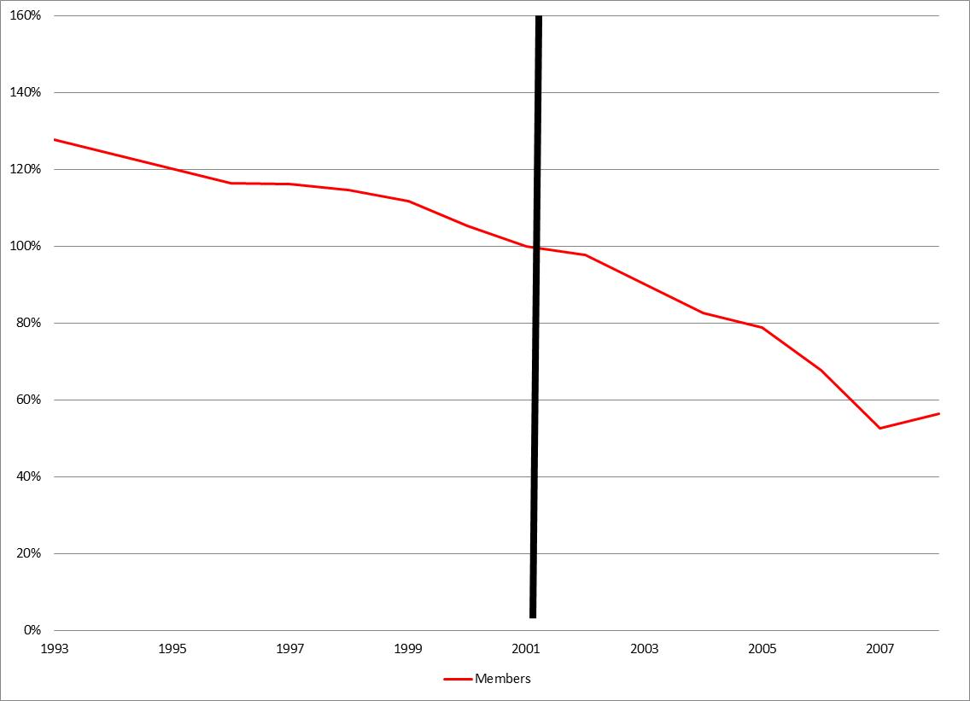
Fisheries – notional example
Members before/after
Counterfactual #1

Slide 14
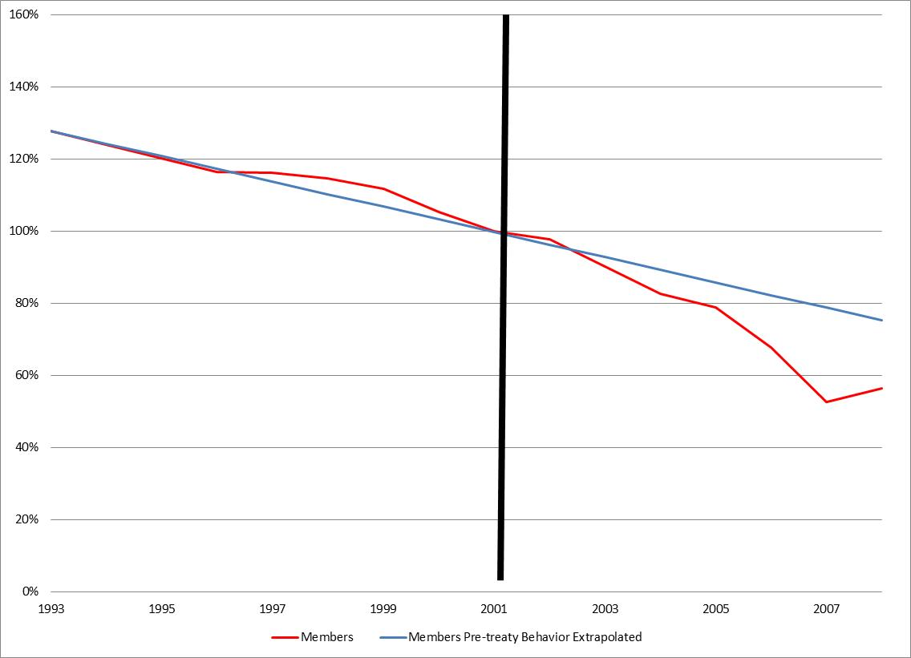
Fisheries – hypothetical example
Members before/after
Counterfactual of Member
behavior using Members PRIOR
behavior when they weren’t members
Counterfactual #1

Slide 15
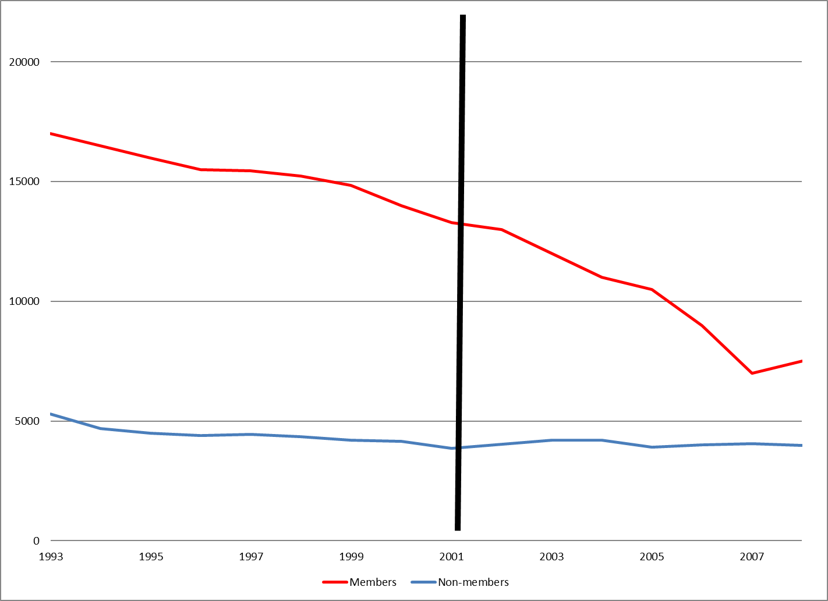
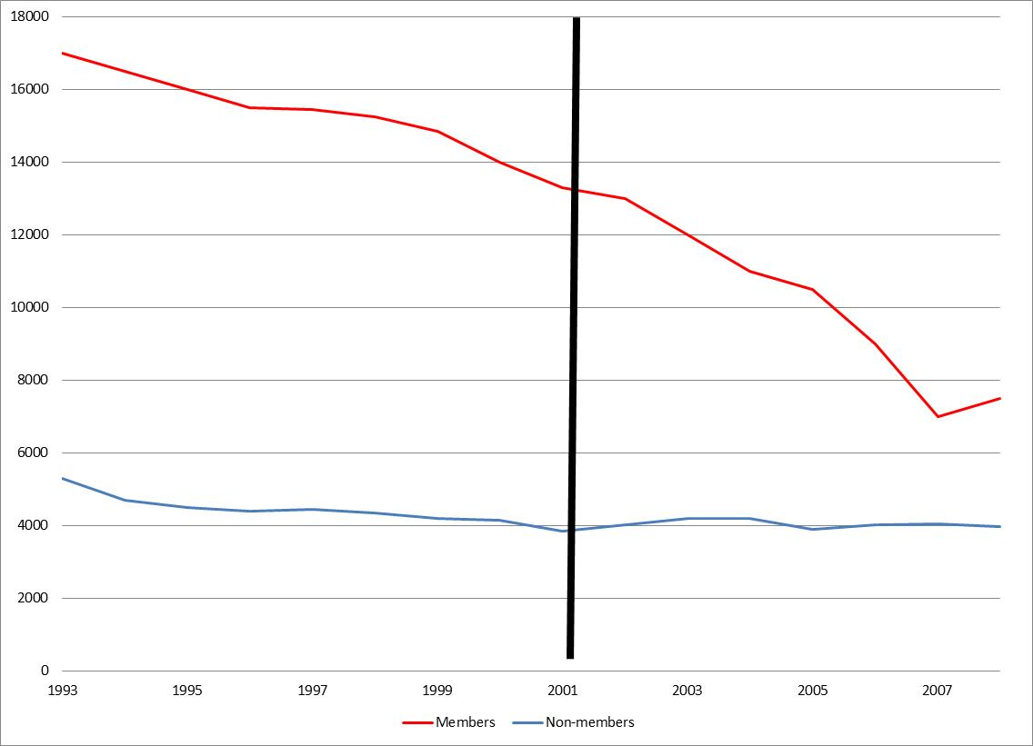
Fisheries – hypothetical example
Members / Non-members
Counterfactual #2

Slide 16
Fisheries – hypothetical example
Members / Non-members
Counterfactual #2

Slide 17
Fisheries – hypothetical example
Members / Non-members
Counterfactual #2

Slide 18
Fisheries – hypothetical example
Members / Non-members
Counterfactual #2

Slide 19
Fisheries – hypothetical example
Members / Non-members
Counterfactual of Member
behavior using trajectory of NON-members behavior who weren’t members
Counterfactual #2

Slide 20
Fisheries – hypothetical example
Members / Non-members
Course takehomes:
  Two different BASES to estimate counterfactual of what members would have done if they had NOT been members
  Generating SAME counterfactual but doing it on a different basis

Slide 21
Whaling example
Course takehomes:
  Always two possible measures of effectiveness
    Goal Achievement
    Counterfactual
  Can Succeed on Counterfactual and Fail on Goal Achievement

Slide 22
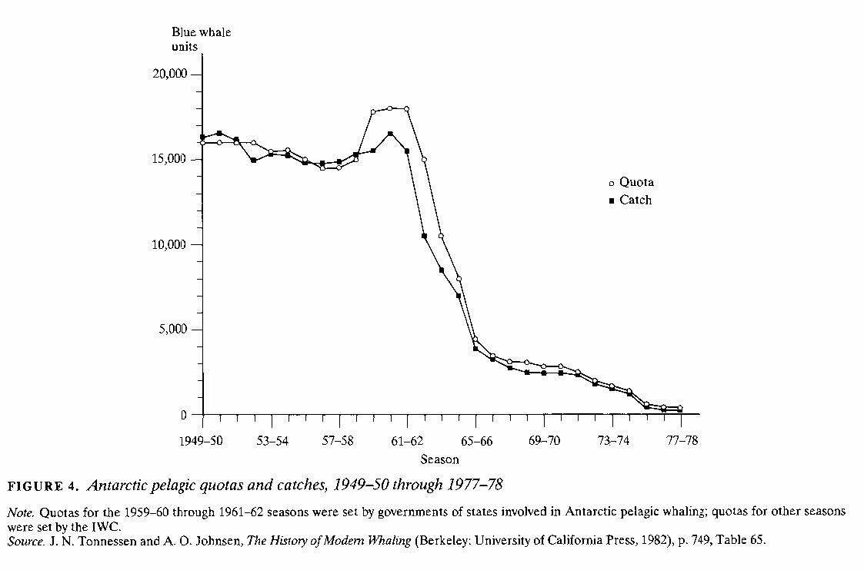

Slide 23
Goal

Slide 24
Goal
Failure Relative To Goal

Slide 25
Counterfactual

Slide 26
Counterfactual
Success Relative To Counterfactual

Slide 27
Counterfactual
Goal
Failure Relative To Goal
Success Relative To Counterfactual

Slide 28
Catch may cause Quota
Rather than Vice Versa
Implies NO effect

Slide 29
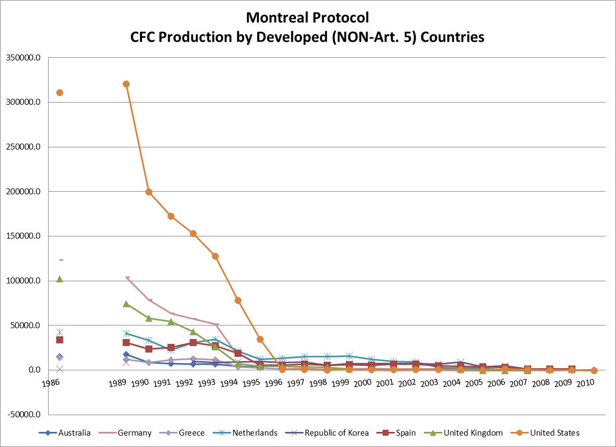
Phaseout by ~1995

Slide 30
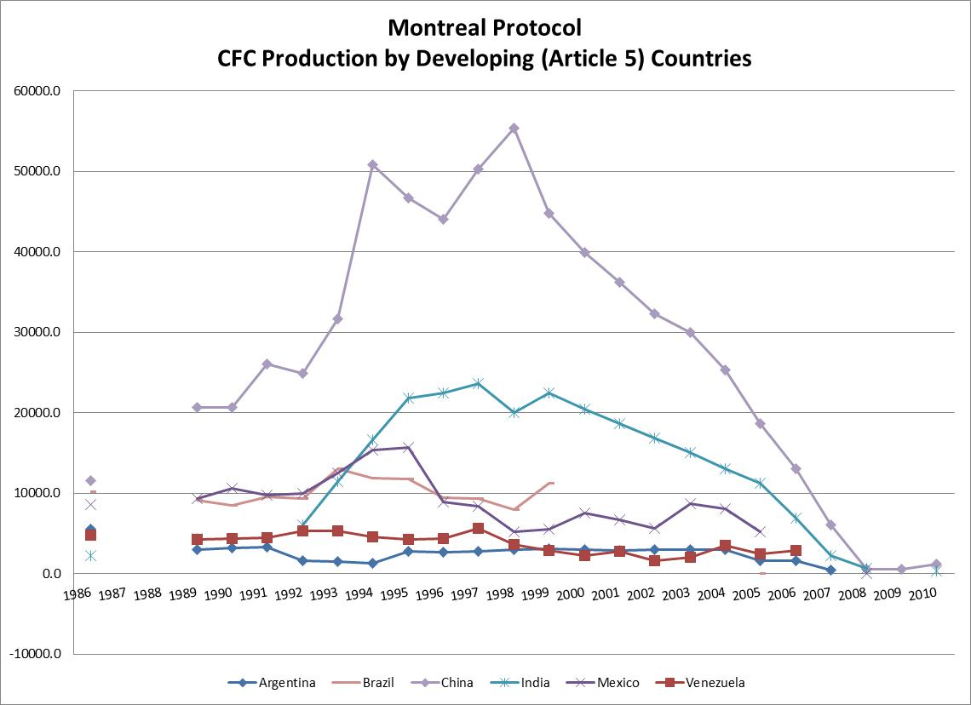
Phaseout by ~2005

Slide 31
Montreal Protocol
Analysis of Influence
Developed countries
  Rapid change that is hard to explain otherwise
  Economics weren’t supportive initially
Developing countries: change at different point in time
Process: Not compliance due to enforcement concerns but due to political pressures leading to scientific research which produced economically beneficial products
Course takehomes:
  Counterfactual based on comparing different regulation of members, not membership vs. non-membership
  Effective institutional design improved over time

Slide 32
Climate Change and International Institutions
Paris Climate Talks
Pledges and their Influence?

Slide 33
Climate Change and International Institutions
Course takehomes:
  Problem structure may make it really hard to solve a problem, especially if countries unwilling

Slide 34
Conclusions
How do we evaluate institutional influence on behavior?
How does problem structure increase or decrease institutional influence?
How does institutional design increase or decrease institutional influence?

