Slide 1
Presenting your research
ONE Powerpoint or PDF slide
2 minutes
Simple – not expecting much

Slide 2
Four basic response options
Mitigation
  Reduce our generation of GHGs
  “Many impacts can be reduced, delayed or avoided by mitigation” (IPCC, 2007)
Adaptation
  Change how we live when climate changes do occur
  “Unmitigated climate change would, in the long term, be likely to exceed the capacity of natural, managed and human systems to adapt” (IPCC, 2007)
Geo-engineering
  Develop technologies to reduce incoming solar energy or “store” carbon we emit
Grief
  Accept losses, changes we can’t avoid or adapt to

Slide 3
Adaptation, Geo-engineering and Grieving

Slide 4
Criteria for Comparing Mitigation/Adaptation/Geoengineering
Intended consequences
  Humans
  Other animals, plants, etc.
Unintended consequences
  Ocean acidification
Ease of action
Cost of action
Distribution of costs
Distribution of benefits
Cost efficiency and cost effectiveness

Slide 5
Adaptation
Exposure
Vulnerability
Adaptive capacity
Adaptation
Resilience

Slide 6
Why adaptation vs. mitigation?
Timescale mismatch – changes will happen even IF we return to prior levels eventually. Impacts are coming and so will need to adapt.
Vulnerability is increasing – adaptation to climate impacts are growing even without growing climate change because of demographic shifts, particularly to the coast and other vulnerable areas.
Impacts are going to happen and vulnerable are demanding help.

Slide 7
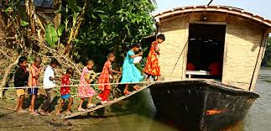
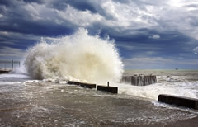
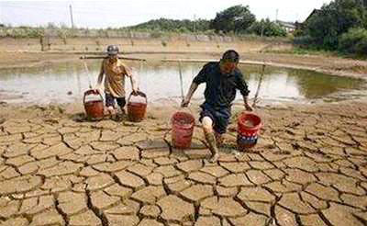
What is being done?
Adaptation
Relocate and displace
Protect infrastructure
Change behaviors

Slide 8
Preparing for Climate Change
Vicki Arroyo, The Rockefeller Foundation grantee
  Climate change and resilience.

Slide 9
Caveats on adaptation
Climate change not main cause of vulnerabilities
  Flooding and cyclone risks are due mainly to demographic shifts
  Reduced water availability due to population not climate change
Political implications
  “Poor and vulnerable” will find it hard/impossible to adapt
  “Rich and vulnerable” who can adapt easily have weak incentives to help others
What adaptation can’t do:
  Many people won’t be able to adapt because of lack of resources.
  Loss and damage negotiations of Warsaw (2013): “Residual damage” (Parry et al) when society doesn’t make all the changes need to fully adapt, with some remaining damage
  Animals and plants cannot adapt.

Slide 10
Geo-engineering options (Boyd 2008)
Carbon burial. Store CO2 under pressure below Earth’s surface
Geochemical carbon capture. Dissolve CO2 during emission in seawater.
Atmospheric carbon capture. Capture CO2 from air masses chemically via towers that “scrub” the wind.
Ocean fertilization. Nitrogen fertilization of ocean waters to boost phytoplankton productivity which sinks and “sequesters” CO2 in deep oceans.
Stratospheric aerosols. Inject sulphur particles into upper stratosphere, using balloons or projectiles, which are there to form aerosols to reflect sunlight.
Cloud-whitening. Spray seawater droplets into air below marine clouds to increase their size.
Sunshades in space. Launch many sunshades into orbit to redirect incoming sunlight in space
National Academy of Sciences study of this currently underway

Slide 11
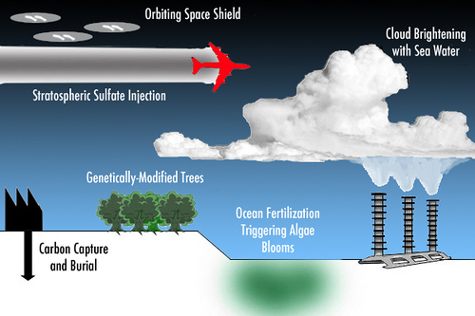
What may be done?
Geo-engineering

Slide 12
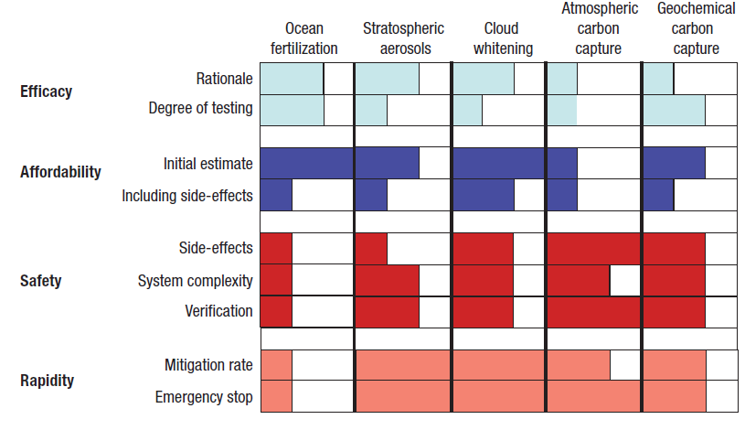
Geo-engineering options
Boyd, Philip W. 2008. Ranking geo-engineering schemes. Nature . Vol 1 (November)

Slide 13
Geo-engineering the planet
Schneider’s intentional vs. unintentional
  Unintentional: climate change!
  Intentional: effort to avoid problems of climate change
  But if we manipulate it intentionally, responsibility shifts
    Will connections of additional damage be clear enough to blame those who intentionally manipulated the climate? Victor et al. argues yes but Schneider argues no
    And, additional damage due to climate change (unintentional geo-engineering) ARE what loss and damage negotiations are about

Slide 14
Geo-engineering caveats
May not fix climate change problem
  At all
  For long periods of time
Doesn’t fix other CO2 problems, e.g., ocean acidification
Side effects
Inability to control perfectly
Moral hazard: reduced efforts toward mitigation

Slide 15
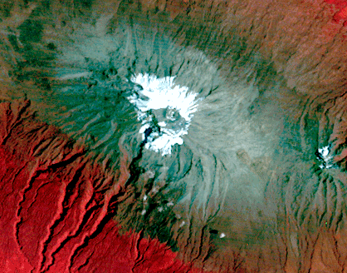
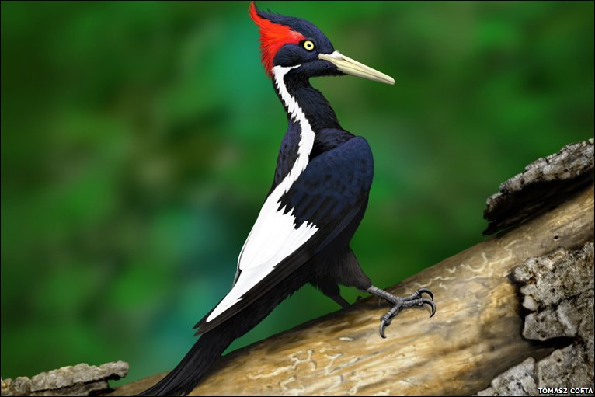
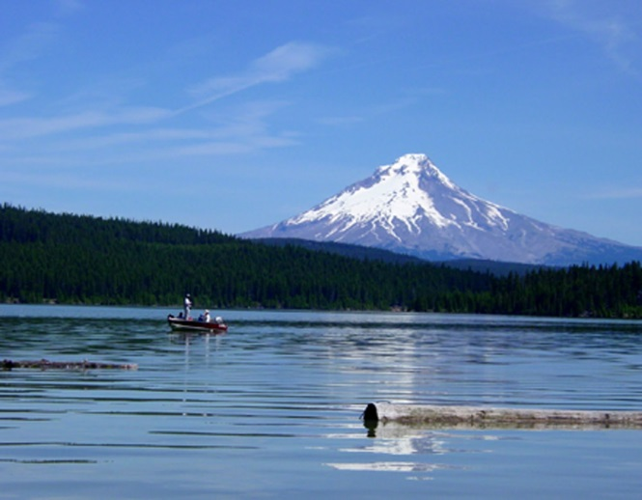
What has been lost?
Grieving and loss
The Snows of Kilimanjaro
1976
Ivory-billed Woodpecker:
Killed by Hurricane Katrina?
http://earthshots.usgs.gov/earthshots/Mount-Kilimanjaro
Mt.Hood:
Like this in Winter?
http://www.gambassa.com/public/project/profile/0/0/2771/AveryHorne%27sIvoryBilledWoodpeckerreport.jpg
http://mthoodrentals.blogspot.com/2011/05/schools-almost-out-have-you-planned.html

Slide 16
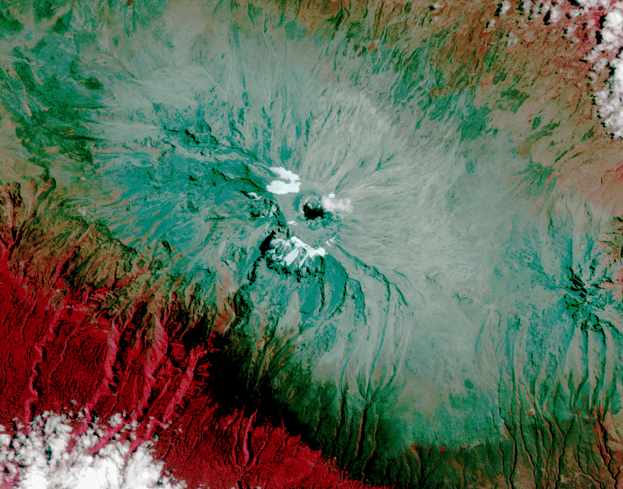
What has been lost?
Grieving and loss
The Snows of Kilimanjaro
2010
Ivory-billed Woodpecker:
Killed by Hurricane Katrina?
http://earthshots.usgs.gov/earthshots/Mount-Kilimanjaro
Mt.Hood:
Like this in Winter?
http://www.gambassa.com/public/project/profile/0/0/2771/AveryHorne%27sIvoryBilledWoodpeckerreport.jpg
http://mthoodrentals.blogspot.com/2011/05/schools-almost-out-have-you-planned.html

Slide 17
What should we do?

