Slide 1
Good News on Climate Change or
Why We’re Going to Beat this Thing!

Slide 2
Thanks to the following for their suggestions!
Tobias Belschner, Berlin Graduate School for Transnational Studies
Lena Bendlin, Free University Berlin
Pam Chasek, Int’t Institute for Sustainable Development
Radoslav S. Dimitrov, University of Western Ontario
Navroz Dubash, Centre for Policy Research, New Delhi
Ian Fry, Australian National University
Christopher Gore, Ryerson University
Rasmus Karlsson, Hankuk University of Foreign Studies
Jeff McGee, University of Newcastle, Australia
Peter Newell, University of Sussex
Sebastian Oberthur, Vrije Universiteit Brussel
Kate O’Neill, UC-Berkeley
Jonathan Rosenberg, University of Alaska
Jonas Schoenefeld, University of East Anglia
Paul Steinberg, Harvey Mudd College
Geoffrey Wandesforde-Smith, UC-Davis

Slide 3
We are making some headway without really trying

Slide 4
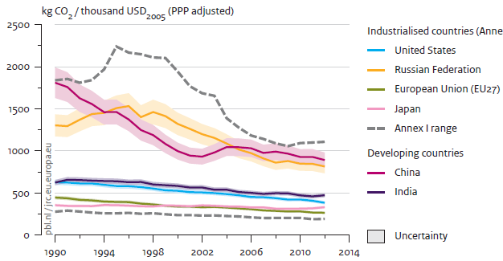
CO2 per dollar declining in all major countries
Trends in global CO2 emissions: 2013 Report, PBL Netherlands Environmental Assessment Agency
http://edgar.jrc.ec.europa.eu/news_docs/pbl-2013-trends-in-global-co2-emissions-2013-report-1148.pdf

Slide 5
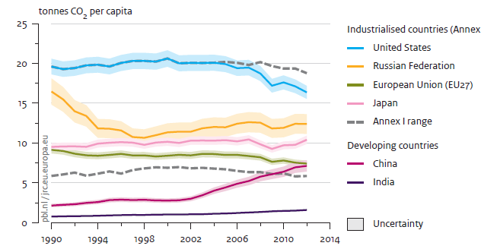
CO2 per person declining in US and Europe
Trends in global CO2 emissions: 2013 Report, PBL Netherlands Environmental Assessment Agency
http://edgar.jrc.ec.europa.eu/news_docs/pbl-2013-trends-in-global-co2-emissions-2013-report-1148.pdf

Slide 6
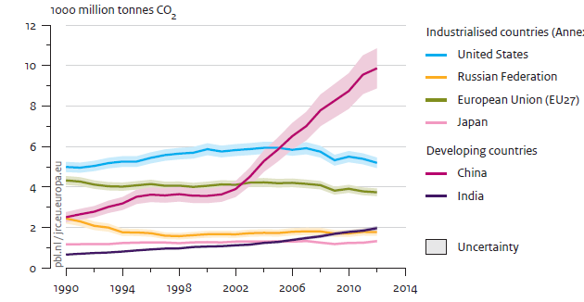
Total CO2 declining in US and Europe
Trends in global CO2 emissions: 2013 Report, PBL Netherlands Environmental Assessment Agency
http://edgar.jrc.ec.europa.eu/news_docs/pbl-2013-trends-in-global-co2-emissions-2013-report-1148.pdf

Slide 7
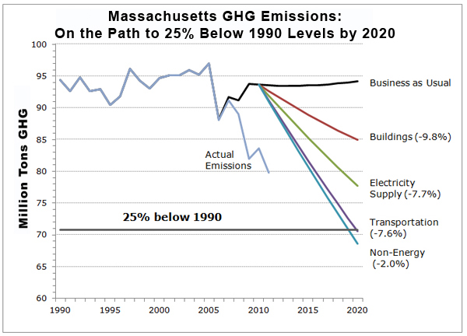
Can REALLY make headway if we try Mass economy is growing
Source unknown but not R. Mitchell

Slide 8
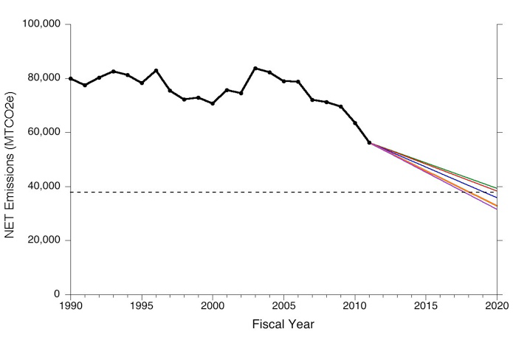
Can REALLY make headway if we try University of New Hampshire
Source unknown but not R. Mitchell

Slide 9
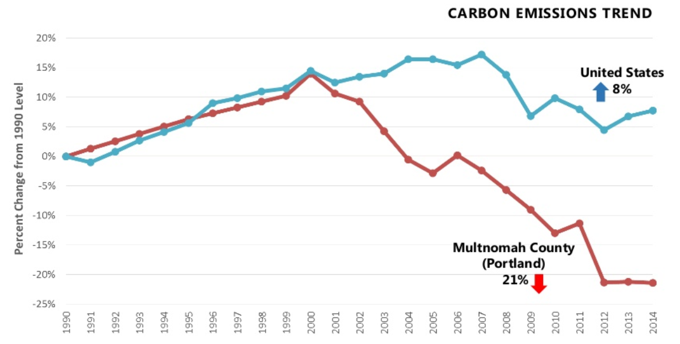
Can REALLY make headway if we try Portland vs. US
Mauricio LeClerc, PBOT, https://www.slideshare.net/academusgmbh/parade-of-cities-at-the-umd17-portland

Slide 10
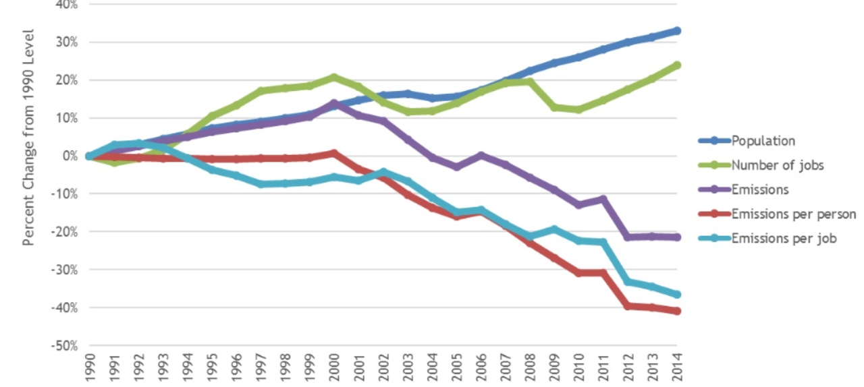
Can REALLY make headway if we try
Population & jobs up, CO2 down
Mauricio LeClerc, PBOT, https://www.slideshare.net/academusgmbh/parade-of-cities-at-the-umd17-portland

Slide 11
Technological Developments
Are Promising

Slide 12
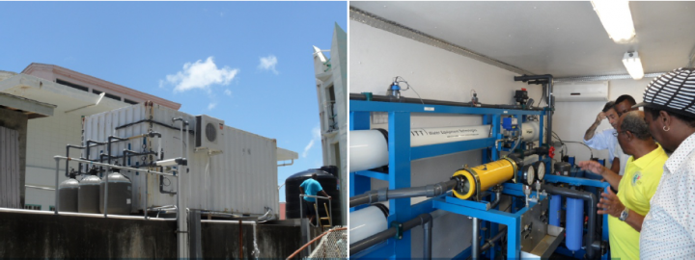

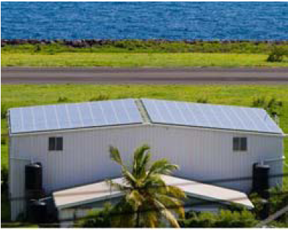
Some island states are adapting
St. Vincent and Grenadines island of Bequia installs solar panels to power a desalination plant to avoid saltwater intrusion
https://weadapt.org/knowledge-base/ecosystem-based-adaptation/special-programme-for-adaptation-to-climate-change-spacc?utm_source=weADAPT&utm_campaign=e1f32e00f9-Monthly+Newsletter&utm_medium=email&utm_term=0_be94db1743-e1f32e00f9-97775189

Slide 13
Germany renewables in use
Clean-energy sources meet more of German electricity demand than any other source (Bloomberg news)
Biggest German utility company to get rid of gas and coal plants and focus on renewable energy (Guardian)

Slide 14
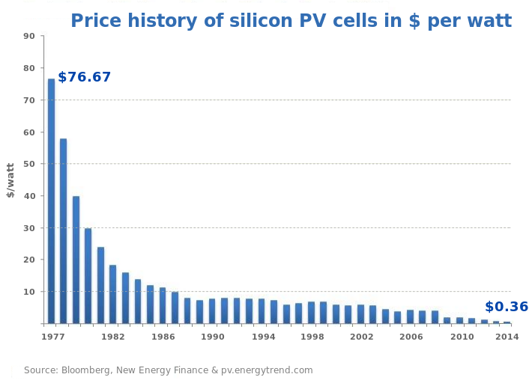
Renewable energy getting cheaper
http://commons.wikimedia.org/wiki/File:Swanson-effect.jpg#mediaviewer/File:Price_history_of_silicon_PV_cells_since_1977.svg

Slide 15
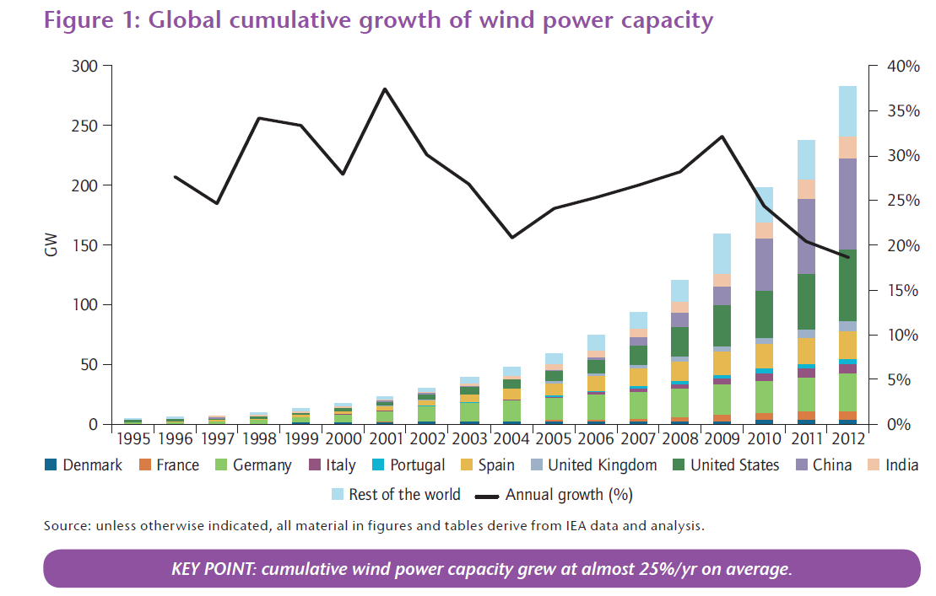
More renewable energy installed
http://www.iea.org/publications/freepublications/publication/Wind_2013_Roadmap.pdf

Slide 16
Batteries May Make Solar and Wind Energy Viable
New battery technologies help overcome a major obstacle to renewable energy, by providing storage
But also, innovation in running hydropower dams “backwards” with excess electricity from windmills to store energy
http://www.ted.com/talks/donald_sadoway_the_missing_link_to_renewable_energy.html

Slide 17
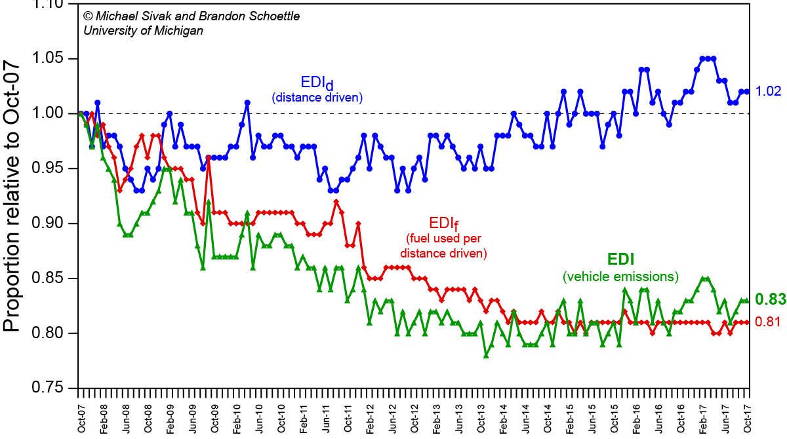
We can get Americans to Drive More Fuel-Efficient Cars and to Drive Them Fewer Miles
Source: http://www.umich.edu/~umtriswt/img/EDI_October-2017.png

Slide 18
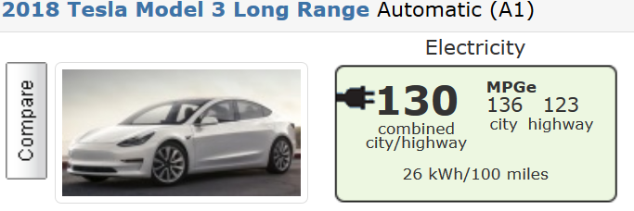
Cool Electric Cars get 100 to 130 mpg
Tesla Model 3 gets equivalent of 130 mpg and Model S gets equivalent of 100 mpg
https://www.fueleconomy.gov/feg/bymake/Tesla2018.shtml

Slide 19
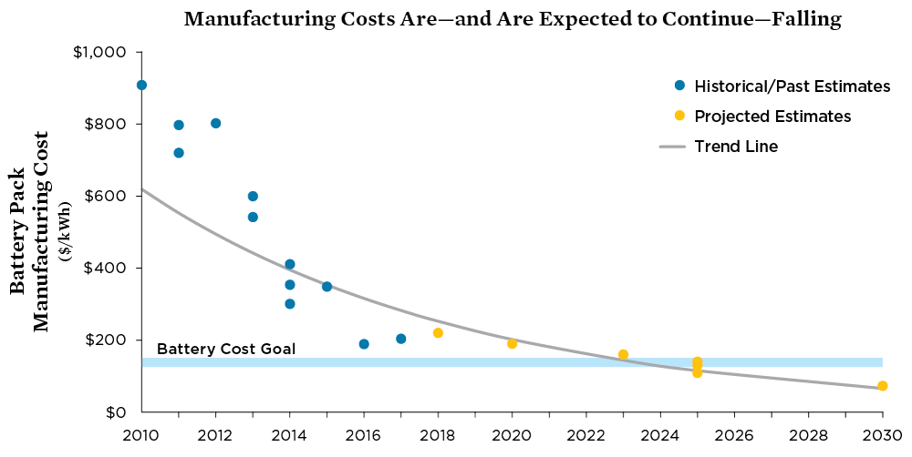
Batteries for Cars (and for Solar and Wind) Getting Cheaper
New battery technologies help overcome a major obstacle to renewable energy, by providing storage
https://www.ucsusa.org/sites/default/files/images/2017/09/cv-factsheets-ev-battery-cost.png

Slide 20
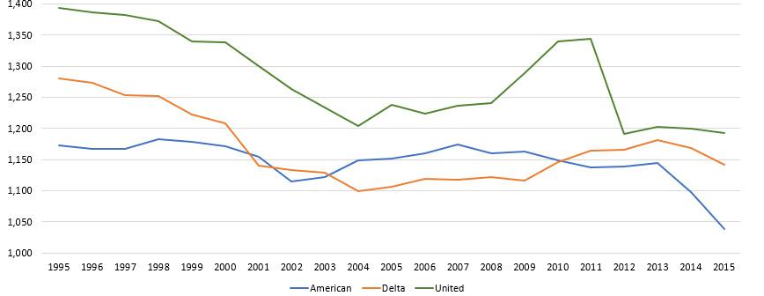
Planes are becoming more fuel efficient and may get moreso
Gallons of fuel per flight hour
An MIT-led team designed an airplane estimated to use 70% less fuel than current planes (and reduces noise and nitrogen oxide pollutants too)
Sources: http://web.mit.edu/newsoffice/2010/nplus3-0517.html and
https://seekingalpha.com/article/4060633-improving-fuel-efficiency-american-delta-united

Slide 21
International Cooperation is Succeeding at Fostering New Energy Technologies
Research into generating electricity through fusion rather than fission is making steady, if slow, progress.
Research supported through international cooperation of China, EU, India, Japan, Korea, Russia, and the US
If successful, it is environmentally safe and offers a real alternative to fossil fuels
http://www.iter.org/

Slide 22
Social and Political Changes
Are Very Promising

Slide 23

People starting movements
Voluntary simplicity movement
“Tiny House” movement
Transition Movement: grassroots communities building community resilience in face of climate change

Slide 24
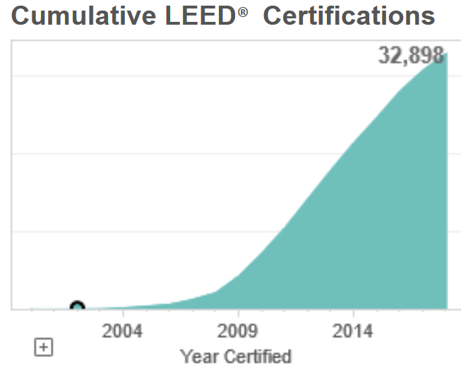
LEED Buildings make rapid headway
Leadership in Energy and Environmental Design (LEED) idea launched by Green Building Council in 1998 by “industry mavericks”
Over 32,000 LEED projects cover 4.5 billion sq.ft.
New US embassies must meet LEED standards

Slide 25
California prices carbon
California adopts cap-and-trade system and set its own ambitious emissions reduction target of 40% below 1990 levels by 2030
https://climatepolicyinitiative.org/2015/05/01/californias-new-2030-climate-target-aims-to-quicken-the-pace-of-lowering-emissions/

Slide 26
German City Creates
Energy Technology Park
Covenant of Mayors: over 6,000 mayors have committed to meet or exceed EU’s 20% CO2 reduction objective by 2020
Gelsenkirchen Germany (an old coal, steel and glass industry city) set up energy technology park with help from European Union and set a voluntary carbon reduction target to go from “a city of a thousand furnaces to a city of a thousand suns” (Newell, Phillips, & Mulvaney Pursuing Clean Energy Equitably).

Slide 27
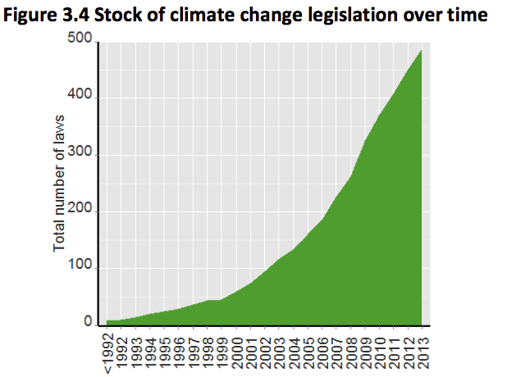
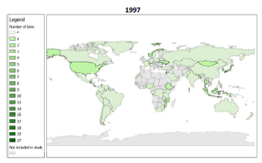
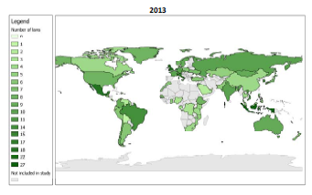
http://www.qualenergia.it/sites/default/files/articolo-doc/IVCCL.pdf

Slide 28
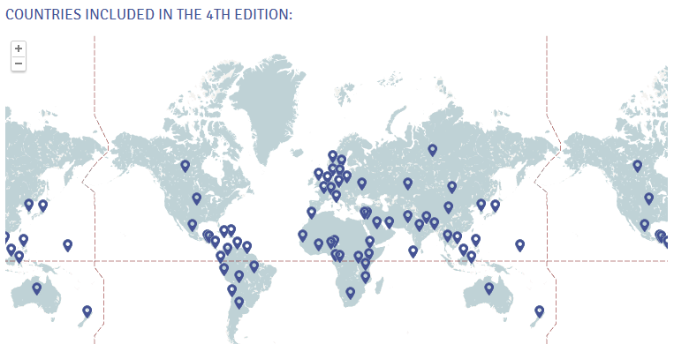
More countries are regulating GHGs even without international rules
More countries adopting climate legislation AND strategies: 67% of GHGs in 2012 (up from 45% in 2007)
Including developing countries in Asia & Latin America
UK climate change act (80% GHG reduction by 2050)
Dubash, Hagemann, Hohne, and Upadhyaya, 2013, Developments in national climate change mitigation legislation and strategy, http://dx.doi.org/10.1080/14693062.2013.845409
GLOBE Climate Legislation Study, http://www.globeinternational.org/studies/legislation/climate

Slide 29
Indonesian Islamic leaders preach conservation
The Islamic Leader Forum for Environmental Care (FORDALING) argues that the Koran directly addresses the need to protect nature in Ayat-Ayat Konservasi (Islamic Verses for Conservation) and educated Islamic leaders to use sermons to promote nature conservation
http://www.enn.com/wildlife/article/42391

Slide 30
Efforts to Address the Climate
And Social Justice
“Just Energy”: innovative collaboration of NGO, engineers, lawyers, academics, and consultants that is helping low-income communities in South Africa to provide "a fair return on renewable energy for local people and investors alike.“
http://just-energy.org/

Slide 31
International climate policy is improving
(despite appearances)
Paris 2015
  Other countries moving forward, even without US leadership
  New commitments likely at 2020 Conference of Parties
World Bank is halting financing of coal-fired plants
Lots of transnational action below state government level
  Government-to-business partnerships
  City-to-city partnerships
  Government-to-city/state partnerships
  Corporate partnerships
  NGO-to-government partnerships

Slide 32
Ideas for Reducing
Your Carbon Footprint

Slide 33
Discussion:
What can each of us do?

Slide 34
Ideas for Reducing
Your Carbon Footprint
Don’t get the question wrong!
  Don’t ask: “how can I reduce my carbon footprint”
  Ask: “how can I live my life so the world emits less carbon”
Do something political
Do something social
Do something economic
Try to do more tomorrow than today:
  “get the trend right, not the level”

