Slide 1
Civil Society in Global Environmental Politics
Prof. Jessica Green
University of Toronto
Lecture for Prof. Mitchell
29 October 2020

Slide 2
Outline
What do we mean by civil society?
NGOs as insiders
Cultural change and world civic politics
NGOs and policy change: their constraints and how they deal with them
Thinking more broadly

Slide 3
Civil society – some terms
NGOs
  can be “green” or business-oriented
Transnational actors: TEAGs, TANs
Movements and movement organizations
Civil society organizations
Local / grassroots groups
  E.g Love Canal Homeowners Association, Concerned Love Canal Renters Association
Lots of different terms, most allude to same basic ideas – outside of government, advocating for change. Main differences are in tactics and organizational form

Slide 4
NGOs in the UN system
Article 71 of the Charter: The Economic and Social Council may make suitable arrangements for consultation with non-governmental organizations which are concerned with matters within its competence.
Notes:
NGOs can be “consulted”. That means they can attend meetings, sometimes they can speak, or present conference papers.
BUT THEY MUST BE VETTED BY STATES.

Slide 5
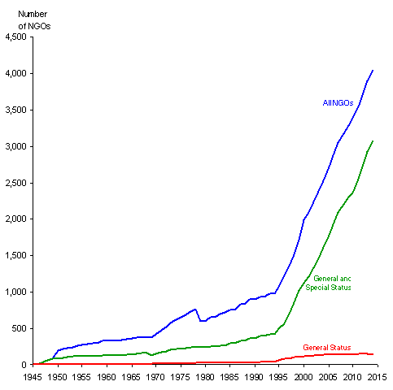
NGOs in the UN

Slide 6
What do they do?
Research – think tanks
  Provide info on policy options – esp. important when uncertainty is prevalent.
  “States can maximize policy information and research while minimizing expenditures” (Raustiala)
Monitoring state commitments
  Sounding “fire alarms” during negotiations and in implementation period.
  Climate Action Network’s “Fossil of the Day”
  Report on negotiations: Earth Negotiations Bulletin

Slide 7
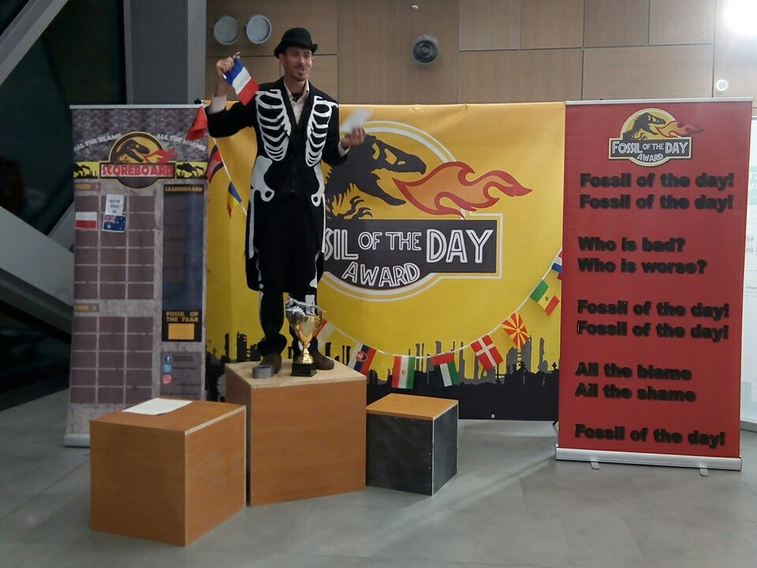

Slide 8
What do NGOs do?
Lobby governments within the framework of negotiations, and domestically
“Enhance domestic signalling”
  Action alerts that you get on various listservs to call your Senator, etc. This is a form of domestic signalling.
  NGO access may allow particular gov’ts to…credibly pass the blame

Slide 9
NGOs as insiders
“If NGOs indeed challenge the state-centric system, why do states allow such wide access and participatory roles?” (Raustiala, 725).
In this view, they work squarely within the intergovernmental process, they help governments strike and implement deals, and they only participate at the leisure of states.

Slide 10
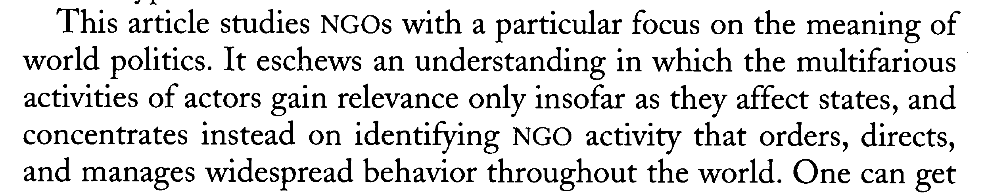
NGOs and “cultural change”
NGOs as engines of cultural change, engaging in world civic politics.
  “influencing the ideational structure within which states and corporations operate” (Wapner 2015, “Forcing Cultural Change”)
  Break down the “cash register” notion of politics – that politics only counts if it changes state behavior.
  “The state and the state-system sit at the end of the line like a cash register does in a store, gauging the political value of all that goes before them.”

Slide 11
NGOs and cultural change
Challenges the relationship between law and behavior. Is it:
  Law → Δ behavior OR
  Δ culture → Δ behavior → Δ law?

Slide 12
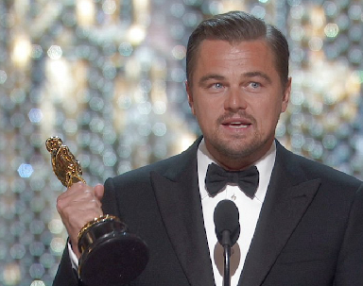
The value of cultural change?
“Being “green” as it were, is now almost a prerequisite for high minded citizenship” (Paul Wapner)
“Climate change is real. It is happening right now. It’s the most urgent threat facing our entire species and we need to work collectively together and stop procrastinating.” (2016 Academy Award Speech)
Notes:
Is this important?

Slide 13
How do you know cultural change is happening?
“the widespread acceptance of the term sustainable development provides one indication of…successful cultural change”
The increased legitimacy of the environmental movement, including the acceptance of NGOs into the formal political process.
Do you agree? Alternative explanations?

Slide 14
NGOs and policy change
Tl,dr: it’s complicated.

Slide 15
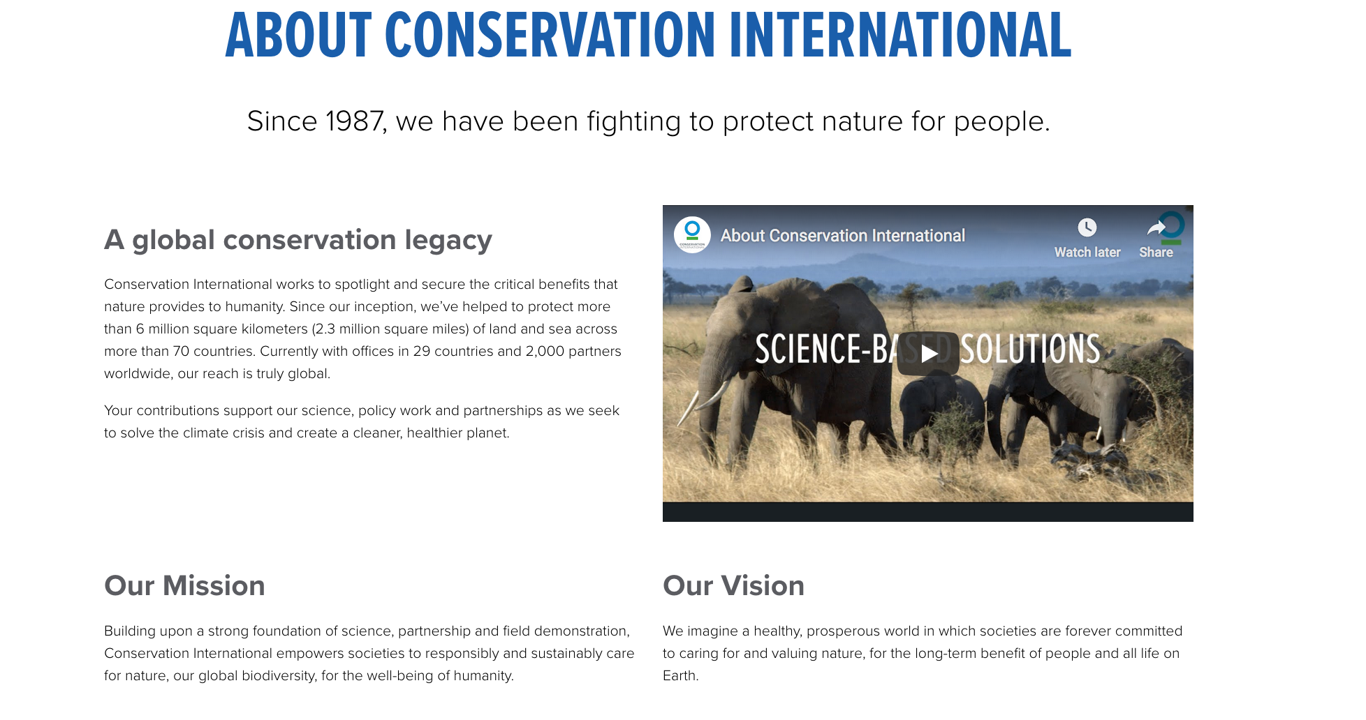

Slide 16
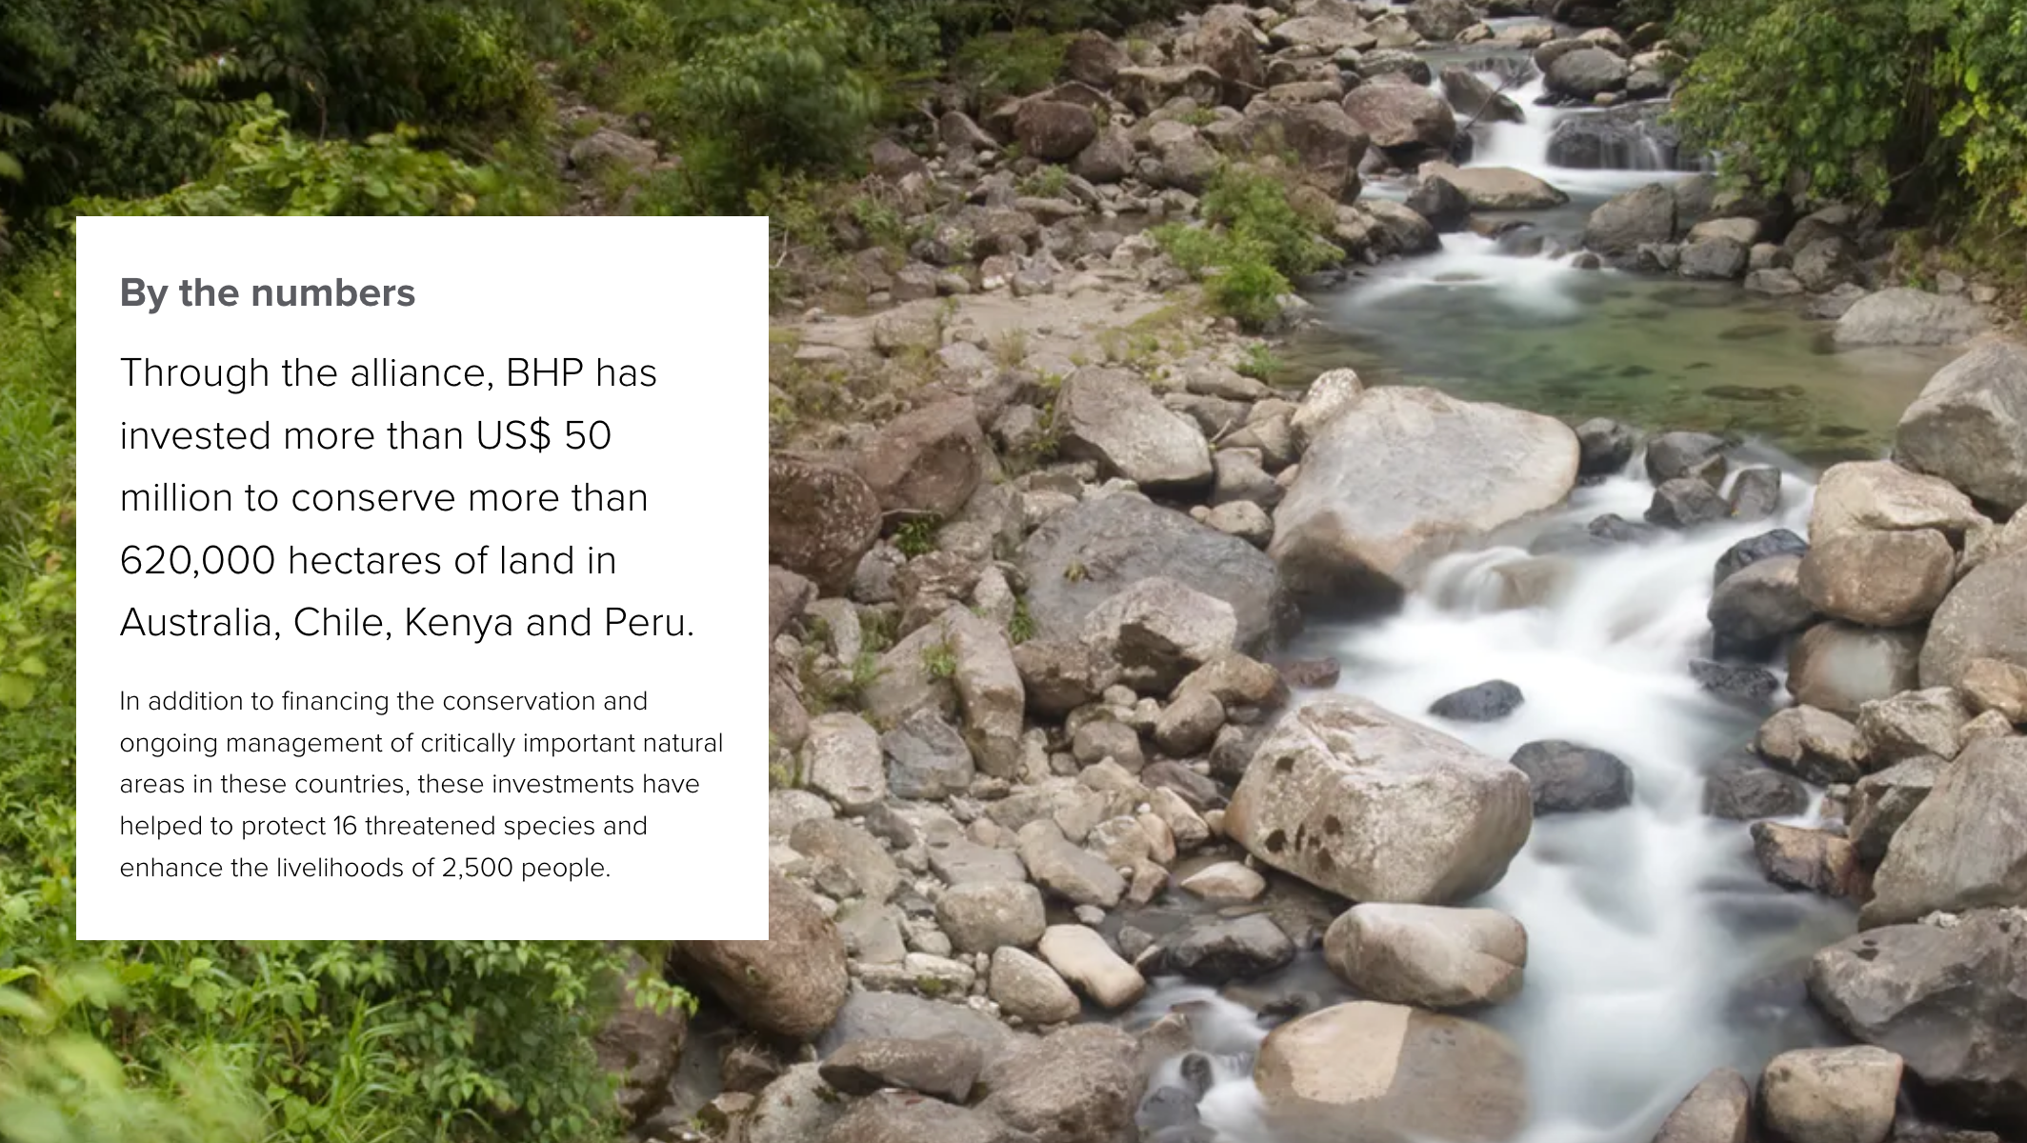

Slide 17
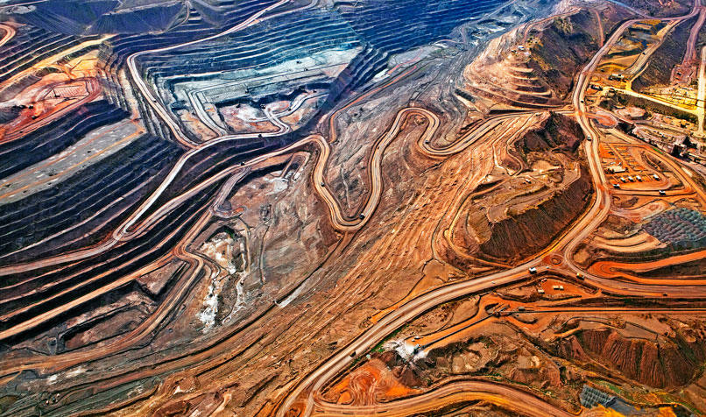
Iron Ore Mine, Western Australia making BHP among top 3 iron ore producers in the world. The mine planned expansion in 2018 to last thru 2021.

Slide 18
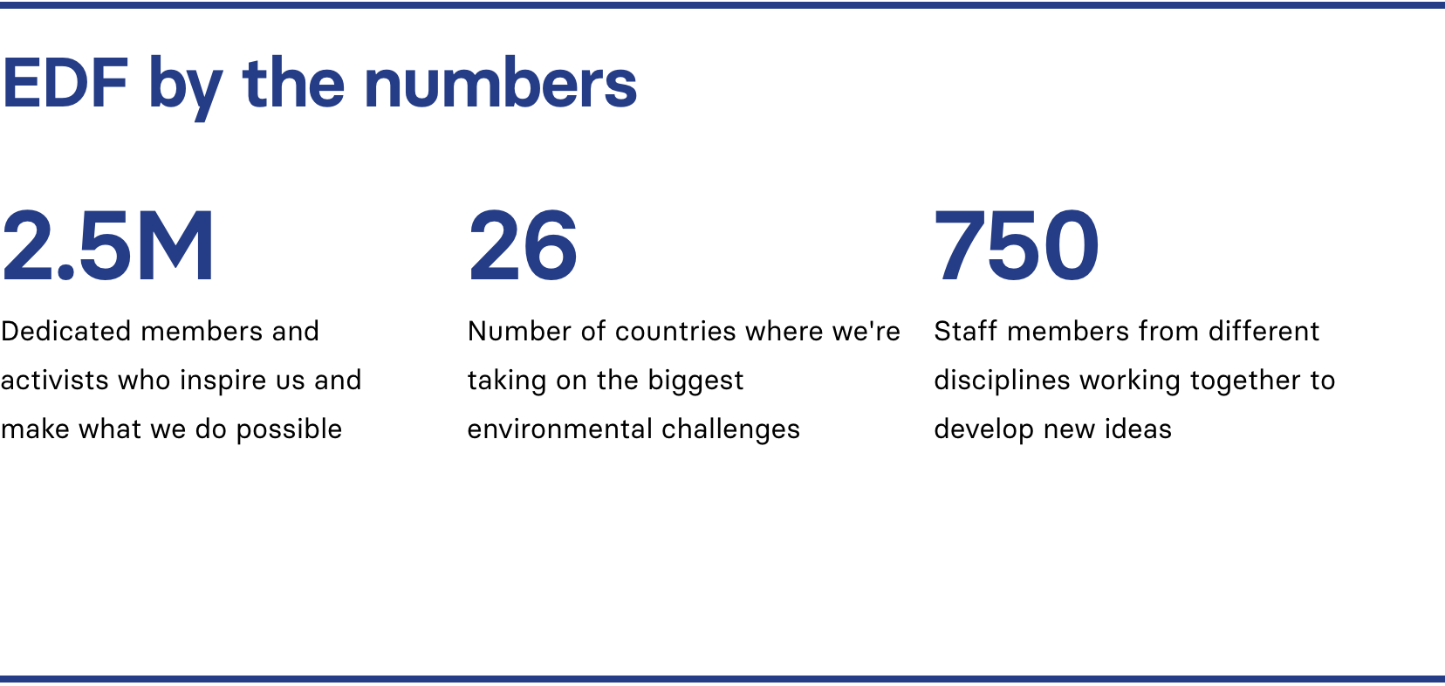
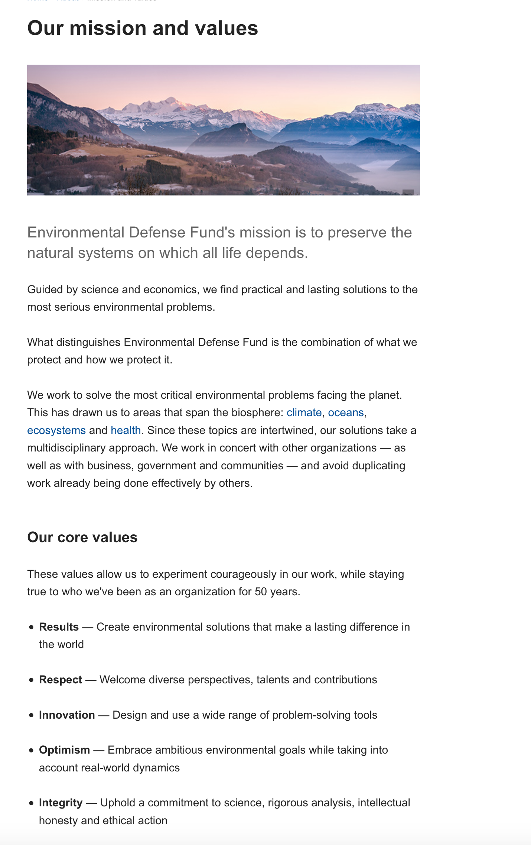

Environmental Defense
Since 1967, their initial strategy? “Sue the bastards” – at the time, a novel approach.

Slide 19
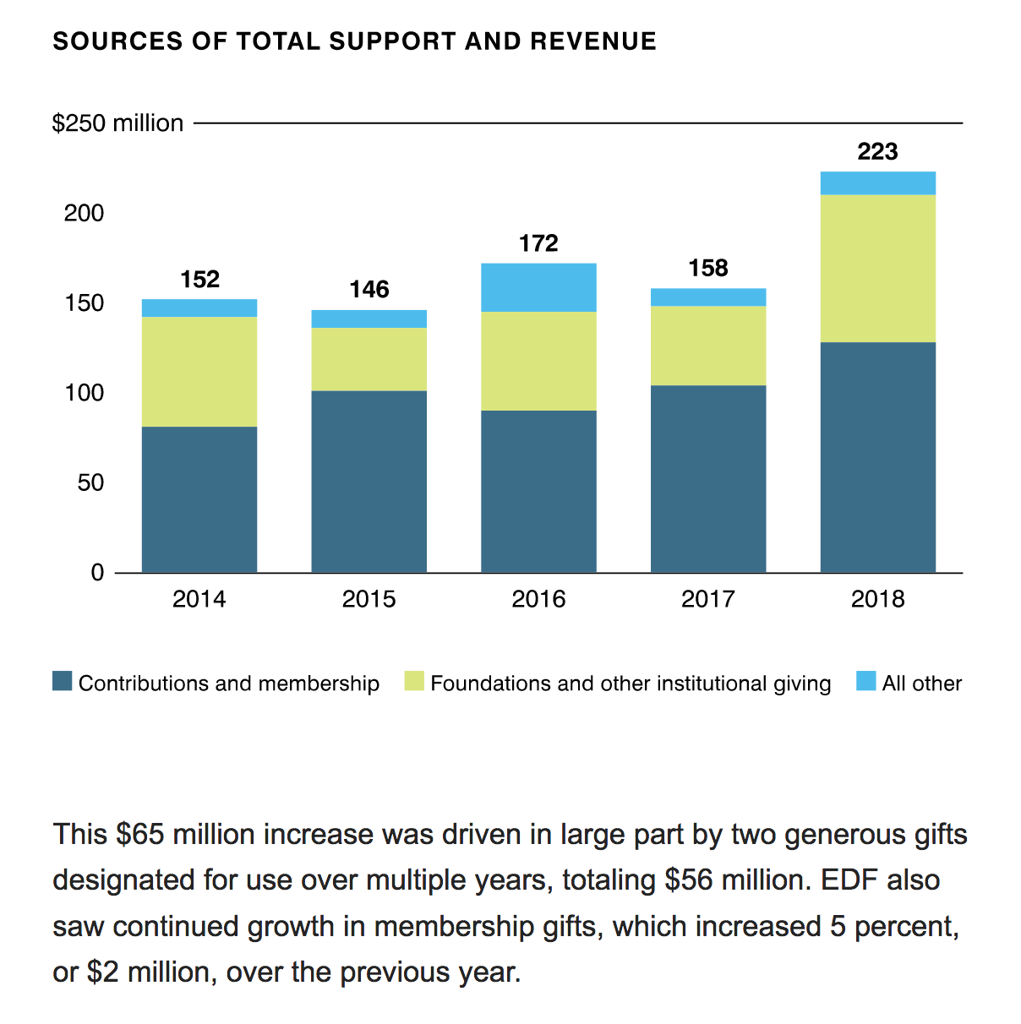
EDF Finances

Slide 20
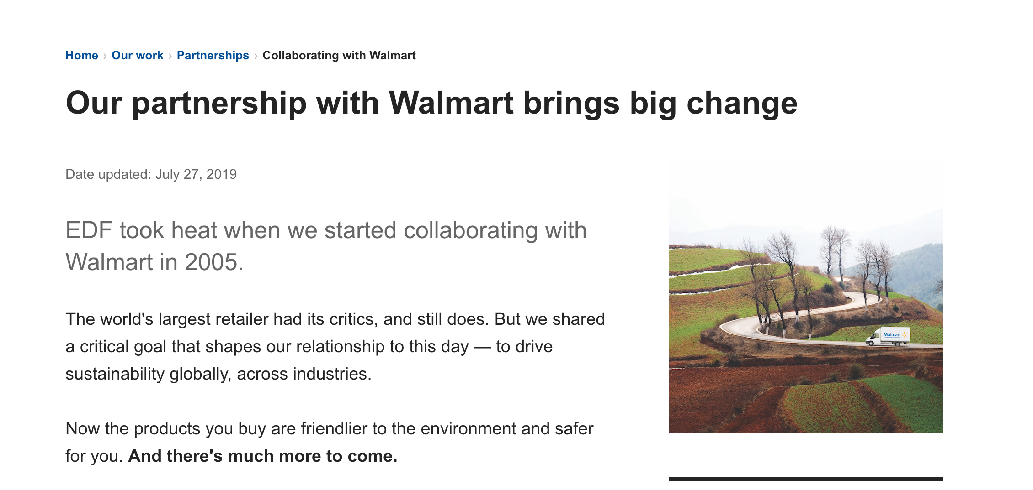
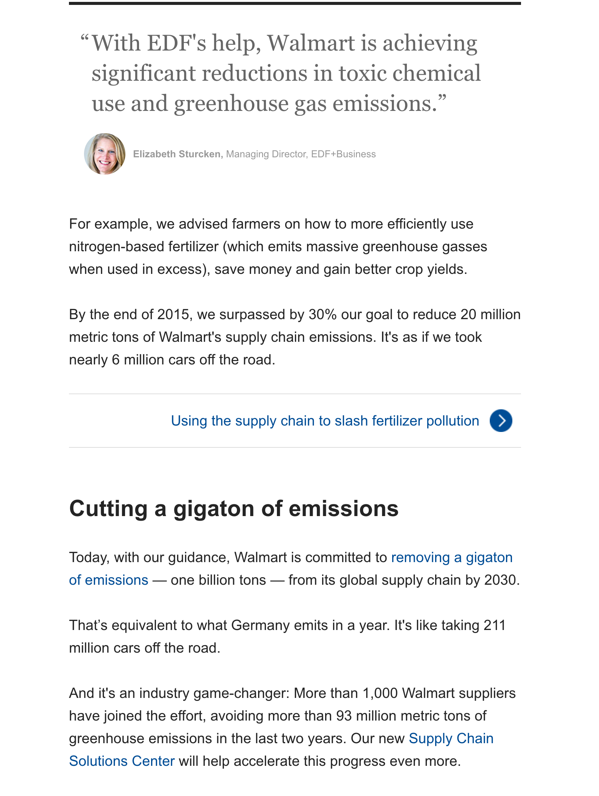
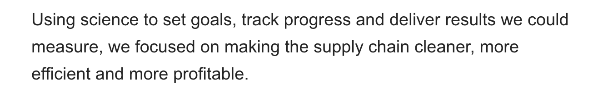

Slide 21
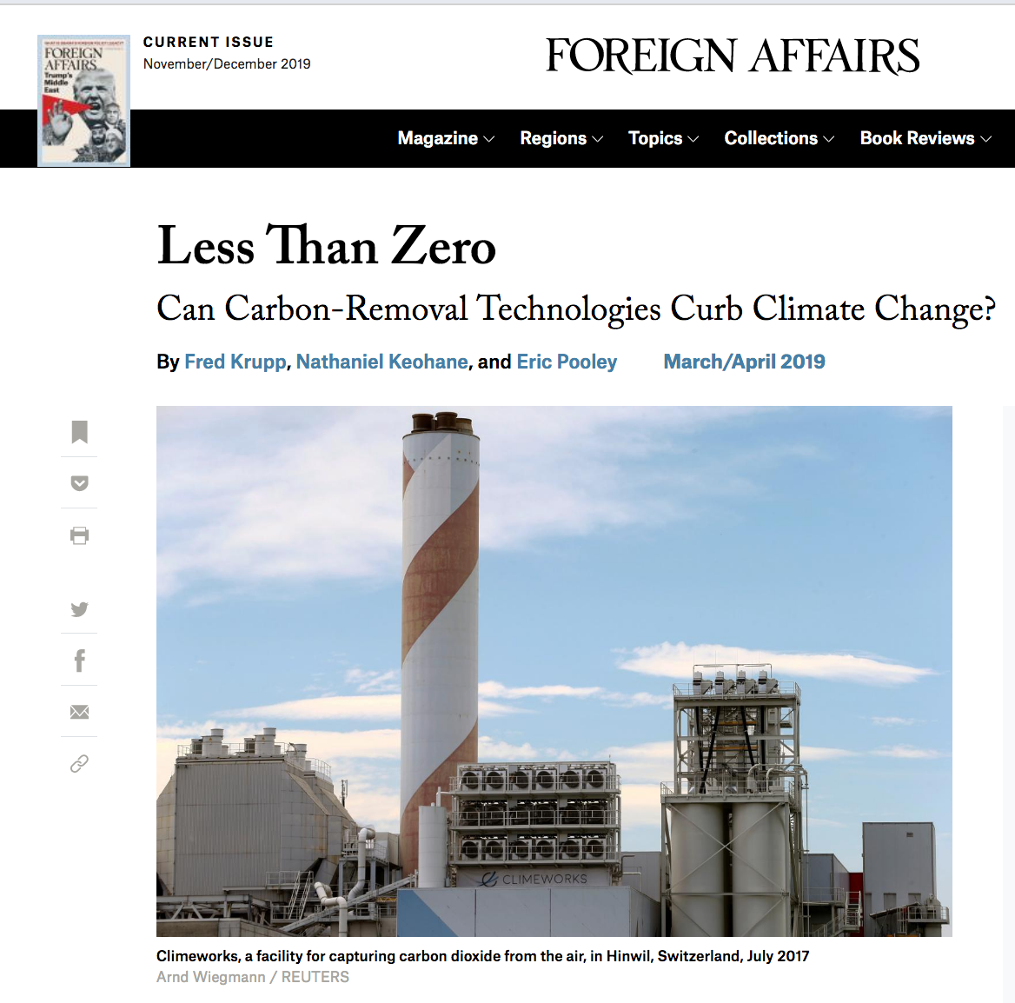
Notes:
"Acting swiftly to cut carbon pollution, including by moving to clean energy across the global economy and protecting tropical forests, is absolutely central to protecting our health, economy, and future. But removing carbon from the atmosphere must also be part of any comprehensive ‘Plan A' for solving the climate crisis," said Krupp, president of EDF. "The world has waited too long to act – we need both clean energy and carbon pollution removal now."

Slide 22

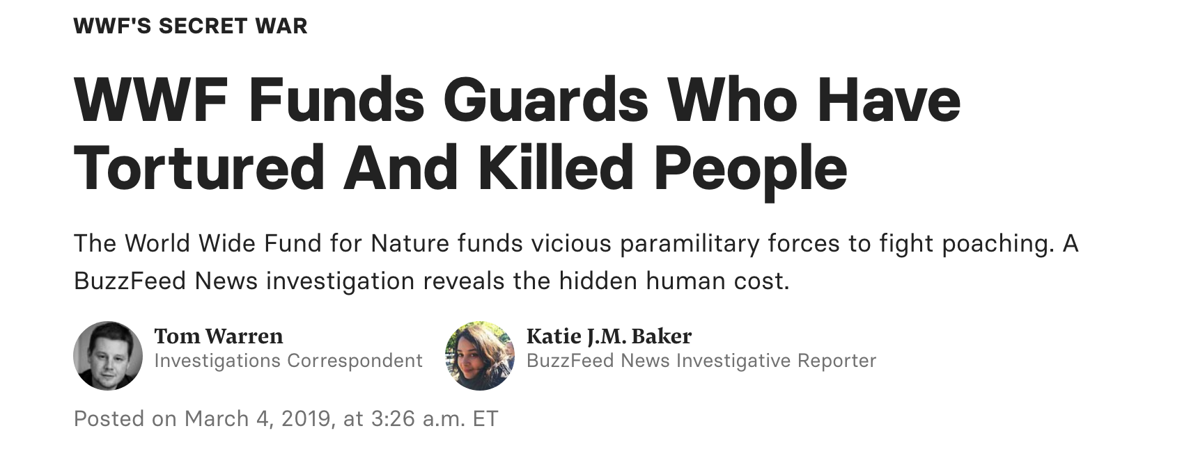

Slide 23
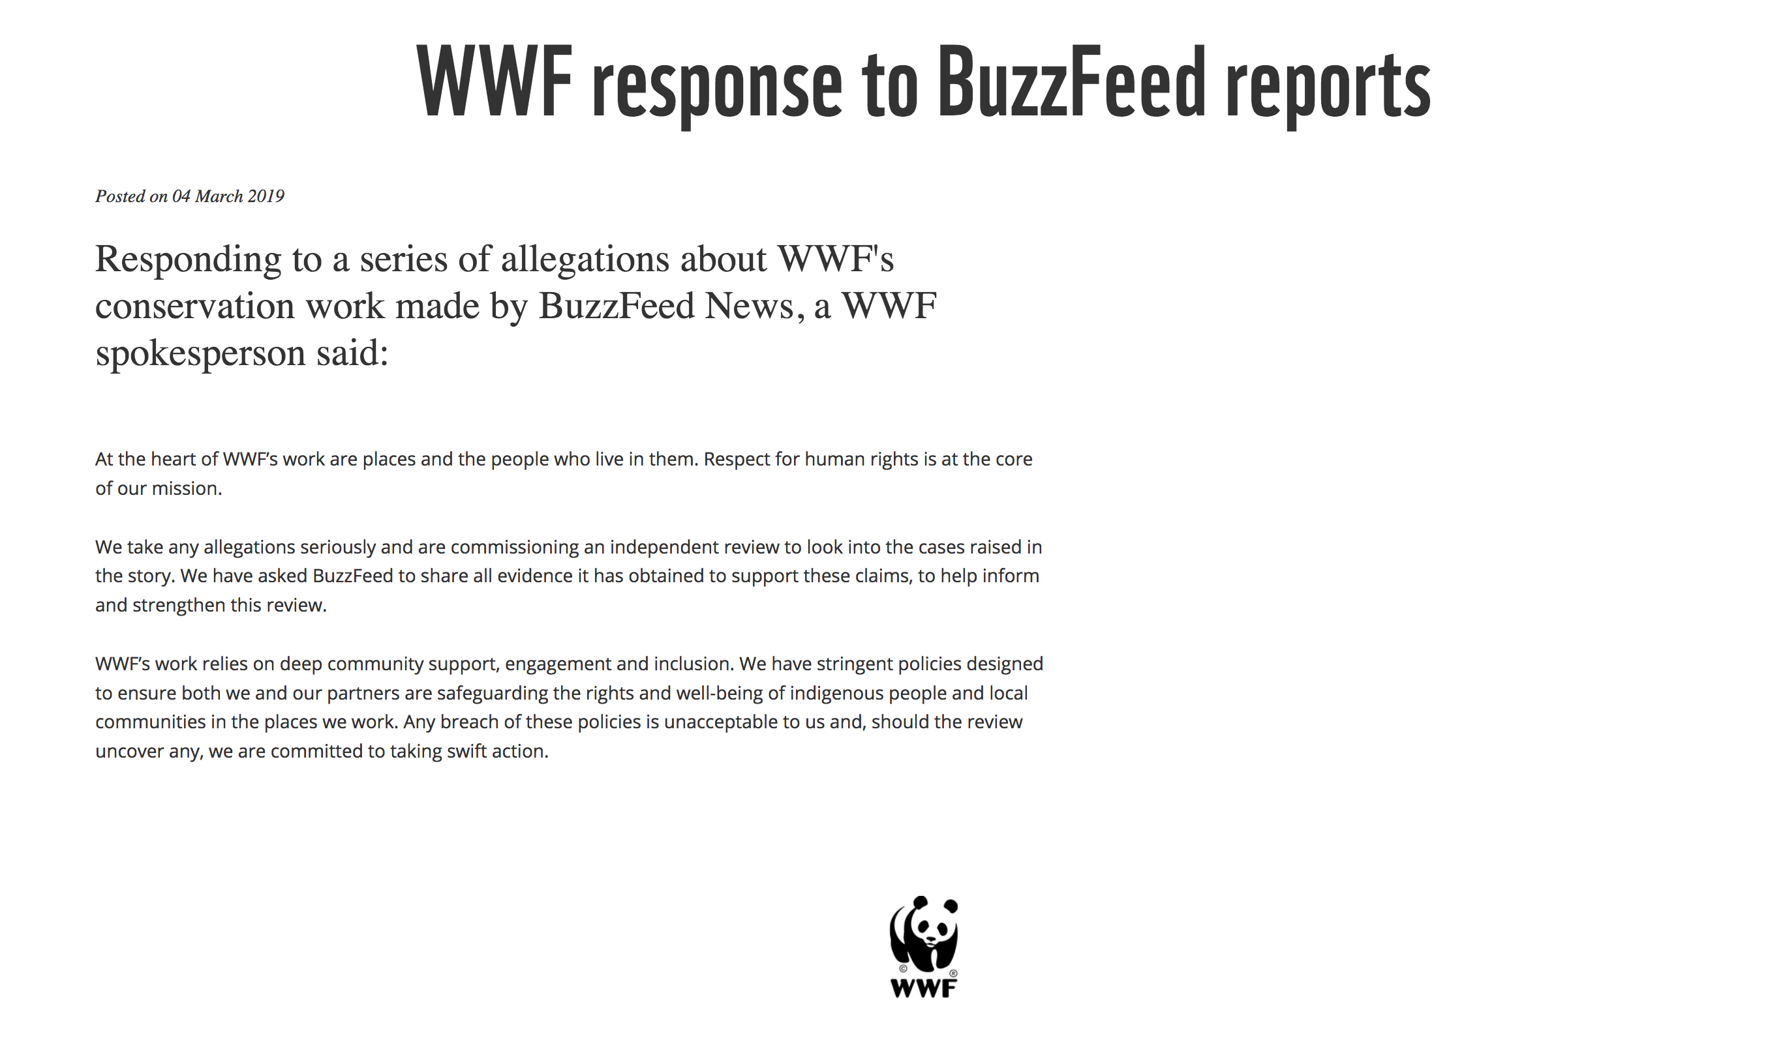

Slide 24
The institutionalization of activism
Big budgets (see, e.g. EDF)
Increased funding from corporations and family foundations
  And competition for that $$
Brand differentiation as a way to please external audiences, gain funding.
The nonprofit industrial complex: “quit dissent and institutionalize corporatist values”
A comfortable career saving the world

Slide 25
The result? Vanilla victories
Establish authority to become politically salient
Maintain political salience and authority by pleasing multiple stakeholders: everyone likes the flavor vanilla!
Make strategic choices about targets – pick battles you can win
Ultimately, if you want to be a leading INGO, then your best bet is vanilla victories
  “Environmentalists failure to achieve more is because they…accept incremental progress.” (Nordhaus and Shellenberger)

Slide 26
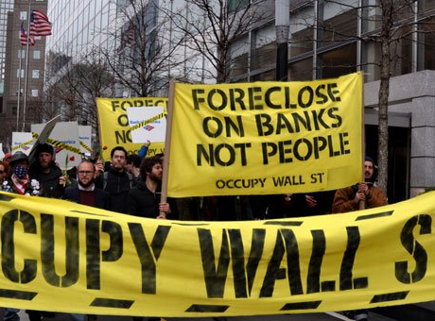
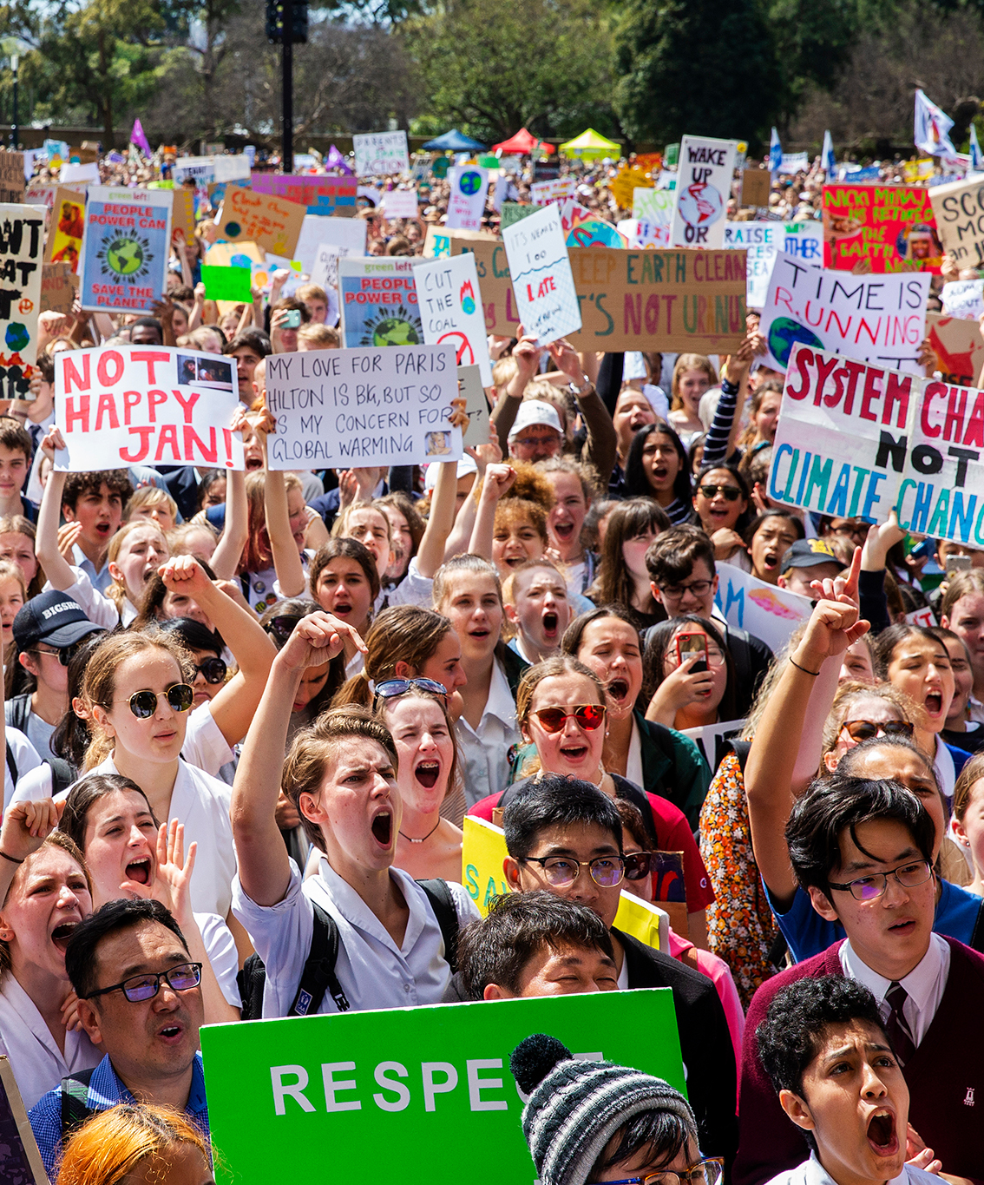
What’s the alternative?

Slide 27
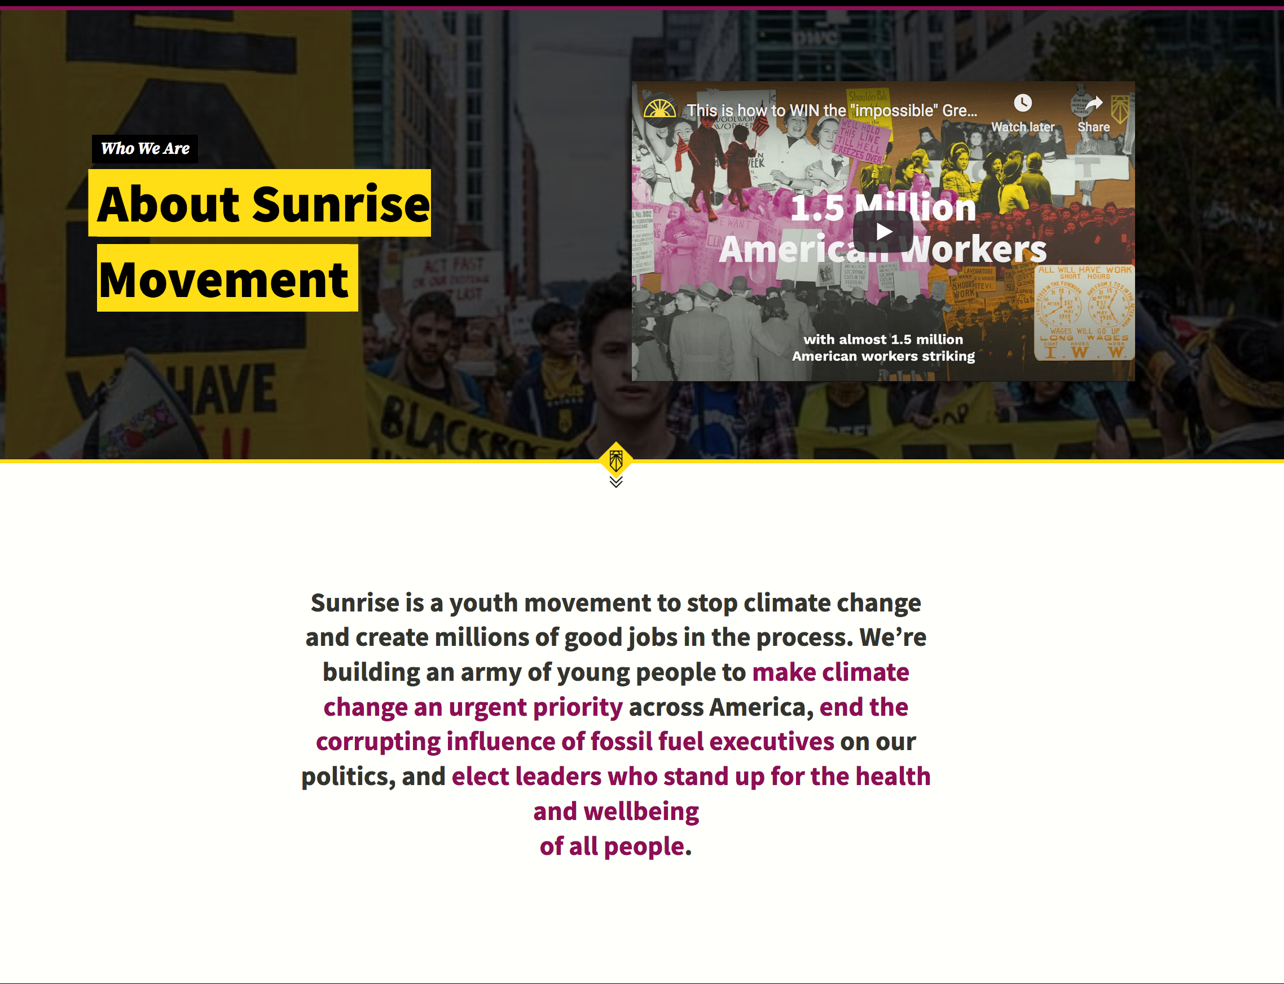
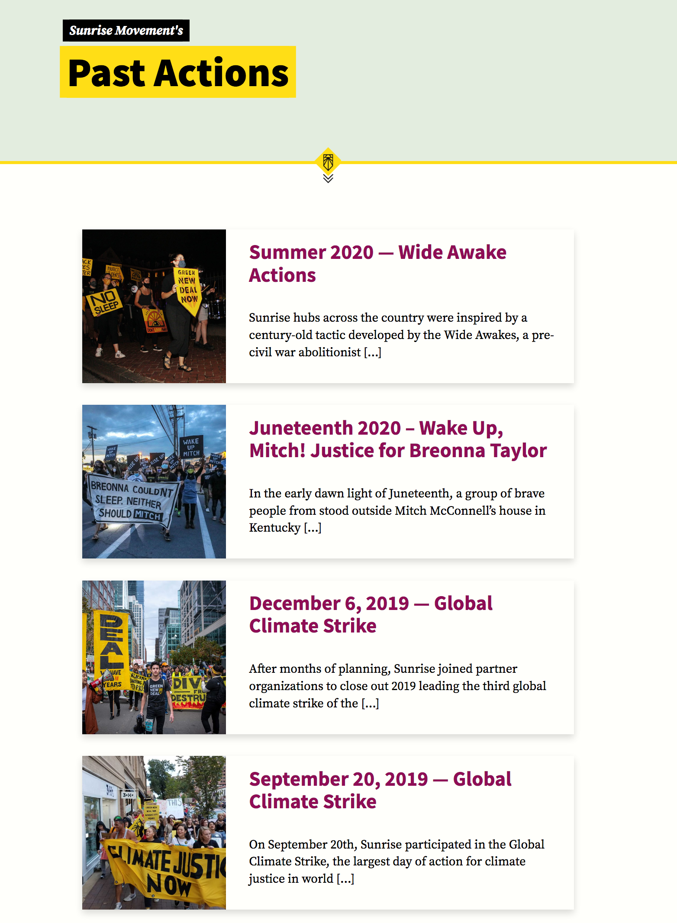

Slide 28
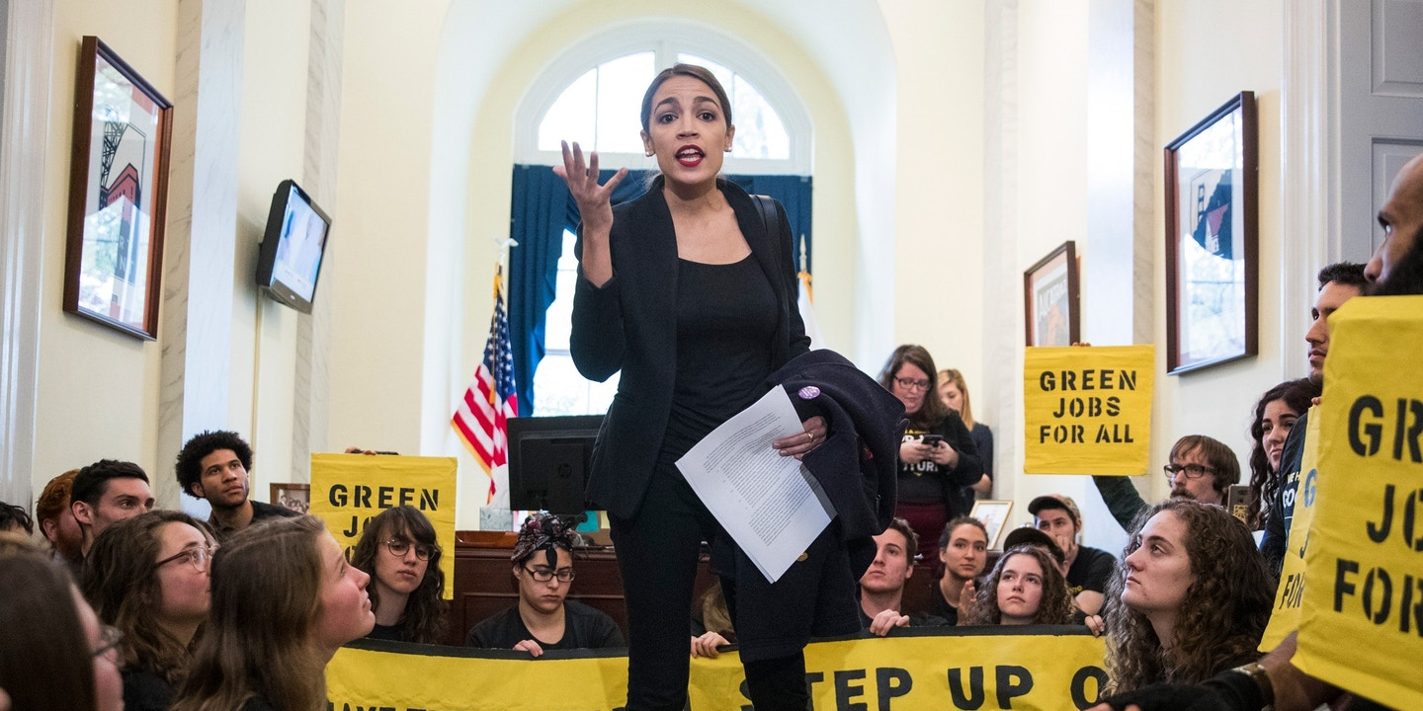

Slide 29
Movements vs. Organizations
Movements : Organizations :: Politics : policy
Decarbonization vs. Carbon pricing
Public health vs Pollution controls

Slide 30
Recap…
One role for NGOs is as part of the intergovernmental process.
  Their involvement is approved by states, and as a result, their job is to help states in the multilateral process.
Leading NGOs have to work hard to create their authority, and once they do so, they’re constrained as to what they can do / propose w/o jeopardizing that authority and relevance.
But there is a much more more expansive view – NGOs as drivers of cultural change, reinventing the way we think about the environment, changing norms and discourse.

Slide 31
Recap
While movements may address some of the shortcomings and centrist tendencies of organizations, they have their own problems – both with structure and with efficacy.
Bottom line? Political change is HARD.

