Slide 1
Introduction
How to read for this class
Plagiarism
Office hours today
i-clickers
  If have one, get it out
  If don’t have one, buy or borrow one
IR items in the news

Slide 2
I>clicker:
What is the meaning of power in IR?
Control over resources
Influence over outcomes
Both of the above

Slide 3
Lecture 2
Intro, readings, etc.
Intro to alternative theories of IR
How international politics and domestic politics differ
Three levels of causes / three levels of analysis
Causes of the Peloponnesian War
Power –
  2 meanings
  Paradox of unrealized power

Slide 4
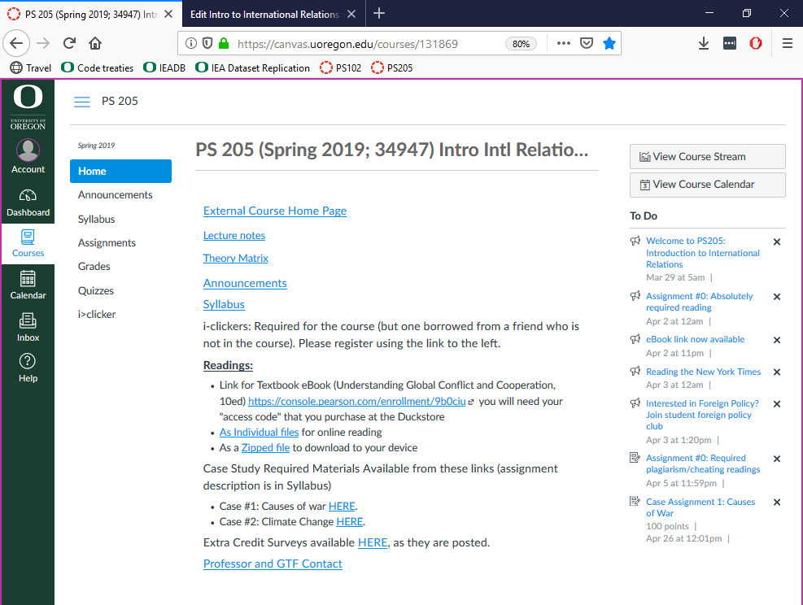

Slide 5
Course Logistics
Website: Canvas / External. Questions?
Syllabus: Online. Questions?
Theory Matrix: Use it!
Canvas Announcements: Getting them?
Online Readings: Access okay?
Case Study Assignments
  Readings included in Online Readings

Slide 6
How international relations differ from domestic politics
Anarchy
Self-help system
Law not enforceable
Weaker sense of community and shared norms

Slide 7
Explanation and the need for multiple theories
Accurately explaining

Slide 8
Explanation and the need for multiple theories
Accurately explaining
Various aspects of

Slide 9
Explanation and the need for multiple theories
Accurately explaining
Various aspects of
Complex phenomena

Slide 10
Explanation and the need for multiple theories
Accurately explaining
Various aspects of
Complex phenomena
Requires reliance on

Slide 11
Explanation and the need for multiple theories
Accurately explaining
Various aspects of
Complex phenomena
Requires reliance on
Multiple theories

Slide 12
Blind Men & Women and the Elephant
Multiple Theories
International Relations
Feminist theory
(Aristophanes)
Realism
(Thucydides)
No theory gets it all correct but each theory contributes to a more complete and accurate view of how international relations work.
Institutionalism
(Crawford)

Slide 13
Three levels of causes of war
(and other things in IR - Nye metaphor)
Deep (or ultimate) causes: "logs and drought"
  System structure, anarchy, power of actors, interests
Intermediate causes: "kindling"
  Structures of decision-making: democracy/dictatorship, capitalist/communist
  State interests and policy choices
Proximate: "matches"
  Actions/Decisions of individuals, mistakes, etc.
  Types of decision-makers

Slide 14
Alternative theories of IR
Realism
Institutionalism
Disenfranchised theories
Constructivism – important but not covered in this class
6 tenets of each – theory matrix on Blackboard
  Focus
  Actors
  Goals
  Means
  Organizing Principle
  Dynamics

Slide 15
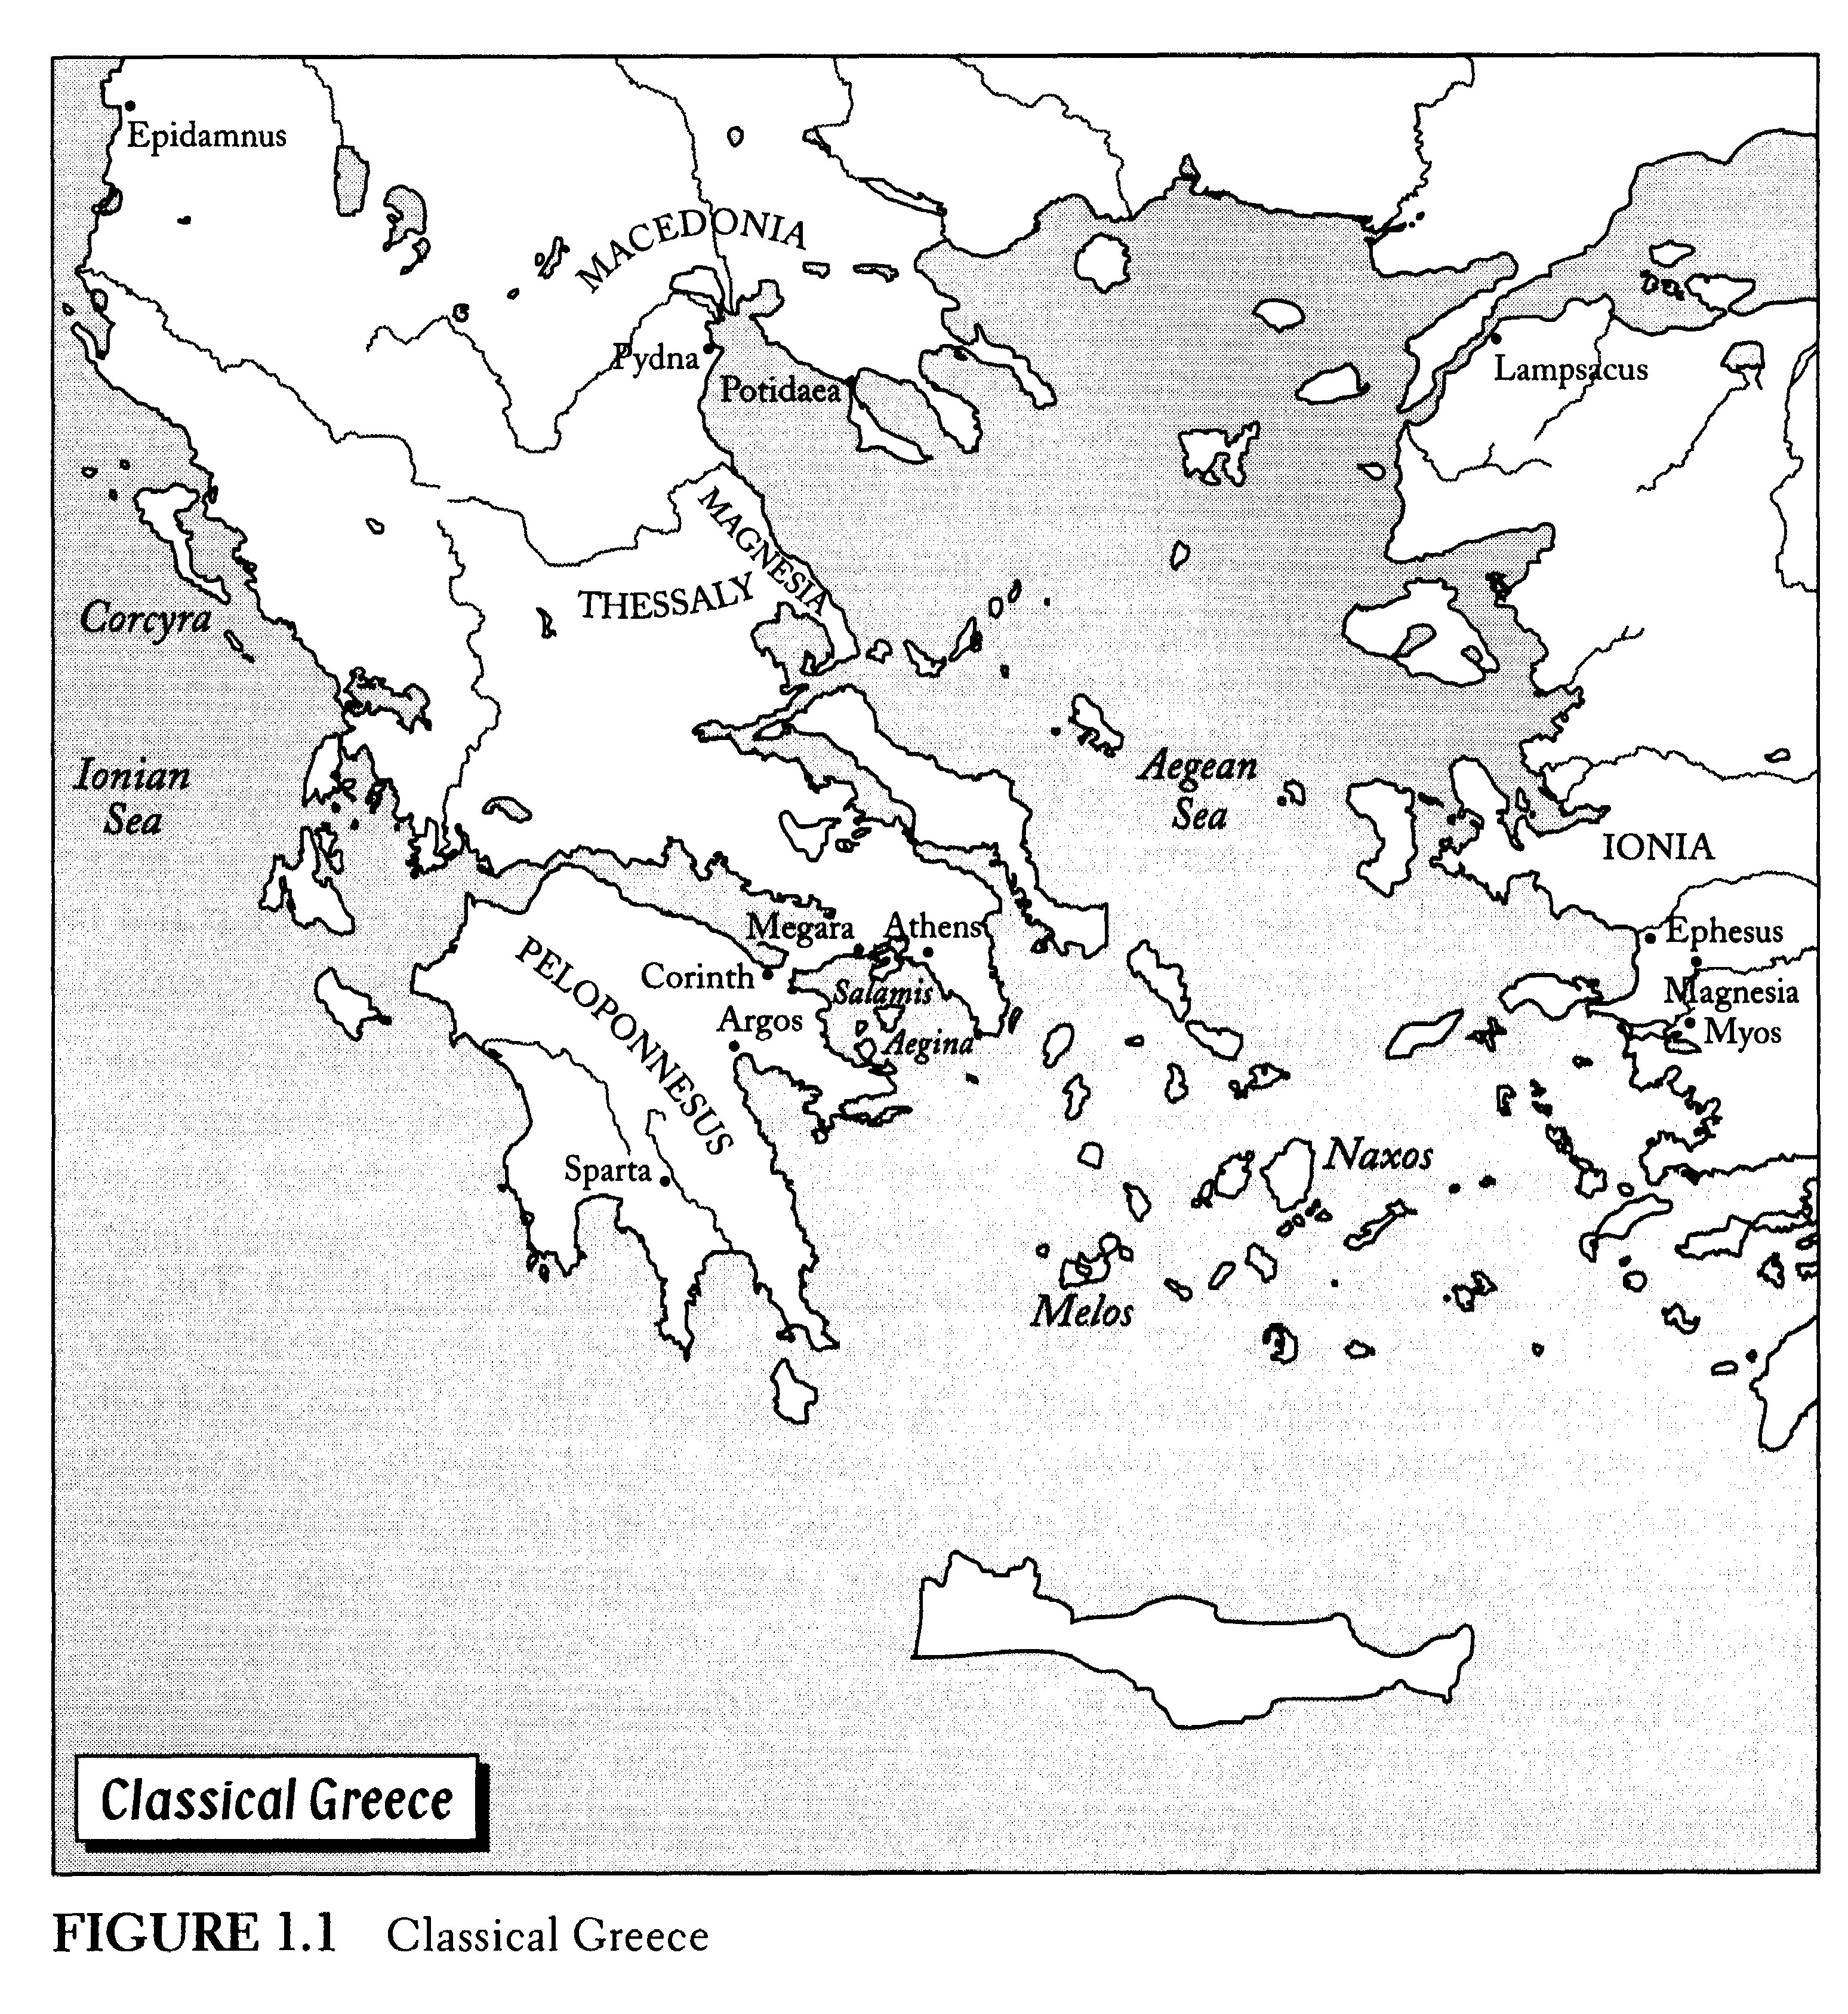

Slide 17
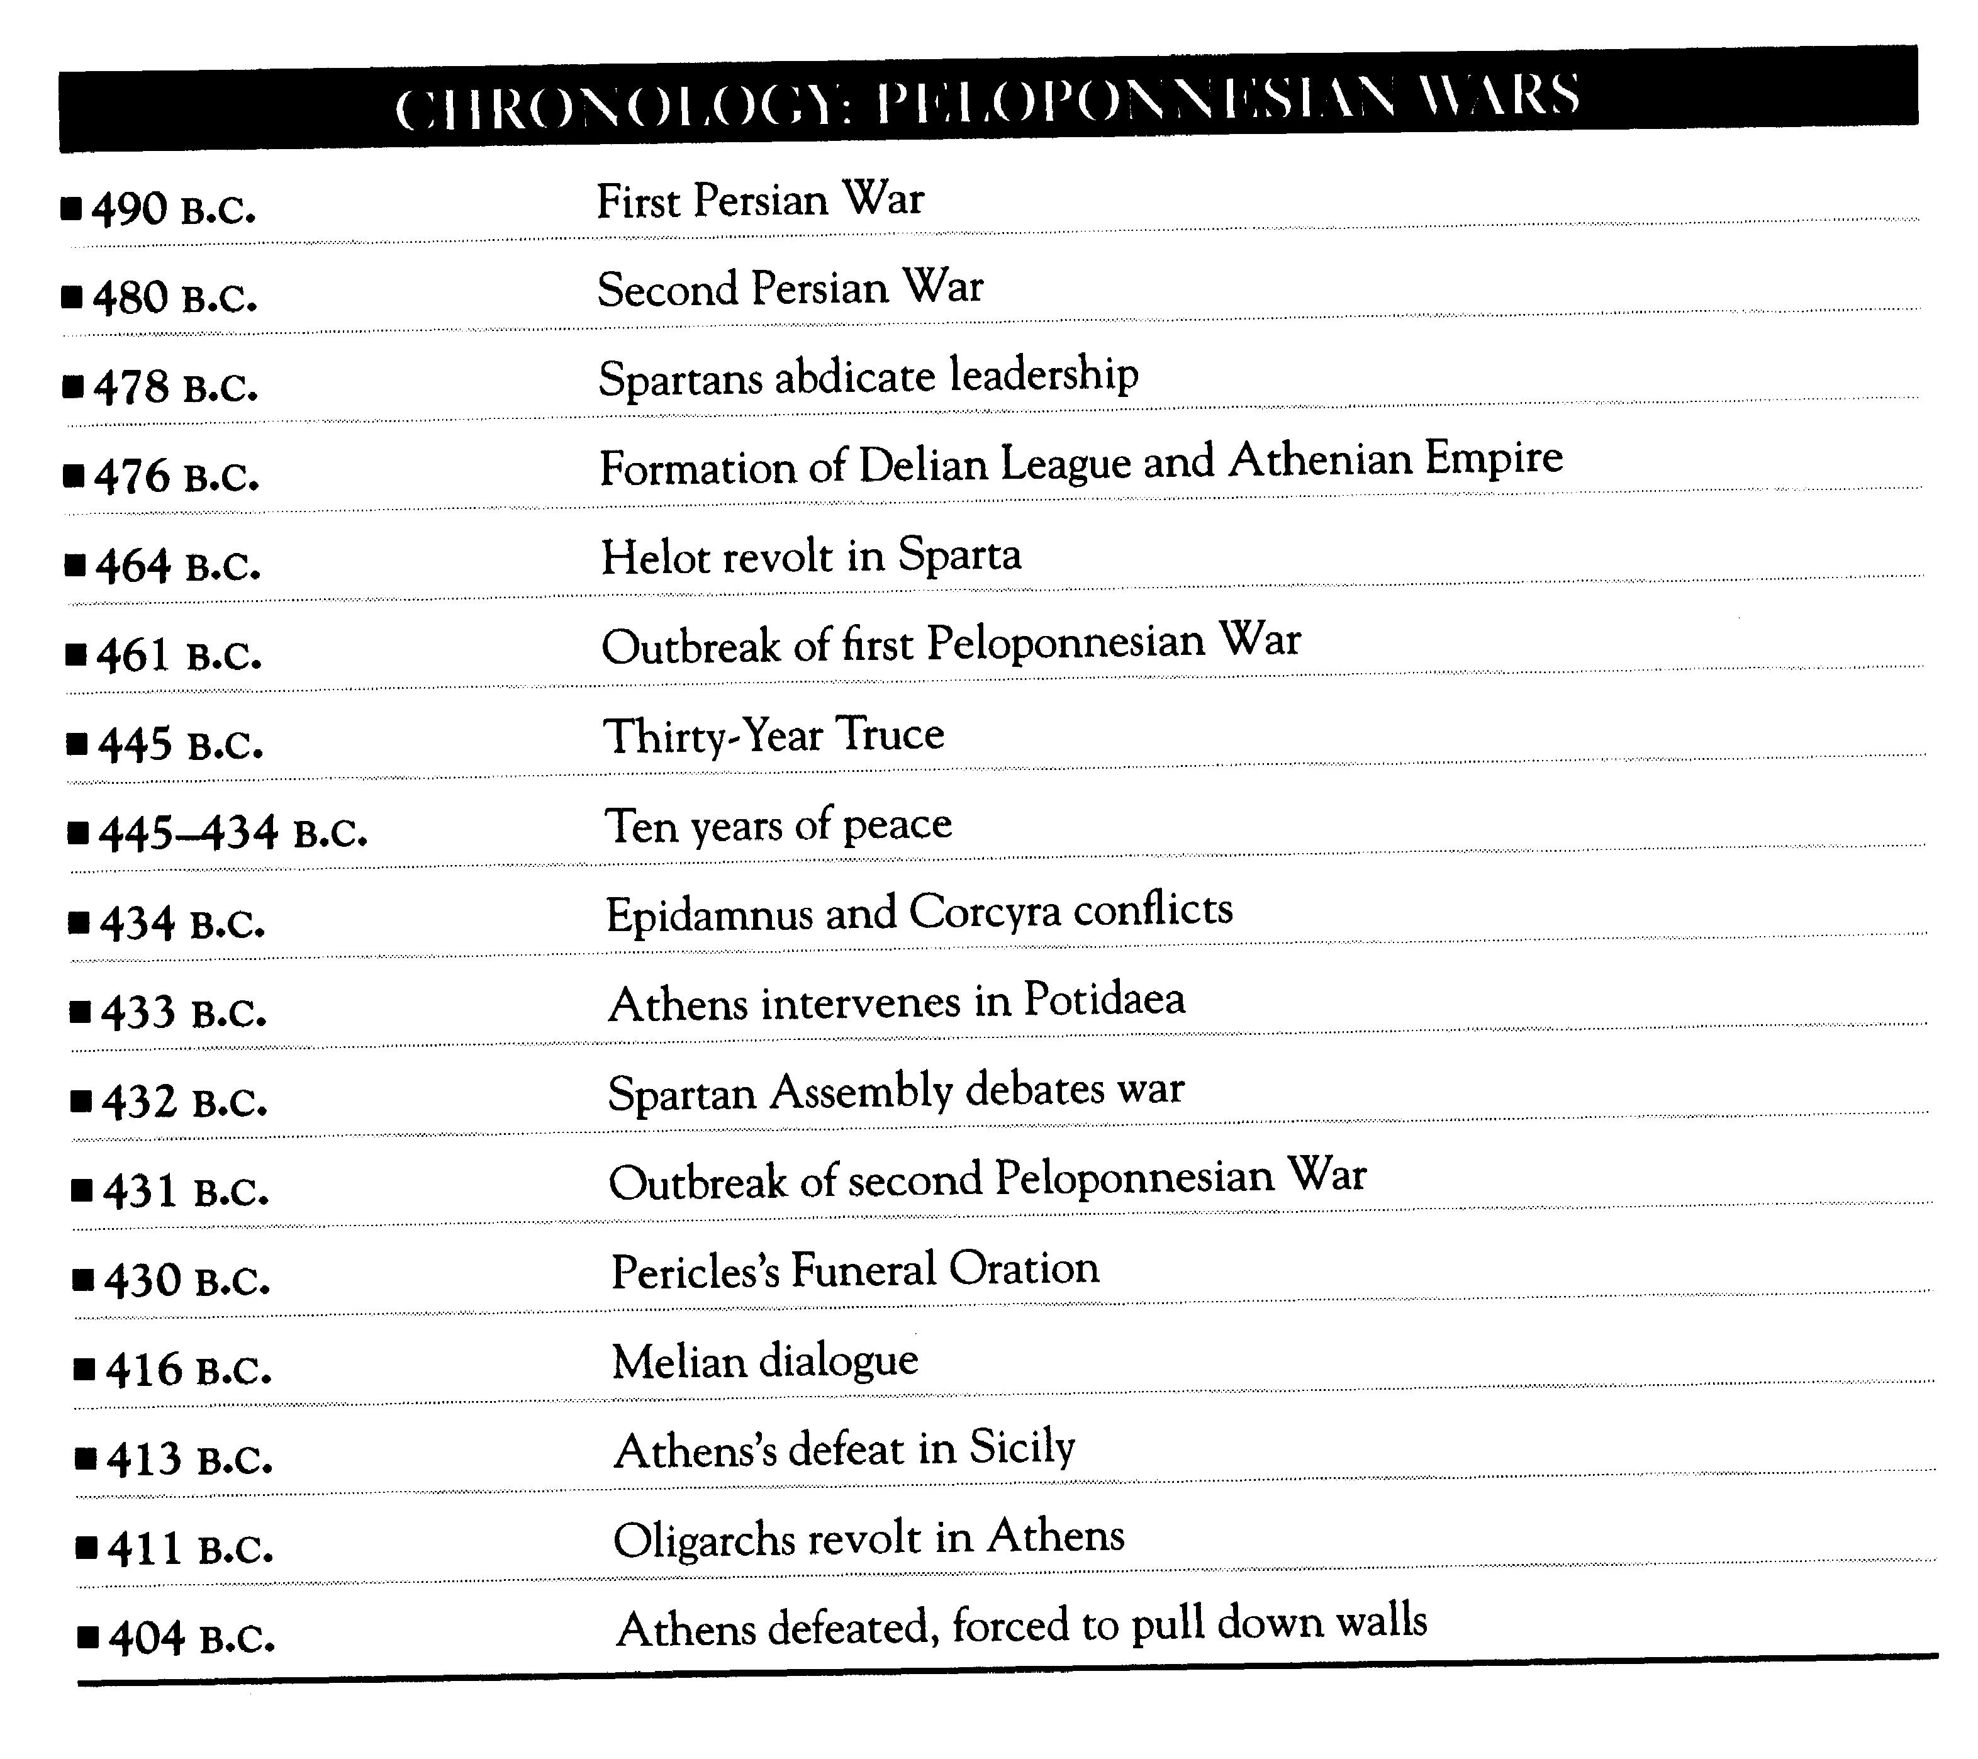

Slide 18
Causes of Peloponnesian War
Deep causes – structure and dist’n of power
  “growth of Athenian power and the fear which this caused in Sparta”
Intermediate causes
  Historical animosity of Athens and Sparta
  Political structure that gave women little voice (Lysistrata)
Proximate causes
  Getting involved in Epidamnus and Potidaea
  Misperceptions/misjudgments of other side

Slide 19
Two meanings of power
Control of resources:
  Tangible and intangible resources provide potential to wield influence
Influence over outcomes:
  Ability of one nation to make another nation do things they would not otherwise do.

Slide 20
Two aspects of power
Relational
  "Power over whom?"
  Whether state has power depends on comparison to another state
Situational
  "Power to do what?“
  Whether state has power depends on what “powerful” state wants “weak” state to do

Slide 21
Paradox of unrealized power
The paradox: sometimes powerful states are not powerful
  States with lots of resources (1st sense) can …
  fail to wield influence over others (2nd sense)
Usually, there is no paradox (21 of 30 wars won by country with larger military

Slide 22
Summary
Three levels of causation: deep, intermediate, proximate
Three levels of analysis: structure, state, individual
Applying levels to Peloponnesian War case
Two meanings of power: resources/influence
Two aspects of power: relational/situational
Paradox of unrealized power: strong don’t always influence the weak

