Slide 1
News item:
Senator Rubio on Iran & capabilities
As part of this deal … the Iranians get rid of a vast amount of enriched uranium, almost all they have. They limit the amount of enrichment that they will have. They limit the number of centrifuges they will operate and they will allow inspections for decades, actually. So you would say, all that, forget about it, it's done.
They retain not only just infrastructure, they retain centrifuges, too. They may not be spinning them, but they will retain them in their possession. They continue to develop their long range missile capabilities, which are unstopped. There's no prohibition on them acquiring a weapon design as they probably, may even already have. They continue to sponsor terrorism all over the world. … They continue to be run by a radical Shia cleric who has apocalyptic views of the future and of their role in it. … Their infrastructure will remain in place and at some point, they could follow the North Korean model very easily, … they can cook up an excuse for why they need to have a weapon program and move forward on it.
Is war inevitable then?
I hope not. My hope is that we can delay a program long enough and you would hope that there would be some sort of change in leadership in Iran that would at least allow them to decide that they would rather have an economy than have a weapon. You can't guarantee it. But at the end of the day no one wants war, but I actually think that this deal could advance the prospects of war.

Slide 2
Before we Start
Institutionalism

Slide 3
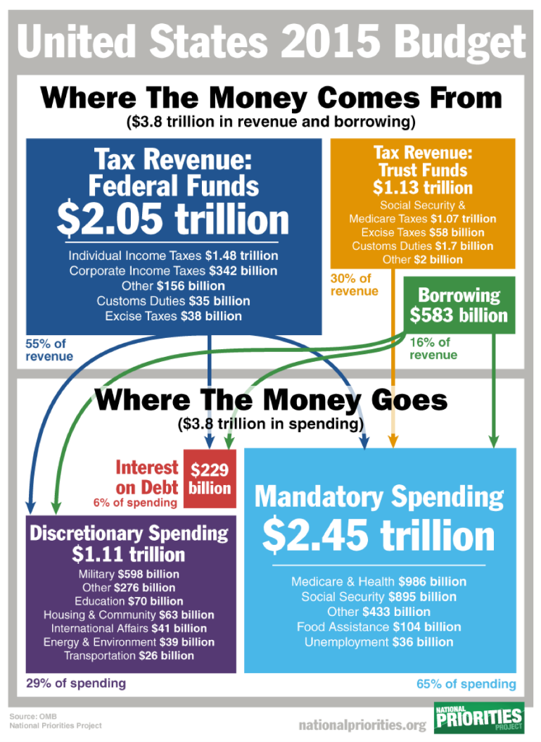

Slide 4
Iclicker Survey
What percent of discretionary US Budget (non-Social Security, non-Health-Medicare) is spent on US Military?
25%
40%
55%
70%

Slide 5
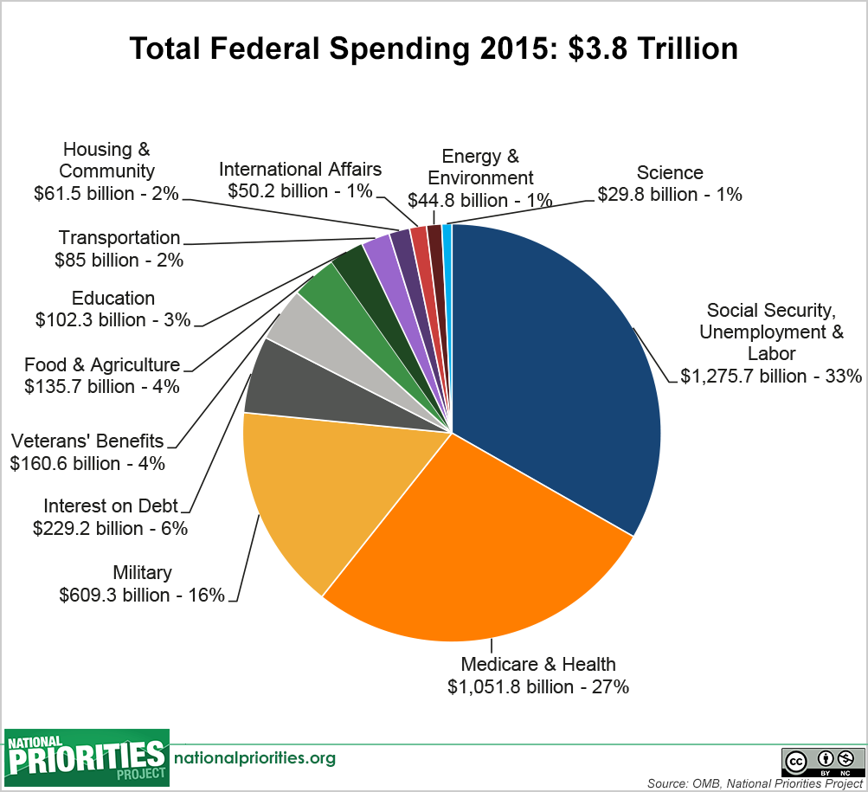

Slide 6
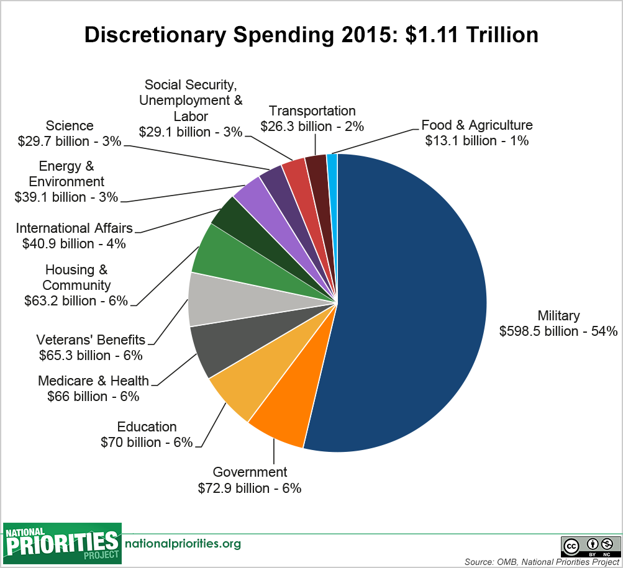

Slide 7
Institutionalism

Slide 8
Outline
Institutionalism in a nutshell
Six tenets of institutionalism
Power of institutions
Interests: realists vs. institutionalists
How states create cooperation within anarchy
Institutionalism summarized

Slide 9
Institutionalism in a Nutshell
States can cooperate if they have or create interdependence.
States sometimes take interdependent action to achieve long run interests
Interdependence: reciprocal costly effects of transactions
  Sensitivity: costs before country changes policies
  Vulnerability: costs even after has changed policies
Interdependence need not be symmetric or beneficial
Sometimes referred to as “liberal institutionalism” or “liberalism” but for this class please simply use institutionalism

Slide 10
Examples to think about
Syrian chemical weapons treaty: Did this treaty make any difference in behavior? That is gist of institutionalist vs. realist debate.
Do you worry that the Paris Climate Agreement isn’t strong enough? Do you worry that it will cripple the world economy if we really address climate change through this treaty? BOTH perspectives are fundamentally institutional – they both believe institutions matter.
If there were a Israel/Palestinian peace treaty, do you think it would stop the conflict in the Middle East?
Bailout of Greece by many other countries who receive few direct benefits from doing so.

Slide 11
 | Realism | Institutionalism | Disenfranchised
Focus – what is being explained? | Conflict
Actors – who are considered the main actors to watch? | States are primary and act as unitary rational actors
Goals – what are the goals of the main actors? | Survival, security, and hence, power
Means – what means do actors use to achieve their goals? | Military force is usable, effective, and fungible
Organizing Principles – how is the international system organized? | Anarchy and self-help
Dynamics – what does the process of international relations look like? | Acquisition and balancing of power

Slide 12
 | Realism | Institutionalism | Disenfranchised
Focus – what is being explained? | Conflict | Cooperation
Actors – who are considered the main actors to watch? | States are primary and act as unitary rational actors
Goals – what are the goals of the main actors? | Survival, security, and hence, power
Means – what means do actors use to achieve their goals? | Military force is usable, effective, and fungible
Organizing Principles – how is the international system organized? | Anarchy and self-help
Dynamics – what does the process of international relations look like? | Acquisition and balancing of power

Slide 13
 | Realism | Institutionalism | Disenfranchised
Focus – what is being explained? | Conflict | Cooperation
Actors – who are considered the main actors to watch? | States are primary and act as unitary rational actors | Multiple actors (states, MNCs, NGOs); not always unitary or rational
Goals – what are the goals of the main actors? | Survival, security, and hence, power
Means – what means do actors use to achieve their goals? | Military force is usable, effective, and fungible
Organizing Principles – how is the international system organized? | Anarchy and self-help
Dynamics – what does the process of international relations look like? | Acquisition and balancing of power

Slide 14
 | Realism | Institutionalism | Disenfranchised
Focus – what is being explained? | Conflict | Cooperation
Actors – who are considered the main actors to watch? | States are primary and act as unitary rational actors | Multiple actors (states, MNCs, NGOs); not always unitary or rational
Goals – what are the goals of the main actors? | Survival, security, and hence, power | Econ & social goals as well as security
Means – what means do actors use to achieve their goals? | Military force is usable, effective, and fungible
Organizing Principles – how is the international system organized? | Anarchy and self-help
Dynamics – what does the process of international relations look like? | Acquisition and balancing of power

Slide 15
 | Realism | Institutionalism | Disenfranchised
Focus – what is being explained? | Conflict | Cooperation
Actors – who are considered the main actors to watch? | States are primary and act as unitary rational actors | Multiple actors (states, MNCs, NGOs); not always unitary or rational
Goals – what are the goals of the main actors? | Survival, security, and hence, power | Econ & social goals as well as security
Means – what means do actors use to achieve their goals? | Military force is usable, effective, and fungible | Asymmetry in interdependence; issue-specific power
Organizing Principles – how is the international system organized? | Anarchy and self-help
Dynamics – what does the process of international relations look like? | Acquisition and balancing of power

Slide 16
 | Realism | Institutionalism | Disenfranchised
Focus – what is being explained? | Conflict | Cooperation
Actors – who are considered the main actors to watch? | States are primary and act as unitary rational actors | Multiple actors (states, MNCs, NGOs); not always unitary or rational
Goals – what are the goals of the main actors? | Survival, security, and hence, power | Econ & social goals as well as security
Means – what means do actors use to achieve their goals? | Military force is usable, effective, and fungible | Asymmetry in interdependence; issue-specific power
Organizing Principles – how is the international system organized? | Anarchy and self-help | Anarchy mitigated by norms, rules, & institutions
Dynamics – what does the process of international relations look like? | Acquisition and balancing of power

Slide 17
 | Realism | Institutionalism | Disenfranchised
Focus – what is being explained? | Conflict | Cooperation
Actors – who are considered the main actors to watch? | States are primary and act as unitary rational actors | Multiple actors (states, MNCs, NGOs); not always unitary or rational
Goals – what are the goals of the main actors? | Survival, security, and hence, power | Econ & social goals as well as security
Means – what means do actors use to achieve their goals? | Military force is usable, effective, and fungible | Asymmetry in interdependence; issue-specific power
Organizing Principles – how is the international system organized? | Anarchy and self-help | Anarchy mitigated by norms, rules, & institutions
Dynamics – what does the process of international relations look like? | Acquisition and balancing of power | Alternation of cooperation & conflict

Slide 18
i>clicker survey
What is the main thing Institutionalists seek to explain?
Why peace treaties take so long to negotiate
Why states seek to seize the territories of other states
Why states have never used military power to oppress other states
How it is that states sometimes are able to cooperate, despite the anarchy of the international system

Slide 19
The Power of Institutions
Realists:
  Institutions REFLECT power
Institutionalists
  Yes, institutions REFLECT power BUT…
  Might be “selection effects” – good states join, bad states don’t join
  BUT they also can and sometimes do CONSTRAIN power
  Institutional rules and norms
    Decrease uncertainty
    Avoid misperceptions
    Foster interdependence (iteration, linkage)
    Stabilize expectations

Slide 20
Interests:
Realism vs. Institutionalism
In BOTH views, states are pursuing their self-interests!!!
Realists:
  States pursue short-term myopic interests with fear of cooperation
Institutionalists
  States often pursue short-term myopic interests
  BUT they also may pursue long-term interests that can only be achieved through cooperation and they attempt to do so by creating institutions that will address the risks that cooperation entails

Slide 21
How do states create cooperation within anarchic international realm
Permissive conditions that foster cooperation
  Survival not at stake
  Interactions are iterative
  Easier problems, e.g., coordination (air traffic control) vs. collaboration (arms races, trade wars)
  Fewer players
Conscious strategies to promote cooperation
  Reciprocity: Tit-for-Tat, linkage and contingency
  Transparency and information
  Iteration or "Shadow of future“
  Reduce transaction costs
  Rules of thumb
  Norms: require actors to explain themselves

Slide 22
Institutionalism summarized
Ideals, norms, and rules, as well as power and interests, determine outcomes
Structure matters but states can influence structure to some extent
States seek solutions to their problems and attempt to make absolute welfare gains through cooperation that seeks to mitigate anarchy’s effects

