Slide 1
Outline
Review realism and institutionalism
Intro to feminist/disenfranchised theories of IR
Feminist/disenfranchised theories in a nutshell
Facts that need explaining
Six tenets of feminist/disenfranchised theories of IR
Three variants of feminist theory
Gender and race in the military

Slide 2
 | Realism | Institutionalism | Disenfranchised
Focus – what is being explained? | Conflict | Cooperation
Actors – who are considered the main actors to watch? | States are primary and act as unitary rational actors | Multiple actors (states, MNCs, NGOs); not always unitary or rational
Goals – what are the goals of the main actors? | Survival, security, and hence, power | Econ & social goals as well as security
Means – what means do actors use to achieve their goals? | Military force is usable, effective, and fungible | Asymmetry in interdependence; issue-specific power
Organizing Principles – how is the international system organized? | Anarchy and self-help | Anarchy mitigated by norms, rules, & institutions
Dynamics – what does the process of international relations look like? | Acquisition and balancing of power | Alternation of cooperation & conflict

Slide 3
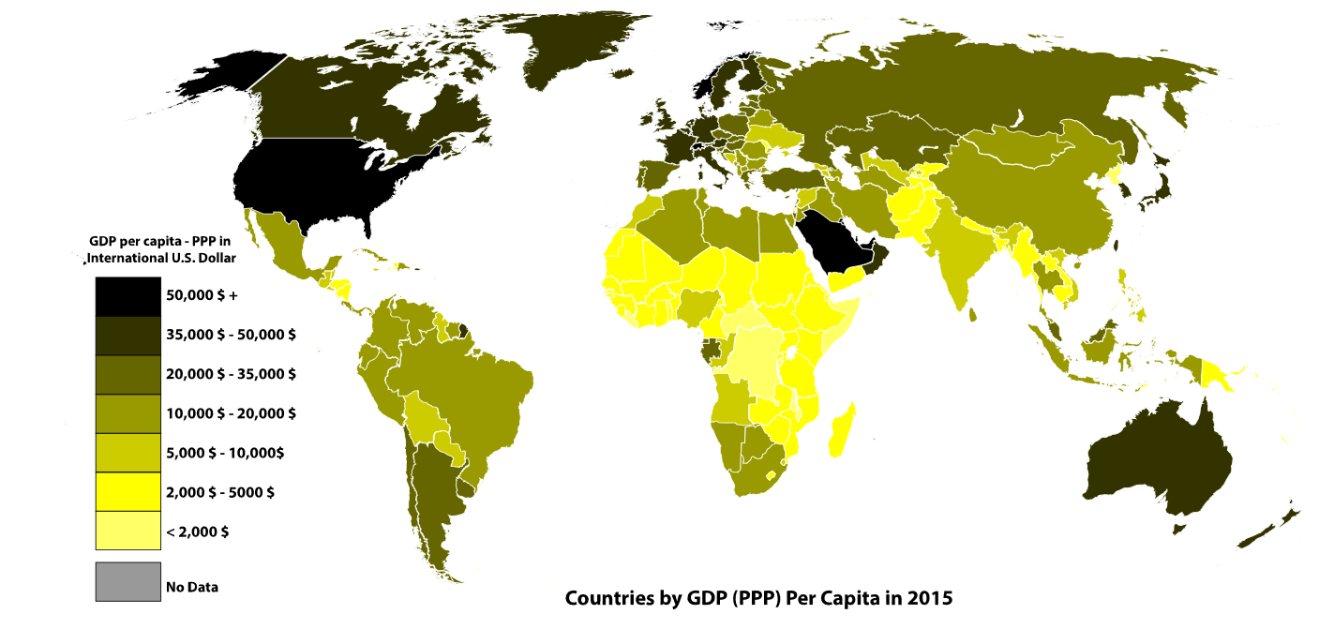
Examples of race and religion in international relations
Wars
  Race/Ethnicity: European contacts; China (Uighurs); Rwanda (Hutu/Tutsi); Mali (Tuaregs)
  Religion: Crusades; Yemen (Huthi-Shia rebels); Iraq - Sunni/Shia/Kurds; India/Pakistan; Burma (Rohingya)
Economics ➔
Human Rights – patterns
in their protection
Environmental issues –
dominated by Northern concerns

Slide 4
Examples of gender in international relations
Men are 95% of the world’s primary policy-makers (women as Commander in Chief or SecDef?) See supporting statistics HERE. A political science paper on women as defense ministers is HERE.
Women do most of world’s work, grow most of world’s food but receive little of its income and own little of its property. UN statistics are HERE.
Women disproportionately illiterate, impoverished, underrepresented, killed at birth -- most of these are supported HERE, along with other statistics, but on female infanticide, see HERE.
Rape as common strategy of war and outside of war. See considerable evidence HERE.
Not all sex-specific outcomes favor men -- this is my own claim, based on a summary of the evidence, mainly learned from a colleague and former PhD student, Charli Carpenter. See her book HERE.
Regardless of who benefits, gender matters for the consequences one receives in the world! My own claim.

Slide 5
Disenfranchised version:
If race and religion don’t matter, then why:
Did Crusades / colonialism / slavery / internment of Japanese but not Germans / 9-11 / Holocaust happen?
How explain Yugoslavia, Rwanda, Iraq, etc?
Why does US deal with treaties with Native Americans differently than with other countries?
Although African Americans have fought in the US military in every war since the Revolution, why did integration in the US military not occur until 1948?

Slide 6
Intro to Disenfranchised Theories of IR
Our identities matter BUT our identities are “socially constructed”
"Much of contemporary feminism is also committed to … emancipatory goals” {Tickner, 1997}
Social theories influence social processes they attempt to describe and explain
  “Knowledge cannot be divorced from its political consequences” {Tickner, 1997}
Conflict over what is studied in IR AND how we study it
Explain “behavior of states run by men and international system that results from interactions of states run by men"

Slide 7
Disenfranchised Theories in a Nutshell
Structural inequality leads to individual insecurity
The pattern:
  Absence of women from practice of IR
  Absence of women from scholarship of IR
  Assume states provide for security of their citizens but simply not true for many women
Harm to women is ubiquitous across states but generally unaddressed

Slide 8
 | Realism | Institutionalism | Disenfranchised
Focus – what is being explained? |  |  | Gender/racial conflicts rather than interstate conflict
Actors – who are considered the main actors to watch?
Goals – what are the goals of the main actors?
Means – what means do actors use to achieve their goals?
Organizing Principles – how is the international system organized?
Dynamics – what does the process of international relations look like?

Slide 9
 | Realism | Institutionalism | Disenfranchised
Focus – what is being explained? |  |  | Gender/racial conflicts rather than interstate conflict
Actors – who are considered the main actors to watch? |  |  | Gender, racial identity matters as much as national identity
Goals – what are the goals of the main actors?
Means – what means do actors use to achieve their goals?
Organizing Principles – how is the international system organized?
Dynamics – what does the process of international relations look like?

Slide 10
 | Realism | Institutionalism | Disenfranchised
Focus – what is being explained? |  |  | Gender/racial conflicts rather than interstate conflict
Actors – who are considered the main actors to watch? |  |  | Gender, racial identity matters as much as national identity
Goals – what are the goals of the main actors? |  |  | Individual security and well-being (but state provides only for some)
Means – what means do actors use to achieve their goals?
Organizing Principles – how is the international system organized?
Dynamics – what does the process of international relations look like?

Slide 11
 | Realism | Institutionalism | Disenfranchised
Focus – what is being explained? |  |  | Gender/racial conflicts rather than interstate conflict
Actors – who are considered the main actors to watch? |  |  | Gender, racial identity matters as much as national identity
Goals – what are the goals of the main actors? |  |  | Individual security and well-being (but state provides only for some)
Means – what means do actors use to achieve their goals? |  |  | Gender/racial identities in service of state; marginalized power in cooperation (vs. force)
Organizing Principles – how is the international system organized?
Dynamics – what does the process of international relations look like?

Slide 12
 | Realism | Institutionalism | Disenfranchised
Focus – what is being explained? |  |  | Gender/racial conflicts rather than interstate conflict
Actors – who are considered the main actors to watch? |  |  | Gender, racial identity matters as much as national identity
Goals – what are the goals of the main actors? |  |  | Individual security and well-being (but state provides only for some)
Means – what means do actors use to achieve their goals? |  |  | Gender/racial identities in service of state; marginalized power in cooperation (vs. force)
Organizing Principles – how is the international system organized? |  |  | Patriarchy, gendered and racial hierarchical structures
Dynamics – what does the process of international relations look like?

Slide 13
 | Realism | Institutionalism | Disenfranchised
Focus – what is being explained? |  |  | Gender/racial conflicts rather than interstate conflict
Actors – who are considered the main actors to watch? |  |  | Gender, racial identity matters as much as national identity
Goals – what are the goals of the main actors? |  |  | Individual security and well-being (but state provides only for some)
Means – what means do actors use to achieve their goals? |  |  | Gender/racial identities in service of state; marginalized power in cooperation (vs. force)
Organizing Principles – how is the international system organized? |  |  | Patriarchy, gendered and racial hierarchical structures
Dynamics – what does the process of international relations look like? |  |  | Reconstruction & maintenance of gendered and racial hierarchies

Slide 14
i>clicker survey
What is the main thing Disenfranchised Theory seek to explain?
Why peace treaties take so long to negotiate
Why states seek to seize the territories of other states
Why states have never used military power to oppress other states
What explains why so much conflict occurs between states based on race, religion, and ethnicity and within states based on race, religion, ethnicity, and gender

Slide 15
Three variants of feminist theory
Feminist empiricism
  Facts about women neglected
  Same intellectual project, different facts
Feminist standpoint
  Perspectives of women neglected and marginalized
  Same intellectual project, different theories
Feminist postmodernism
  Deep notions of inquiry and truth are gendered
  Different intellectual project

Slide 16
Gender in the military
Who gets conscripted into militaries?
  Exclusion of women counter to realist expectations
Hypermasculinization of troops
“Power over” vs. “power with”
Women play a role in making modern military work
Srebenica and the role of gender – the power of “taken for granted” gender norms

Slide 17
Feminist theories summarized
Three linked perspectives/approaches
  Perhaps best seen as different levels in a single feminist critique of existing theories of IR
Confront us with problematic nature of international relations itself, the study of international relations, and the methodology of the study of international relations and other social sciences

Slide 18
QUIZ Instructions
PREFERRED: Use your I>clicker
OR
ONLY if you do not have an I>clicker, please
  Get out a piece of paper
  Put your name on paper
  Write down Question number and your answer

Slide 19
QUIZ
10 questions
1 minute per question
Quiz ends at 10:10am
If you have any concerns that your I>clicker is not working, get out a piece of paper and:
  Write your name on the top
  Write Question # and answer for all 10 questions
  Hand in at end of quiz

