Slide 1
Outline
Case study questions and rubric
Three types of interactions among states
Which do states care about: Relative gains or Absolute gains? Or both?
Structural realism (Waltz)
Structure as wedge between intentions and outcomes
Why relative gains matter
Prisoners’ Dilemma
Security Dilemma
Review of realism

Slide 2
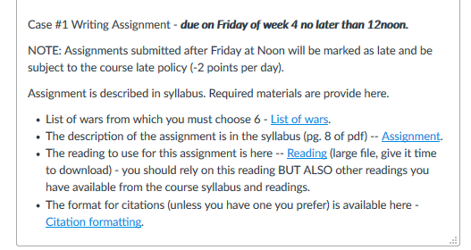
Case Study #1: Causes of War
Goal: Engage in your own research – figure stuff out for yourself. Its fun!
Take notes by War // WRITE UP BY theory you are evaluating
Table now available online
Make argument that matches your
evidence, even if don’t like it!
<=1,000 words Look at each
explanation & assess how much
evidence from 6 wars you chose
supports each theory/claim about
a cause

Slide 3
 | Realism | Institutionalism | Disenfranchised
Focus – what is being explained? | Conflict
Actors – who are considered the main actors to watch? | States are primary and act as unitary rational actors
Goals – what are the goals of the main actors? | Survival, security, and hence, power
Means – what means do actors use to achieve their goals? | Military force is usable, effective, and fungible
Organizing Principles – how is the international system organized? | Anarchy and self-help
Dynamics – what does process of international relations look like? | Acquisition and balancing of power

Slide 4
Three types of interactions among states
Harmony
  Independent decision-making produces GOOD outcomes
Conflict
  Independent decision-making produces BAD outcomes
Cooperation
  Interdependent decision-making produces GOOD outcomes (in context where independent decision-making WOULD HAVE created bad outcomes)

Slide 5
Theory & International Institutions:
Likelihood of Cooperation
Realism: Cooperation among states unlikely, just strategic interaction. Harmony or Coercion, not cooperation. Unlikely because states concerned about relative gains and short-term interests.
Institutionalism: TRUE Cooperation among states possible. More likely when states concerned about absolute gains, low concerns about security, and long-term benefits exceed short-term costs.
Disenfranchised theory: Cooperation among states unlikely to benefit disenfranchised individuals. Cooperation will tend to reinforce existing gendered/ethnic/religious power structures.

Slide 6
Theory & International Institutions:
Conditions & Types of Cooperation
Realism: expect treaties when
  "Codify" existing / expected future behavior; nukes on seabed, moon.
  Hegemonic states force other states to cooperate: Warsaw Pact.
  Coordination games, few distributional effects: airplane traffic; diplomatic immunity.
Institutionalism expect treaties when
  Significant and reciprocal interdependence
  Relative gains are LOW concern
  Treaty designs can overcome obstacles to cooperation
Disenfranchised theory expect treaties when
  Structure and “dialogue” reflects norms rather than interests
  Material sources of power become less important
  Treaties will reinforce interests of powerful actors ACROSS states

Slide 7
Why relative gains matter
 | Country A | Country B
No trade | 100M GDP | 100M GDP
Trade pact (year 1) | 120M GDP | 130M GDP
Trade pact (year 2) | 110M GDP + 100 tanks | 110M GDP + 200 tanks
War by B on A (year 3)
Status (year 4) | 0M GDP + 0 tanks | 220M GDP + 100 tanks

Slide 8
Which do states care about:
Relative gains? Absolute gains? Both?
States care mainly about RELATIVE gains (Realist view), because can never let down your guard about security in an anarchic international world
  Def’n: States compare future situation to “OTHER country’s” FUTURE situation
  Goal: States concerned with security
  Means: States believe only military power influences outcomes & furthers interests
  Military power is necessarily RELATIVE: not “how much?” but “more than others?”
  States seek RELATIVE gains, i.e., improve their situation compared to OTHERS
States often care about ABSOLUTE gains (Institutionalist view), because sometimes security is not in question
  Def’n: States compare future situation to “OWN country’s” PAST situation
  Goal: States have security “covered” and so focus on economic growth, etc.
  Means: States believe some non-military sources of power can further interests
  States seek ABSOLUTE gains, i.e., improve their situation compared to LAST YEAR

Slide 9
Structural realism
Structure forms wedge between intentions and outcomes – people do not get what they strive for
Structure composed of:
  Ordering principle – anarchy
  Relative capabilities – distribution of power
Structure dictates outcomes
Relative gains concerns dominate

Slide 10
Structure as a wedge between intentions and outcomes
What we expect (and don’t need to explain):
Intentions → Outcomes

Slide 11
Structure as a wedge between intentions and outcomes
What we expect (and don’t need to explain):
Intentions → Outcomes
What we don’t expect and must explain:
Intentions → Outcomes

Slide 12
Structure as a wedge between intentions and outcomes
What we expect (and don’t need to explain):
Intentions → Outcomes
What we don’t expect and must explain:
Structure
Intentions → Outcomes

Slide 13
Structural realism
What it explains:
  Continuity / consistency of conflict across race, religion, time, culture, technology, etc.
DIFFERS from a claim that war stems from human nature

Slide 14
Prisoners’ Dilemma
Puzzle: Leaders of nations are not stupid so why do they engage in war and arms races even though they don't want to? Why does it make sense for nations to build arms and seek greater military power when they know that doing so will only increase the insecurity of other nations, causing them to build more arms, in the long run leading to the expenditure of money but no greater security? How can two nations that both want peace and security create conditions that make war occur, or at least very likely?
Explanation: Prisoners' Dilemma as metaphor for how “structure” creates incentives for countries to behave in ways that make them worse off than would be if cooperated.
How structures can prevent actors from getting their desired outcomes
How individuals pursuing clear incentives in pursuit of self-interest leads them to behave in ways that lead them NOT to best achieve those self-interests
Examples in international relations:
  Arms races, trade wars, pollution problems

Slide 15
United States’ perspective
 |  | Soviet Union
 |  | Reduce nukes | Increase nukes
United States | Reduce nukes | US no less secure (100) | US overrun (-1000)
 | Increase nukes | US super-secure (500) | US insecure & poor (-200)

Slide 16
Soviet Union’s perspective
 |  | Soviet Union
 |  | Reduce nukes | Increase nukes
United States | Reduce nukes | Soviets no less secure (100) | Soviets super-secure (500)
 | Increase nukes | Soviets overrun (-1000) | Soviets insecure & poor (-200)

Slide 17
Overall game
 |  | Soviet Union
 |  | Reduce nukes | Increase nukes
United States | Reduce nukes | Soviets no less secure (100) US no less secure (100) | Soviets super-secure (500) US overrun (-1000)
 | Increase nukes | Soviets overrun (-1000) US super-secure (500) | Soviets insecure & poor (-200) US insecure & poor (-200)

Slide 18
Iclicker poll
Which “cell” is the likely outcome?
 |  | Soviet Union
 |  | Reduce nukes | Increase nukes
United States | Reduce nukes | Soviets no less secure (100) US no less secure (100) | Soviets super-secure (500) US overrun (-1000)
 | Increase nukes | Soviets overrun (-1000) US super-secure (500) | Soviets insecure & poor (-200) US insecure & poor (-200)
A
B
C
D

Slide 19
“Solving” the PD game
We can find the stable equilibrium
But its unsatisfactory to both sides
But they can’t escape it

Slide 20
United States’ perspective
 |  | Soviet Union
 |  | Reduce nukes | Increase nukes
United States | Reduce nukes | US no less secure (100) | US overrun (-1000)
 | Increase nukes | US super-secure (500) | US insecure & poor (-200)
What should US do?

Slide 21
United States’ perspective
 |  | Soviet Union
 |  |  | Increase nukes
United States | Reduce nukes |  | US overrun (-1000)
 | Increase nukes |  | US insecure & poor (-200)
First, assume Soviets increase nukes. What should US do?

Slide 22
United States’ perspective
 |  | Soviet Union
 |  |  | Increase nukes
United States | Reduce nukes |  | US overrun (-1000)
 | Increase nukes |  | US insecure & poor (-200)
If Soviets increase nukes, US clearly prefers to increase nukes.

Slide 23
United States’ perspective
 |  | Soviet Union
 |  | Reduce nukes
United States | Reduce nukes | US no less secure (100)
 | Increase nukes | US super-secure (500)
Now, assume Soviets reduce nukes. What should US do?

Slide 24
United States’ perspective
 |  | Soviet Union
 |  | Reduce nukes
United States | Reduce nukes | US no less secure (100)
 | Increase nukes | US super-secure (500)
If Soviets reduce nukes, US still prefers to increase nukes.

Slide 25
United States’ perspective
 |  | Soviet Union
 |  | Reduce nukes | Increase nukes
United States | Reduce nukes | US no less secure (100) | US overrun (-1000)
 | Increase nukes | US super-secure (500) | US insecure & poor (-200)
So, no matter what Soviets do, US prefers to increase nukes!

Slide 26
Soviet Union’s perspective
 |  | Soviet Union
 |  | Reduce nukes | Increase nukes
United States | Reduce nukes | Soviets no less secure (100) | Soviets super-secure (500)
 | Increase nukes | Soviets overrun (-1000) | Soviets insecure & poor (-200)
What should Soviets do?

Slide 27
Soviet Union’s perspective
 |  | Soviet Union
 |  | Reduce nukes | Increase nukes
United States
 | Increase nukes | Soviets overrun (-1000) | Soviets insecure & poor (-200)
First, assume US increases nukes. What should Soviets do?

Slide 28
Soviet Union’s perspective
 |  | Soviet Union
 |  | Reduce nukes | Increase nukes
United States
 | Increase nukes | Soviets overrun (-1000) | Soviets insecure & poor (-200)
If US increase nukes, Soviets clearly prefer to increase nukes.

Slide 29
Soviet Union’s perspective
 |  | Soviet Union
 |  | Reduce nukes | Increase nukes
United States | Reduce nukes | Soviets no less secure (100) | Soviets super-secure (500)
Now, assume US reduces nukes. What should Soviets do?

Slide 30
Soviet Union’s perspective
 |  | Soviet Union
 |  | Reduce nukes | Increase nukes
United States | Reduce nukes | Soviets no less secure (100) | Soviets super-secure (500)
If US reduces nukes, Soviets still prefers to increase nukes.

Slide 31
Soviet Union’s perspective
 |  | Soviet Union
 |  | Reduce nukes | Increase nukes
United States | Reduce nukes | Soviets no less secure (100) | Soviets super-secure (500)
 | Increase nukes | Soviets overrun (-1000) | Soviets insecure & poor (-200)
So, no matter what US does, Soviets prefer to increase nukes!

Slide 32
Overall game
 |  | Soviet Union
 |  | Reduce nukes | Increase nukes
United States | Reduce nukes | Soviets no less secure (100) US no less secure (100) | Soviets super-secure (500) US overrun (-1000)
 | Increase nukes | Soviets overrun (-1000) US super-secure (500) | Soviets insecure & poor (-200) US insecure & poor (-200)
BUT, since both US and Soviets increase nukes, they both end
up insecure & poor,

Slide 33
Overall game
 |  | Soviet Union
 |  | Reduce nukes | Increase nukes
United States | Reduce nukes | Soviets no less secure (100) ***Arms Control*** US no less secure (100) | Soviets super-secure (500) US overrun (-1000)
 | Increase nukes | Soviets overrun (-1000) US super-secure (500) | Soviets insecure & poor (-200) ***Arms Race*** US insecure & poor (-200)
BUT, since both US and Soviets increase nukes, they both end
up insecure & poor, even though they would prefer greater
security at lower cost!

Slide 34
Iclicker
When two states try to decide whether to engage in free trade or impose high tariffs, is it a Prisoners Dilemma or not?
Yes
No

Slide 35
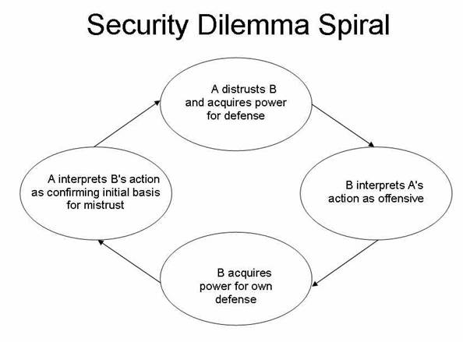

Slide 36
Causes of
Security Dilemma
Anarchy/self-help structure of int’l system
Lack of trust
Misperception and miscommunication
Ambiguity regarding offense/defense of military forces and actions

Slide 37
Aspects of
PD & Security Dilemma
Relative gains concerns
Even if only absolute gains concerns, cooperation still difficult
Role of trust
Role of iteration
Role of external sanctions
Role of number of actors
Role of information
Role of diffuse reciprocity

