Slide 1
Reading Takehome messages
Milner “Globalization, development, and international institutions”
  IMF, WB, and WTO offer possibility of helping with respect to development but they don’t always deliver on their promise for identifiable reasons
  Research can allow us to improve these institutions
Micklethwait and Wooldridge “The globalization backlash” explores myths that globalization
  Means the Triumph of Giant Companies
  Is Destroying the Environment
  Makes Geography Irrelevant
  Means Americanization
  Means a Race to the Bottom in Labor Standards
  Concentrates Power in Undemocratic Institutions Like the WTO
  Is Irreversible

Slide 2
Outline
Intro to IPE and Trade (prep for guest lecture by Columbia Sportswear)
Situation of developing countries
State of development (video)
Solutions to development
Structural adjustment

Slide 3
Intro to Free Trade to
Prepare for Guest Lecture

Slide 4
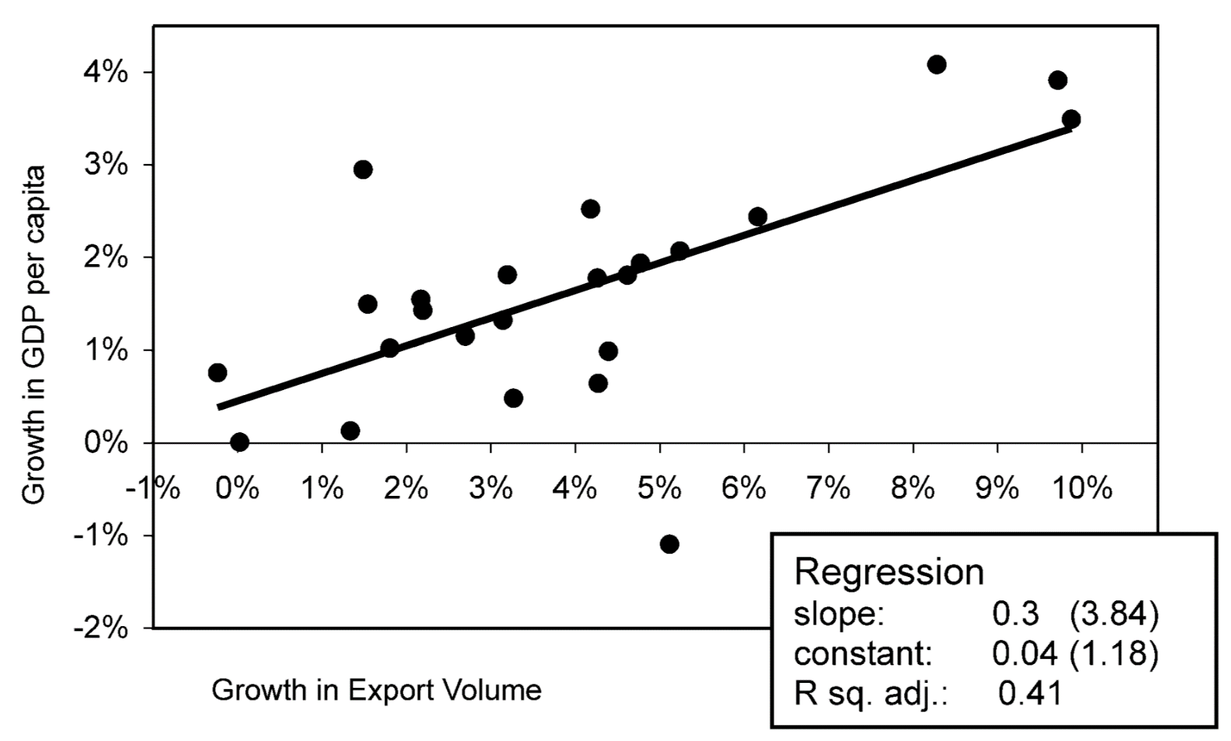
Exports and Economic Growth go together
https://ourworldindata.org/wp-content/uploads/2016/09/TradeGrowth_Ventura2006.png

Slide 5
Key point:
Increased trade has 3 types of effects
Employment effects
  Makes things BETTER for capitalists and workers in companies that can EXPORT to other countries
  Makes things WORSE for capitalists and workers in companies that must COMPETE WITH IMPORTS from other countries
Price effects
  Makes things better for consumers in BOTH countries
Other effects
  Inequality, environmental protection, etc.
  Transition costs can be huge and long-lasting

Slide 6
Overview:
What are “gains from trade”?
States, AS A WHOLE, gain from free trade
  By specializing in what they do better/cheaper than other countries, they can get more of what they want
  But NOT EVERYONE gains from trade
Free trade helps consumers and exporters but harms import-competing sector
States must COOPERATE in international institutions to achieve these gains from trade – it’s a Prisoners Dilemma, so it will NOT happen unilaterally
States create institutions only if focused on absolute gains *not* relative gains

Slide 7
Impacts of free-er trade by sector
SECTORS | Sign of Impact | Impact Per person | # of people impacted
Export sector | + | Large | Small (but many are unemployed)
Import-competing sector | - | Large | Small
Consumer | + | Really small | VERY large
Biggest Exports
Machinery/computers: US$201.7 billion (13%)
Electrical machinery: $174.2 billion (11.3%)
Mineral fuels / oil: $138 billion (8.9%)
Aircraft, spacecraft: $131.2 billion (8.5%)
Vehicles: $130.1 billion (8.4%)
Biggest Exporters
Apple
Exxon Mobil
Johnson & Johnson (medical)
Chevron Corporation (oil, gas)
Procter & Gamble (household)
Pfizer (pharmaceuticals)
The Coca-Cola Company (beverages)
Merck & Co (pharmaceuticals)

Slide 8
So: Why Does Free Trade Not Happen?

Slide 9
Obvious effects of free trade
Lower prices
More stuff
Different stuff
  No more Fiats
  No more French pasta
Different jobs
  Fiat employees lose their jobs
  Lots of new jobs making Peugeots
  French pasta employees lose their jobs
  Lots of new jobs in Italian pasta factories

Slide 10
Political Mobilization & Free Trade
Consumers: effects on each are small
  They don’t mobilize politically
Import-competing sector: effects are large
  Employers stop campaign contributions
  Employees drive to Rome and Paris and protest
Export sector: effects are large but latent
  Employers lobby but …
  “New hires” are currently unemployed…

Slide 11
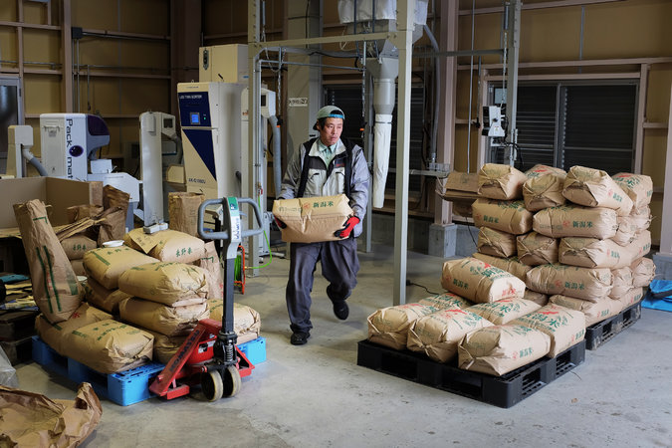
Protectionism occurs despite gains from trade because import-competing sectors have power
“For decades, Japan has defended its 778% tariffs on rice with a kind of religious zeal. Rice is a sacred crop, the government has argued, not open to trade negotiations. Its farmers are not just defenders of a proud agrarian heritage, but form the nation’s spiritual center as well.”
NYT, 9 January 2014

Slide 12
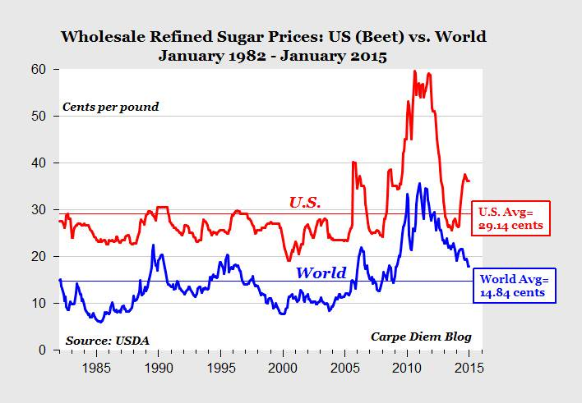
A real story of tariffs & trade
Sugar in US: 320M eat 24B lbs/year (75 lbs/person/yr)
Tariffs make US price 6-10¢/lb higher than world price
So increased cost is 75*.06= $4.50 per person per year
BUT $4.50*320M or ~$1.5B total for US consumers
~4,000 US farmers might lose jobs if tariff removed
24 billion lbs of sugar/year NOT purchased from farmers in Brazil, Thailand, India who would hire new workers if tariff was removed
https://www.forbes.com/sites/timworstall/2017/01/18/if-us-sugar-tariffs-make-americans-poorer-then-donald-trumps-tariffs-will-make-americans-what/
http://www.worldstopexports.com/sugar-exports-country/

Slide 13
Free Trade and
International Organization

Slide 14
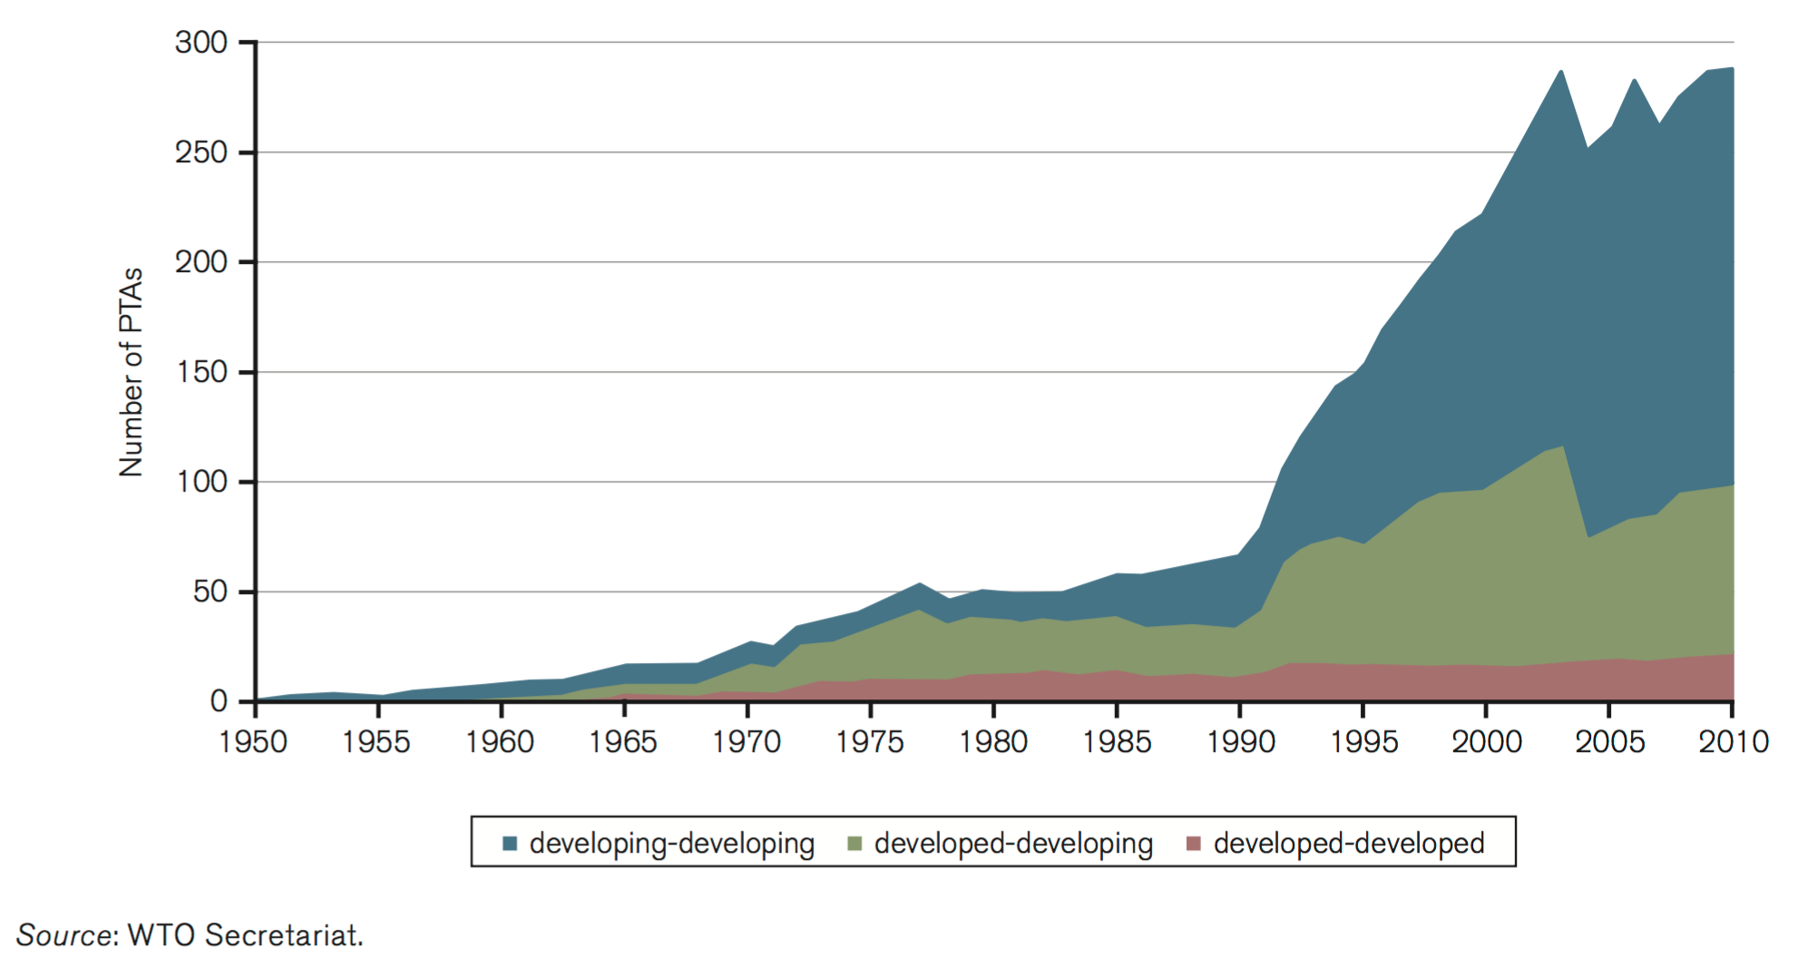
More Trade Agreements
Number of preferential trade agreements by country group, 1950-2010 – Figure B1 in WTO Trade Report (2011)
https://ourworldindata.org/wp-content/uploads/2016/09/PTAs_WTO2011.png

Slide 15
Institutions:
World Trade Organization
“Developed countries’ tariff cuts were for the most part phased in over five years from 1 January 1995. The result is a 40% cut in their tariffs on industrial products, from an average of 6.3% to 3.8%.”
“Over three quarters of WTO members are developing or least-developed countries. All WTO agreements contain special provision for them, including longer time periods to implement agreements and commitments, measures to increase their trading opportunities and support to help them build the infrastructure for WTO work, handle disputes, and implement technical standards.”

Slide 16
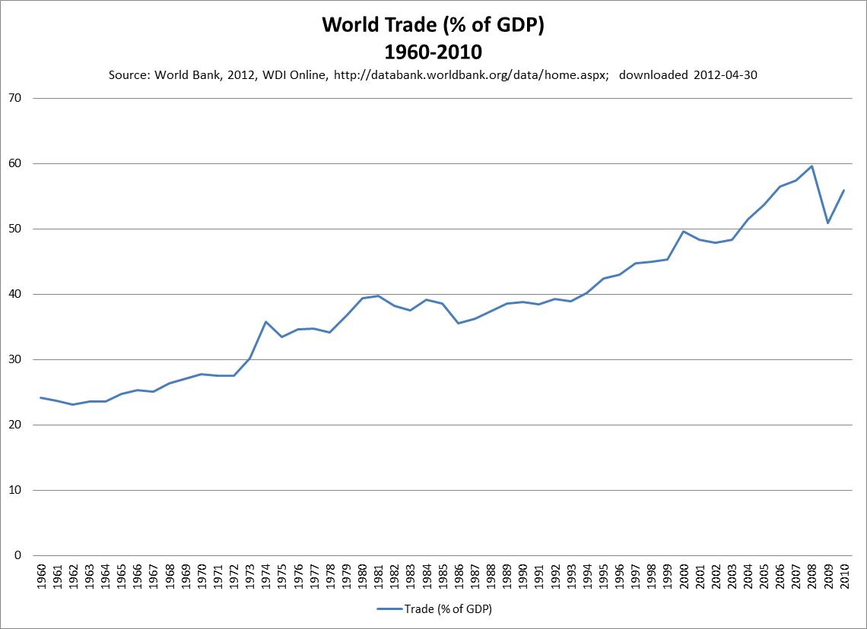

Slide 17
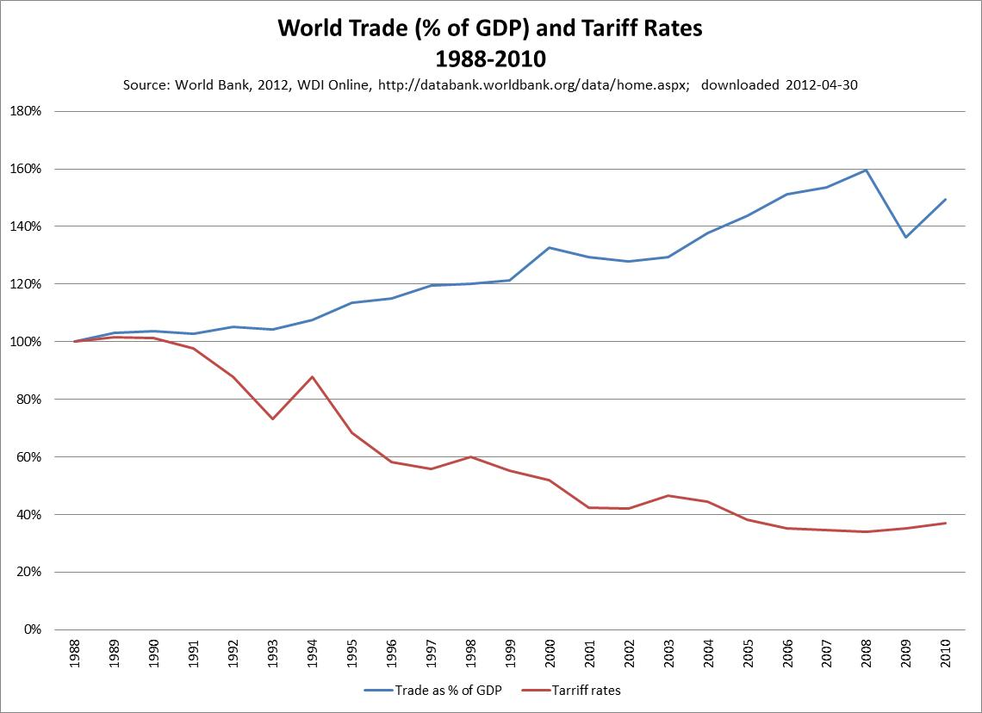

Slide 18
Institutions:
International Labor Organization
Convention concerning Equal Remuneration for Men and Women Workers for Work of Equal Value
  “ensure the application to all workers of the principle of equal remuneration for men and women workers for work of equal value”

Slide 19
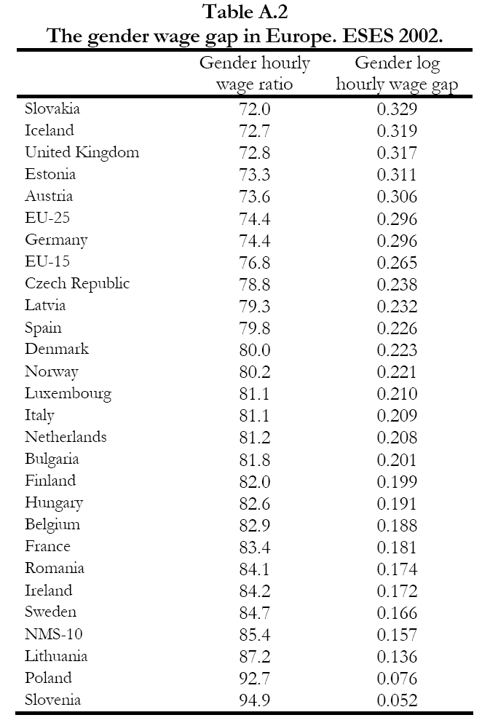
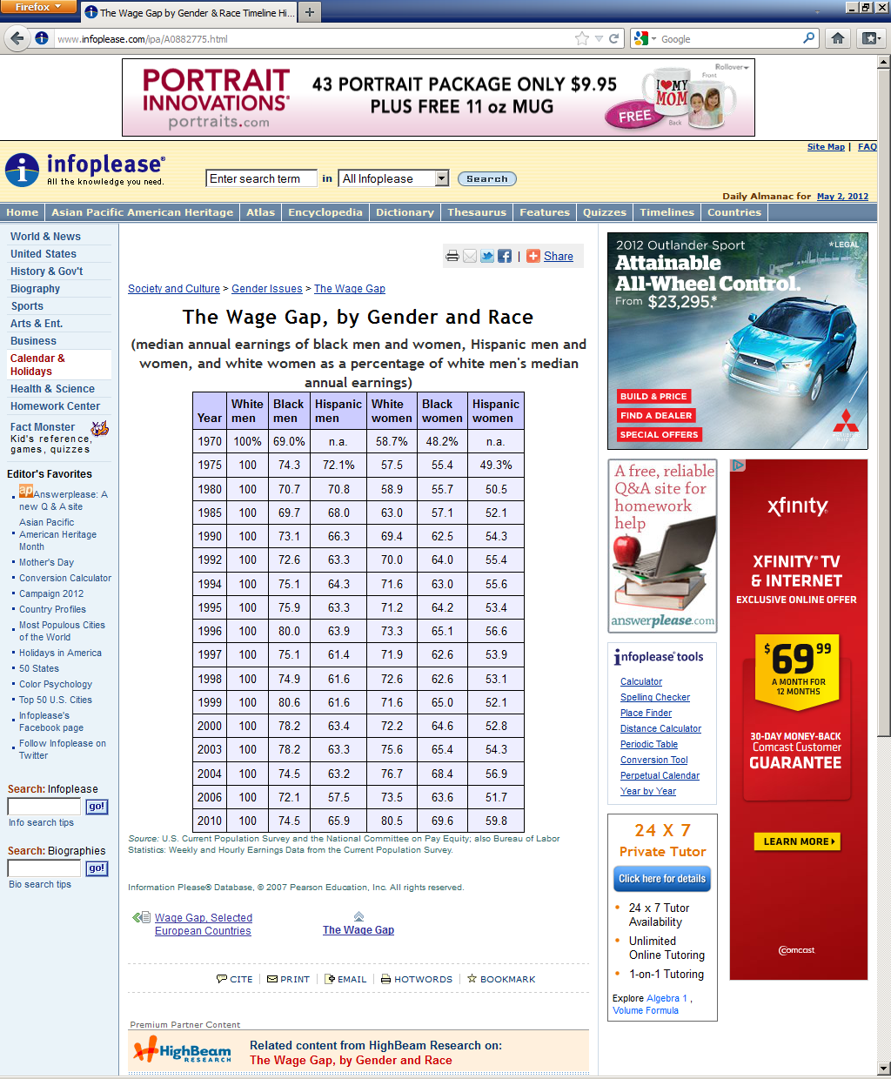
http://cep.lse.ac.uk/leed/docs/public/genderpay_simon2.pdf and http://www.infoplease.com/ipa/A0882775.html

Slide 20
The situation of developing states and its causes

Slide 21
Globalization
"Social, economic and technological unification of the globe" (Gilpin in Art/Jervis, 353).
Increasing-but not fairer-flows of everything
Due to:
  Technological change
  Economic pressure
  Social pressures
  Deliberate governmental policy

Slide 22
Globalization as Power Shift
Globalization: major change in who has power
State cannot control flows as did before
From developing to industrialized states
From governments to multinationals
From industrialized states to transnational actors
From governments to international institutions
Greater concentrations of power PLUS sometimes empowering the less powerful

Slide 23
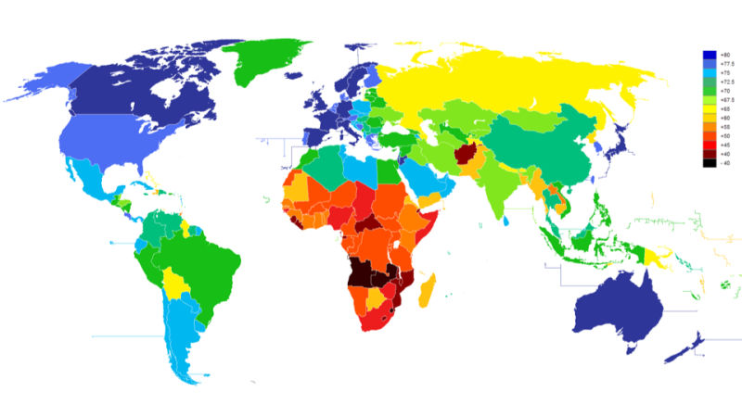
Life Expectancy
https://i.kinja-img.com/gawker-media/image/upload/s--wdA9Ffpu--/c_scale,f_auto,fl_progressive,q_80,w_800/186qma93rced6jpg.jpg

Slide 24
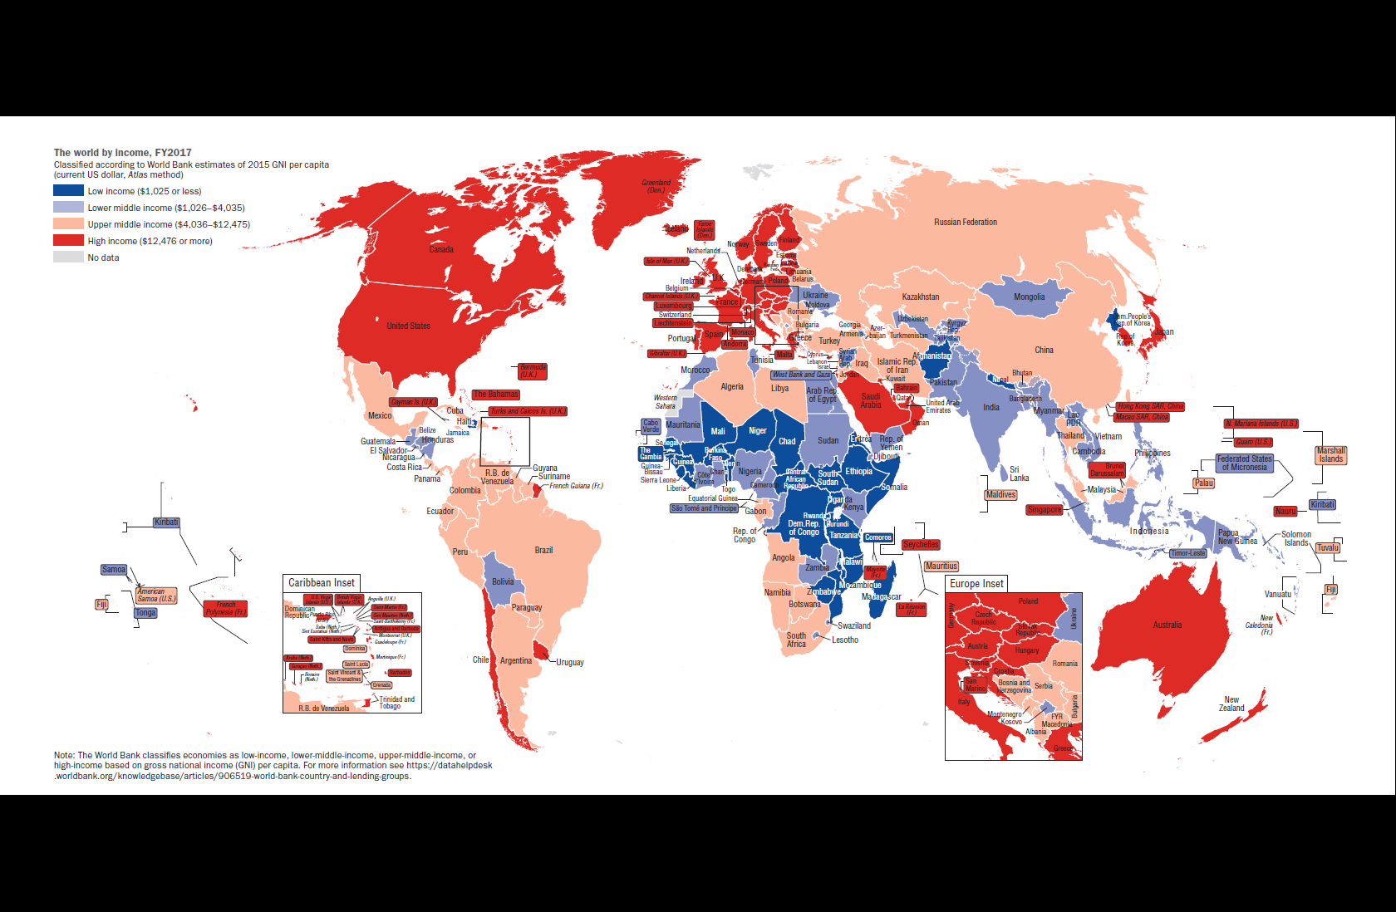
Income
https://data.worldbank.org/products/wdi-maps

Slide 25
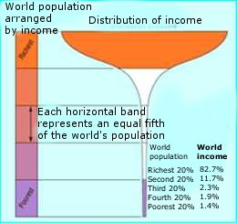
Income Inequality
Annual income flows of the richest 500 people exceeds that of the poorest 416 million
Cost of ending extreme poverty – $300 billion – less than 2% of the income of the richest 10% of the world’s population
Inequality of world incomes: what should be done? R. Wade http://www.opendemocracy.net/themes/article.jsp?id=6&articleId=257
Human Development Report 2005: The World at a Crossroads. http://www.undp-kuwait.org/Downloads/HDR2005_En.pdf

Slide 26
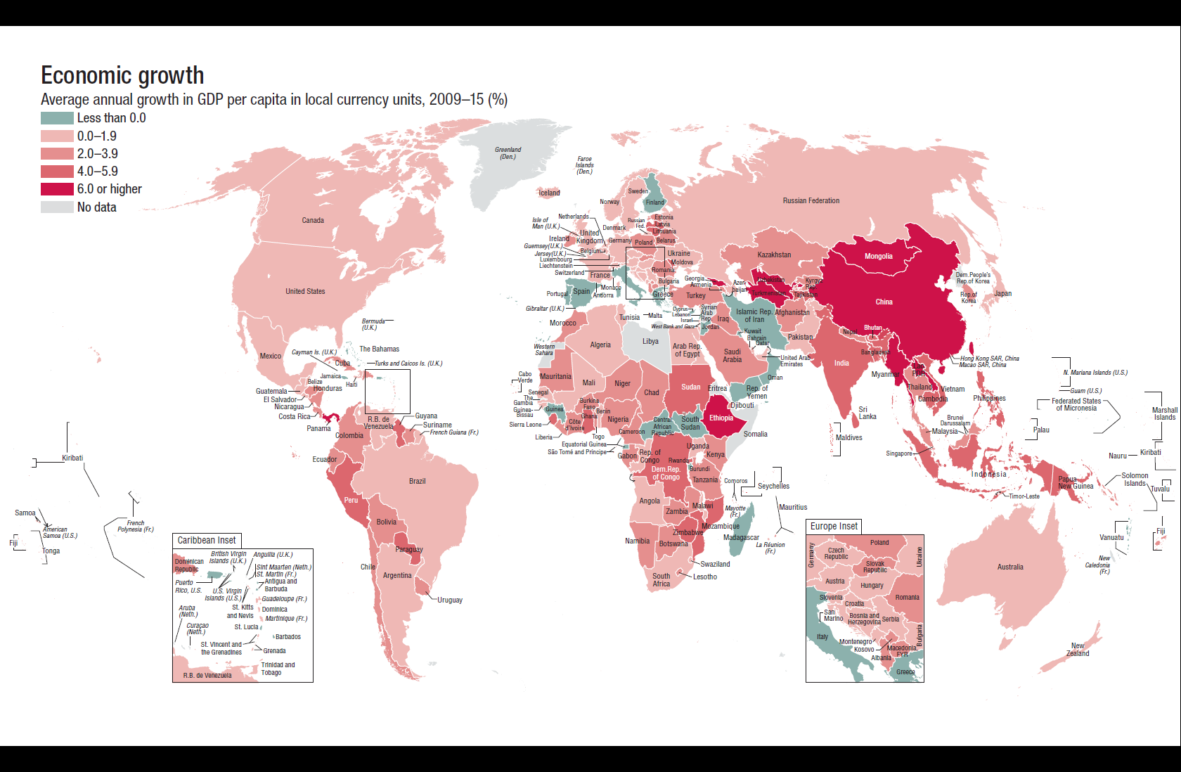
Economic Growth
https://data.worldbank.org/products/wdi-maps

Slide 27
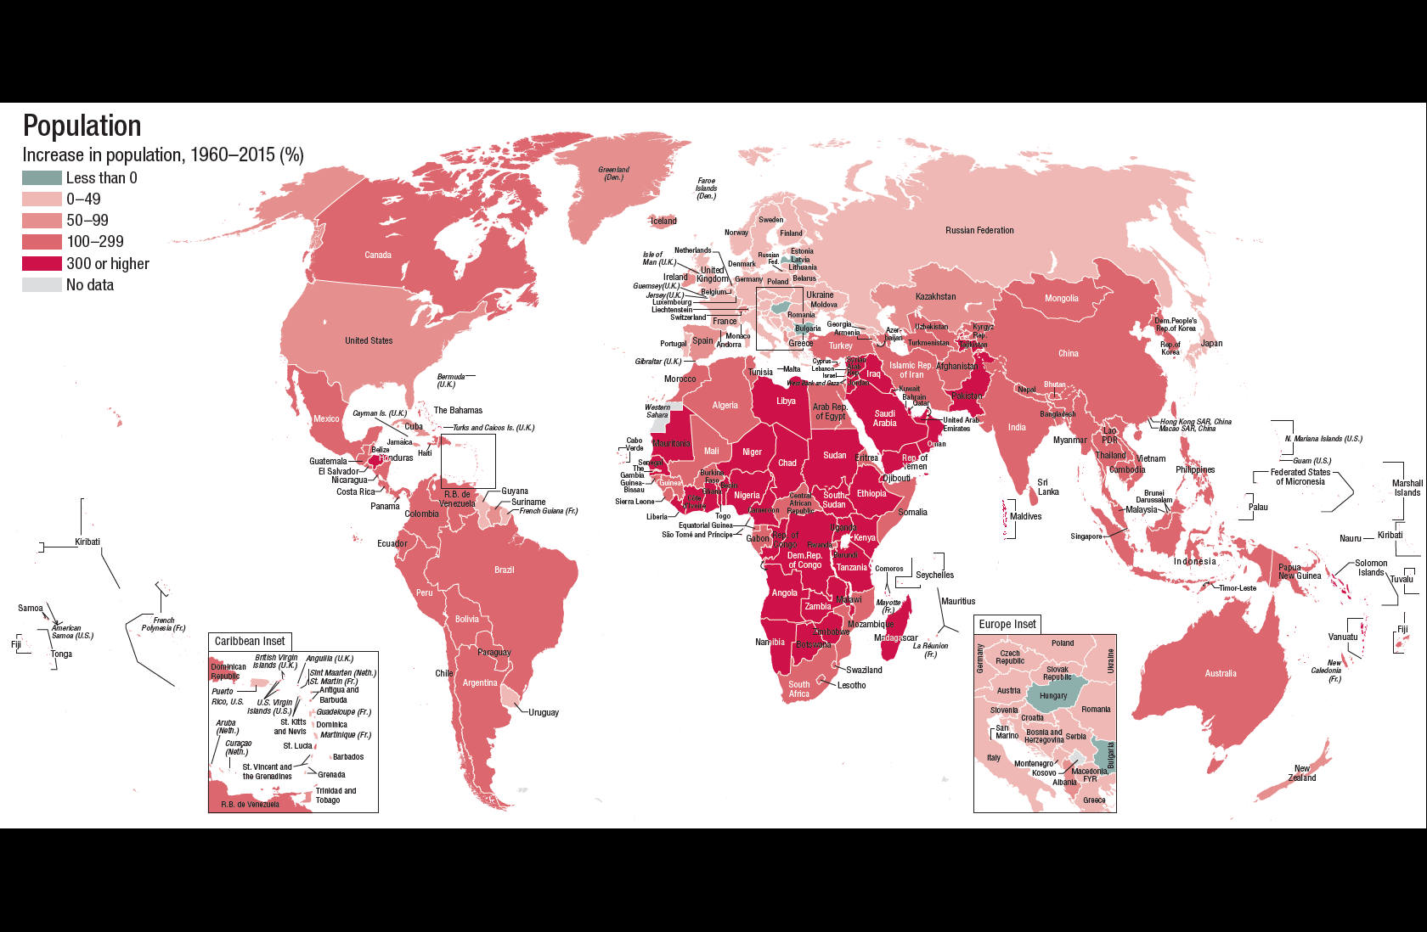
Population Growth
https://data.worldbank.org/products/wdi-maps

Slide 28
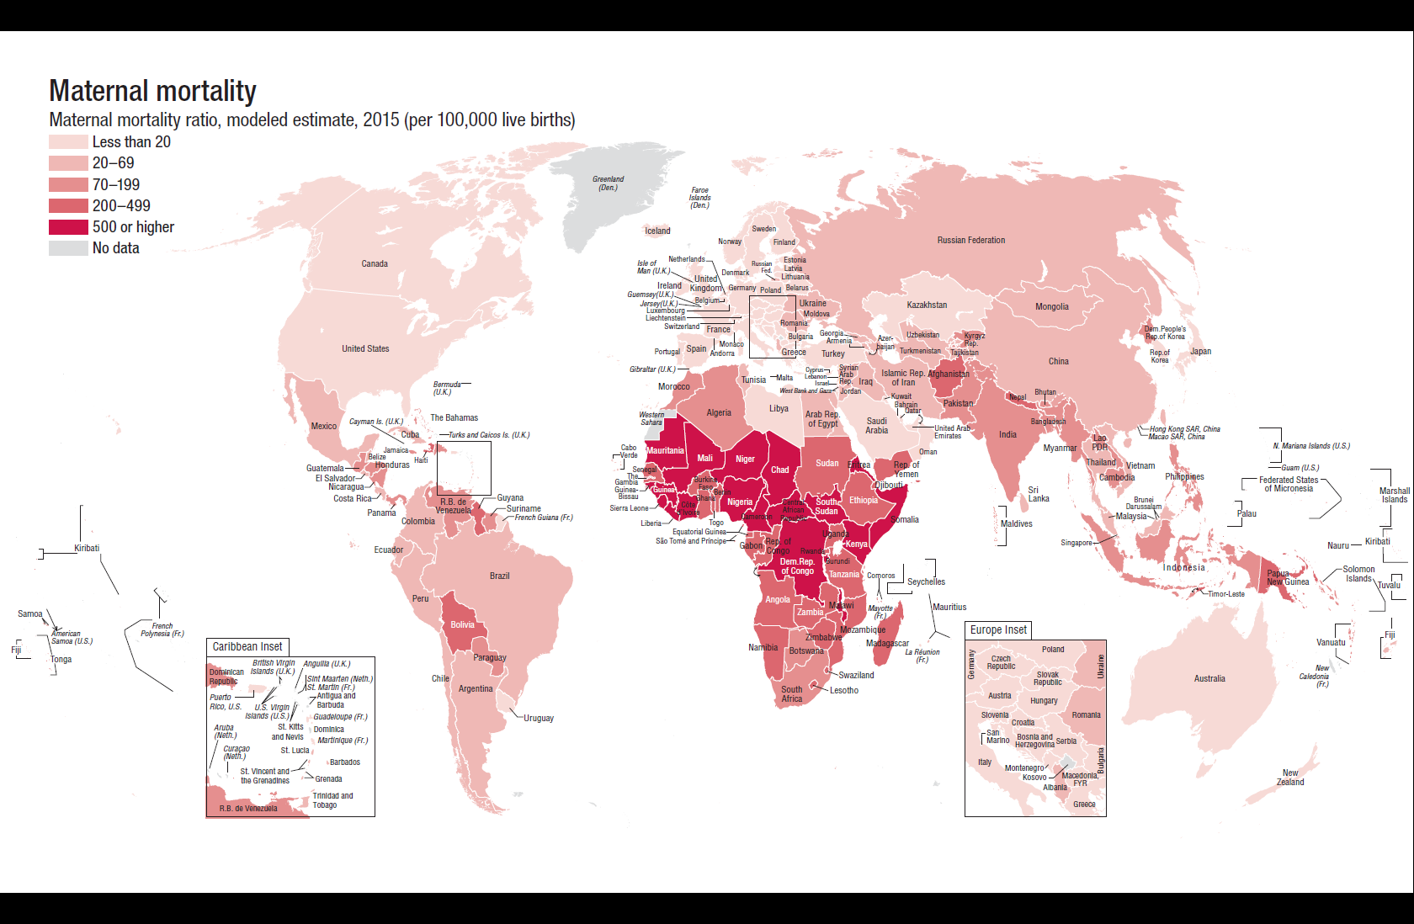
Maternal Mortality
https://data.worldbank.org/products/wdi-maps

Slide 29
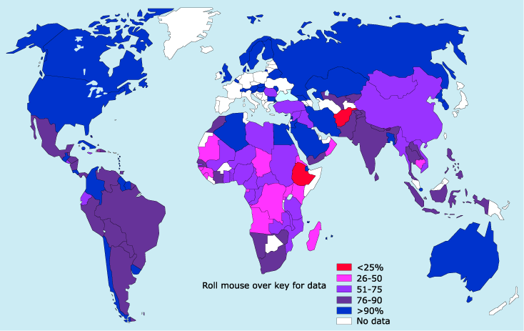
Clean Water
https://www.nature.com/nature/focus/water/map.html

Slide 30
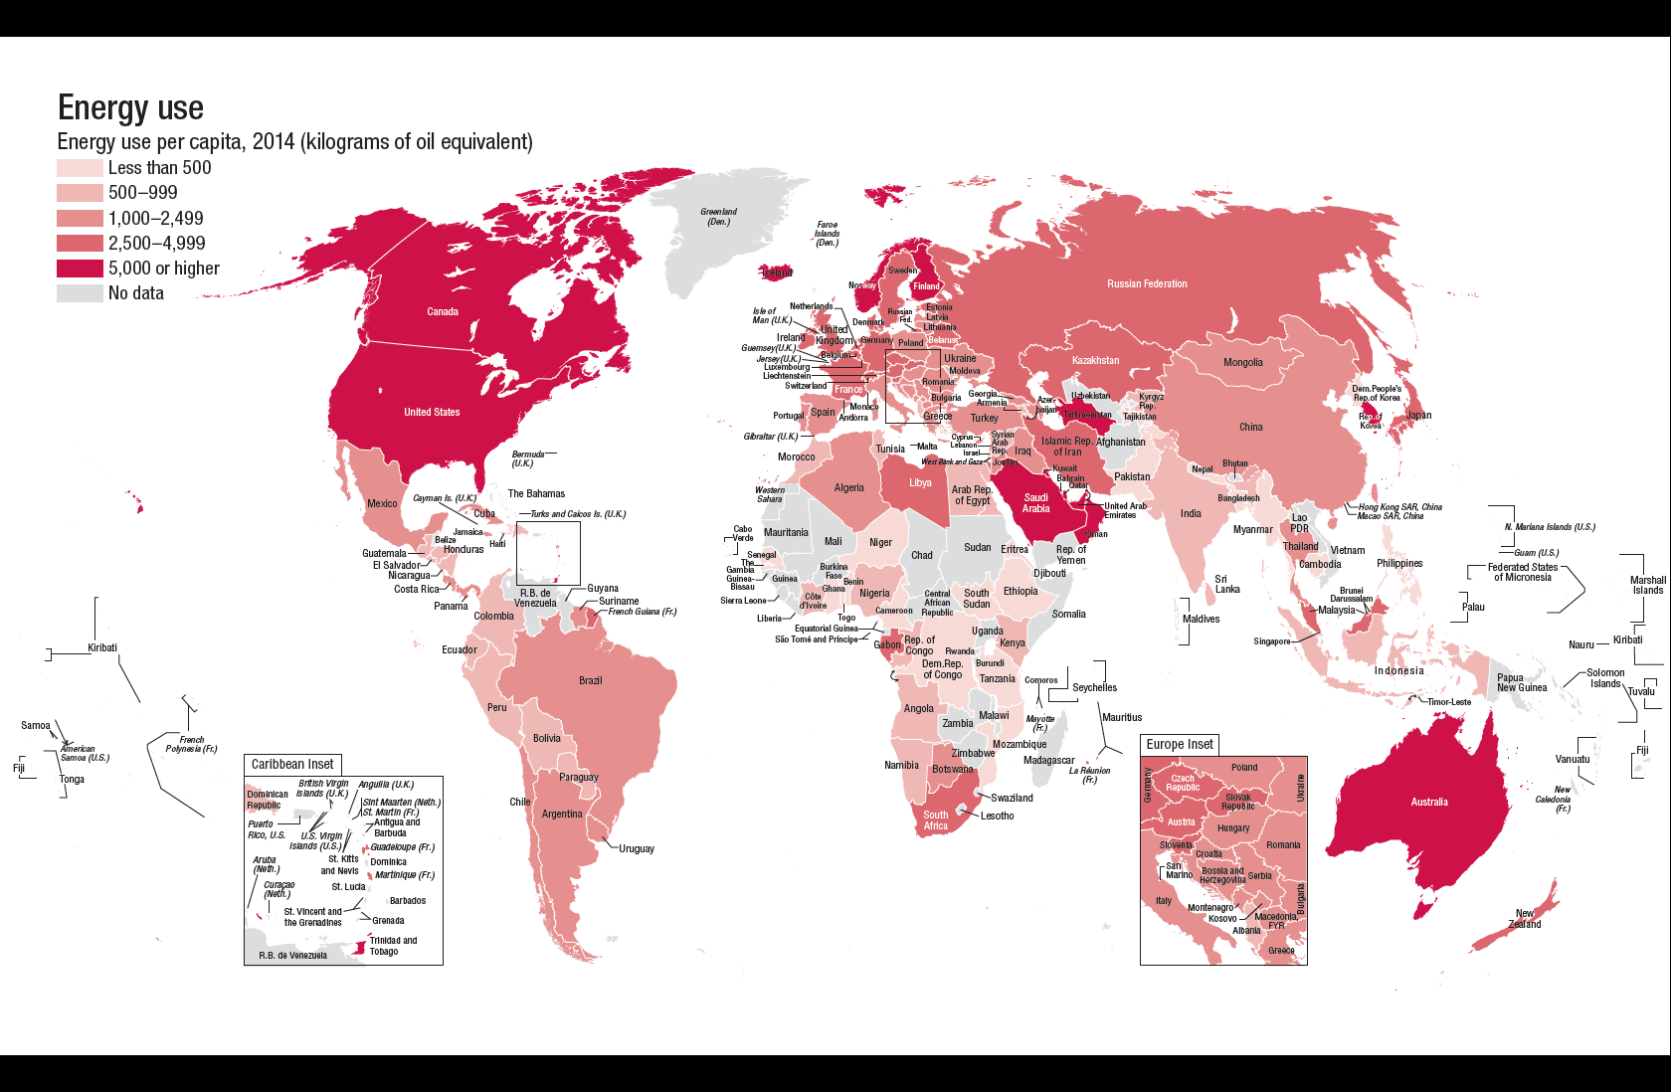
Energy Use
https://data.worldbank.org/products/wdi-maps

Slide 31
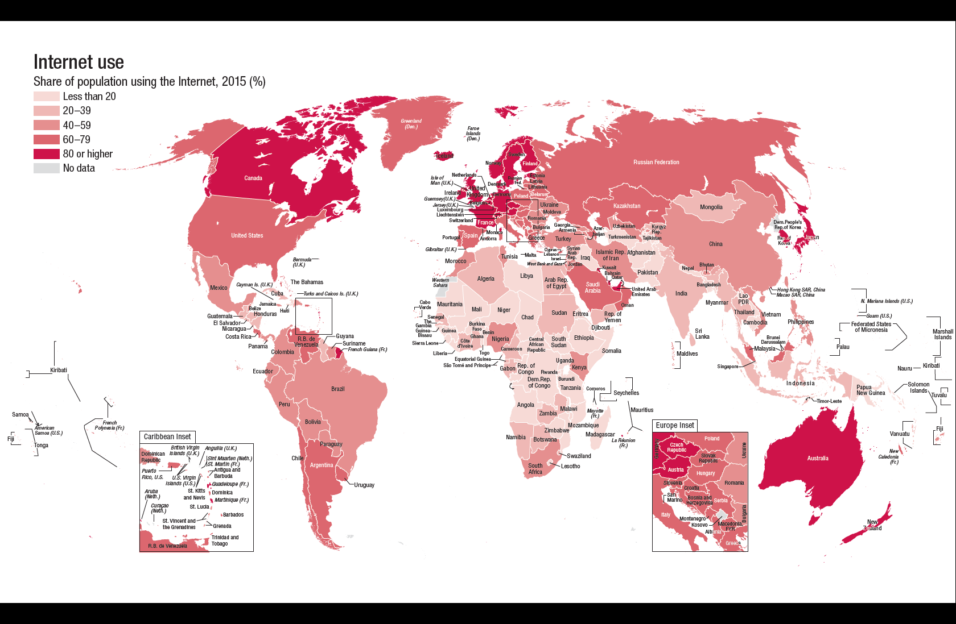
Internet Use
https://data.worldbank.org/products/wdi-maps

Slide 32
The State of Development
(as presented by an expert)
Hans Rosling talk

Slide 33
Solutions? to the Problem

Slide 34
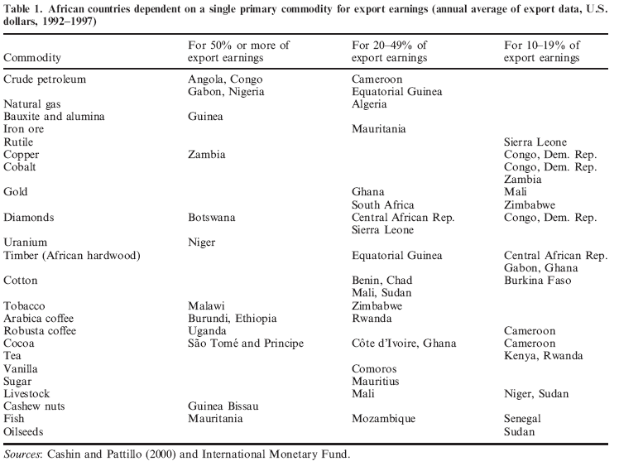
Source: http://www.xolimited.com/download/rpt/31.pdf

Slide 35
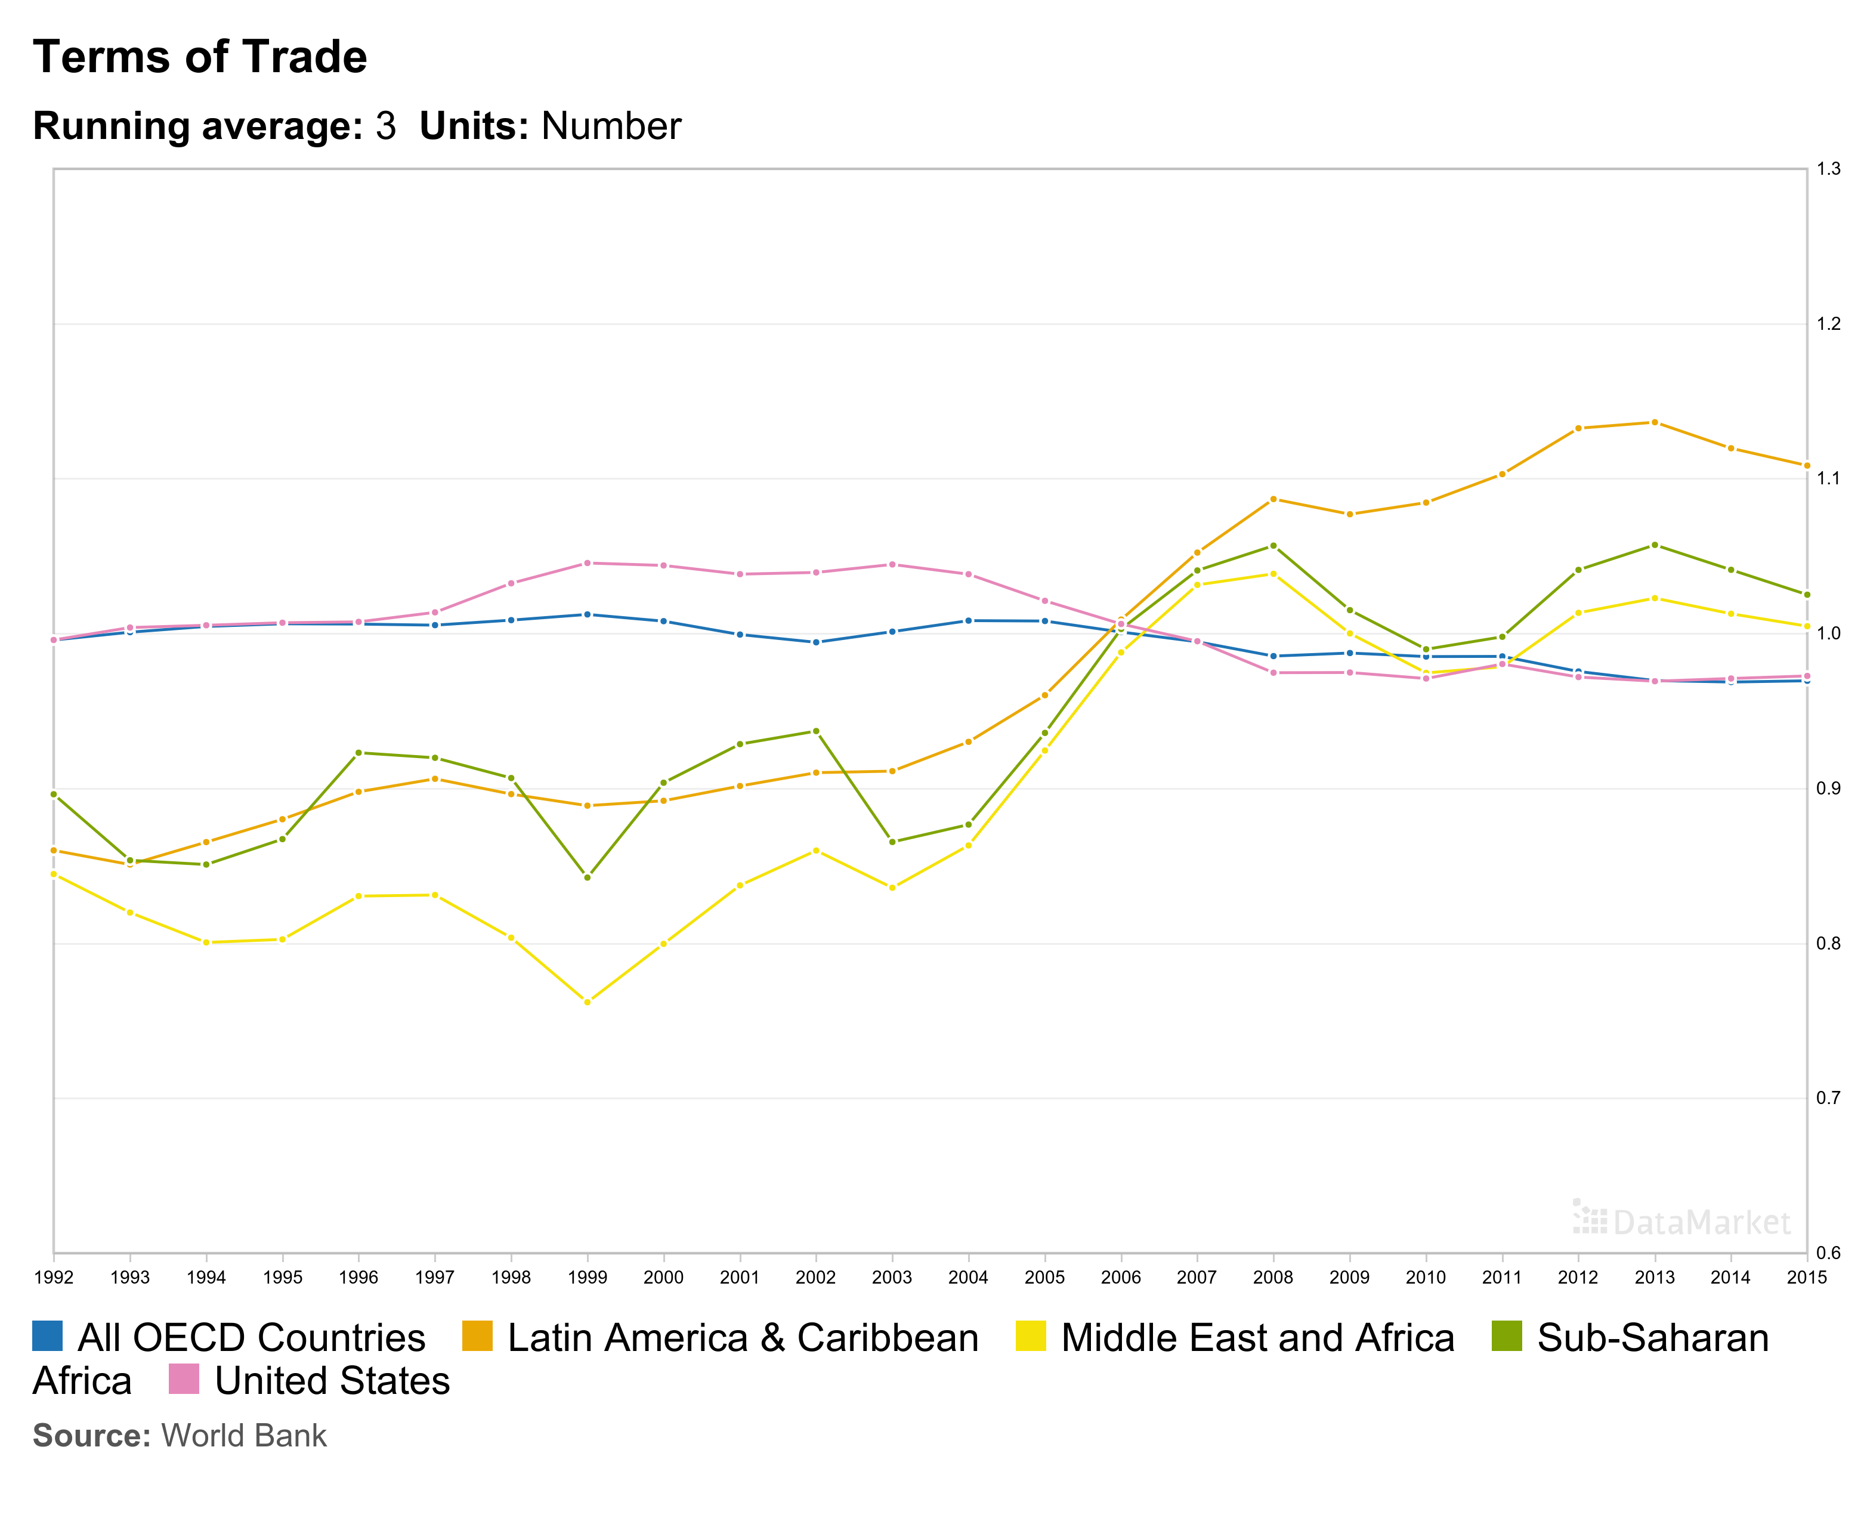
Trends in Terms of Trade
How much it costs to buy a given amount of imports
Increasing for poor countries // Flat or decreasing for rich countries
Latin America
US
Africa
OECD
ME and Africa
https://datamarket.com/data/set/1xsq/terms-of-trade#!ds=1xsq!20nd=6i.1o.2t.s.33&display=line&s=5mx&f=rolling:3
Provider: World Bank. Data date: 06/10/2014

Slide 36
Solutions to Problems of Development
Autonomy
International institutions
Collective bargaining
Socialist revolution and NIEO
Liberal orthodoxy
Structural adjustment policies

Slide 37
Structural Adjustment
What’s involved?
  Devaluing currency.
  Reducing trade and FDI barriers
  Government reform of state enterprises
  Reduce or eliminate budget deficits
  Get government out of marketplace
How rich impose structural adjustment on poor
IMF loans impose structural adjustment as a condition of loan

Slide 39
1: Access to Clean Water?
Two groups
Form two groups:
  Yes: > 70%. Stay put and have clean water.
  No: < 70%. Walk to get dirty water.
Interpretation: % of population in your country with access to clean water.
Globally: approximately 20% of the world population (1.5 billion people) do NOT have access to clean water. Many people must walk over a mile to get water and it is often not clean.

Slide 40
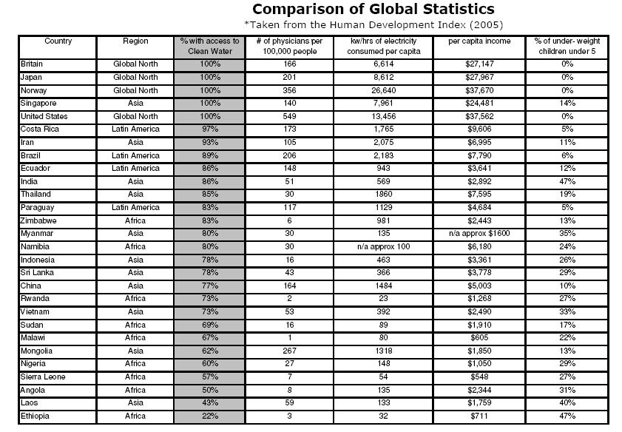

Slide 41
2: Health care? line from high to low
Form line from highest to lowest
  Norway, US, Mongolia: 250 doctors/100,000 people
  9 countries: 100 - 250 doctors/100,000 people
  8 countries: 25 - 100 doctors/100,000 people
  8 countries: less than 25 doctors/100,000 people
Interpretation: number of doctors per 100,000 people in your country
Globally: healthcare is FAR more available in developed countries and Latin America than it is in Africa

Slide 42
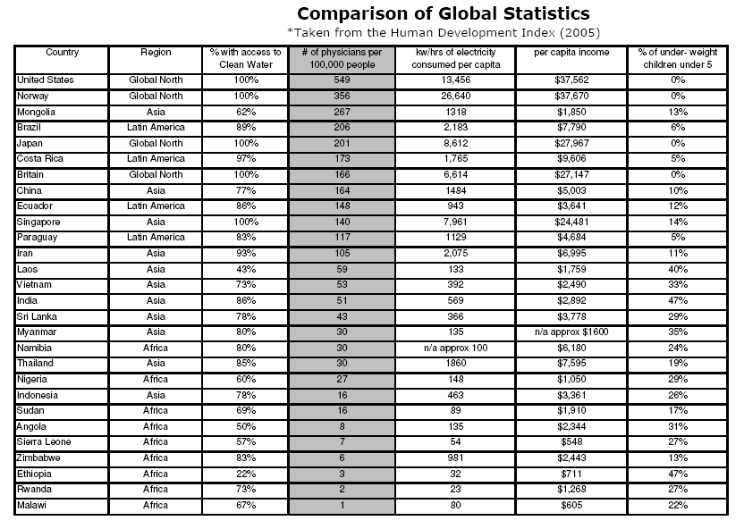

Slide 43
3: Energy?
Three groups
Form three groups:
  5,000 and up
  500 – 5000
  under 500
Interpretation: sticks represent energy consumption. Number is kilowatt hours of electricity per capita.
Globally: Look at distribution across cards

Slide 44
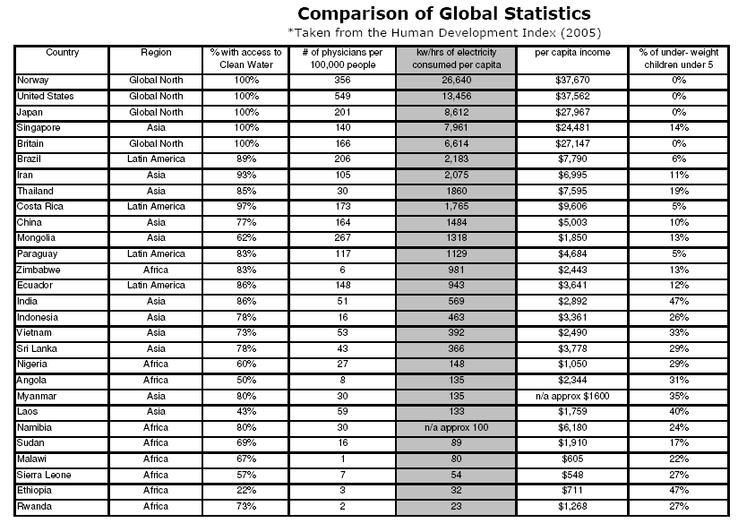

Slide 45
4: Per capita income?
Three groups
Form three groups:
  Group 1 - $10,000 +
  Group 2 - $1,500 - $10,000
  Group 3 - under $1,000
Interpretation: average per capita income of people in each country. Average, but a few who have much more, many much less
Globally:
  developed states average = $26,000/person
  Latin America average = $7,000/person
  South Asia average = $2,700/person
  Sub Saharan Africa average = $1,800/person

Slide 46
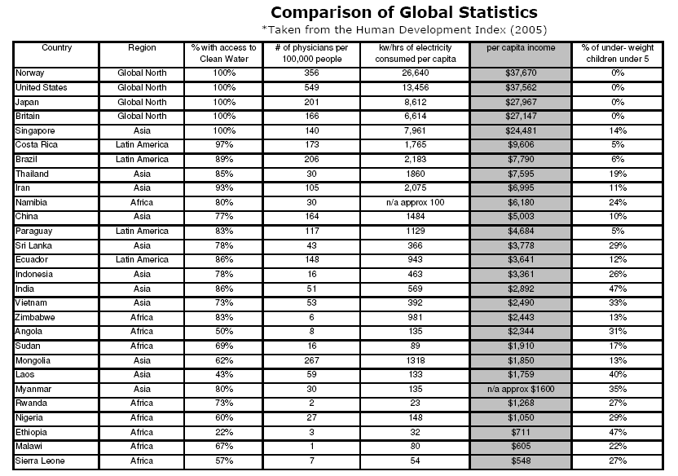

Slide 47
5: Nutrition?
Four groups
Form 4 groups:
  Developed countries
  Latin America
  Asia
  Africa
Interpretation: % of children younger than 5 years old who are underweight.
Globally: Enough food in world but not well distributed. Many children and adults are hungry and malnourished. 900 million undernourished children; 25% of children underweight.

Slide 48
