Slide 1
Overview
News items
  Gaza demonstrations & recognition of Jerusalem
  North Korea summit – will its signature matter?
  Iran Nuclear deal – will its demise matter?
The European Union (lecture notes courtesy of Craig Parsons)

Slide 2
Takehome messages from readings
Grieco article - relevance of theory and need to ensure theory helps address facts. If facts change, theory may need to change. Why does the EU seem to challenge realism?
  Basically the opposite of realism: voluntary transfers of major sovereignty to institutions with explicit autonomous power
  Realist John Mearsheimer predicted intra-European conflict would grow after 1990…
Boholt, The European Union

Slide 3
The EU and Theories of IR

Slide 4
Theory and the future of the EU?
Institutionalism
  Greek bailout – major evidence of institutional influence – think counterfactually. Without EU would Greece (177% debt to GDP ratio) receive $75B from and $45B from France.
  Brexit and 2017 French vote reflected sovereignty over EU institutional overreach
Disenfranchised
  Brexit and 2017 French vote reflected migration and racial/ethnic definition of nationalism
  Turkey’s struggle for EU membership reflects concerns related to 98% Muslim population

Slide 5
European Union from an institutionalist perspective
Security concerns are central to EU formation but …
States seek security through interdependent economic institutions and the “ties that bind”
States give up much sovereignty to institution
They do so in ways that involve
  short-term risks in exchange for long-term rewards
  interdependent vs. independent decision-making
Individual choices matter a lot
Corporations (non-state actors) matter a lot
Domestic politics matter a lot

Slide 6
The puzzle of the EU and explaining the EU

Slide 7
Puzzles of the EU
Given the tension between free trade and protectionism, how did the EU develop?
Why is free trade big in Europe but not Southeast Asia & other regions?

Slide 8
Basics and background
Unlikely candidate for integration
Monnet: "Faire L'Europe, c'est faire la paix“
  1951: European Coal and Steel Community
  1957: European Economic Community and Euratom
  1967: ECSC, EEC, and Euratom become European Community
  1978: EMS and ERM
  1985: Single European Act with 1992 at common market date
  1985: Schengen Agreement, abolishing internal border controls
  1992: Maastricht European Union. Euro (monetary union), ECB, goal of military/foreign policy union // Single European Market
  2001: Treaty of Nice fix EU institutions to address eastward expansion
  2002: European coins and notes
  2018: Brexit

Slide 9
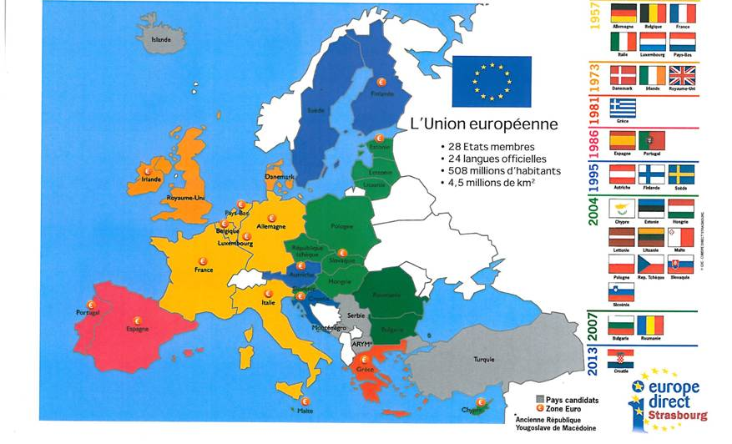
The growth of EU member states over time

Slide 10
Spillover: functional and geographic
Definition: expansion of integration beyond its initial bounds
From goods to more goods to services to exchange rates to single currency
From few countries to many
From trade to regulation (in many areas)
EC countries try in 1979 to “peg” currencies in European Monetary System
  But hard to maintain against speculation
  So…maybe must move to single currency?
Notice that there is an “inherent logic”
Notice that economics trumps politics and security
BUT notice that no military integration!!

Slide 11
Spillover: processes and logics
Functional linkage of tasks (“real” linkages)
“Constructed” linkages and political coalitions (more on that at end of lecture)
Elite socialization with ideology and identity appeal
Transnational coalitions, e.g.,:
  Courts, international norms and “rule of law”
  Business groups want lower costs and level playing field
New technologies make marketing more broadly more economically viable and increase opportunities to reap more economic gains

Slide 12
What IS the EU?
A body – progressively – created by treaties among 28 national governments
States delegate responsibilities in many policy areas
  Treaties give it the power to make own laws and regs…
  Over 100,000 pages so far
Greatest voluntary transfer of power by states in history

Slide 13
An international organization?
IOs created by treaty between states
Usually technical, elite (no citizen input)
  UN, IMF, WTO, NATO, NAFTA, ASEAN
Vary in degree of centralization…
But classically IOs for voluntary cooperation
  Majority voting rare, often not binding

Slide 14
A state?
Organization with ultimate control of a given territory (sovereignty)
  Fixed: not just something you sign up for
Central gov and laws trump all others
In modern West, democratic (citizen input)
Vary in degree of centralization…
But seen as given, not voluntary
  Binding decisions, majority voting, central gov main player

Slide 15
Which does EU resemble more??
An IO in origin:
  Created by Treaty of Rome (1957) as European Economic Community
  Treaties can only be modified by unanimous negotiation among member-states
  Membership changes over time (though no one leaves…)
And more IO-like than any functioning state
  Very decentralized
  Member-state leaders most powerful actors

Slide 16
But by far most state-like IO…
Unusually state-like even at origin
  Treaty with no exit clause
  Three branches of government…
  …including own binding legal system (ECJ)
    Soon claims to trump even national constitutions!
    Later gains partial “legal personality” (can sign treaties)
And gradually gets major power…

Slide 17
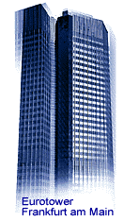


Real Power
MAIN POWER:
REGULATION
A specialized gov set up
around something like US
federal Commerce Clause
(so governs all trade-related policies…
which is most!)
AND:
MONETARY POLICY
(the euro)
Just as centralized as US
WEAKER:
TAX/SPEND
Budget capped
at 1.4% of GDP
(spending mostly
on agriculture, aid to poorer regions)
(overall spends about 1/5 budget of UK or France)
WEAKEST:
FOR POL/SECURITY
Constant coop, but
member-states still
act independently
on many big issues

Slide 18
Explaining increased European Union integration in 1980s and 90s

Slide 19
Conditions for integration
Economic difficulties (Eurosclerosis) create potential for gains from integration
  And it ends up working (therefore, spillover)
Ideological fragmentation over value of integration
No strong international policy conflicts
No strong cultural divides (despite languages)
Technocrats replace diplomats
Uncontested regional leadership (Germany)

Slide 20
EEC Crisis and “eurosclerosis”: conditions have to be right
EEC formed in 1957 among 6 original states
No major steps forward in EEC through 1970s
Pressures against increasing supranationality
  French remain wary of supranationality
  Anti-supranational Brits join in 1973
Economic crisis of 1970s
  Leaves little political attention for EEC
  National economies diverge in response to inflation, unemployment
By end of 1970s, EEC largely stagnant

Slide 21
Conditions for a possible European deal?
Broad shift toward “neoliberal” policies starts in 1980s
  Ronald Reagan in US
  Thatcher in Britain
  Even French moving this way by 1984
European business wants bigger, freer market
  EEC treaty removed formal barriers but need other things for a single market
  Some inherent pressures from opening Pandora’s box of free trade

Slide 22
Interests are not enough to explain the Single European Act
Economic interests (of export sector and consumers) are generally too weak to prompt enough pressure to get free trade
How do we know?
  Countries don’t do it unilaterally, e.g., Japan
  Even countries that are committed to free trade “backslide,” e.g., US regularly imposes steel tariffs
  We don’t see free trade in agricultural goods (even with respect to Europe!)
So, there must be politics in the story of EU development

Slide 23
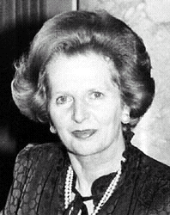
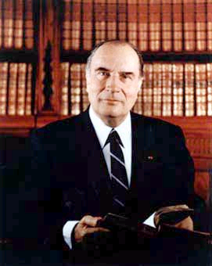


“Relaunch”: Even if conditions are right, you need leadership
Thatcher, British conservative, PM (1979)
  Ideologue broke with prior centrist consensus
  Supports free markets and free trade
  Hates centralization, regulation, and supranationality
Mitterand, Socialist, French President (1981)
  Supports EEC and French socialism
  Economic crisis prompts “U-turn” in 1983
  Looking to relaunch EEC
Delors, French socialist, Euro Commission Pres (1985)
  Supports free-markets and supranationality
  Looking to relaunch EEC
Kohl, German center-right, Chancellor (1982)
  Supports supranationality
  Open to free markets
  Wants “statesmen” legacy; becomes friends with Mitterrand

Slide 24
EU is free trade but a whole lot more some of which some don’t like
EU is free trade PLUS regulations that are not free market
Thatcher/Britain: like freer trade and less government in markets; accept supranationality in exchange
Delors/Mitterand/French: like supranationality, idea of Europe, and socialist regulation; accept liberalization in exchange
Kohl/Germans: Germans in middle on SEA: support free trade more than French and supranationality more than British
“A certain idea of Europe” matters: Mitterand accepts more free market because he wants Europe

Slide 25
Delors crafts a deal:
Neoliberalism for supranationality
1987: Single European Act to combine 300 free market rules in 1 package based on “mutual recognition” and on horse-trading where individual rules had failed
Neutral frame as “completing Single Market” by 1992
Goes beyond prior government agreements
Delors (EurCom President’s) deal:
  Persuades Mitterrand, Kohl to focus “relaunch” on “single market”
  Persuades Thatcher and neoliberals to accept EEC Treaty revision to get Europe-wide deregulation

Slide 26
Results on the ground
Huge burst of legislative activity
  In late 1980s, majority of national-level legislation is pass-through of EU directives
Barriers to European market drop
  Standards for goods harmonized or mutually-recognized
  Full capital mobility established
Firms react: cross-border mergers & acquisitions soar
Major development of non-economic EC policies
  Environment
  Education
  Culture

Slide 27
And “spillover”?
Inherent pressures continue
Late 1980s people start talking about next step:
  “Monetary union”
Basic problem: fluctuating exchange rates since 1971 distort single market
  Expanding financial markets make it worse
EC countries try in 1979 to “peg” currencies in European Monetary System
  But hard to maintain against speculation
  So…maybe must move to single currency?

Slide 28
Explaining Economic and Monetary Union
(the Euro and beyond)

Slide 29
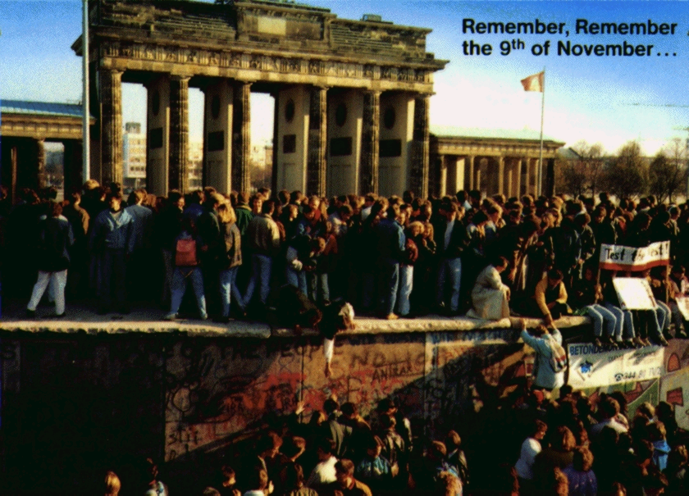
German reunification propels European integration
Fall of Berlin Wall 1989 ends division of Germany
Surprisingly, East & West Germany quickly reunite
Fear that reunified Germany will turn back on EC
Creates (in Germany and elsewhere) impetus for new commitment to Europe

Slide 30
New efforts to revise European Community with Economic and Monetary Union (EMU)
1990-1991: negotiations on “Economic and Monetary Union”
  Freeze exchange rates by 1999
  Create new currency
  Create European Central Bank (ECB) to manage new currency
  Make Euro credible and stable by “criteria” and “Stability and Growth Pact”
But opposition because: single currency generates single interest rate which may be too low for booming countries, and too high for struggling ones

Slide 31
Basics of the “monetary deal”
German interests:
  German business benefits from single market and single currency but NOT monetary union (already have strong currency and disciplined monetary policy)
  Tempers currency volatility – fosters economic discipline in other countries
  BUT their currency is already good
  Help build Europe (Kohl, if not all Germans)
French interests:
  Bind Germans into Europe
  Strengthen currency by coupling with Deutschmark
  Continue to build Europe

Slide 32
“Monetary deal” continued
Other countries’ interests
  Bind Germans into Europe
  “Bigger is better” for currencies, so many countries benefit
UK interests
  Stays out of monetary union
  Continues to like larger market
  Institutional stickiness (once in, hard to get out)

Slide 33
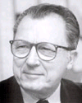
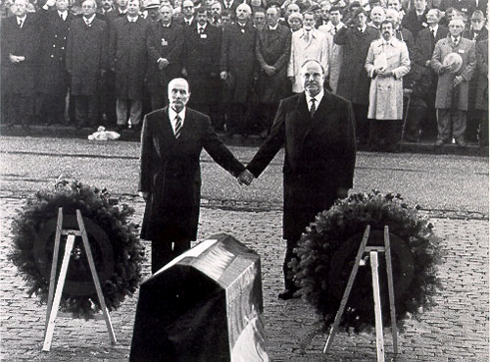
Architects of Maastricht and EMU: Mitterrand and Kohl (plus Delors)

Slide 34
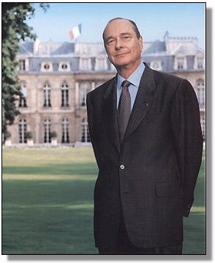
Opponents of Maastricht and EMU
Many in UK, led by Thatcher
Lots of EMU opponents in France
and elsewhere too…
UK will sign Maastricht Treaty
but “opts out” of EMU deal
Jacques Chirac, leader of Gaullists
(French President 1995-2007)
Plus most economists argue that it is a risky plan!

Slide 35
BUT Euro actually happens
Not foregone conclusion!
  Many thought in 1991: no way will be implemented
Difficulties of transition immense
  National convergence: “Maastricht criteria” say must cut national deficits to 3% GDP or less
  Must set up new European Central Bank, win confidence of markets
  Stick to this through changes in leadership…
  And rollout of Euro notes/coins (2002) is a major bureaucratic task that actually works

Slide 36
And it has staying power and influences government actions
Euro has remained a strong currency and weathered various storms
Even the financial crisis of last five years has not led to its demise
Germans (and others) have incurred financial (and political) costs they clearly would not have incurred in the absence of the EU

Slide 37
And then there’s Brexit

Slide 38
Brexit
Pressures for economic protectionism remain – same dynamics as Trump protection efforts
Pressures of sovereignty and nationalism also remain
Questions is whether this is:
  “28 steps forward, 1 step back”
  OR
  “Step 1 in the great EU unraveling”
What do you think? Two dynamics involved – which will win?

