Slide 1
Outline
“International institutions” readings takehomes
International Institutions/Regimes
  What they are
  Two competing views of their influence
  Types of problems they resolve
  Evaluating their effectiveness
  Strategies for influencing state behavior

Slide 2
Readings: Takehome Messages
Young & Osherenko, “Theories of regime formation”
  Example of research in social sciences
  Three types of hypotheses: power-based; interest-based; knowledge-based
Mearsheimer, “False promise of int’l institutions”
  States always concerned about relative gains; evidence doesn’t support institutional claims
  Rejecting BoP makes war more likely
  Compare Mearsheimer today to Grieco on Thursday – both are realists but responses to institutions are quite different

Slide 3
International Institutions
Institutions and Regimes (synonyms)
  "Norms, procedures, rules agreed to … to regulate an issue area" (Haas 1980, 397).
  Cooperative effort by states to overcome collective action problems
International example: human rights

Slide 4
International Institutions
International institutions are more than just the rules (just like democracy is more than just the Constitution)
  Written rules are PART of it, but only part
  General norms
  Actors involved
  Processes
  Expectations

Slide 5
Which is the REALIST View of Influence of Int’l Institutions
A
-----------------------------------------
B
Behavior and Outcomes
Power and Interests
International Institutions
Behavior and Outcomes
Power and Interests
International Institutions

Slide 6
Theoretical Views of the Importance of Institutions
Realist view: no influence of institutions
Institutionalist view: institutions may influence
Behavior and Outcomes
Power and Interests
International Institutions
Behavior and Outcomes
Power and Interests
International Institutions

Slide 7
Four Types of Problems
Institutions Arise to Address
Coordination games
  Humorous version / non-humorous version
  When German Army integrated Czech and Romanian units, chose English as common language (~2015)
  Once rules agreed to, no reason to cheat
  E.g., air traffic control, sea lanes
Collaboration games
  Ongoing incentives to cheat
  E.g., trade, arms control, environment
Upstream-downstream problems
  Ongoing incentives to cheat
  Upstream state has no incentive to act
Normative “problems”
  One/more state wants others to adopt their view

Slide 8
Collaboration (Prisoners Dilemma) Problems/Games
International Trade
Key Points: Symmetry of actions & affects Agreement requires reciprocity Strong incentives to cheat Monitoring HARD Enforce important |  | COLUMN
 |  | Decrease Tariffs | Increase Tariffs
ROW | Decrease Tariffs | C gets SOLID growth R gets SOLID growth | C gets HIGH growth R gets LOW growth
 | Increase Tariffs | C gets LOW growth R gets HIGH growth | C gets SLOW growth R gets SLOW growth

Slide 9
Coordination Problems/Games
Air traffic control, Sea Lanes
Key Points: Symmetry of actions & affects Agreement requires reciprocity Weak incentives to cheat Monitoring EASY Enforce NOT important |  | FRANCE
 |  | Pilots and ATC Speak English | Pilots and ATC Speak French
US | Pilots and ATC Speak English | No Crashes BUT High Training Costs No Crashes AND No Training Costs | Crashes AND High Training Costs Crashes AND No Training Costs
 | Pilots and ATC Speak French | Crashes AND No Training Costs Crashes AND High Training Costs | No Crashes AND No Training Costs No Crashes BUT High Training Costs

Slide 10
Upstream/Downstream Problems/Games
River Pollution, Air Pollution
Key Points: NO Symmetry of action & affect Agreement requires payment Strong incentives to cheat Monitoring EASY Enforcement important |  | FRANCE (Upstream State)
 |  | Pollute Rhine River | Do NOT Pollute Rhine River
NETHERLANDS (Downstream State) | Pollute Rhine River | Clean River + Manufacturing Strong Manufacturing Strong but Weak Agriculture | Clean River but Manufacturing Weak Manufacturing Strong PLUS Strong Agriculture
 | Do NOT Pollute Rhine River | Clean River + Manufacturing Strong Weak Manufacturing but Weak Agriculture | Clean River but Manufacturing Weak Manufacturing Strong PLUS Strong Agriculture

Slide 11
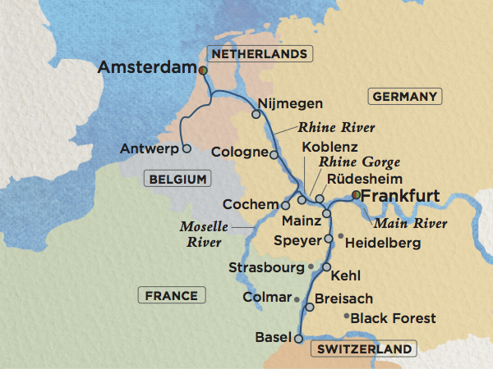
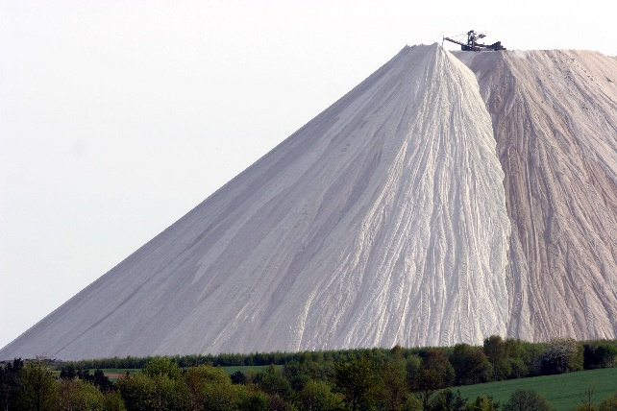
Mountain of table salt (from potash mining and processing) in Germany
https://i.imgur.com/PX5tcwC.jpg

Slide 12
Normative Problems/Games
Human Rights – Gender Wage Gap (by country)
Key Points: Asymmetry of actions & affects Agreement requires pressure Strong incentives to cheat Monitoring MAY BE EASY Enforce Hard to Impose |  | US & Other States already meeting rules
 |  | Reduce Gender Wage Gap so Female >= $0.67 | Do NOT Reduce Gender Wage Gap so Female >= $0.67
US & Other States already meeting rules | Reduce Gender Wage Gap so Female >= $0.67 | Costly at home but Some International Benefits No Change Required | Maintain Status quo; pressed by other countries No Change Required
 | Do NOT Reduce Gender Wage Gap so Female >= $0.67 | Costly at home but Some International Benefits Wage Gap Driven by Other Factors | Maintain Status quo; pressed by other countries Wage Gap Driven by Other Factors

Slide 13
Functions of Institutions
Manage complexity
Reduce transaction costs
Create rules
Increase reciprocity
Improve information
Create/strengthen norms

Slide 14
Assessing the Effectiveness of
International Institutions

Slide 15
Institutional Effectiveness Matters
Realists don’t think they matter
Institutionalists think they do
Disenfranchised think they matter for more powerful groups but not for less powerful groups
We CARE whether they matter in real life, but DO they?
  Free Trade Agreements
  North Korea // Iran Nuclear Deal // Nuclear Weapons Ban Treaty
  Paris Climate Agreement // Fisheries Treaties // Endangered Species
  Equal Pay for Equal Work // Human Rights

Slide 16
Evaluating Institutional Effectiveness
Institutions can always be evaluated against TWO definitions of success
  Goal achievement: Compare actual behavior (or outcomes) to stated goal
  Counterfactual: Compare actual behavior (or outcomes) to what would have occurred otherwise

Slide 17
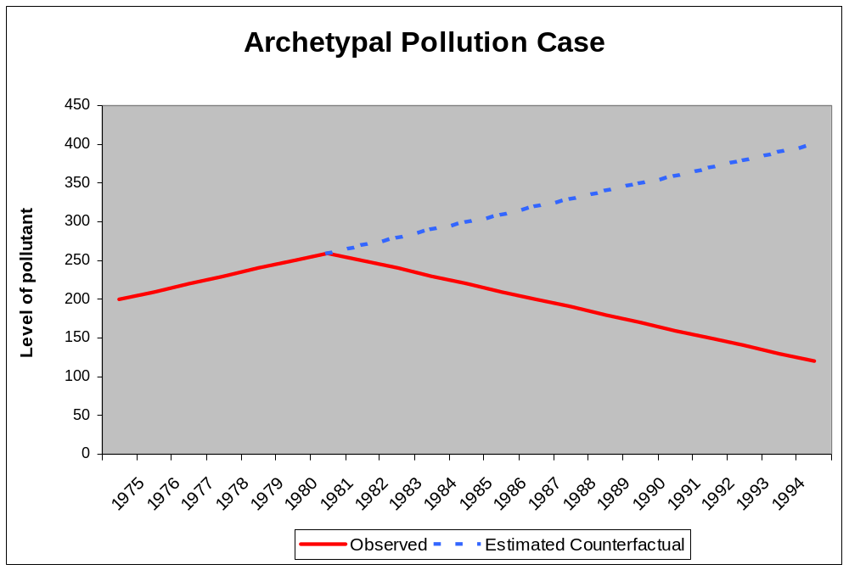
Pollution Agreements:
Evaluating Effectiveness
Treaty In Force
Notes:
Take the Montreal Protocol. Was the Montreal Protocol effective at changing the behavior of industrialized countries? If so, what aspect of the treaty should receive credit for the success? Was it the sanctions threatened under the treaty? Or was the decline in their CFC production due to availability of alternatives that might have happened anyway?
What about the developing countries? Were the rules offering them incentives to reduce CFC production less effective than the sanctions?
And, do the Montreal Protocol’s provisions appear more or less effective than those of the Nitrogen Oxide Protocol of the Convention on Long Range Transboundary Air Pollution?
Questions:
Was either really influential?
If so, what explains their effects and influence?
Is it something about the rules? Or something about regulating CFCs which is different than regulating NOx?
And, if we can identify which of the many possible explanations is the true one, how do we determine how to apply those lessons to other treaties?
These questions apply to the whole range of environmental treaties from climate change and energy use to stratospheric ozone loss to acid rain in Europe to endangered species protection to biodiversity loss to wetlands protection and water quality. Later on in the talk I will be looking at fisheries as one arena in which we can develop some of the theory and methodology so that it can be applied across all these arenas.

Slide 18
Pollution Agreements:
Evaluating Effectiveness
Treaty In Force
Notes:
Take the Montreal Protocol. Was the Montreal Protocol effective at changing the behavior of industrialized countries? If so, what aspect of the treaty should receive credit for the success? Was it the sanctions threatened under the treaty? Or was the decline in their CFC production due to availability of alternatives that might have happened anyway?
What about the developing countries? Were the rules offering them incentives to reduce CFC production less effective than the sanctions?
And, do the Montreal Protocol’s provisions appear more or less effective than those of the Nitrogen Oxide Protocol of the Convention on Long Range Transboundary Air Pollution?
Questions:
Was either really influential?
If so, what explains their effects and influence?
Is it something about the rules? Or something about regulating CFCs which is different than regulating NOx?
And, if we can identify which of the many possible explanations is the true one, how do we determine how to apply those lessons to other treaties?
These questions apply to the whole range of environmental treaties from climate change and energy use to stratospheric ozone loss to acid rain in Europe to endangered species protection to biodiversity loss to wetlands protection and water quality. Later on in the talk I will be looking at fisheries as one arena in which we can develop some of the theory and methodology so that it can be applied across all these arenas.

Slide 19
Pollution Agreements:
Evaluating Effectiveness
Treaty In Force
COUNTERFACTUAL:
Predicted Emissions if Treaty Wasn’t Signed
Notes:
Take the Montreal Protocol. Was the Montreal Protocol effective at changing the behavior of industrialized countries? If so, what aspect of the treaty should receive credit for the success? Was it the sanctions threatened under the treaty? Or was the decline in their CFC production due to availability of alternatives that might have happened anyway?
What about the developing countries? Were the rules offering them incentives to reduce CFC production less effective than the sanctions?
And, do the Montreal Protocol’s provisions appear more or less effective than those of the Nitrogen Oxide Protocol of the Convention on Long Range Transboundary Air Pollution?
Questions:
Was either really influential?
If so, what explains their effects and influence?
Is it something about the rules? Or something about regulating CFCs which is different than regulating NOx?
And, if we can identify which of the many possible explanations is the true one, how do we determine how to apply those lessons to other treaties?
These questions apply to the whole range of environmental treaties from climate change and energy use to stratospheric ozone loss to acid rain in Europe to endangered species protection to biodiversity loss to wetlands protection and water quality. Later on in the talk I will be looking at fisheries as one arena in which we can develop some of the theory and methodology so that it can be applied across all these arenas.

Slide 20
Pollution Agreements:
Evaluating Effectiveness
Treaty In Force
COUNTERFACTUAL:
Predicted Emissions if Treaty Wasn’t Signed
Success of Treaty Relative to COUNTERFACTUAL
Notes:
Take the Montreal Protocol. Was the Montreal Protocol effective at changing the behavior of industrialized countries? If so, what aspect of the treaty should receive credit for the success? Was it the sanctions threatened under the treaty? Or was the decline in their CFC production due to availability of alternatives that might have happened anyway?
What about the developing countries? Were the rules offering them incentives to reduce CFC production less effective than the sanctions?
And, do the Montreal Protocol’s provisions appear more or less effective than those of the Nitrogen Oxide Protocol of the Convention on Long Range Transboundary Air Pollution?
Questions:
Was either really influential?
If so, what explains their effects and influence?
Is it something about the rules? Or something about regulating CFCs which is different than regulating NOx?
And, if we can identify which of the many possible explanations is the true one, how do we determine how to apply those lessons to other treaties?
These questions apply to the whole range of environmental treaties from climate change and energy use to stratospheric ozone loss to acid rain in Europe to endangered species protection to biodiversity loss to wetlands protection and water quality. Later on in the talk I will be looking at fisheries as one arena in which we can develop some of the theory and methodology so that it can be applied across all these arenas.

Slide 21
Pollution Agreements:
Evaluating Effectiveness
Treaty In Force
GOAL:
Emissions Level Treaty Sought to Achieve
Notes:
Take the Montreal Protocol. Was the Montreal Protocol effective at changing the behavior of industrialized countries? If so, what aspect of the treaty should receive credit for the success? Was it the sanctions threatened under the treaty? Or was the decline in their CFC production due to availability of alternatives that might have happened anyway?
What about the developing countries? Were the rules offering them incentives to reduce CFC production less effective than the sanctions?
And, do the Montreal Protocol’s provisions appear more or less effective than those of the Nitrogen Oxide Protocol of the Convention on Long Range Transboundary Air Pollution?
Questions:
Was either really influential?
If so, what explains their effects and influence?
Is it something about the rules? Or something about regulating CFCs which is different than regulating NOx?
And, if we can identify which of the many possible explanations is the true one, how do we determine how to apply those lessons to other treaties?
These questions apply to the whole range of environmental treaties from climate change and energy use to stratospheric ozone loss to acid rain in Europe to endangered species protection to biodiversity loss to wetlands protection and water quality. Later on in the talk I will be looking at fisheries as one arena in which we can develop some of the theory and methodology so that it can be applied across all these arenas.

Slide 22
Pollution Agreements:
Evaluating Effectiveness
Treaty In Force
GOAL:
Emissions Level Treaty Sought to Achieve
Failure of Treaty
Relative to GOAL
Notes:
Take the Montreal Protocol. Was the Montreal Protocol effective at changing the behavior of industrialized countries? If so, what aspect of the treaty should receive credit for the success? Was it the sanctions threatened under the treaty? Or was the decline in their CFC production due to availability of alternatives that might have happened anyway?
What about the developing countries? Were the rules offering them incentives to reduce CFC production less effective than the sanctions?
And, do the Montreal Protocol’s provisions appear more or less effective than those of the Nitrogen Oxide Protocol of the Convention on Long Range Transboundary Air Pollution?
Questions:
Was either really influential?
If so, what explains their effects and influence?
Is it something about the rules? Or something about regulating CFCs which is different than regulating NOx?
And, if we can identify which of the many possible explanations is the true one, how do we determine how to apply those lessons to other treaties?
These questions apply to the whole range of environmental treaties from climate change and energy use to stratospheric ozone loss to acid rain in Europe to endangered species protection to biodiversity loss to wetlands protection and water quality. Later on in the talk I will be looking at fisheries as one arena in which we can develop some of the theory and methodology so that it can be applied across all these arenas.

Slide 23
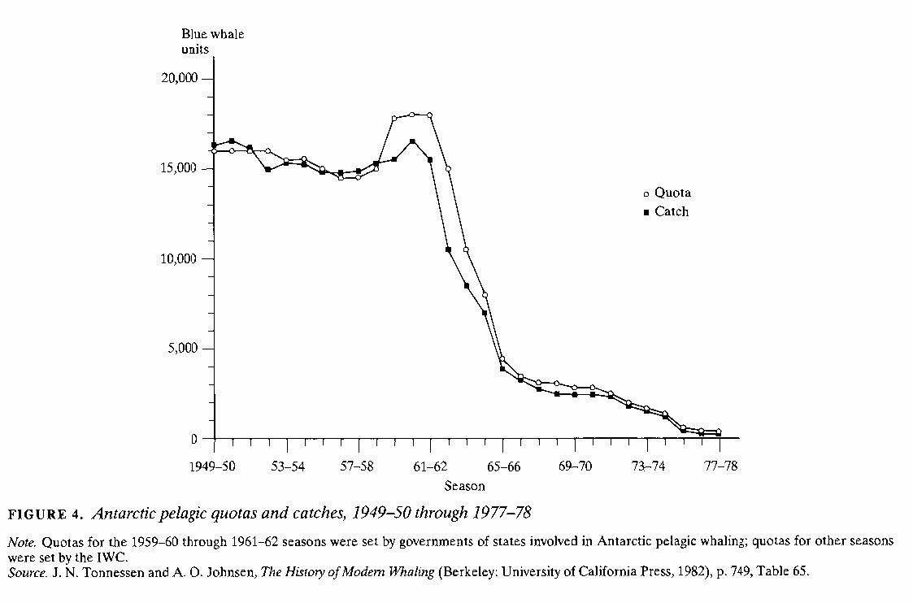
Was the Whaling Treaty a success?

Slide 24
“Having decided to conclude a convention to provide for the proper conservation of whale stocks and thus make possible the orderly development of the whaling industry” (ICRW, 1946)
Goal

Slide 25
“Having decided to conclude a convention to provide for the proper conservation of whale stocks and thus make possible the orderly development of the whaling industry” (ICRW, 1946)
Goal

Slide 26
“Having decided to conclude a convention to provide for the proper conservation of whale stocks and thus make possible the orderly development of the whaling industry” (ICRW, 1946)
Goal
Failure Relative To Goal

Slide 27
Counterfactual

Slide 28
Counterfactual
Catch LOWER than would have been otherwise, allowing population to recover
But higher population allows MORE catch for longer than would have been possible otherwise
Success Relative To Counterfactual

Slide 29
Both a success and a failure
Counterfactual
Goal
Failure Relative To Goal
Success Relative To Counterfactual

Slide 30
Evaluating Institutional Effectiveness
Institutions can always be evaluated against TWO definitions of success
  Goal achievement: Compare actual behavior (or outcomes) to stated goal
  Counterfactual: Compare actual behavior (or outcomes) to what would have occurred otherwise

