Slide 1
Upstream/Downstream Problems/Games
River Pollution, Air Pollution
Key Points: NO Symmetry of action & affect Agreement requires payment Strong incentives to cheat Monitoring EASY Enforcement important |  | FRANCE (Upstream State)
 |  | Pollute Rhine River | Do NOT Pollute Rhine River
NETHERLANDS (Downstream State) | Pollute Rhine River | Clean River + Manufacturing Strong Manufacturing Strong but Weak Agriculture | Clean River but Manufacturing Weak Manufacturing Strong PLUS Strong Agriculture
 | Do NOT Pollute Rhine River | Clean River + Manufacturing Strong Weak Manufacturing but Weak Agriculture | Clean River but Manufacturing Weak Manufacturing Strong PLUS Strong Agriculture

Slide 2
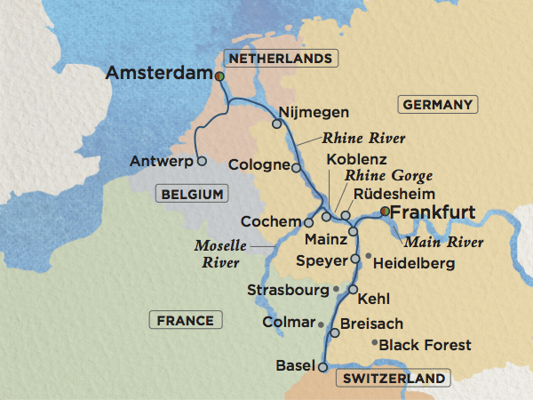
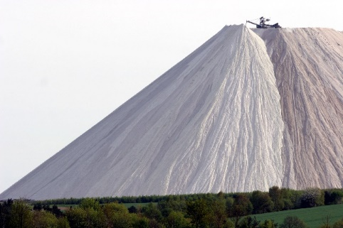
Mountain of table salt (from potash mining and processing) in Germany
https://i.imgur.com/PX5tcwC.jpg

Slide 3
Normative Problems/Games
Human Rights – Gender Wage Gap (by country)
Key Points: Asymmetry of actions & affects Agreement requires pressure Strong incentives to cheat Monitoring MAY BE EASY Enforce Hard to Impose |  | US & Other States already meeting rules
 |  | Reduce Gender Wage Gap so Female >= $0.67 | Do NOT Reduce Gender Wage Gap so Female >= $0.67
US & Other States already meeting rules | Reduce Gender Wage Gap so Female >= $0.67 | Costly at home but Some International Benefits No Change Required | Maintain Status quo; pressed by other countries No Change Required
 | Do NOT Reduce Gender Wage Gap so Female >= $0.67 | Costly at home but Some International Benefits Wage Gap Driven by Other Factors | Maintain Status quo; pressed by other countries Wage Gap Driven by Other Factors

Slide 4
Functions of Institutions
Manage complexity
Reduce transaction costs
Create rules
Increase reciprocity
Improve information
Create/strengthen norms

Slide 5
Assessing the Effectiveness of
International Institutions

Slide 6
Institutional Effectiveness Matters
Realists don’t think they matter
Institutionalists think they do
Disenfranchised think they matter for more powerful groups but not for less powerful groups
We CARE whether they matter in real life, but DO they?
  Free Trade Agreements
  North Korea // Iran Nuclear Deal // Nuclear Weapons Ban Treaty
  Paris Climate Agreement // Fisheries Treaties // Endangered Species
  Equal Pay for Equal Work // Human Rights

Slide 7
Evaluating Institutional Effectiveness
Institutions can always be evaluated against TWO definitions of success
  Goal achievement: Compare actual behavior (or outcomes) to stated goal
  Counterfactual: Compare actual behavior (or outcomes) to what would have occurred otherwise

Slide 8
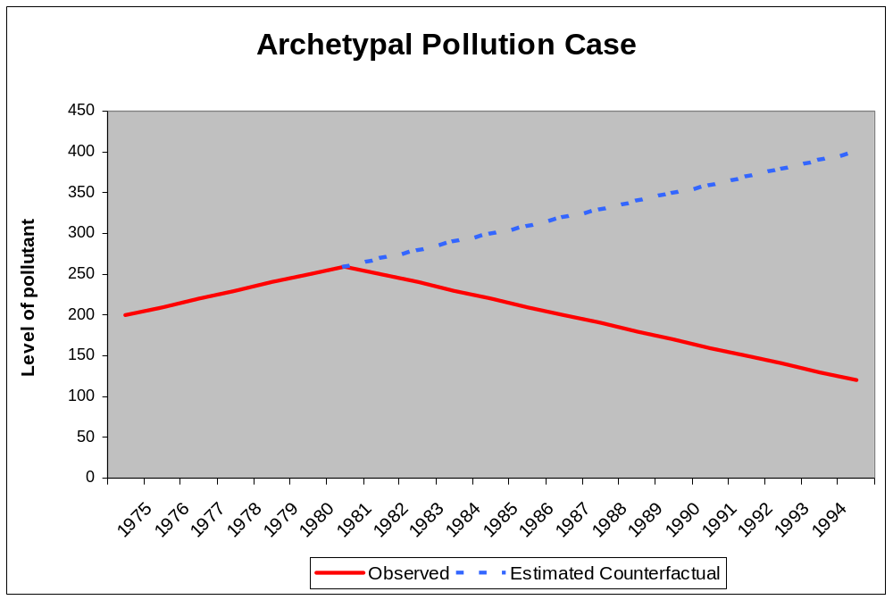
Pollution Agreements:
Evaluating Effectiveness
Treaty In Force
Notes:
Take the Montreal Protocol. Was the Montreal Protocol effective at changing the behavior of industrialized countries? If so, what aspect of the treaty should receive credit for the success? Was it the sanctions threatened under the treaty? Or was the decline in their CFC production due to availability of alternatives that might have happened anyway?
What about the developing countries? Were the rules offering them incentives to reduce CFC production less effective than the sanctions?
And, do the Montreal Protocol’s provisions appear more or less effective than those of the Nitrogen Oxide Protocol of the Convention on Long Range Transboundary Air Pollution?
Questions:
Was either really influential?
If so, what explains their effects and influence?
Is it something about the rules? Or something about regulating CFCs which is different than regulating NOx?
And, if we can identify which of the many possible explanations is the true one, how do we determine how to apply those lessons to other treaties?
These questions apply to the whole range of environmental treaties from climate change and energy use to stratospheric ozone loss to acid rain in Europe to endangered species protection to biodiversity loss to wetlands protection and water quality. Later on in the talk I will be looking at fisheries as one arena in which we can develop some of the theory and methodology so that it can be applied across all these arenas.

Slide 9
Pollution Agreements:
Evaluating Effectiveness
Treaty In Force
Notes:
Take the Montreal Protocol. Was the Montreal Protocol effective at changing the behavior of industrialized countries? If so, what aspect of the treaty should receive credit for the success? Was it the sanctions threatened under the treaty? Or was the decline in their CFC production due to availability of alternatives that might have happened anyway?
What about the developing countries? Were the rules offering them incentives to reduce CFC production less effective than the sanctions?
And, do the Montreal Protocol’s provisions appear more or less effective than those of the Nitrogen Oxide Protocol of the Convention on Long Range Transboundary Air Pollution?
Questions:
Was either really influential?
If so, what explains their effects and influence?
Is it something about the rules? Or something about regulating CFCs which is different than regulating NOx?
And, if we can identify which of the many possible explanations is the true one, how do we determine how to apply those lessons to other treaties?
These questions apply to the whole range of environmental treaties from climate change and energy use to stratospheric ozone loss to acid rain in Europe to endangered species protection to biodiversity loss to wetlands protection and water quality. Later on in the talk I will be looking at fisheries as one arena in which we can develop some of the theory and methodology so that it can be applied across all these arenas.

Slide 10
Pollution Agreements:
Evaluating Effectiveness
Treaty In Force
COUNTERFACTUAL:
Predicted Emissions if Treaty Wasn’t Signed
Notes:
Take the Montreal Protocol. Was the Montreal Protocol effective at changing the behavior of industrialized countries? If so, what aspect of the treaty should receive credit for the success? Was it the sanctions threatened under the treaty? Or was the decline in their CFC production due to availability of alternatives that might have happened anyway?
What about the developing countries? Were the rules offering them incentives to reduce CFC production less effective than the sanctions?
And, do the Montreal Protocol’s provisions appear more or less effective than those of the Nitrogen Oxide Protocol of the Convention on Long Range Transboundary Air Pollution?
Questions:
Was either really influential?
If so, what explains their effects and influence?
Is it something about the rules? Or something about regulating CFCs which is different than regulating NOx?
And, if we can identify which of the many possible explanations is the true one, how do we determine how to apply those lessons to other treaties?
These questions apply to the whole range of environmental treaties from climate change and energy use to stratospheric ozone loss to acid rain in Europe to endangered species protection to biodiversity loss to wetlands protection and water quality. Later on in the talk I will be looking at fisheries as one arena in which we can develop some of the theory and methodology so that it can be applied across all these arenas.

Slide 11
Pollution Agreements:
Evaluating Effectiveness
Treaty In Force
COUNTERFACTUAL:
Predicted Emissions if Treaty Wasn’t Signed
Success of Treaty Relative to COUNTERFACTUAL
Notes:
Take the Montreal Protocol. Was the Montreal Protocol effective at changing the behavior of industrialized countries? If so, what aspect of the treaty should receive credit for the success? Was it the sanctions threatened under the treaty? Or was the decline in their CFC production due to availability of alternatives that might have happened anyway?
What about the developing countries? Were the rules offering them incentives to reduce CFC production less effective than the sanctions?
And, do the Montreal Protocol’s provisions appear more or less effective than those of the Nitrogen Oxide Protocol of the Convention on Long Range Transboundary Air Pollution?
Questions:
Was either really influential?
If so, what explains their effects and influence?
Is it something about the rules? Or something about regulating CFCs which is different than regulating NOx?
And, if we can identify which of the many possible explanations is the true one, how do we determine how to apply those lessons to other treaties?
These questions apply to the whole range of environmental treaties from climate change and energy use to stratospheric ozone loss to acid rain in Europe to endangered species protection to biodiversity loss to wetlands protection and water quality. Later on in the talk I will be looking at fisheries as one arena in which we can develop some of the theory and methodology so that it can be applied across all these arenas.

Slide 12
Pollution Agreements:
Evaluating Effectiveness
Treaty In Force
GOAL:
Emissions Level Treaty Sought to Achieve
Notes:
Take the Montreal Protocol. Was the Montreal Protocol effective at changing the behavior of industrialized countries? If so, what aspect of the treaty should receive credit for the success? Was it the sanctions threatened under the treaty? Or was the decline in their CFC production due to availability of alternatives that might have happened anyway?
What about the developing countries? Were the rules offering them incentives to reduce CFC production less effective than the sanctions?
And, do the Montreal Protocol’s provisions appear more or less effective than those of the Nitrogen Oxide Protocol of the Convention on Long Range Transboundary Air Pollution?
Questions:
Was either really influential?
If so, what explains their effects and influence?
Is it something about the rules? Or something about regulating CFCs which is different than regulating NOx?
And, if we can identify which of the many possible explanations is the true one, how do we determine how to apply those lessons to other treaties?
These questions apply to the whole range of environmental treaties from climate change and energy use to stratospheric ozone loss to acid rain in Europe to endangered species protection to biodiversity loss to wetlands protection and water quality. Later on in the talk I will be looking at fisheries as one arena in which we can develop some of the theory and methodology so that it can be applied across all these arenas.

Slide 13
Pollution Agreements:
Evaluating Effectiveness
Treaty In Force
GOAL:
Emissions Level Treaty Sought to Achieve
Failure of Treaty
Relative to GOAL
Notes:
Take the Montreal Protocol. Was the Montreal Protocol effective at changing the behavior of industrialized countries? If so, what aspect of the treaty should receive credit for the success? Was it the sanctions threatened under the treaty? Or was the decline in their CFC production due to availability of alternatives that might have happened anyway?
What about the developing countries? Were the rules offering them incentives to reduce CFC production less effective than the sanctions?
And, do the Montreal Protocol’s provisions appear more or less effective than those of the Nitrogen Oxide Protocol of the Convention on Long Range Transboundary Air Pollution?
Questions:
Was either really influential?
If so, what explains their effects and influence?
Is it something about the rules? Or something about regulating CFCs which is different than regulating NOx?
And, if we can identify which of the many possible explanations is the true one, how do we determine how to apply those lessons to other treaties?
These questions apply to the whole range of environmental treaties from climate change and energy use to stratospheric ozone loss to acid rain in Europe to endangered species protection to biodiversity loss to wetlands protection and water quality. Later on in the talk I will be looking at fisheries as one arena in which we can develop some of the theory and methodology so that it can be applied across all these arenas.

Slide 14
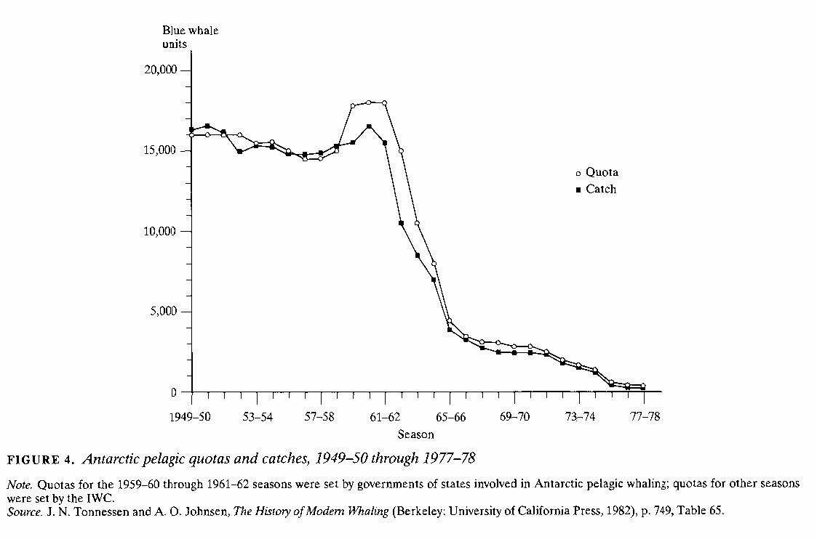
Was the Whaling Treaty a success?

Slide 15
“Having decided to conclude a convention to provide for the proper conservation of whale stocks and thus make possible the orderly development of the whaling industry” (ICRW, 1946)
Goal

Slide 16
“Having decided to conclude a convention to provide for the proper conservation of whale stocks and thus make possible the orderly development of the whaling industry” (ICRW, 1946)
Goal

Slide 17
“Having decided to conclude a convention to provide for the proper conservation of whale stocks and thus make possible the orderly development of the whaling industry” (ICRW, 1946)
Goal
Failure Relative To Goal

Slide 18
Counterfactual

Slide 19
Counterfactual
Catch LOWER than would have been otherwise, allowing population to recover
But higher population allows MORE catch for longer than would have been possible otherwise
Success Relative To Counterfactual

Slide 20
Both a success and a failure
Counterfactual
Goal
Failure Relative To Goal
Success Relative To Counterfactual

Slide 21
Evaluating Institutional Effectiveness
Institutions can always be evaluated against TWO definitions of success
  Goal achievement: Compare actual behavior (or outcomes) to stated goal
  Counterfactual: Compare actual behavior (or outcomes) to what would have occurred otherwise

Slide 22
Human Rights

Slide 23
10 human rights treaty bodies that monitor implementation of major human rights treaties
Committee on the Elimination of Racial Discrimination (CERD)
Committee on Economic, Social and Cultural Rights (CESCR)
Human Rights Committee (CCPR)
Committee on the Elimination of Discrimination against Women (CEDAW)
Committee against Torture (CAT)
Committee on the Rights of the Child (CRC)
Committee on Migrant Workers (CMW)
Subcommittee on Prevention of Torture (SPT)
Committee on the Rights of Persons with Disabilities (CRPD)
Committee on Enforced Disappearances (CED

Slide 24
Numerous Human Rights Treaties
Global
Africa
Americas
Europe
Middle East
ASEAN Human Rights-related Declarations

Slide 25
Human Rights Survey Results

Slide 26
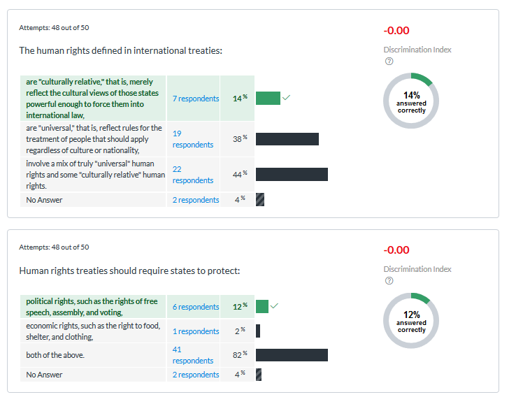

Slide 27


Slide 28
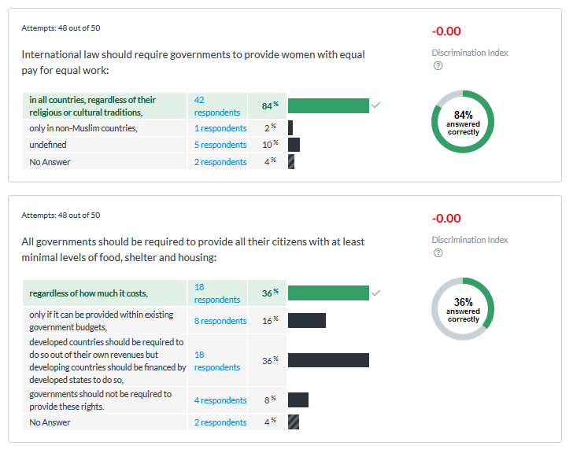

Slide 29
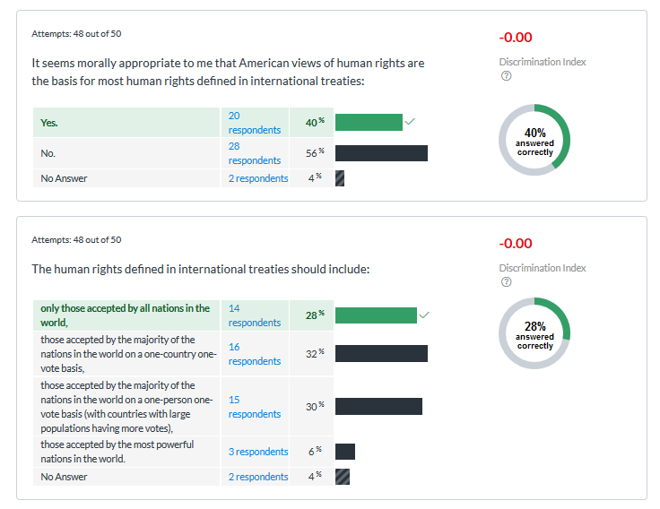

Slide 30


Slide 31
Human Rights Overview
Numerous conventions on wide range of human rights
Civil, political rights: negative “governments shall not…”
  Life and liberty, no slavery
  No arbitrary arrest, presumed innocent, cruel and unusual punishment,
  Right to assembly, free expression, equal suffrage
  Freedom of movement within states and freedom to leave own state
Economic, social rights: positive “governments must …."
  Marry and form family
  Education, work, and leisure
  Adequate standard of living

Slide 32
Small Group Discussion
Criteria for “violation” of human rights
  "Who" commits it? Government, culture, "the economy"?
  Views of those whose rights are being violated? If oppressed say they accept their lot in an oppressive system, should we accept that as evidence that they are not oppressed?
  Other criteria you think are important?
Take action or not? If so, which action?
  Type of action?
  Magnitude of action?
  Cost of action to us?
  Other criteria you think are important?

Slide 33
NGOs and Transnational Activist Networks in Human Rights
Fundamental contradiction of realist expectations (to extent they have influence)
What they do
  Press for creation of NEW international institutions and strengthen EXISTING regimes
  Monitor performance
  Mobilize public opinion and sympathetic governments to oppose violations
  Improve victims' capacity to defend themselves

Slide 34
NGOs and Transnational Activist Networks in Human Rights
How they do it
  Broaden scope of conflict
  Shift terms of debate
  Make principled but pragmatic demands

Slide 35
NGOs and Transnational Activist Networks in Human Rights
Capacities that NGOs have but states lack
  Focus on single issue: keep "clean" / "pure"
  Collect information within other countries borders in ways considered legitimate
  More willing than states to criticize other governments
  Work transnationally to develop support

Slide 36
Thinking about HR
Tension between sovereignty norm and human rights norms
Universal human rights but conditioned by societies
How should we define human rights?
Once define them, how should we respond when they are violated?

Slide 38
Beber et al. reading for next class
Its an article about the impact of UN peacekeeping troops when they are brought into Liberia
Think about what “effects” you expect them to have on the security of the Liberians in Monrovia
Then, read the article
Think about whether the UN troops have the effect you expect them to have
Also, carefully notice HOW the authors identify what effects the UN peacekeepers had

