Slide 1
Protecting Human Rights:
Institutions, NGOs, and the
Myanmar Genocide

Slide 2
Convention on Genocide defines genocide as:
Including only acts that involve killing
Including acts intended to prevent births by a specific group of people
Including acts even if there is no “intent to destroy” a group
Including only acts that are based on racial differences

Slide 3
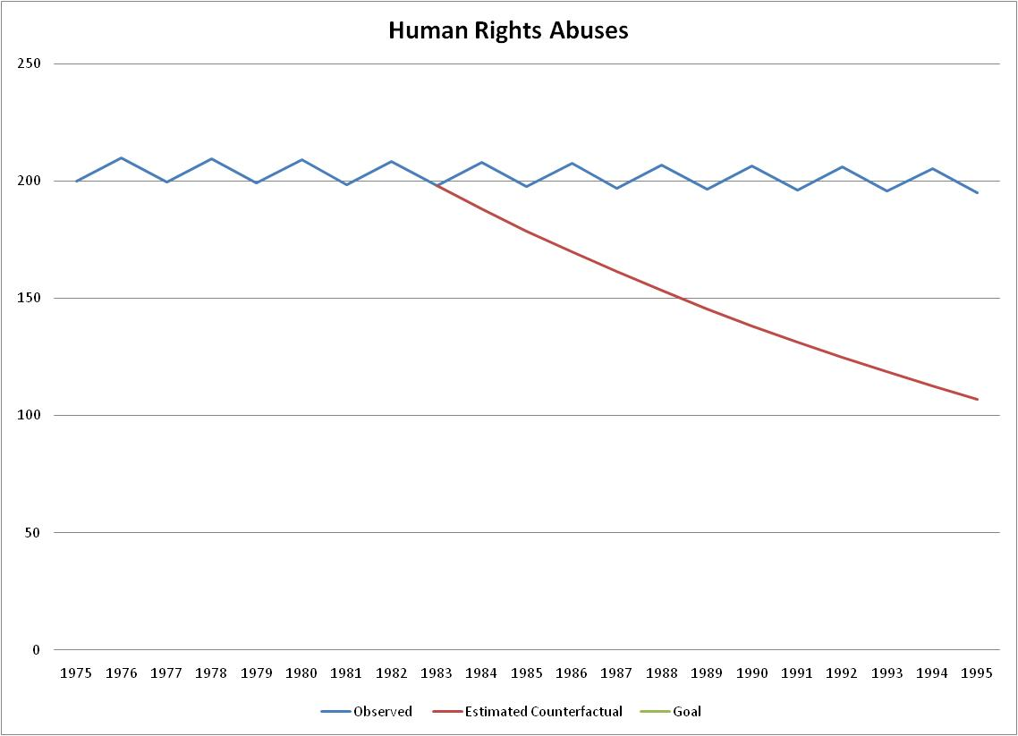
ESTIMATE of Behavior if NO treaty
What is this area called?
Actual behavior
AREA in Green is called:
Counterfactual success
Counterfactual failure
Goal achievement success
Goal achievement failure

Slide 4
Convention on the Prevention and Punishment of the Crime of Genocide: Obligations
Article I : “genocide, whether committed in time of peace or in time of war, is a crime under international law which they undertake to prevent and to punish.”
Article II: “genocide means any of the following acts committed with intent to destroy, in whole or in part, a national, ethnical, racial or religious group, as such:
  Killing members of the group;
  Causing serious bodily or mental harm to members of the group;
  Deliberately inflicting on the group conditions of life calculated to bring about its physical destruction in whole or in part;
  Imposing measures intended to prevent births within the group;
  Forcibly transferring children of the group to another group.
Article III: The following acts shall be punishable:
  Genocide;
  Conspiracy to commit genocide;
  Direct and public incitement to commit genocide;
  Attempt to commit genocide;
  Complicity in genocide.

Slide 5
Convention on the Prevention and Punishment of the Crime of Genocide: Response to Violation
Article IV: “Persons committing genocide or any of the other acts enumerated in article III shall be punished, whether they are constitutionally responsible rulers, public officials or private individuals.”
Article VI: “Persons charged with genocide or any of the other acts enumerated in article III shall be tried by a competent tribunal of the State in the territory of which the act was committed, or by such international penal tribunal as may have jurisdiction with respect to those Contracting Parties which shall have accepted its jurisdiction.”
Article VIII: “Any Contracting Party may call upon the competent organs of the United Nations to take such action under the Charter of the United Nations as they consider appropriate for the prevention and suppression of acts of genocide or any of the other acts enumerated in article III.”

Slide 6
Trigger Warning
This shows some horrific evidence of what has gone on in Myanmar in the recent past and today.
In my opinion, this is as important to watch and learn about as it is difficult to watch and learn about.
If you simply cannot because of your own personal experience, you are welcome to leave. However, I strongly encourage you to stay and watch.

Slide 7
Things to look for and take notes on during the video
Realism:
  Role of military force
  Unitary actor – who the leader of the country is makes little difference in country’s policy
  Principles of dominant religion do not seem to influence what “state” sees as in its interests
Disenfranchised theory:
  Role of race and religion in state behavior
  Role of gender in state behavior
  Role of individuals in identifying and documenting the problem
  Power of Rohingya to push back comes from their collective power, not power of force or power of institutions
Institutionalism
  Role of NGOs
  Role of treaties and international institutions (UNHCR)

Slide 8
Iclicker
Will the Convention and UNHCR help?
Yes
No

Slide 9
Myanmar's Killing Fields
This is NEWS, not History
PBS Frontline 04/26/18
Nobel Laureate Aung San Suu Kyi was seen as Myanmar’s hope. Now, she’s accused of standing by as the country’s military waged a brutal campaign against Rohingya Muslims. FRONTLINE tracks down secret footage and talks to the victims of a campaign the United Nations has described as having the “hallmarks of genocide.”
https://www.pbs.org/video/myanmars-killing-fields-wwdvdm/
(Start at 1:30 – 50 minutes long)

