Slide 1
International institutions/regimes defined
International treaties + corresponding international orgs
PLUS
Expectation that states *should* follow rules, even if don’t
PLUS
NGOs / MNCs behaviors shaped by treaties
PLUS
Norms that states use to guide their behavior
OVERALL, institutions/regimes as all elements that create GOVERNANCE of an issue area

Slide 2
Environmental Survey

Slide 3
Iclicker
Human impacts on global environment:
Relatively small so far
Hurting poor and rich people about the same
Largely due to climate change
None of the above

Slide 4
How Humans Are
Altering the Earth
(not counting climate change!)

Slide 5
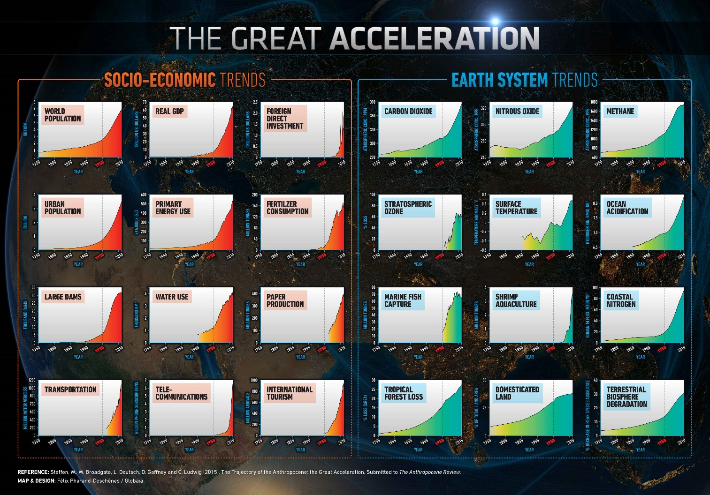

Slide 6
Google Earth Videos
Links HERE
Mining
Deforestation
Industrialization
Water

Slide 7
Resource use and overuse

Slide 8
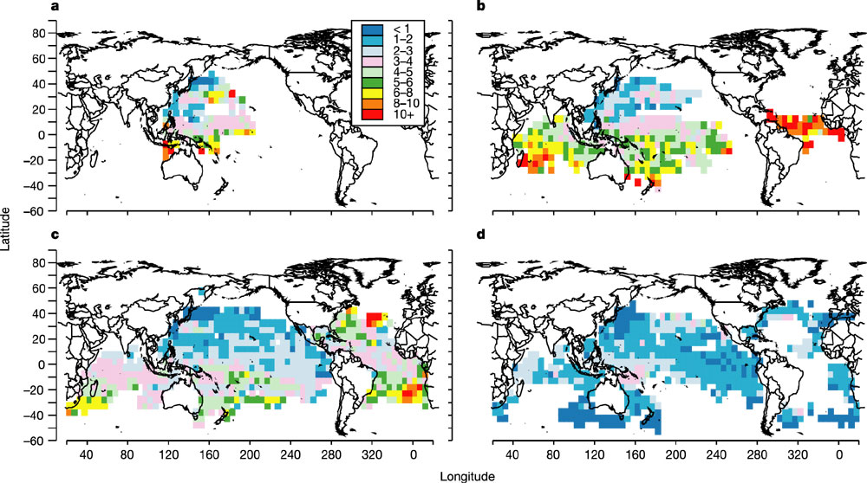
Decline in Large Fish Biomass
(fish/100 hooks on Japanese longlines)
1952
1958
1964
1980
Source: Myers, Ransom A., and Boris Worm. 2003. “Rapid worldwide depletion of predatory fish communities.” Nature 423, 280-283. http://www.nature.com/cgi-taf/DynaPage.taf?file=/nature/journal/v423/n6937/full/nature01610_fs.html

Slide 9
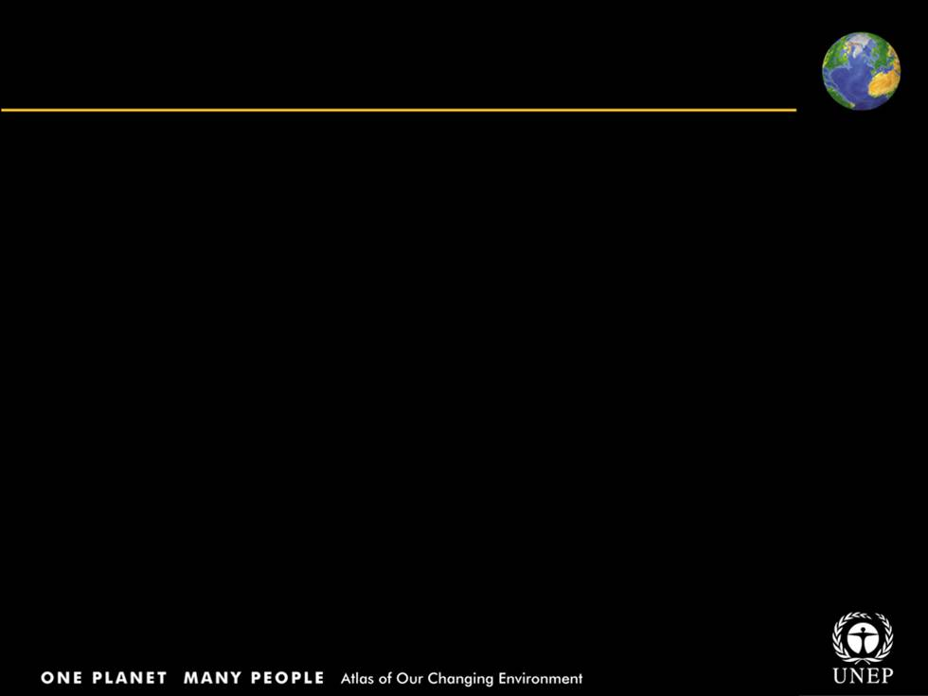
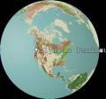
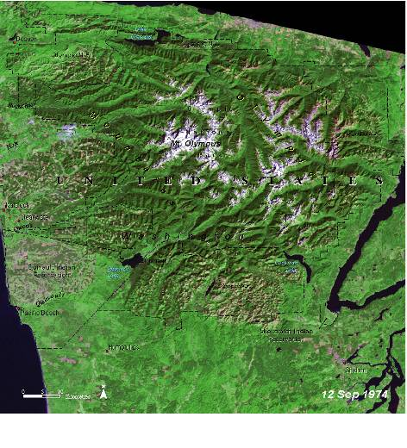
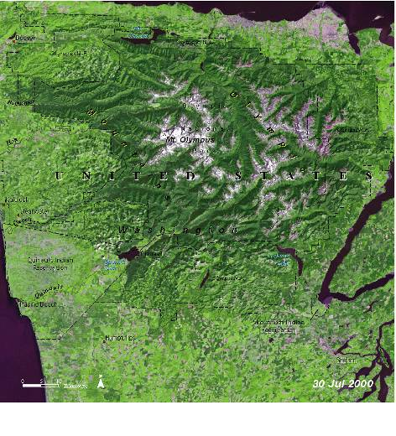
Disappearing temperate forests of Olympic Peninsula, United States
1974: Shows patchwork of purple and pink, indicating clear-cutting
2000: Evidence of good re-growth of trees in forest reserve areas
Notes:
On the slopes and the surrounding areas of Mt. Olympus in the Olympic Peninsula of the Pacific Northwest, one of the last remnants of temperate forests in the United States is quickly disappearing. Between 1971 and 2002, nearly half a million hectares (1.1 million acres), or almost 29 per cent of the forest covering the Peninsula, was clear-cut. That is an area equal in size to the Olympic National Park and its fi ve adjacent wilderness areas. The 1974 image shows the characteristic patchwork of purple and pink areas where clear-cutting has taken place. Light green patches signify regrowth in the forest areas. On a percentage basis, forests owned by Native tribes on the Peninsula were the most severely impacted during this period of time: 48 per cent of the forests on Native lands were clear-felled. In the 2000 image, clear-cutting is obviously still continuing, as is development to the north, west, and south of the national park. There is evidence of good regrowth of trees in forest reserve areas in preparation for the next clear-felling cycle.

Slide 10
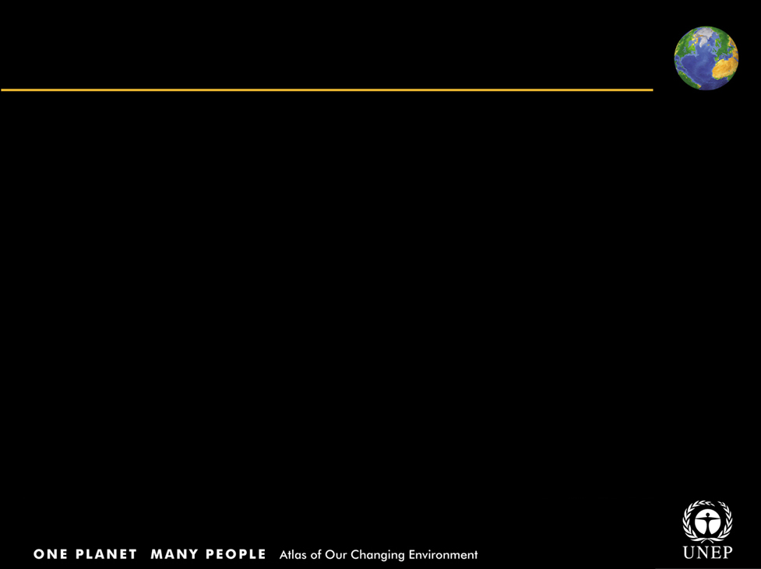
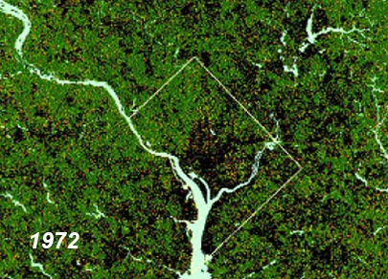
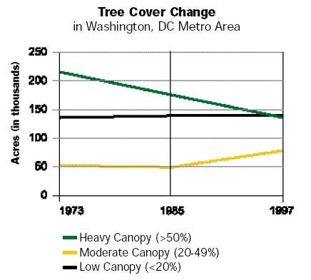
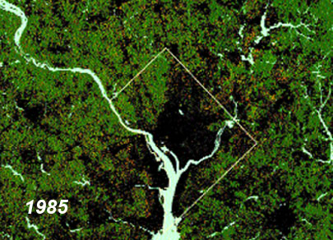
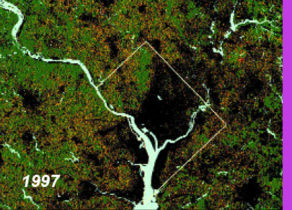
American Deforestation
Casey Trees, Washington, D.C.
Title
Body text
Satellite images showing the dramatic loss of trees in the District moved Mrs. Casey to action.
Casey Trees Endowment Fund was created to restore the tree cover of the District of Columbia.

Slide 11
Pollution

Slide 12
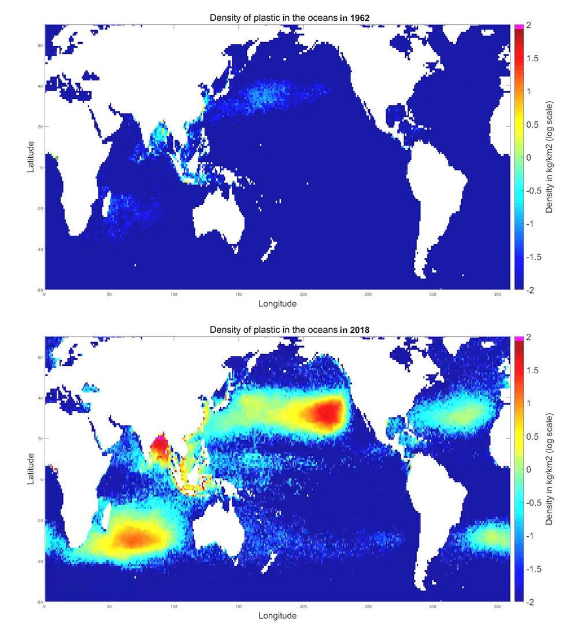
Plastic in the Oceans
1962
2018
Source: https://www.nytimes.com/2018/03/22/climate/great-pacific-garbage-patch.html

Slide 13
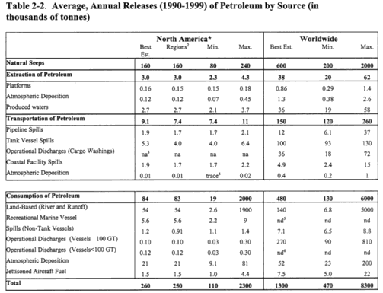
Oil Entering the Oceans
Source: National Academy of Sciences’ Committee on Oil in the Sea. 2002. Oil in the Sea III: Inputs, Fates, and Effects Washington, DC: Ocean Studies Board, Division on Earth and Life Studies, and Marine Board, Transportation Research Board, p. 33. Available at: http://books.nap.edu/books/0309084385/gifmid/41.gif

Slide 14
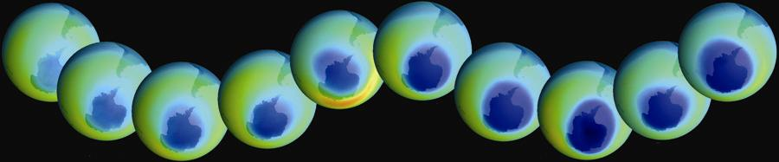
Ozone Depletion
Title
Body text
Growth of the Antarctic ozone hole over 20 years, as observed by the satellite
Darkest blue areas represent regions of maximum ozone depletion.

Slide 15
Land use / Habitat Destruction

Slide 16
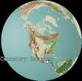
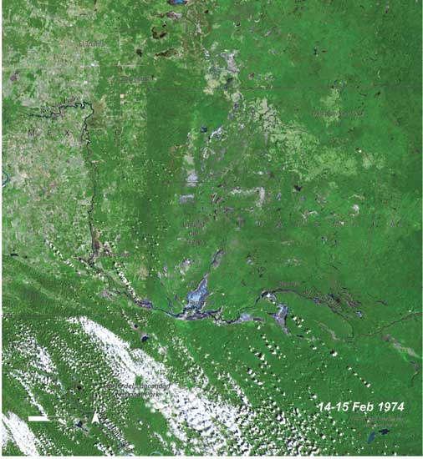
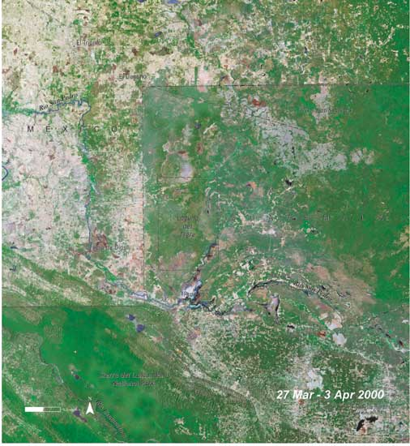
Different land use practices visible
across country border, Mexico/Guatemala
1974 - 2000: Conversion of forest to agriculture
Now country border can be seen even from space
Notes:
The border between Guatemala and Mexico runs through Mexico’s Chiapas Forest and Guatemala’s El Peten. In this pair of images, the border even without the black lines that have been overlaid on the images to show the outlines of the two countries. The region crossed by this border was once biologically very diverse. On the Guatemalan side, it still is, as most of the El Peten remains as closed canopy forest because of lower population densities and the protected status of the Sierra de Lacondon and Laguna del Tigre National Parks. Across the border in Chiapas, however, a larger and increasing population has an obvious effect on the landscape. Between 1974 and 2000, much of the forest on the Mexican side of the border has been converted to cropland or pasture.

Slide 17
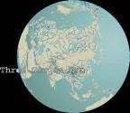
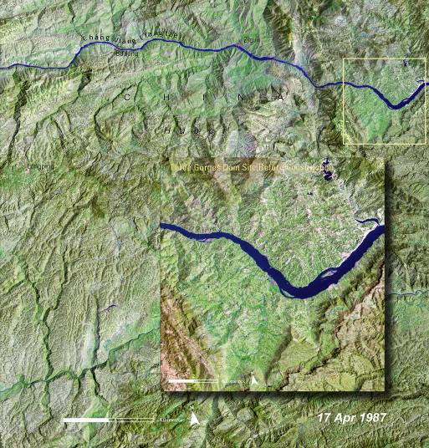
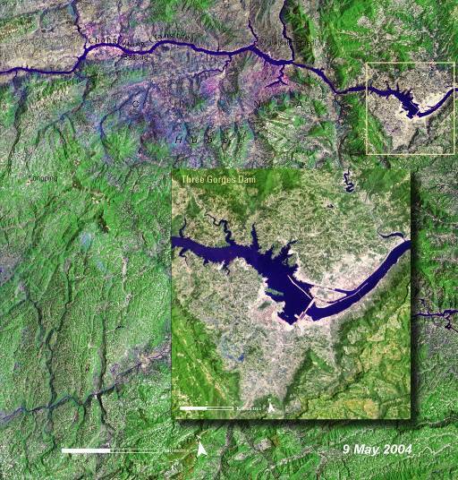
Changes due to Three Gorges Dam construction, China
Changes due to the construction of dam
1987: Nature of the river and surrounding landscape before the dam
2004: The enormous dam is clearly visible
Notes:
The Three Gorges Dam on the Chang Jiang (Yangtze) River in China is one of the largest single construction projects ever attempted on the planet. The dam was constructed to supply approximately one-ninth of China’s electricity—as much power as could be generated by at least fifteen nuclear power plants. It is a relatively environmentally clean option compared to coal burning or nuclear power plants. It is also hoped that the dam will help control flooding on a river where seasonal floods during the past century has caused death of over one million people. However, the Three Gorges Dam project has also had negative environmental and social impacts as a result of the massive construction efforts and the submergence of land along the river above the dam. The former village of Zigui (top center of image) has already been submerged. The 1987 image shows the nature of the river and surrounding landscape before work on the dam was begun. In the May 2004 image, the enormous Three Gorges Dam is clearly visible, as is the reservoir of impounded river water that has been created behind it.

Slide 18
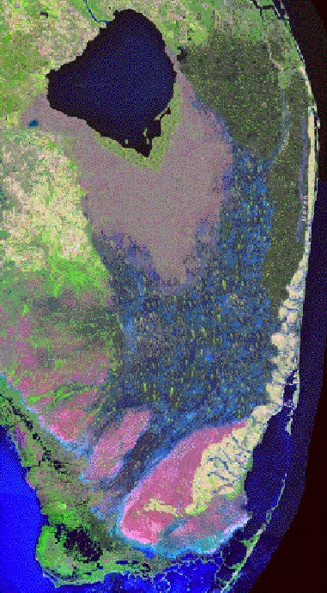
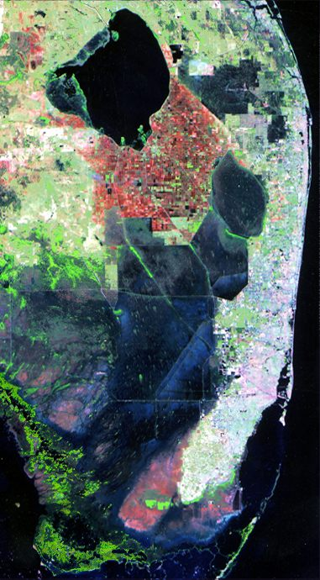
Wetlands Loss:
US Everglades
1850
1995
Source: Exploring the Environment Team. 2003 (23 January) “Remote Sensing: Waterflow” Wheeling Jesuit University, Center for Educational Technologies http://www.cotf.edu/ete/modules/everglades/FEremote2.html

Slide 19
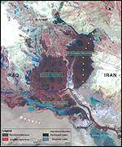
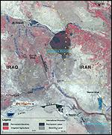
Wetlands Loss:
Intentional Drainage in Iraq
1973
2000
Source: Kirby, Alex. 2001 (16 May) “Mesopotamia's marshes 'set to vanish’” BBC News Online http://news.bbc.co.uk/1/hi/sci/tech/1332128.stm

Slide 20
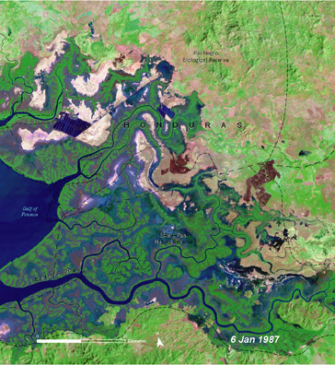
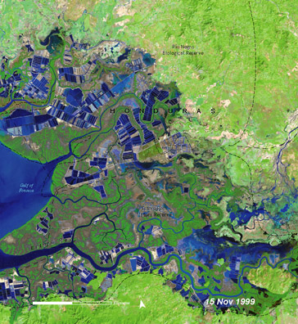
Aquaculture Impact:
Gulf of Fonseca,Honduras
Title
Body text
Over a period of 12 years, the images reveal how shrimp farms and ponds have mushroomed carpeting the landscape around the Gulf of Fonseca, Honduras, in blocks of blue and black shapes.
Honduras is second only to Ecuador in the cultivation and export of shrimp from Latin America.

Slide 21
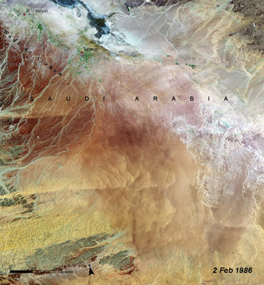
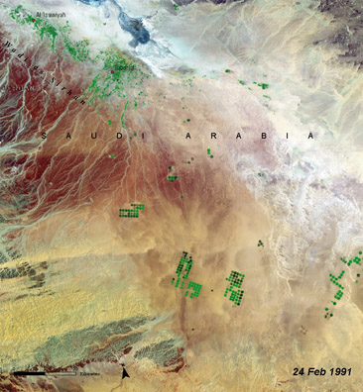
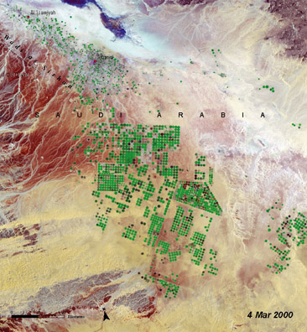
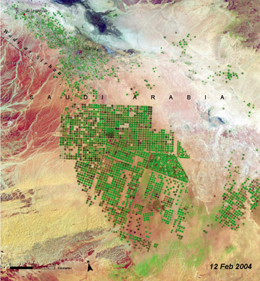
Title
Agriculture Impact:
Al Isawiyah, Saudi Arabia
Body text
Greening of a desert
1986 -A desert landscape
1991 -Irrigation begins…
2000 -And transforms the desert
2004 –Irrigation intensity increases

Slide 22
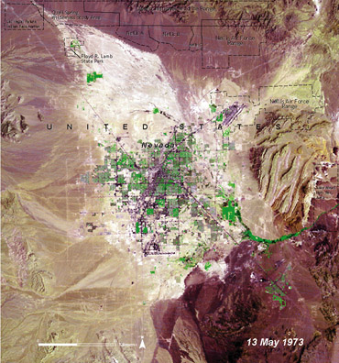
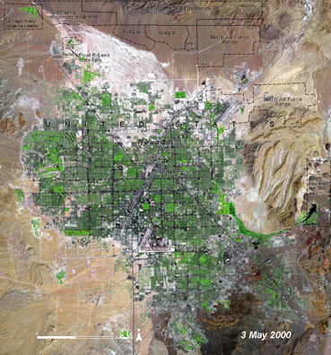
Luxury Impact?
Las Vegas, United States
Title
Body text
1973 -A small settlement
2000 -The landscape is now dramatically modified

Slide 23
Impacts Vary Across Countries

Slide 24
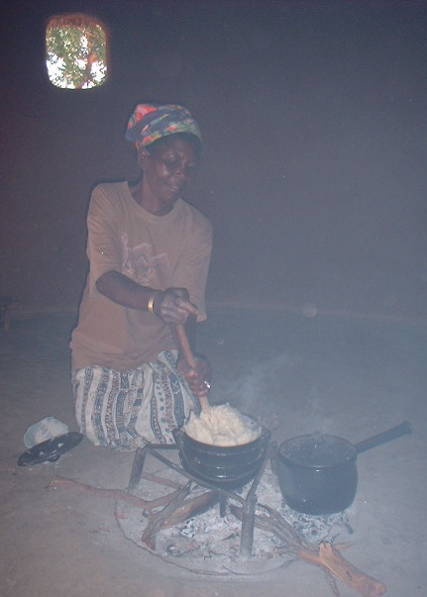
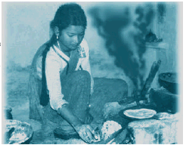
Indoor Air Pollution
“Exposure to indoor air pollution is one of the major contributing factors leading to acute respiratory infections which cause an estimated 4 million deaths of young children each year” – World Bank (1992, pp.52-53)

Slide 25
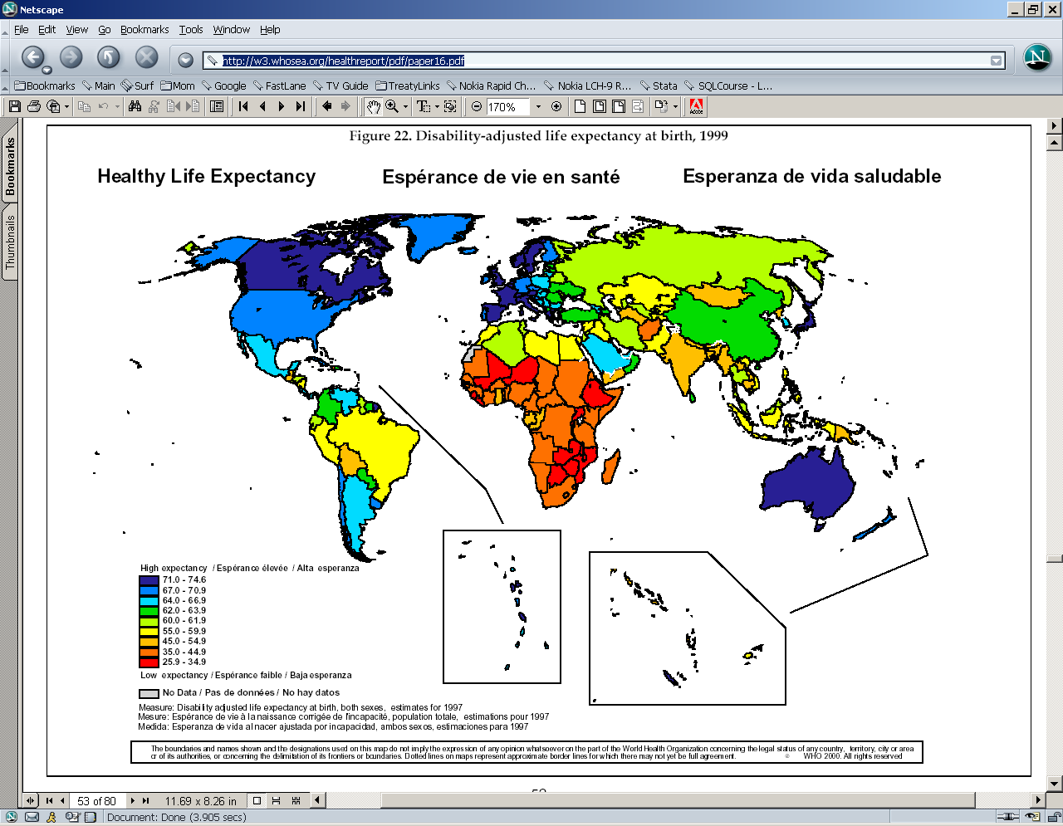
Healthy Life Expectancy
By Country
Source: Colin D Mathers, Ritu Sadana, Joshua A Salomon, Christopher JL Murray, and Alan D Lopez. 2000. "Estimates of DALE for 191 countries: methods and results." Global Programme on Evidence for Health Policy Working Paper No. 16 of the World Health Organization, June. http://w3.whosea.org/healthreport/pdf/paper16.pdf

Slide 26
The Epidemic Scorecard
Disease | Prevalence | Deaths | New Cases
AIDS | 42 million | 3 mil/yr – 300/hr | 5.5 million
Diarrheal diseases (unsafe H2O) | 2.7 Billion | 2 mil/yr – 200/hr | n/a
Tuberculosis | 1 Billion | 2 mil/yr – 200/hr | 8 million
Malaria (mosquitoes) | million | 1 mil/yr – 100/hr | 400 million
Hepatitis B | n/a | 1 mil/yr – 100/hr | 20 million
Measles (preventable) | n/a | 900k/yr – 90/hr | 30 million
Denque fever (mosquitoes) | n/a | 24k/yr – 2/hr | 20 million
Influenza |  | 250k/yr – 25/hr | 4 million
Yellow fever |  | 30k/yr – 3/hr | 200,000
Source: Howard Markel, Stephen Doyle. 2003 (30 April). “The Epidemic Scorecard.” New York Times, A31; Tata Energy Research Institute, “Health of women and children: Intervention to begin at home” 7 July 1999, http://www.teriin.org/news/jul991.htm

Slide 27
And, NOW, back to theory!

Slide 28
How International Environmental Problems Differ from Domestic
More involvement of non-state actors
Shift in power
  New basis of power
  Different distribution of power
  Less fungibility of military power
Science becomes more important
  Compare to security/economic/HR issues
Values also become more important
  Differences in how/how much value on env’t
  Whales vs. cows

Slide 29
Iclicker
Which of the following is true:
Population growth is causing MORE environmental harm than income growth
Population growth is causing LESS environmental harm than income growth
Population growth is causing about the SAME harm as income growth

Slide 30
The IPAT identity
Impact = Population * Affluence * Technology
pollution = people * $/person * pollution/$
Pollution as a function of how many people, how much they can spend, and what is the impact per $ of the stuff they spend it on

Slide 31
Iclicker:
A Tragedy of the Commons is same as an
Upstream/downstream problem
Coordination problem
Prisoners dilemma (collaboration problem)
Incapacity problem

Slide 32
Two Types (at least) of International Environmental Problems
Tragedy of the Commons
  Open access to resource
  Demand exceeds supply
  Politics: "perpetrators" are also "victims” so all have (mixed) incentives to act
  Sanctions or rewards as potential solutions
Upstream/Downstream
  Politics: "perpetrators" are NOT "victims" so latter must engage former
  Harder to resolve
  Rewards NECESSARY for resolution

Slide 33
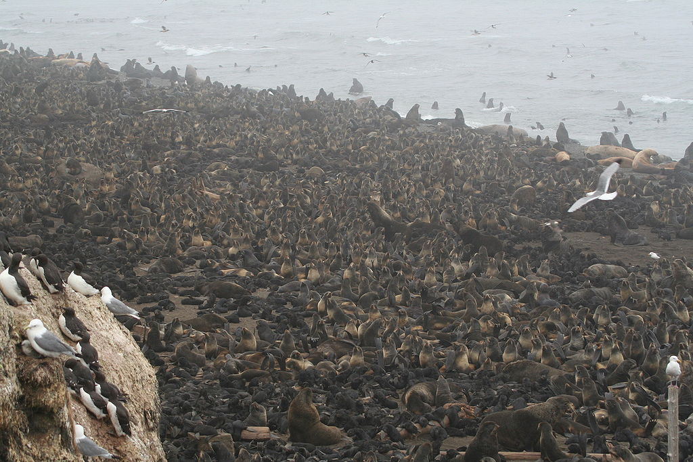
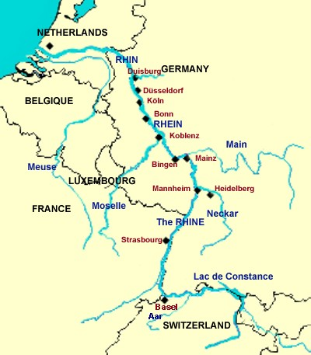
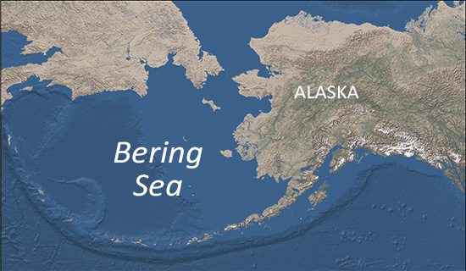
Two Problems: France & Switzerland
Fish in Rhine & Fish in Lake Geneva
Tragedy of the Commons
Upstream/downstream problem
FRANCE
SWITZERLAND

Slide 34
Tragedy of the Commons -- illustrated
How structure rather than incentives dictates outcomes
A “multi-person Prisoners Dilemma”

Slide 35
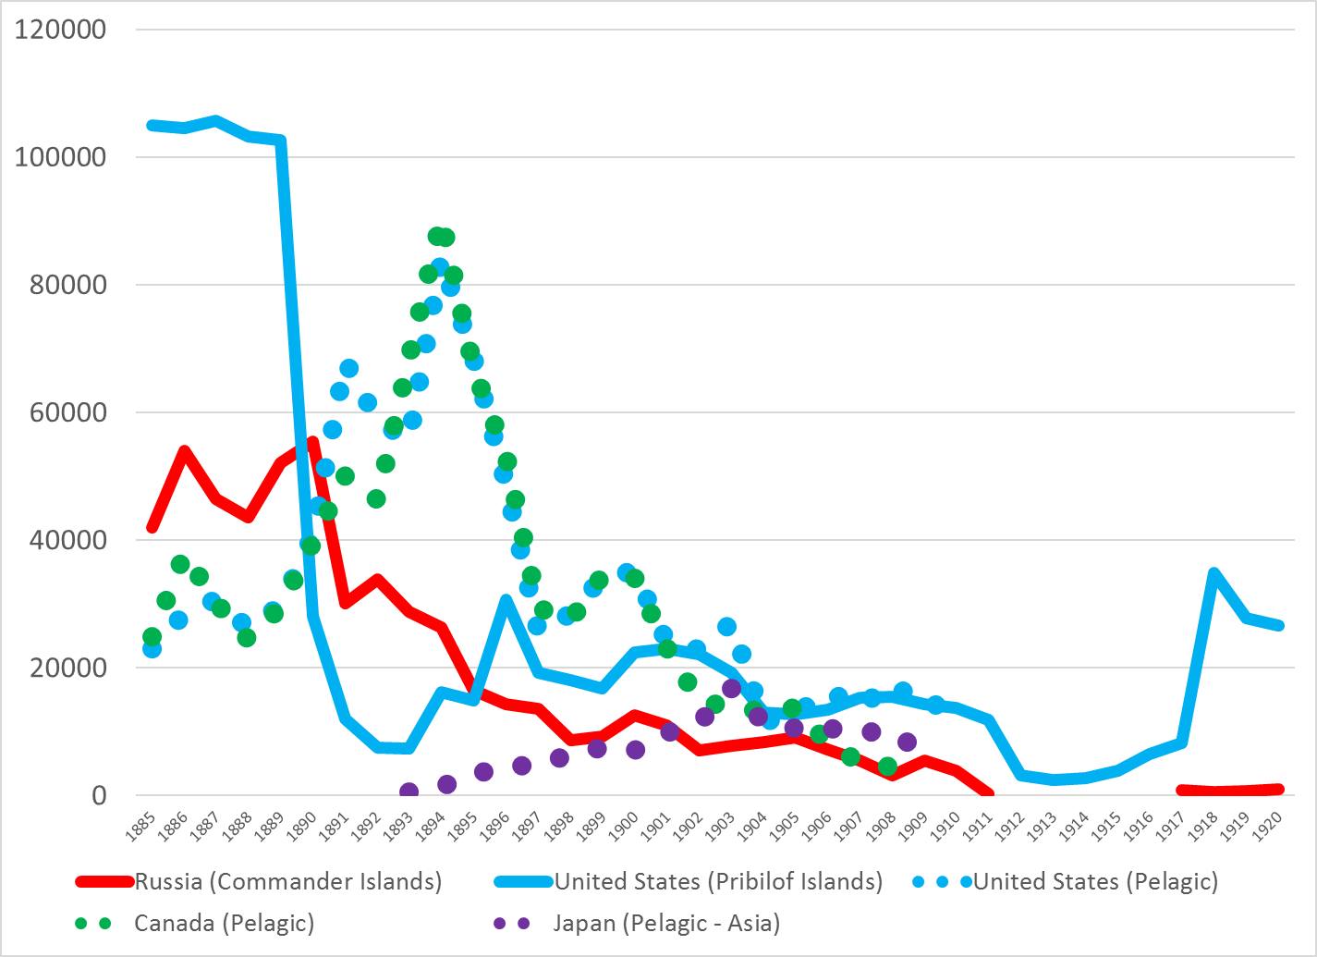
Fur Seals: Slaughter & Recovery

Slide 36
How Many Cows would YOU put on this PRIVATE Farm?
Cows | Milk per cow | Total Milk
1 | 100 | 100
2 | 100 | 200
3 | 94 | 282
4 | 88 | 352
5 | 82 | 410
6 | 76 | 456
7 | 70 | 490
8 | 64 | 512
9 | 58 | 522
10 | 52 | 520
11 | 46 | 506
12 | 40 | 480
13 | 34 | 442
14 | 28 | 392
15 | 22 | 330

Slide 37
How Many Cows Will GROUP put on this COMMON Farm?
Cows | Milk per cow | Total Milk
1 | 100 | 100
2 | 100 | 200
3 | 94 | 282
4 | 88 | 352
5 | 82 | 410
6 | 76 | 456
7 | 70 | 490
8 | 64 | 512
9 | 58 | 522
10 | 52 | 520
11 | 46 | 506
12 | 40 | 480
13 | 34 | 442
14 | 28 | 392
15 | 22 | 330

Slide 38
Tragedy of the Commons -- illustrated
Note that by changing structure (from private to commons) we change the outcome from exploitation to overexploitation
Note that greed is NOT the cause – the farmers are equally greedy in both cases
Note that “good” people who don’t use the commons can’t prevent others from doing so

Slide 39
Upstream/downstream problem
FRANCE
SWITZERLAND

Slide 40
Perspectives on International Environmental Problems
Scientific
  Problem: Lack of knowledge
  Solution: Technology and information
Eco-philosophical
  Problem: Social values are wrong
  Solution: Education
Economic
  Problem: Prices are wrong
  Solution: internalize costs; green taxes

Slide 41
Perspectives on International Environmental Problems
Legal
  Problem: Laws and rights are wrong
  Solution: New laws and regulations
Political
  Problem: powerful lack env’l concern
  Solution: env’lly-concerned lack power

Slide 42
Types of solutions:
Interstate cooperation but also much non-state action
International treaties
  Anarchy means absence of government not of governance
  NGOs as source of pressure for agreement
  NGOs as monitors of agreement - NGO involvement in various treaties, as with Human Rights agreements
  NGOs as enforcers - Sea Shepherd and Greenpeace have taken direct action, even when no violation.
NGO-Governmental agreements
  Debt-for-Nature swaps
  Greenpeace-China work on CFCs
Business-government agreements
  Merck/INBio agreement

