Slide 1
Final Exam

Slide 2
A Brief Introduction to Climate Change

Slide 3
Climate change:
An introduction
Climate change is challenging
What are we doing and what gases do they emit?
How do those gases raise global temperatures?
Why should we trust the science?
What are the impacts of climate change?
Who’s responsible?
What do we need to do?
What are we doing?
What are some policy options?

Slide 4
Climate change is challenging
Responsible behaviors: numerous and deeply embedded in all aspects of life
Magnitude: impacts of inaction and costs of action are large
Trends and timelines: population and affluence (IPAT) growing by 1.8% and 1.3% per year, technology declining by 0.7% per year
Alternatives: not available or economically unattractive
Evidence that its hard: 30 years of knowledge, 20 years of policy, yet little progress

Slide 5
Basic science of climate change:
Chemistry, causes, impacts

Slide 6
Basics of climate change:
Basic science: chemistry, causes, impacts
Generating concern: from Knowledge To Negotiation
Generating agreement: from Negotiation To Agreement
Generating action: from Agreement To Action

Slide 7
Why trust the science?
Why do you trust your doctor?
Distinguish fact-­‐based from value-­‐based claims
Credible sources: expertise and trustworthiness
Individuals using scientiﬁc method
Sociology of science and peer review; institutionally conservative IPCC
Conﬁrmation of predictions from theory
Multiple independent sources of same info
Multiple indicators of same trend
Best explanation, not just a possible explanation
Accounting for all data, not just selected data

Slide 8
IPCC Summary’s of research:
Evidence of CC is Getting Stronger
1st report (1990): unequivocal detection of enhanced greenhouse gas effect not likely for decade or more
2nd report (1995): balance of evidence suggests a discernible human influence on global climate
3rd report (2001): new, stronger evidence that most warming observed of last 50 years is due to humans
4th report (2007): most of increase in global average temps since 1950 is likely due to anthropogenic greenhouse emissions
5th report (2014): “It is extremely likely that human influence has been the dominant cause of the observed warming since the mid-20th century ”
Slide courtesy of Greg Bothun, U of Oregon

Slide 9
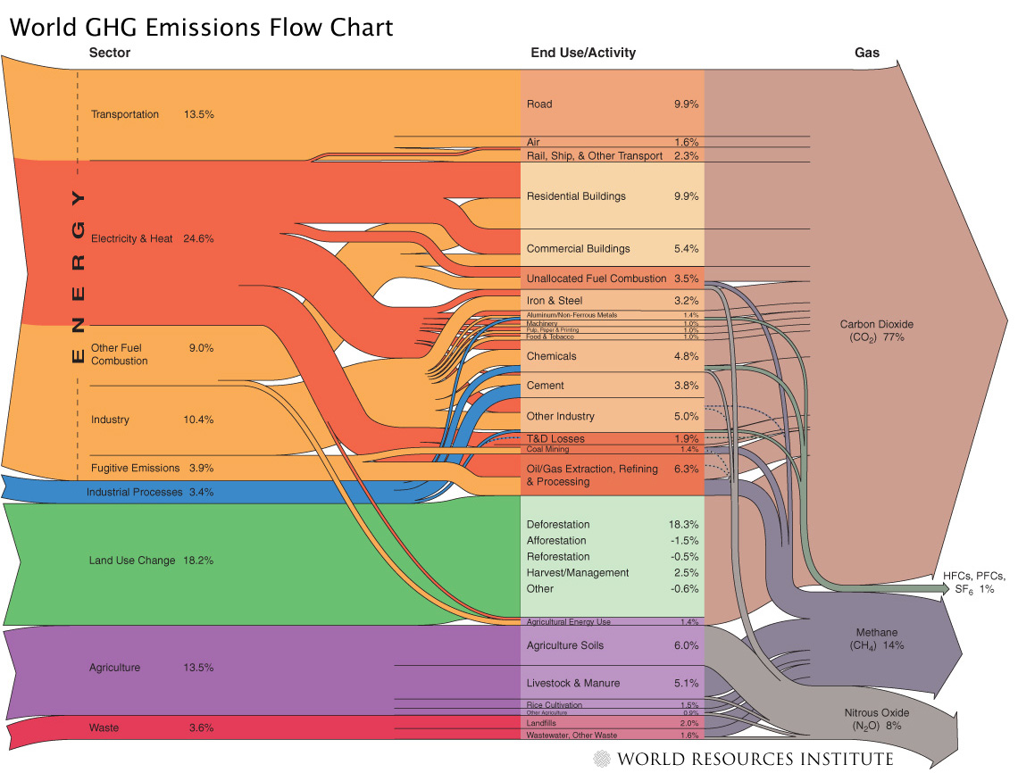
A Chart with Too Much Detail!
Source: World Resources Institute: http://www.wri.org/image/view/9529/_original

Slide 10
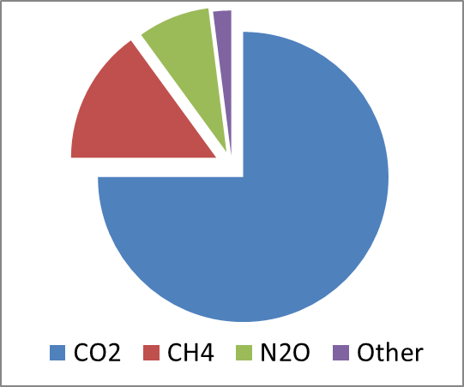
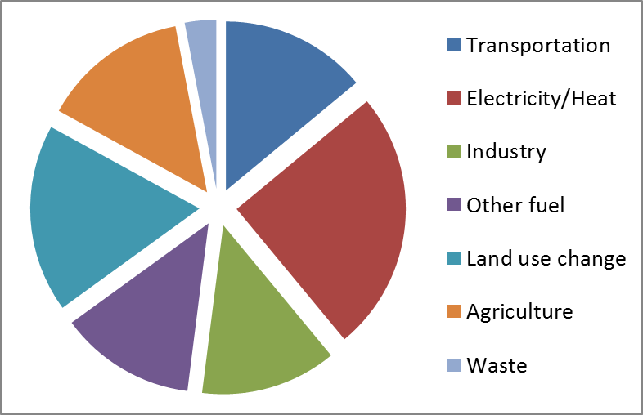
Basics of that chart:
3 main gases & sources
75%: Carbon Dioxide (CO2)
  Fossil fuels for manufacturing,
  transport, heat/cool, electricity
  Deforestation
15%: Methane (CH4)
  Livestock and manure
  Rice cultivation
8%: Nitrous Oxide (N2O)
  Agricultural fertilizer

Slide 11
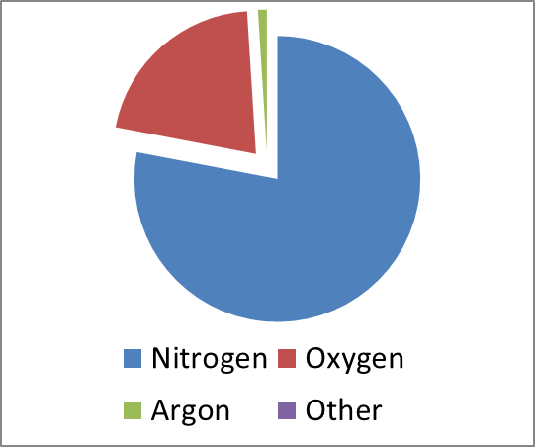
How those gases cause global warming
Many causes of greenhouse effect
Very few non-human factors that
can explain increases in the greenhouse effect
CO2 and CH4:
  VERY small fraction of atmosphere
  N2: 78%; O2: 21%; Ar: 1%; CO2: 0.04%; CH4: 0.0002%
  BUT atmosphere is in equilibrium
  Allow short wavelength light through but block long wavelength light and re-reflect it

Slide 12
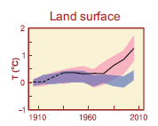
How do we know humans are the cause?
-- Correlation of changes with human activities
-- Computer models do not match observations of temperature unless human forcings are included

Slide 13
Impacts of global warming
Temperature: most areas warmer; some colder; many different
Precipitation: some areas more; some less; some different
Sea level rise and wave heights
More extreme weather: drought, floods, hurricanes
Economic losses
Species loss
Disease “vectors”
Some abrupt changes or “surprises”
FAQs:
  Climate vs. weather?
  How can we predict climate?
  Global warming but regional cooling?

Slide 14
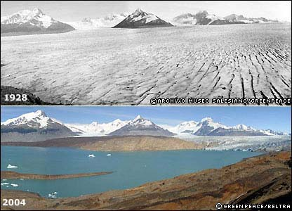
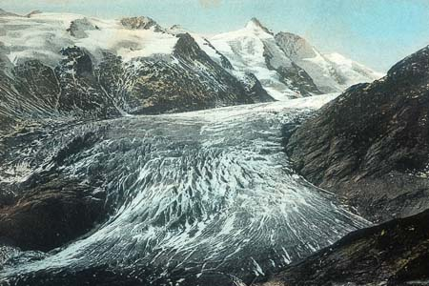
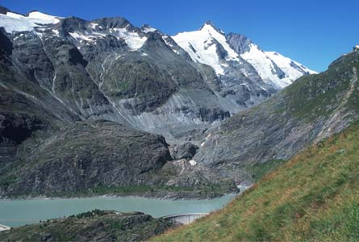
Impacts: Glacial Retreat
Argentina
Austria
Free water storage
1900
Costly water storage
2000
Source: Argentina: http://news.bbc.co.uk/2/shared/spl/hi/picture_gallery/05/sci_nat_how_the_world_is_changing/html/1.stm Gesellschaft für ökologische Forschung 2002. Das gletscherarchiv. http://www.gletscherarchiv.de/.

Slide 15
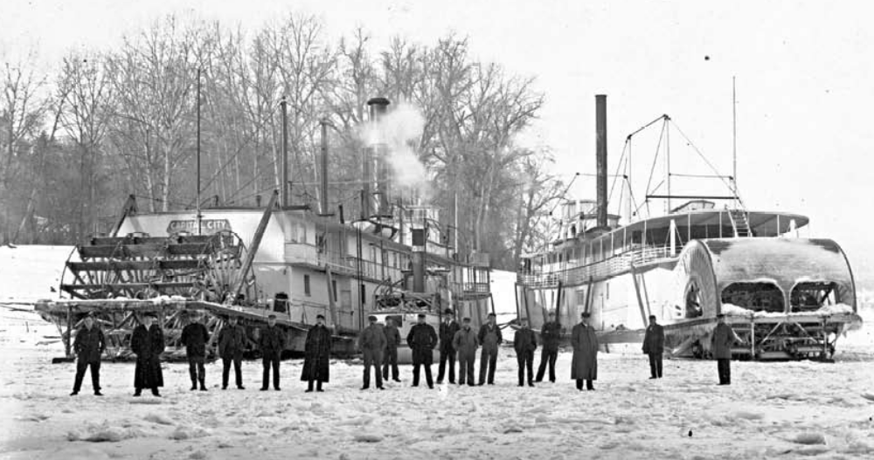
Impacts: Thawing Rivers
The Columbia River froze over 23 times between 1830 & 1930 but has not frozen over since.
Picture: Hood River, Oregon, W. D. Rogers, 1/17/1907; Oregon Historical Society Photo OrHi 35431 (http://librarycatalog.ohs.org/)
Columbia “generally freezes up once in the winter” from a trial in 1882 at http://books.google.com/books?id=wZA8AAAAIAAJ (p. 1393)
*Data on freezes compiled from: http://www.pacificcohistory.org/columbia.htm; http://historyink.com/results.cfm?keyword=Weather&searchfield=topics; and http://www.nwmapsco.com/ZybachB/Thesis/05-081_Chapter_3b.pdf (p. 86)

Slide 16
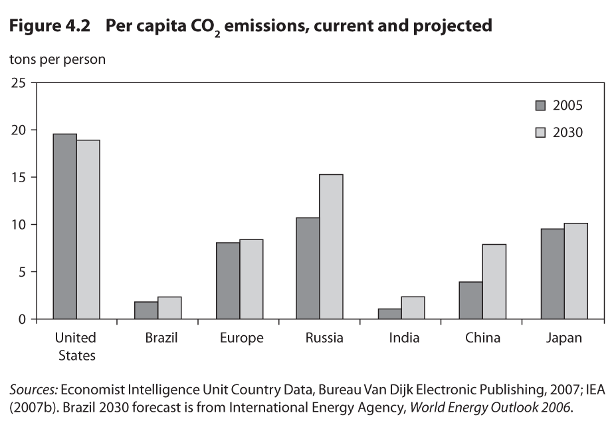
Who’s responsible?
Depends on how you count
% of total global emissions
20%
2%
15%
5%
5%
20%
5%
http://www.wri.org/image/view/9255/_original

Slide 17
Where we need to be:
450ppm=2 t/person
CO2:
  Pre-industrial: ~280ppm
  Current: ~380ppm
  Trajectory to 550ppm by 2100
But major impacts at 450ppm ~4ºF
And stopping at 450ppm is “likely ... unachievable with current & foreseeable technologies” (Stern report)
Sources: T. Wang. 2007. China’s Cumulative Carbon Emission & Pathways over the 21st Century. Accessed: 19 March 2009. At: http://www.sussex.ac.uk/sussexenergygroup/documents/tao_wang_china_s_carbon_emission_pathways_20070902.ppt and US EPA, Recent Atmospheric Changes. Accessed 19 March 2009. At: http://www.epa.gov/climatechange/science/recentac.html

Slide 18
Where we need to be:
450ppm=2 t/person
http://www.wri.org/image/view/9255/_original

Slide 19
Climate Change Treaties and Protocols and Amendments
1992 UN Framework Convention on Climate Change (no targets)
1997 Kyoto Protocol (agreed-upon targets from 1990
for developed countries for 2008 to 2012)
2012 Doha Amendment (agreed-upon targets from 1990 for developed countries for 2013 to 2020)
2015 Paris Agreement (voluntary targets for 165 countries for 2030 but different base years)

Slide 20
Climate change’s problem structure
Some obstacles to progress
Disincentives for unilateral action
  “We” incur costs no to benefit others later
Obstacles to collective action
  Tragedy of Commons + Upstream/Downstream problem
Epistemic and normative contestation
  Disagree over likelihood, benefits, and costs
Psychological barriers to action - many
Population and affluence cause CC but hard to address
Technological solutions are not enough

Slide 21
Trends in Deep Social Causes of Climate Change and their
Implications

Slide 22
Socio-economic causes of climate change
IPAT
Impact = Population * Affluence * Technology
Impact: environmental harm
Population: # of people
Affluence: $ per person (income)
Technology: impact per $ (carbon intensity)

Slide 23
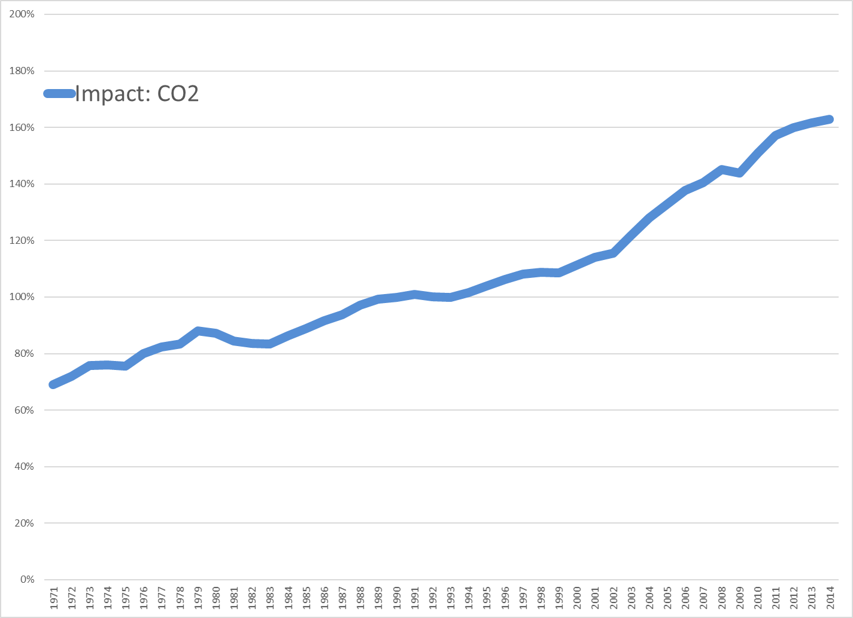
Sources: Calculated using data from World Development Indicators, 2018

Slide 24
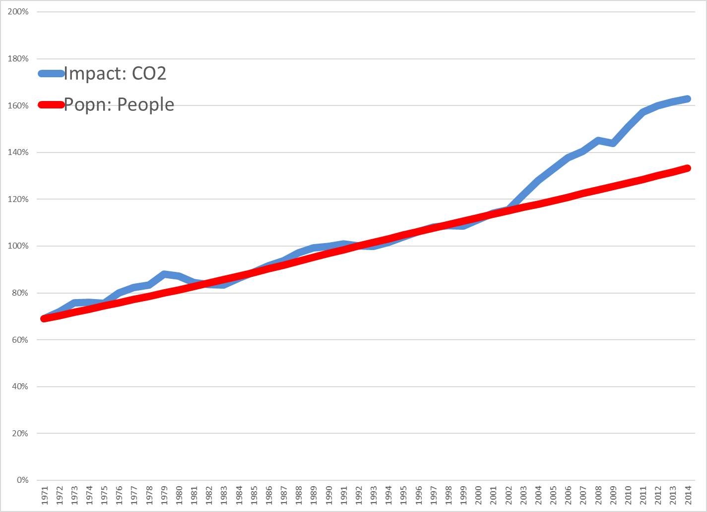
Sources: Calculated using data from World Development Indicators, 2018

Slide 25
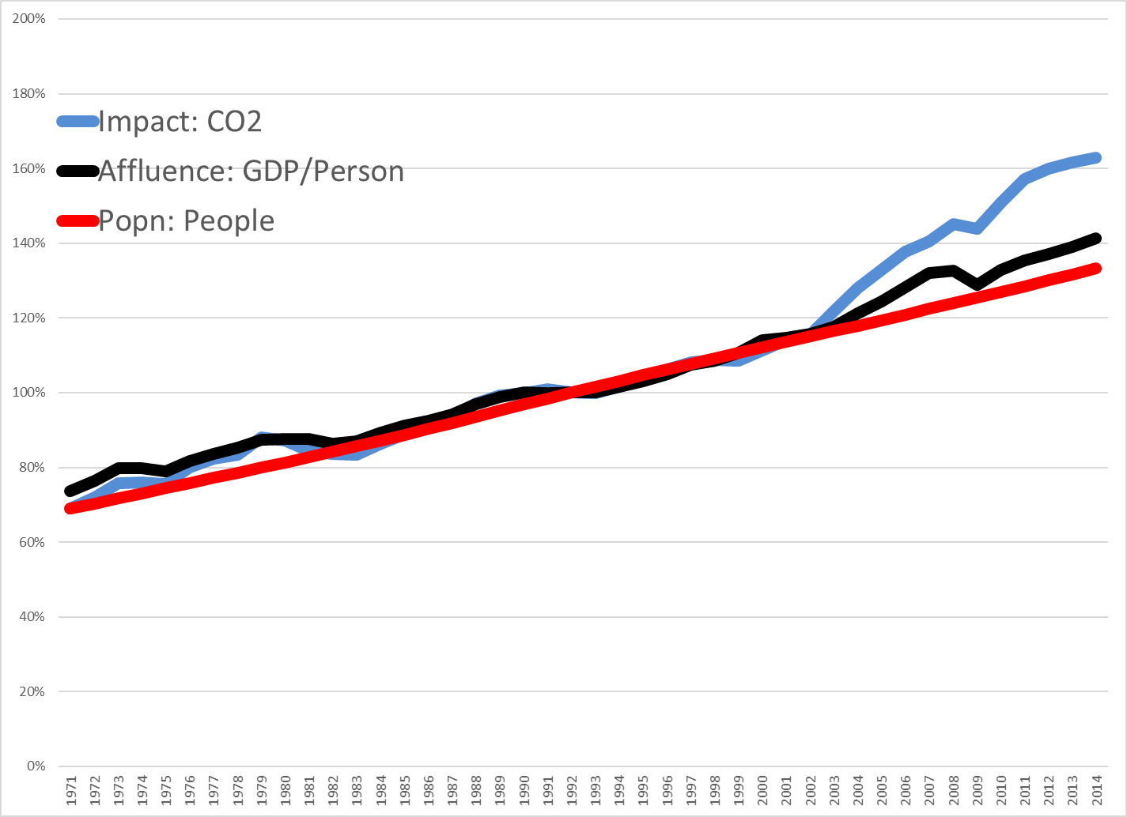
Sources: Calculated using data from World Development Indicators, 2018

Slide 26
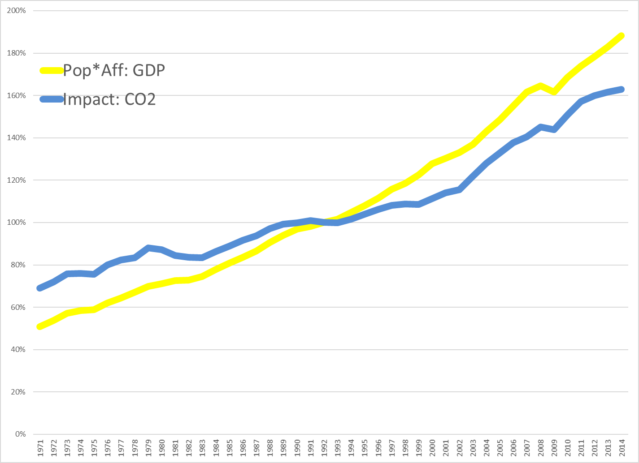
Sources: Calculated using data from World Development Indicators, 2018

Slide 27
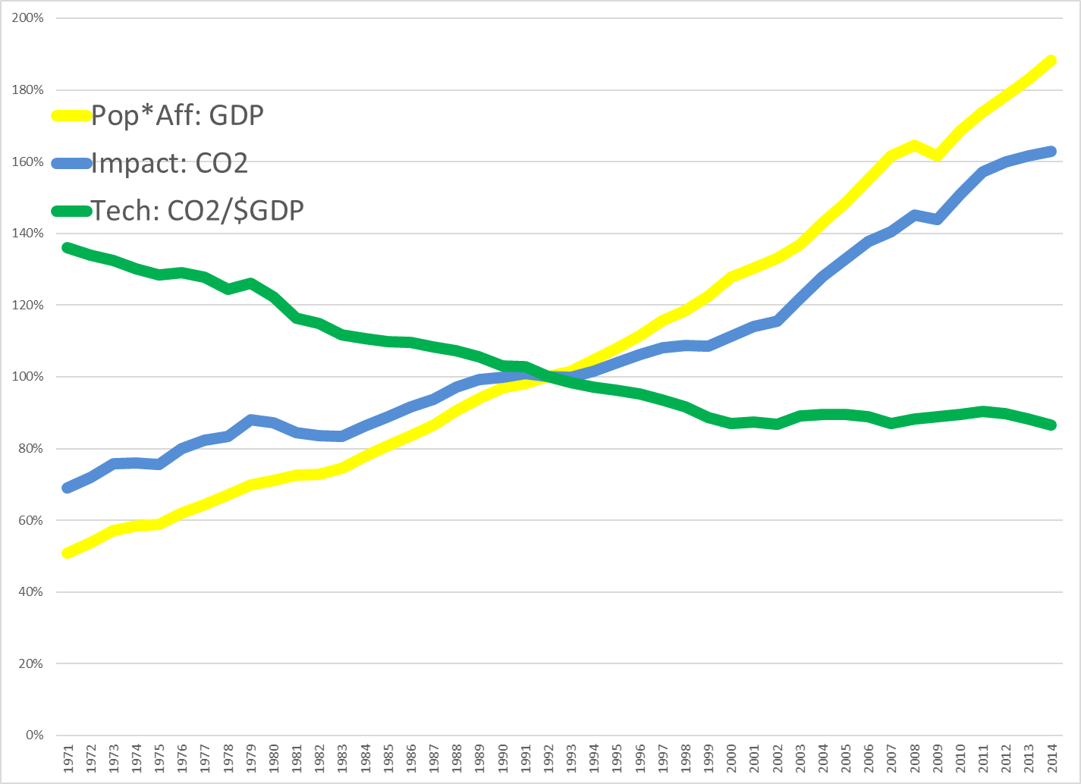
Sources: Calculated using data from World Development Indicators, 2018

Slide 28
Changing Population Growth
Some policies do influence population size, fertility
  Educating women
  Chinese one child policy (China 1.7/woman)
  French pro-natalist policy (France 1.98/woman vs. UK 1.66/woman)
  Catholic position on contraception
So do social norms
  “When are you going to have kids?”
  “I wonder why they don’t have any kids?”
  “Congratulations on your new baby!”
  “I want to live a nice long life.”
Yet population appears “off limits” politically (not mentioned at Copenhagen)
Sources: http://newedexcelgeography.blogspot.com/2008/01/france-pro-natalist-policy.html
http://www.vatican.va/holy_father/paul_vi/encyclicals/documents/hf_p-vi_enc_25071968_humanae-vitae_en.html

Slide 29
Changing Affluence Growth
Some policies do influence consumption patterns
  Buddhist monks
  Jewish observance of Shabbat
  Mormon tithing
  Voluntary simplicity: “frugality of consumption”
So do social norms
  “More, More, More said the baby.”
  “I want a better life for my kids.”
  “I need a raise.”
  “I need a vacation.”
Yet affluence also appears “off limits” politically (though see “Confronting Consumption”)
Source: http://www.simpleliving.net/voluntary_simplicity_part_1.asp

Slide 30
Technological solutions alone may be inadequate
3% per year net growth due to population and affluence requires 3% per year net decline from technology (CO2/$) just to stabilize emissions
Meeting 80% reduction by 2100 requires 2% per year reduction in emissions
Technology must generate ongoing 5% per year emission reductions to achieve required reductions but currently less than 1% per year

Slide 31
What are the policy options?
Mitigation
Adaptation
Geoengineering
Grieving and loss

Slide 32
What is being done?
Mitigation
UN FCCC 1992; Kyoto Protocol 1997; Paris 2015
Governments: India, China, US, Europe, Japan; Costa Rica: 3.5% carbon tax since 1997
States: Regional Greenhouse Gas Initiative; Western Climate Initiative
Cities: ICLEI-Local Governments for Sustainability: >1000 cities, towns
NGOs/Corporations: WWF, Greenpeace, Nike, Levi’s, etc.
Multinational corporations
Religions: Faith Action on Climate Change, Interfaith Power & Light, Evangelical Environmental Network,
Individuals: Voluntary Simplicity, direct action

Slide 33
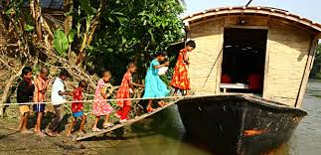
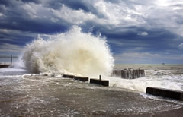
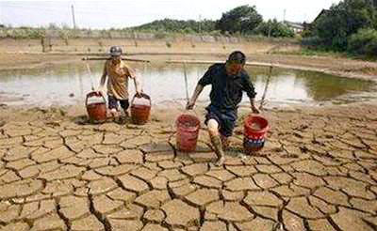
What is being done?
Adaptation
Relocate and displace
Protect infrastructure
Change behaviors

Slide 34
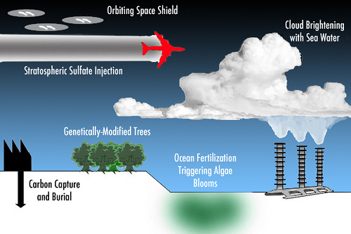
What may be done?
Geo-engineering

Slide 35
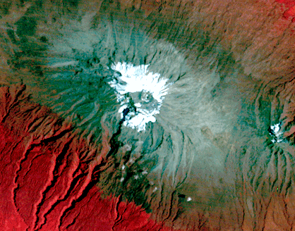
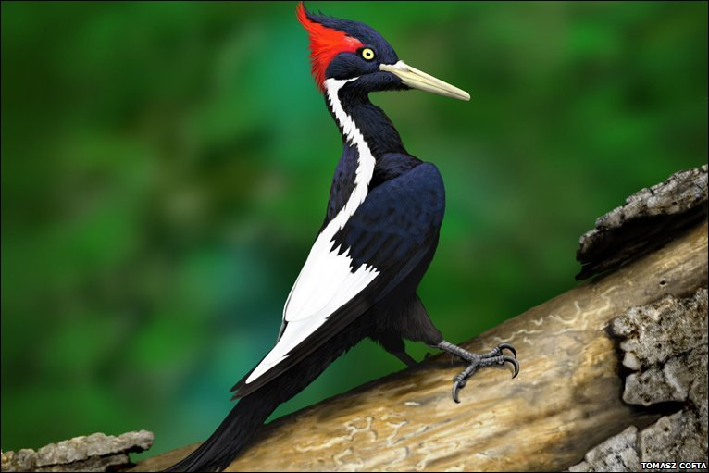
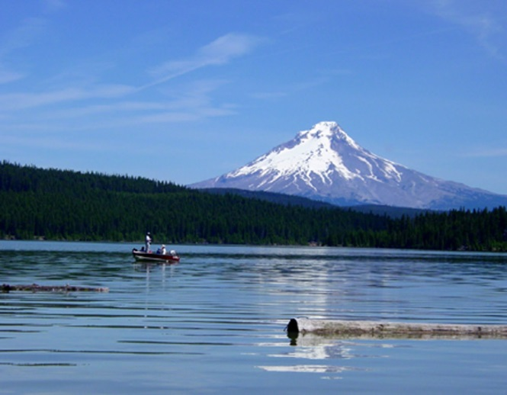
What has been lost?
Grieving and loss
The Snows of Kilimanjaro
1976
Ivory-billed Woodpecker:
Killed by Hurricane Katrina?
http://earthshots.usgs.gov/earthshots/Mount-Kilimanjaro
Mt.Hood:
Like this in Winter?
http://www.gambassa.com/public/project/profile/0/0/2771/AveryHorne%27sIvoryBilledWoodpeckerreport.jpg
http://mthoodrentals.blogspot.com/2011/05/schools-almost-out-have-you-planned.html

Slide 36
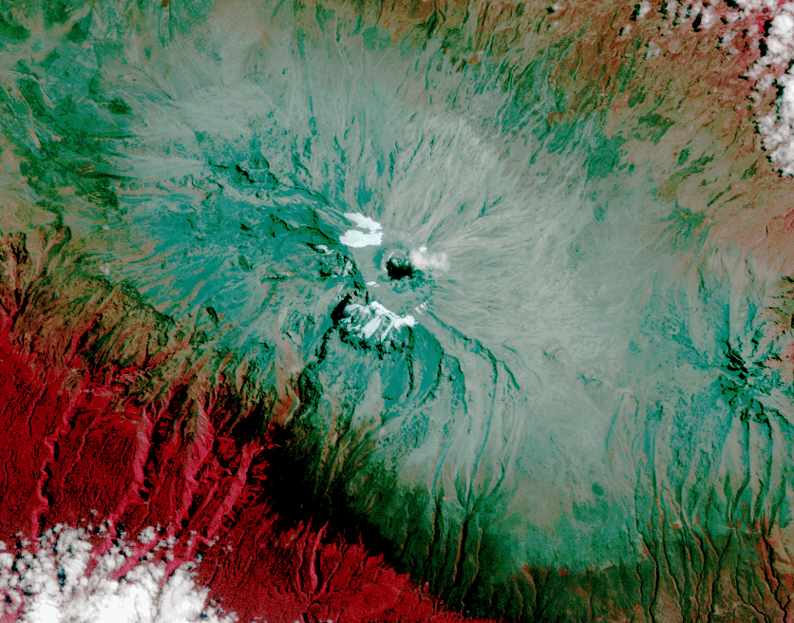
What has been lost?
Grieving and loss
The Snows of Kilimanjaro
2010
Ivory-billed Woodpecker:
Killed by Hurricane Katrina?
http://earthshots.usgs.gov/earthshots/Mount-Kilimanjaro
Mt.Hood:
Like this in Winter?
http://www.gambassa.com/public/project/profile/0/0/2771/AveryHorne%27sIvoryBilledWoodpeckerreport.jpg
http://mthoodrentals.blogspot.com/2011/05/schools-almost-out-have-you-planned.html

Slide 37
This is a hard and scary problem
So, some words to live by
Everyone thinks of changing the world, but no one thinks of changing himself. ~Leo Tolstoy
Nobody made a greater mistake than he who did nothing because he could only do a little. ~Edmund Burke
The true meaning of life is to plant trees, under whose shade you do not expect to sit. ~Nelson Henderson
Unless someone like you cares a whole awful lot, nothing is going to get better. It's not. ~Dr. Seuss

Slide 40
US politics and climate change
Animated video as brief intro to the politics of climate change in the US

Slide 41
Generating concern:
From Knowledge To Negotiation
“Getting to the table”
When do politicians listen to “science” and “scientists”?
  Salient – relevant to policy-makers current decisions
  Credible – generated by people with expertise and trustworthiness
  Legitimate – developed through process that reflects values, perspectives, and concerns of those affected

Slide 42
Generating agreement:
From Negotiation To Agreement
“Getting to Yes”
Why are states Pushers, Draggers, Bystanders, Intermediates with respect to climate change?
  Ecological vulnerability: Costs countries face if problem NOT addressed
  Abatement costs: Costs country will incur if take action to address the problem
  Negotiating position as DV; vulnerability and abatement costs as IV

Slide 43
Determinants of country negotiating positions
 |  | Abatement Costs
 |  | LOW | HIGH
Ecological Vulnerability | LOW | Bystander (indifferent) | Dragger (oppose action)
 | HIGH | Pusher (call for action) | Intermediate (unsure)

Slide 44
Actual positions
Europeans: act now, strong supporters
US: unclear what our position will be
AOSIS: developing states pushing for action because their interests directly and clearly affected
OPEC: oppose action on fossil fuels because costly
Developing countries: avert problem but not the cause and lack capacities to respond
Debates driven by concerns about the need for action, the costs of action, the equity of action, among other things

Slide 45
Goal of negotiations
Find the ZOPA (“zone of possible agreement”) -- intersection of different countries’ positions
Overcome “collective action problems” (incentives to cheat in Tragedy of the Commons problems)
Write agreement to reduce costs or increase benefits to make “pushers” out of draggers, bystanders, intermediates

Slide 46
Disincentives for unilateral action
Costs of action: relatively large ( econ growth), certain, concentrated, and immediate
Benefits of action: uncertain, diffuse, and “distant” future (and, hence, discounted even if large)
Beneficiaries: range of countries (and generations) other than those incurring costs; public good

Slide 47
Obstacles to collective action
Not wholly a Tragedy of the Commons
Collaboration game among concerned states
BUT with some “upstream” unconcerned states
AND coupled to
Game against nature: outcomes/payoffs depend on nature’s response to strategic interaction

Slide 48
Changing Behavior:
How Hard Can It Be?
If I told you I had a new technology that could increase your car’s fuel efficiency by 20% and reduce your CO2 emissions by 20%, would you use it?
How much would you pay for it?

Slide 49
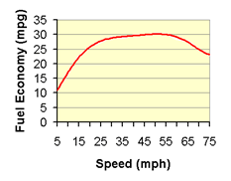
Changing Behavior:
How Hard Can It Be?
It’s the gas pedal
Most people drive 75 mph on freeways
Slowing to 65 mph decreases emissions by ~10%
Slowing to 55 mph decreases emissions by ~20%
No law is required!
Source: http://www.fueleconomy.gov/feg/driveHabits.shtml

Slide 50
Generating action:
From Agreement To Action
Alternative mechanisms
  Sticks – punishment
  Carrots – rewards
  Locks – prevention
  Fields of dreams – new opportunities
  Labels – information
  Sermons – norm development
How do we change behavior

Slide 51
Epistemic and normative contestation
Epistemic contestation: whether climate change is likely and whether benefits of action exceed its costs
Normative contestation: whether averting climate change is good or should be a high priority
Normative “valence:”
  Compare discourse of $700B economic stimulus package vs. expected discourse of $700B climate change package

Slide 52
Psychological barriers to action
Barriers to believing climate change is occurring
  Associative (“System 1”) processing dampens rather than heightens concern
  “Finite pool of worry”
Barriers to acting on belief
  “Pro-environmental intent may not correspond with pro-environmental impact” (Swim et al. 2009, 131)
  “Single action bias”

