Slide 1
Overview
Final exam – questions?
Complete climate change lecture
Ethics and IR
The future of IR
Post-midterm review

Slide 2
Final Exam
Essay (55%)
Medium answer questions: (TWO at 15% each = 30%)
  STUDY FOR FIVE (5) but ONLY ANSWER TWO (2)
  Expect a good answer
  Length of each: something like 2, 3, 4 pages
15 multiple choice questions (15% total)

Slide 3
Final Essay
Compare ability of realism, institutionalism, disenfranchised theories to explain patterns of international relations we observe in ONE PAIR of these four issue area pairs.
a) security and human rights,
b) security and environmental affairs,
c) economic affairs and human rights,
d) economic affairs and environmental affairs.
Compare across 3 theories AND across 2 issue areas.
  what parts of a given issue area are best explained by one theory and which parts are better explained by another theory
  for each theory, whether it does better, worse, or equally well at explaining international relations in one issue area compared to the other issue area you have chosen

Slide 4
Climate Change Wrapup

Slide 5
I-Clicker
Climate Change
I do not believe the climate is warming
I believe the climate is warming but do not believe it is due to human actions
I believe the climate is warming and believe it is due to human actions but DO NOT believe we should take action to avoid climate change
I believe the climate is warming and believe it is due to human actions and BELIEVE we should take action to avoid climate change

Slide 6
Trends in Deep Social Causes of Climate Change and their
Implications

Slide 7
Socio-economic causes of climate change
IPAT
Impact = Population * Affluence * Technology
Impact: environmental harm
Population: # of people
Affluence: $ per person (income)
Technology: impact per $ (carbon intensity)

Slide 8
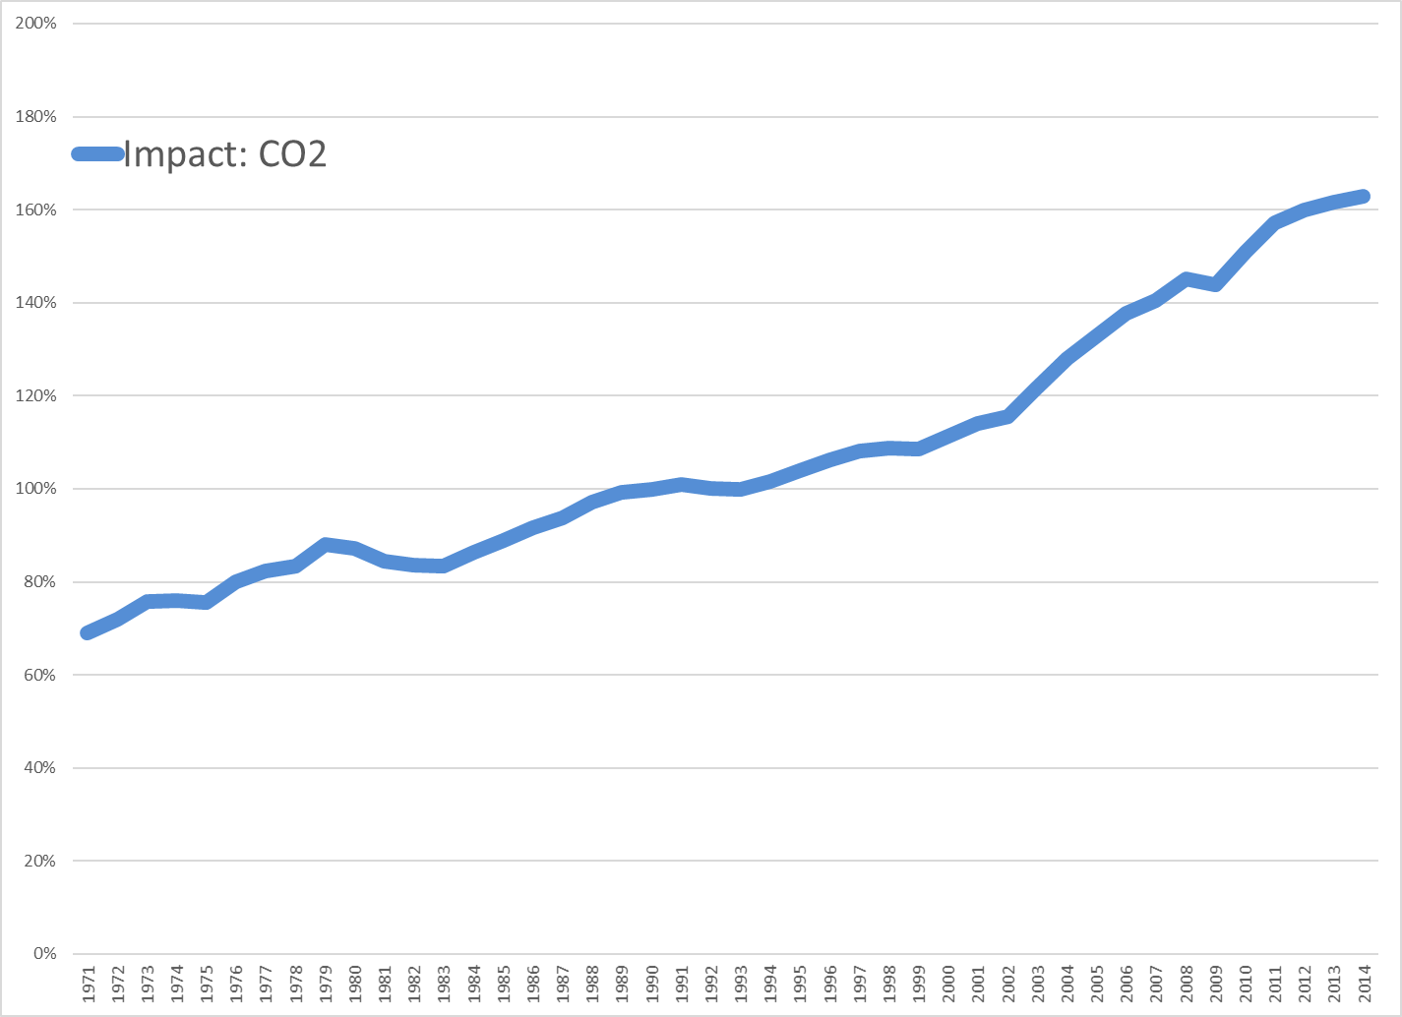
Sources: Calculated using data from World Development Indicators, 2018

Slide 9
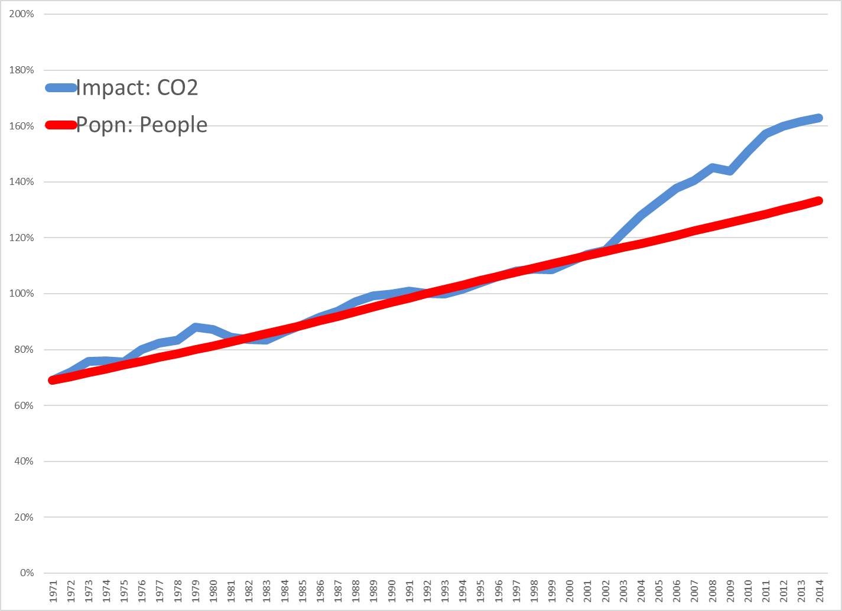
Sources: Calculated using data from World Development Indicators, 2018

Slide 10
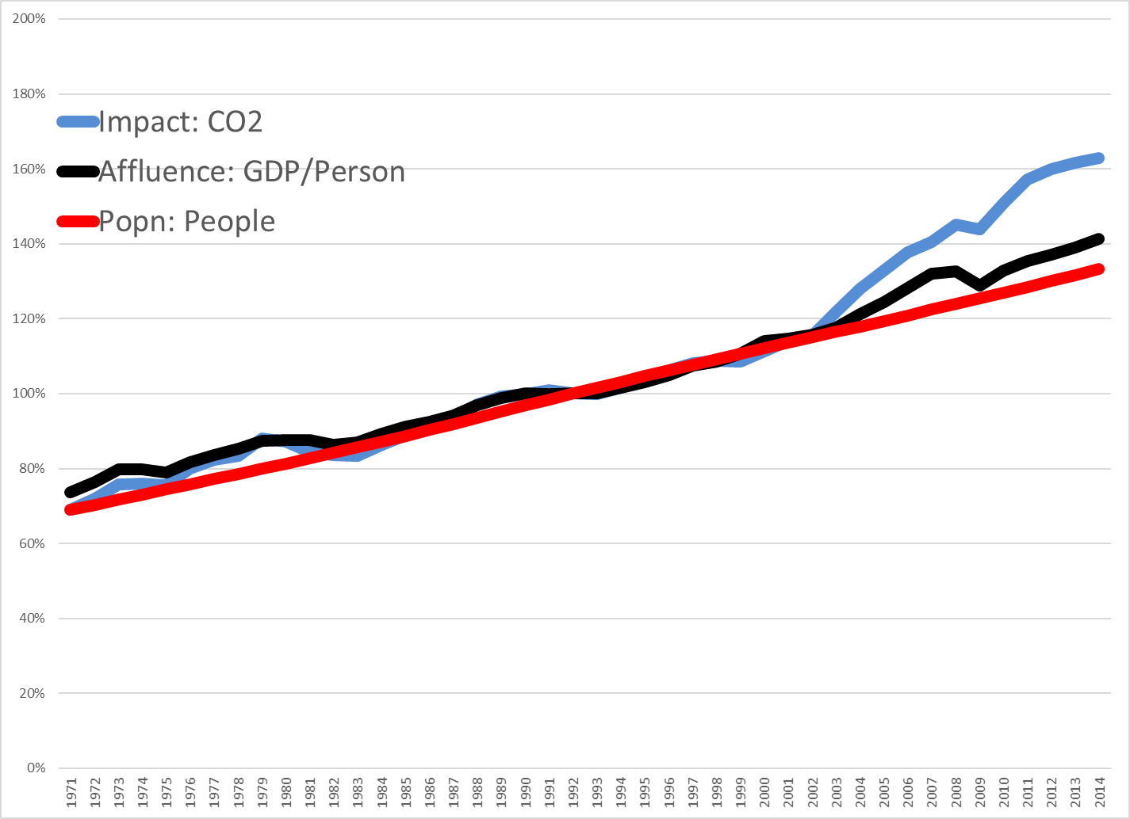
Sources: Calculated using data from World Development Indicators, 2018

Slide 11
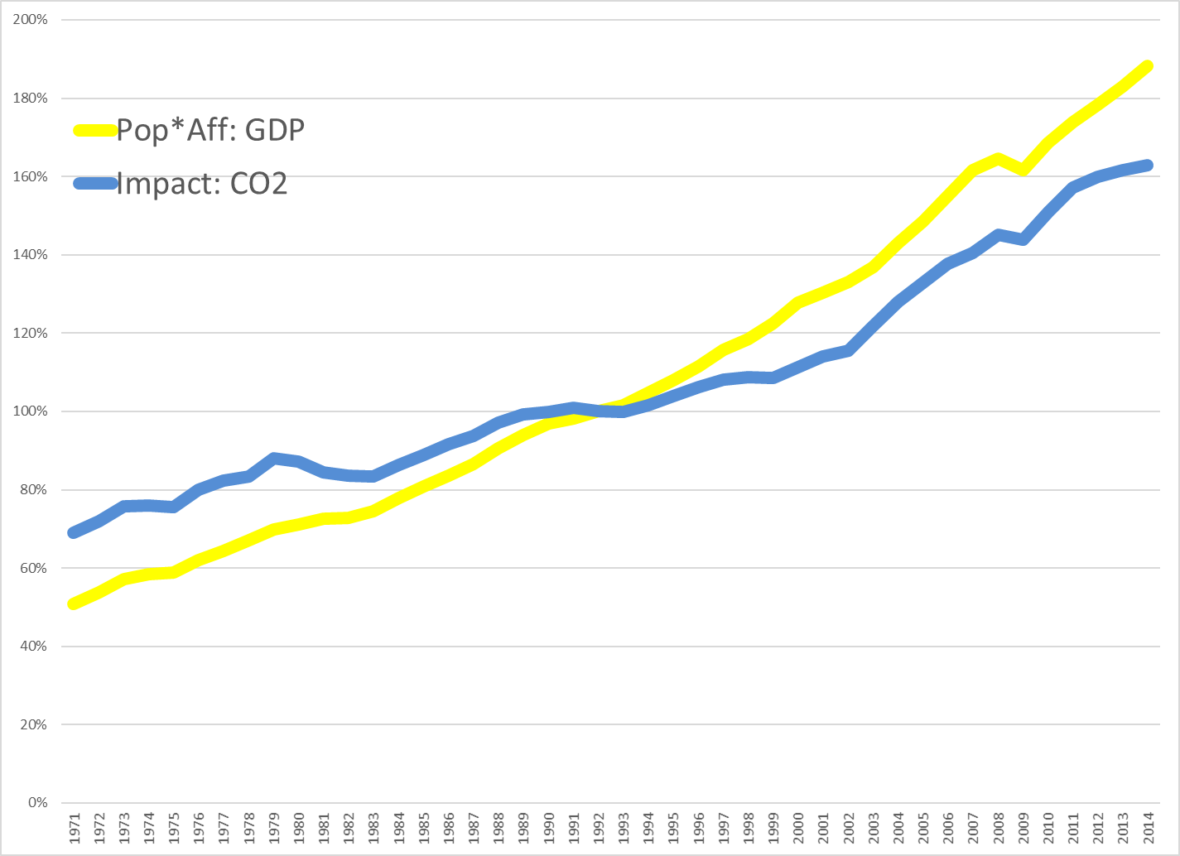
Sources: Calculated using data from World Development Indicators, 2018

Slide 12
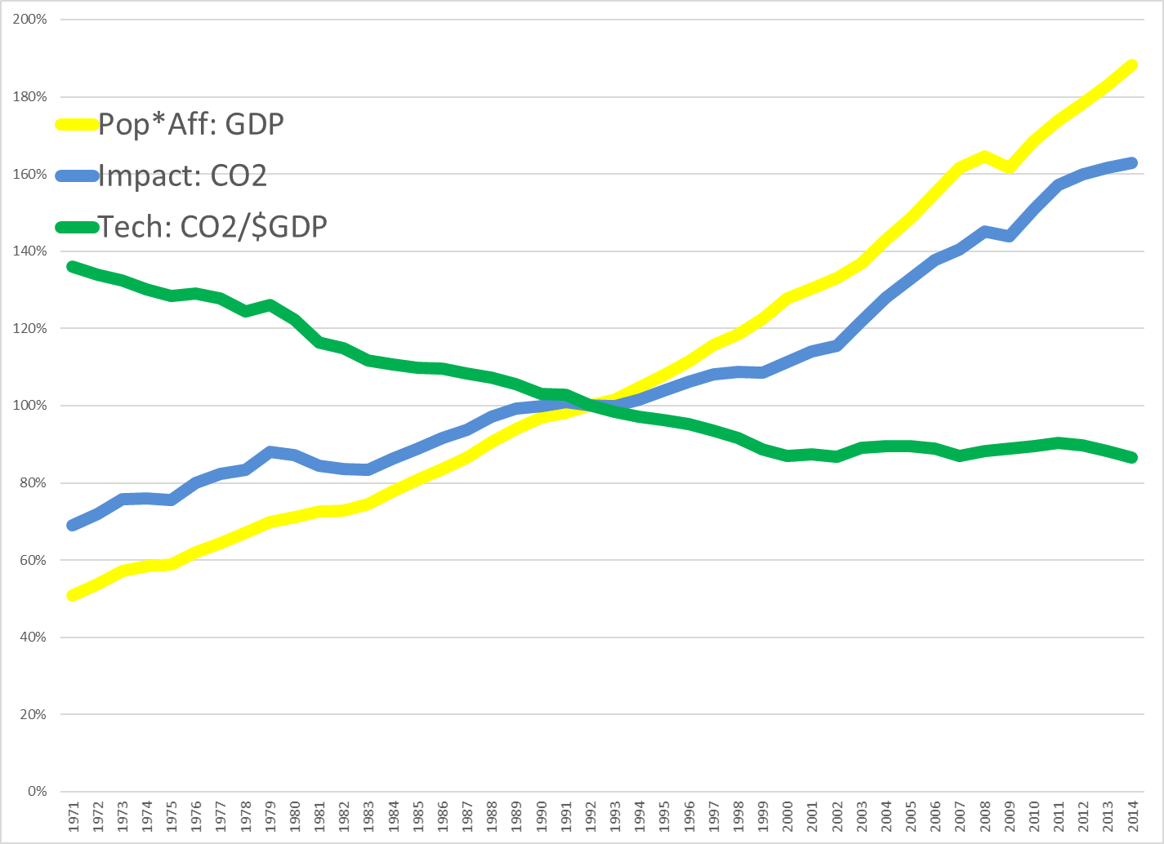
Sources: Calculated using data from World Development Indicators, 2018

Slide 13
Changing Population Growth
Some policies do influence population size, fertility
  Educating women
  Chinese one child policy (China 1.7/woman)
  French pro-natalist policy (France 1.98/woman vs. UK 1.66/woman)
  Catholic position on contraception
So do social norms
  “When are you going to have kids?”
  “I wonder why they don’t have any kids?”
  “Congratulations on your new baby!”
  “I want to live a nice long life.”
Yet population appears “off limits” politically (not mentioned at Copenhagen)
Sources: http://newedexcelgeography.blogspot.com/2008/01/france-pro-natalist-policy.html
http://www.vatican.va/holy_father/paul_vi/encyclicals/documents/hf_p-vi_enc_25071968_humanae-vitae_en.html

Slide 14
Changing Affluence Growth
Some policies do influence consumption patterns
  Buddhist monks
  Jewish observance of Shabbat
  Mormon tithing
  Voluntary simplicity: “frugality of consumption”
So do social norms
  “More, More, More said the baby.”
  “I want a better life for my kids.”
  “I need a raise.”
  “I need a vacation.”
Yet affluence also appears “off limits” politically (though see “Confronting Consumption”)
Source: http://www.simpleliving.net/voluntary_simplicity_part_1.asp

Slide 15
Technological solutions alone may be inadequate
3% per year net growth due to population and affluence requires 3% per year net decline from technology (CO2/$) just to stabilize emissions
Meeting 80% reduction by 2100 requires 2% per year reduction in emissions
Technology must generate ongoing 5% per year emission reductions to achieve required reductions but currently less than 1% per year

Slide 16
What are the policy options?
Mitigation
Adaptation
Geoengineering
Grieving and loss

Slide 17
What is being done?
Mitigation
UN FCCC 1992; Kyoto Protocol 1997; Paris 2015
Governments: India, China, US, Europe, Japan; Costa Rica: 3.5% carbon tax since 1997
States: Regional Greenhouse Gas Initiative; Western Climate Initiative
Cities: ICLEI-Local Governments for Sustainability: >1000 cities, towns
NGOs/Corporations: WWF, Greenpeace, Nike, Levi’s, etc.
Multinational corporations
Religions: Faith Action on Climate Change, Interfaith Power & Light, Evangelical Environmental Network,
Individuals: Voluntary Simplicity, direct action

Slide 18
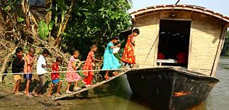
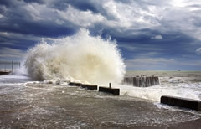
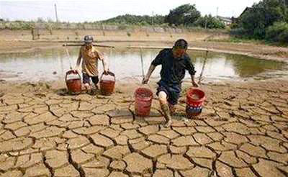
What is being done?
Adaptation
Relocate and displace
Protect infrastructure
Change behaviors

Slide 19
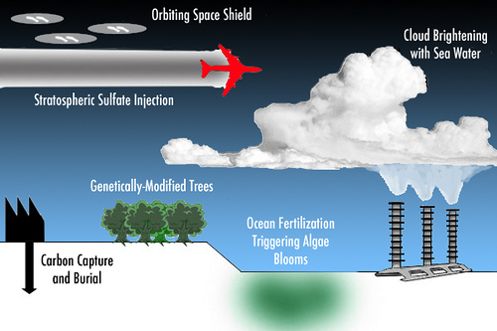
What may be done?
Geo-engineering

Slide 20
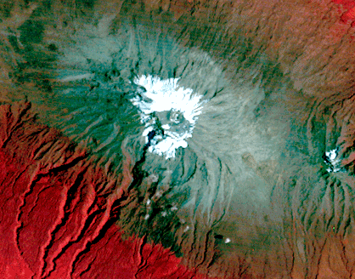
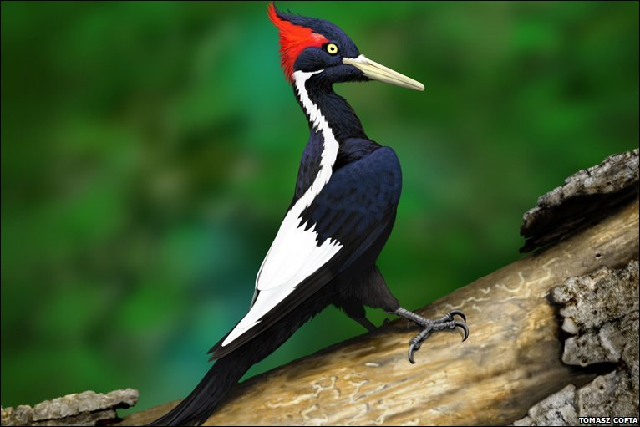
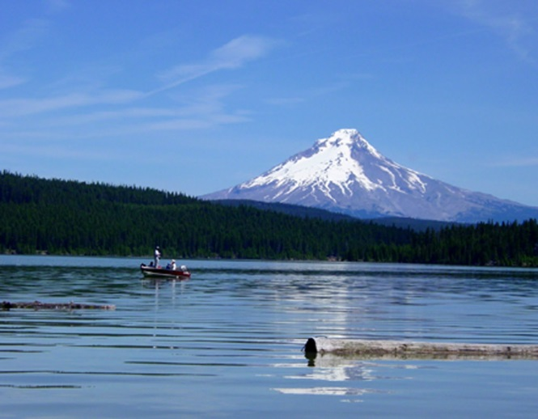
What has been lost?
Grieving and loss
The Snows of Kilimanjaro
1976
Ivory-billed Woodpecker:
Killed by Hurricane Katrina?
http://earthshots.usgs.gov/earthshots/Mount-Kilimanjaro
Mt.Hood:
Like this in Winter?
http://www.gambassa.com/public/project/profile/0/0/2771/AveryHorne%27sIvoryBilledWoodpeckerreport.jpg
http://mthoodrentals.blogspot.com/2011/05/schools-almost-out-have-you-planned.html

Slide 21
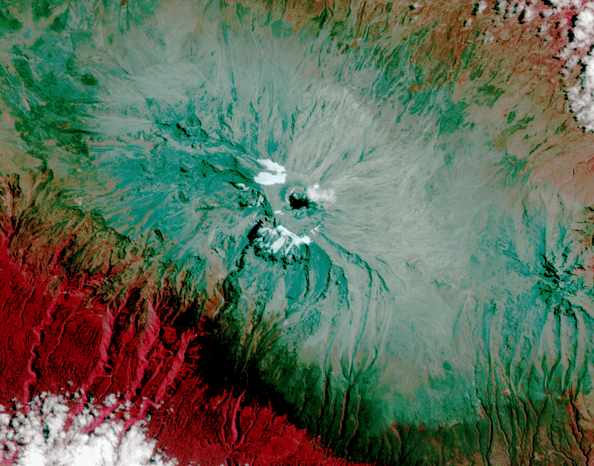
What has been lost?
Grieving and loss
The Snows of Kilimanjaro
2010
Ivory-billed Woodpecker:
Killed by Hurricane Katrina?
http://earthshots.usgs.gov/earthshots/Mount-Kilimanjaro
Mt.Hood:
Like this in Winter?
http://www.gambassa.com/public/project/profile/0/0/2771/AveryHorne%27sIvoryBilledWoodpeckerreport.jpg
http://mthoodrentals.blogspot.com/2011/05/schools-almost-out-have-you-planned.html

Slide 22
Climate Change:
Important to distinguish between
KNOWLEDGE: Facts and well-supported theories of climate change
ARE DIFFERENT THAN
VALUES: Judgements about whether the likely outcomes are good/bad or desirable/undesirable
AND BOTH ARE DIFFERENT THAN
POLICIES: Prescriptions about what actions we should take and how much resources we should spend on them

Slide 23
A hard and scary problem
So, some words to live by
Everyone thinks of changing the world, but no one thinks of changing himself. ~Leo Tolstoy
Nobody made a greater mistake than he who did nothing because he could only do a little. ~Edmund Burke
The true meaning of life is to plant trees, under whose shade you do not expect to sit. ~Nelson Henderson
Unless someone like you cares a whole awful lot, nothing is going to get better. It's not. ~Dr. Seuss

Slide 24
Ethics and
International Relations

Slide 25
Ethics of war
What ethical responsibilities do we have to people of other nations during war?
Logic of war - inherently unlimited. Clausewitz’s notion that once go to war, placing limits is simply a sure way to lose.

Slide 26
Limit of consent - soldiers must have consented
Draft vs. all-volunteer army? What if all-volunteer army is recruited "from among desperately impoverished men, who can find no other way of feeding themselves and their families except by signing up" (Walzer).
Soldiers as victims of war

Slide 27
Just Ends of War
Jus Ad Bellum "Justice of War"
Just/moral reasons for going to war
  Self-defense against overt aggression
  Preemptive intervention
  Balancing prior intervention
  Rescue people threatened with massacre
  Assist self-determination movements when they have demonstrated representative character.

Slide 28
Just Means of War
Jus In Bello "Justice in War"
Just/moral methods of fighting war
How do we distinguish war from murder and massacre?
  Last resort
  Directed by competent authority
  Probability of success
  Proportionality
  Discriminate
  Self-defense
  Soldiers not responsible for war itself

Slide 29
The future of the world:
Zakaria article
Against realism
Interdependence leads to peace, as institutionalists argue
Actors
Trade
Nationalism

Slide 30
Review of post-midterm classes
European Union
Institutional / regime theory
Economic development
Human Rights and genocide
International environment and climate change

